Slide 1

A Seminar on How to Give Bible Studies
聖書研究の授け方
The Power of God’s Word
神の言葉の力
Dr. Ron E. M. Clouzet, NSD Ministerial Secretary
Dr. ロン・クルーゼ ＮＳＤ牧師会長

Slide 2
Session Five
How to Pray for Souls
魂のための祈り
Sunday, July 30, 10:45
７月３０日 日曜日 後半

Slide 3
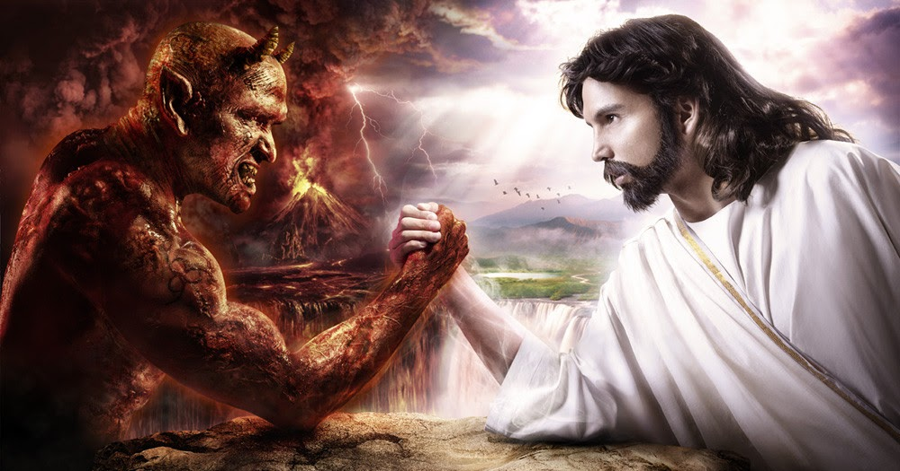

Slide 4
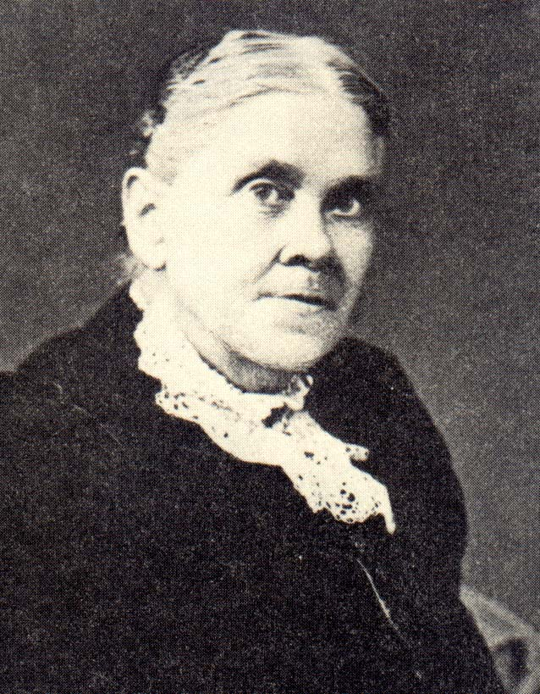
Satan’s Objective: Lead to Doubt God’s Word
サタンの目的：神のみ言葉を疑わせる
“There is nothing that [Satan] desires more than to destroy confidence in God and in His word. Satan stands at the head of the great army of doubters, and he works to the utmost of his power to beguile souls into his ranks.”
The Great Controversy, 526.
サタンは 何よりも、神と神のみ言葉に対する信頼感を失わせようと望んでいる。サタンは懐疑主義者の大軍の首領であって、人々を欺いて自分の味方にしようと全力を尽くしている。
各時代の大争闘

Slide 5
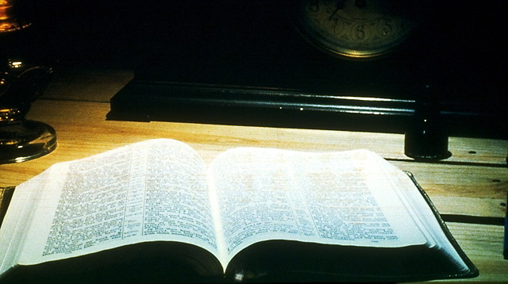
“…For all things are Your servants.”
Psalm 119:91
よろずのものは皆あなたのしもべだからです。 詩篇119:91

Slide 6

Anyone sincerely studying the Bible will be under attack!
聖書を真剣に学ぶ
ものは攻撃に遭う！

Slide 7
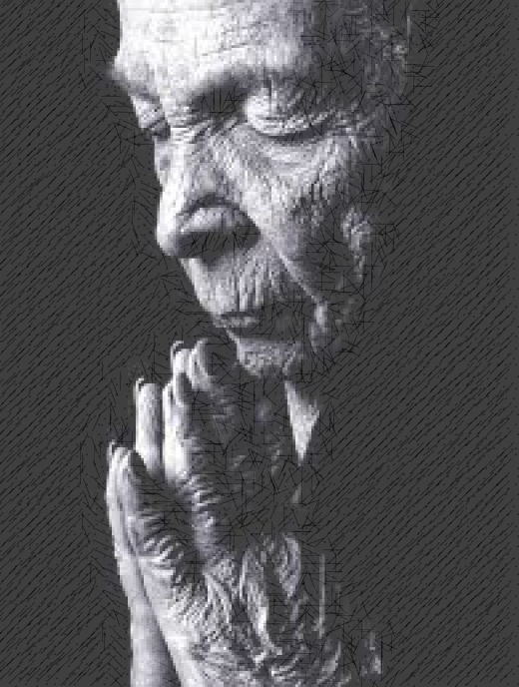
“For though we walk in the flesh, we do not war according to the flesh. For the weapons of our warfare are not carnal but mighty in God for pulling down strongholds,
わたしたちは、肉にあって歩いてはいるが、肉に従って戦っているのではない。 わたしたちの戦いの武器は、肉のものではなく、神のためには要塞をも破壊するほどの力あるものである。

Slide 8
“casting down arguments and every high thing that exalts itself against the knowledge of God.”
2 Corinthians 10:3-5
わたしたちはさまざまな議論を破り、 神の知恵に逆らって立てられたあらゆる障害物を打ちこわし、
コリント人への第二の手紙10:3-5

Slide 9
Wrestle with God for Souls
“If we have the interest that John Knox had when he pleaded before God for Scotland, we shall have success. He cried, ‘Give me Scotland, Lord, or I die.’
もし、ジョン・ノックスがスコットランドのために神に嘆願した時のような関心が私たちにあれば、成功するでしょう。彼は「主よ、スコットランドを私に与えて下さい、でなければ死にます」と叫んだ。

Slide 10
Wrestle with God for Souls
“And when we take hold of the work and wrestle with God, saying, ‘I must have souls; I will never give up the struggles,’ we shall find that God will look upon our efforts with favor.”
Manuscript 14, 1887, in Evangelism, 294.
「仕事に専念し神と格闘しながら『私は魂を獲得しなければいけません、私はこの苦闘を諦めません。』と言うときに、神が私たちの努力を愛をもって見つめて下さることがわかるでしょう」
原稿14, 1887年、伝道

Slide 11
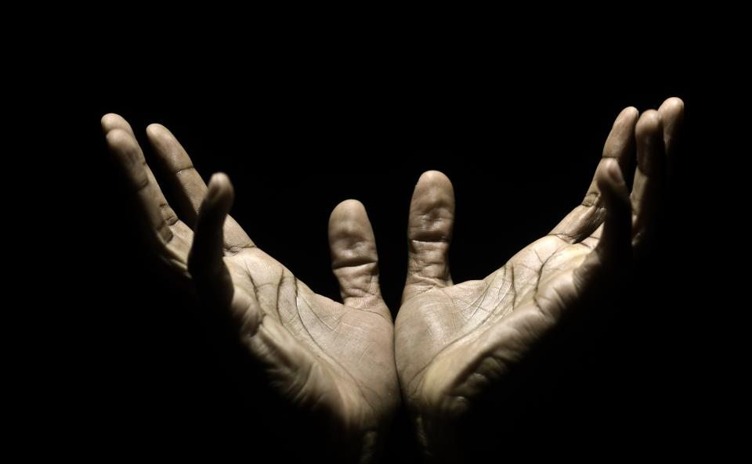
“For the eyes of the Lord run to and fro throughout the whole earth, to show Himself strong on behalf of those whose heart is loyal to Him.”—2 Chronicles 16:9
主の目はあまねく全地を行きめぐり、自分に向かって心を全うする者のために力をあらわされる。
歴代誌下16:9

Slide 12

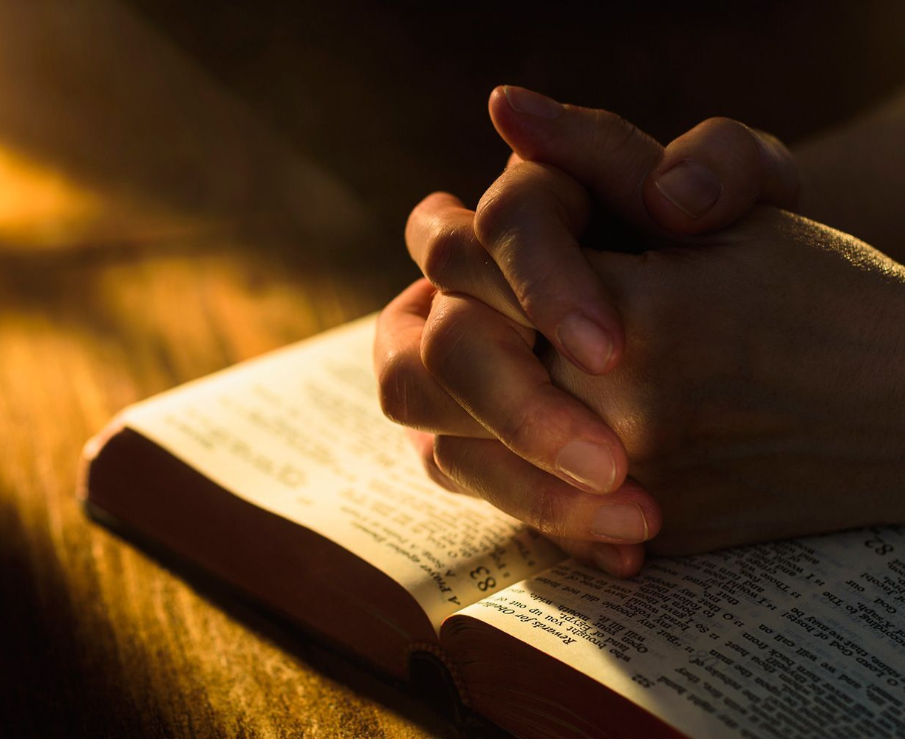
How should we pray for unbelievers?
信じない人のために
どう祈ればいい？

Slide 13
1.
Know They Can Be Saved
彼らも救われることを知る

Slide 14
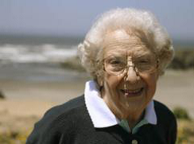
Sister Ford’s Prayers シスターフォードの祈り
Noah and friend decided to attend evangelistic meetings. They were involved in the occult. ノアと友達は伝道集会に出席することにした。彼らはオカルトに関係していた。
They were converted and were baptized with 15 other people at the end of the meetings. 彼らは改心し集会の終わりに１５人のほかの人々と共にバプテスマを受けた。
Notes:
Only a couple of years ago, Noah and his friend began to attend evangelistic meetings at an Adventist church. They had both seen a sign advertising the meetings, and happened to mention it while at a bar. Both were also into the occult, but, somehow, an interest welled up in their hearts to know more about the Bible and end-time events.
They attended the meetings, and the Holy Spirit led them to repentance and conversion. At the end of the evangelistic series they were both baptized! Some 15 other people were also baptized that day.
After the baptism, one of the church members introduced herself to them as Sister Ford, welcoming them to the church, and expressing her great joy about their decision. And then, she told them something they never expected to hear: “I’ve been praying for you.” Neither Noah nor the other new believers had ever met this lady before. How could she have been praying for them?
Here is the rest of the story. Quite a few months before, she was impressed to pray for the people in her town. Not knowing for whom she should pray, exactly, she grabbed the phone book and chose 15 names at random, to pray for them. She prayed for each person by name, out loud, every day, for months.
Lo and behold, Noah was one of them! And not only him—rescued from the darkness of the occult—but eight of the 17 people baptized that day were from Sister Ford’s list! Half of the entire harvest!
God definitely answers prayer on behalf of the lost (see 1 John 5:14-16), even if we don’t know them! The question is, Will you just as definitely pray for them?

Slide 15
Sister Ford’s Prayers シスターフォードの祈り
A sister Ford came to congratulate them. Then, she said: “I’ve been praying for you.” シスターフォードが現れ祝福して、「あなたたちのために祈っていました」と言った。
She had chosen 15 names at random from the phone book, to pray they’d come to the Lord.彼女は電話帳から１５人を無作為に選んで、主のもとへ来るようにと祈っていたのだった。
Notes:
Only a couple of years ago, Noah and his friend began to attend evangelistic meetings at an Adventist church. They had both seen a sign advertising the meetings, and happened to mention it while at a bar. Both were also into the occult, but, somehow, an interest welled up in their hearts to know more about the Bible and end-time events.
They attended the meetings, and the Holy Spirit led them to repentance and conversion. At the end of the evangelistic series they were both baptized! Some 15 other people were also baptized that day.
After the baptism, one of the church members introduced herself to them as Sister Ford, welcoming them to the church, and expressing her great joy about their decision. And then, she told them something they never expected to hear: “I’ve been praying for you.” Neither Noah nor the other new believers had ever met this lady before. How could she have been praying for them?
Here is the rest of the story. Quite a few months before, she was impressed to pray for the people in her town. Not knowing for whom she should pray, exactly, she grabbed the phone book and chose 15 names at random, to pray for them. She prayed for each person by name, out loud, every day, for months.
Lo and behold, Noah was one of them! And not only him—rescued from the darkness of the occult—but eight of the 17 people baptized that day were from Sister Ford’s list! Half of the entire harvest!
God definitely answers prayer on behalf of the lost (see 1 John 5:14-16), even if we don’t know them! The question is, Will you just as definitely pray for them?

Slide 16
Sister Ford’s Prayers シスターフォードの祈り
Eight of the 17 baptized were from her list! バプテスマを受けた１７人のうち、８人が彼女のリストに載っていた。
Notes:
Only a couple of years ago, Noah and his friend began to attend evangelistic meetings at an Adventist church. They had both seen a sign advertising the meetings, and happened to mention it while at a bar. Both were also into the occult, but, somehow, an interest welled up in their hearts to know more about the Bible and end-time events.
They attended the meetings, and the Holy Spirit led them to repentance and conversion. At the end of the evangelistic series they were both baptized! Some 15 other people were also baptized that day.
After the baptism, one of the church members introduced herself to them as Sister Ford, welcoming them to the church, and expressing her great joy about their decision. And then, she told them something they never expected to hear: “I’ve been praying for you.” Neither Noah nor the other new believers had ever met this lady before. How could she have been praying for them?
Here is the rest of the story. Quite a few months before, she was impressed to pray for the people in her town. Not knowing for whom she should pray, exactly, she grabbed the phone book and chose 15 names at random, to pray for them. She prayed for each person by name, out loud, every day, for months.
Lo and behold, Noah was one of them! And not only him—rescued from the darkness of the occult—but eight of the 17 people baptized that day were from Sister Ford’s list! Half of the entire harvest!
God definitely answers prayer on behalf of the lost (see 1 John 5:14-16), even if we don’t know them! The question is, Will you just as definitely pray for them?

Slide 17
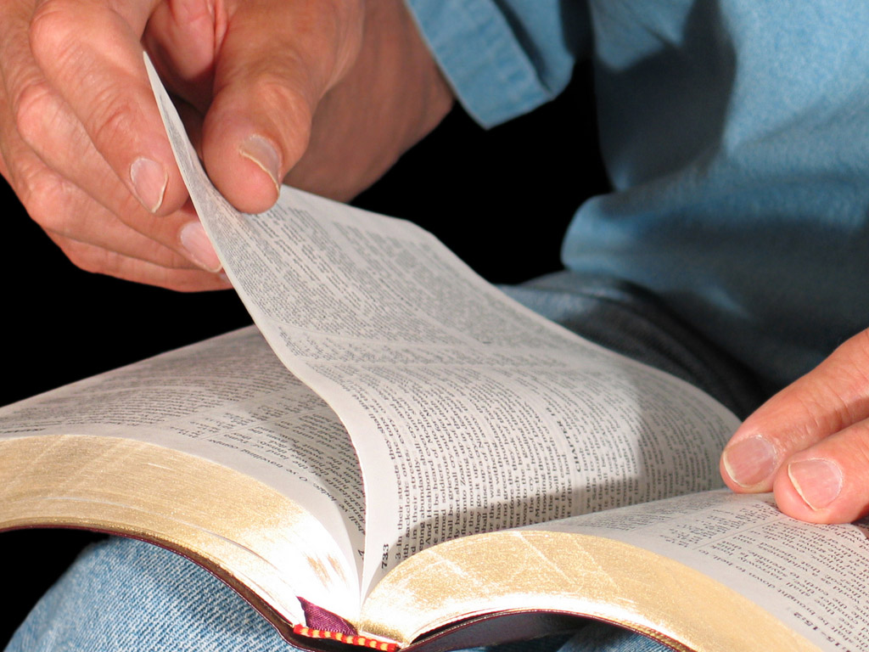
1 John Ⅰヨハネ 5:14, 15
“This is the confidence which we have before Him, that, if we ask anything according to His will, He hears us,
「何事でも神の御心に適うことをわたしたちが願うなら、神は聞き入れてくださる。これが神に対するわたしたちの確信です。

Slide 18
1 John Ⅰヨハネ 5:14, 15
“and if we know that He hears us in whatever we ask we know that we have the requests which we have asked from Him.”
「わたしたちは、願い事は何でも聞き入れてくださるということが分かるなら、神に願ったことは既にかなえられていることも分かります」

Slide 19
C.
He hears us
神は聞き入れて
くださる
Our Part
私たちの部分
our Part
私たちの部分
B. If we ask
according to His will
神の御心に適うことを
私たちが願うなら
B’. If we know
He hears us
聞き入れてくださると
いうことがわかるなら
Result of His work
神の働きの結果
A. We have confidence
私たちには確信がある
A’. We have the requests
私たちには願いがある

Slide 20
1 John Ⅰヨハネ 5:16
“If anyone sees his brother sinning a sin which does not lead to death, he will ask,
「死に至らない罪を犯している兄弟を見たら、その人のために神に願いなさい

Slide 21
1 John Ⅰヨハネ 5:16
“and He will give him life for those who commit sin not leading to death. I do not say that he should pray about that.”
「そうすれば、神はその人に命をお与えになります。これは、死に至らない罪を犯している人々の場合です。死に至る罪があります。これについては、神に願うようにとは言いません」

Slide 22
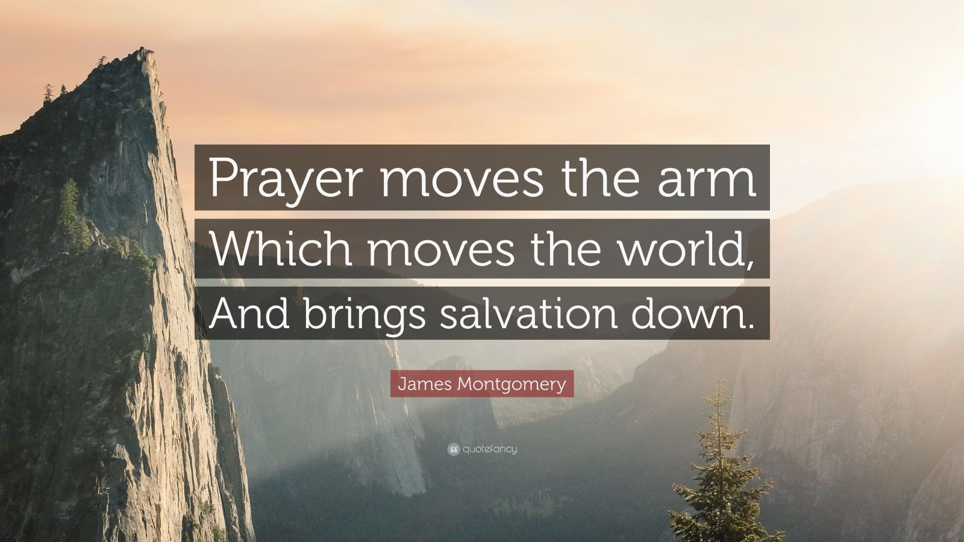
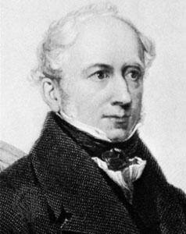
祈りは世界をも動かすほどの腕を動かす そして救いをもたらす
ジェームス・モンゴメリー
Notes:
James Montgomery (1771-1854) was a Scottish poet and hymn writer.

Slide 23
Prayer: The Arm That Moves the World
“By your fervent prayers of faith you can move the arm that moves the world.”
The Adventist Home, 264.
熱烈な信仰の祈りで、あなたは世界をも動かす腕を動かすことができる。
アドベンチストホーム

Slide 24
2.
Understand the
Science of Prayer
祈りの科学を知る

Slide 25
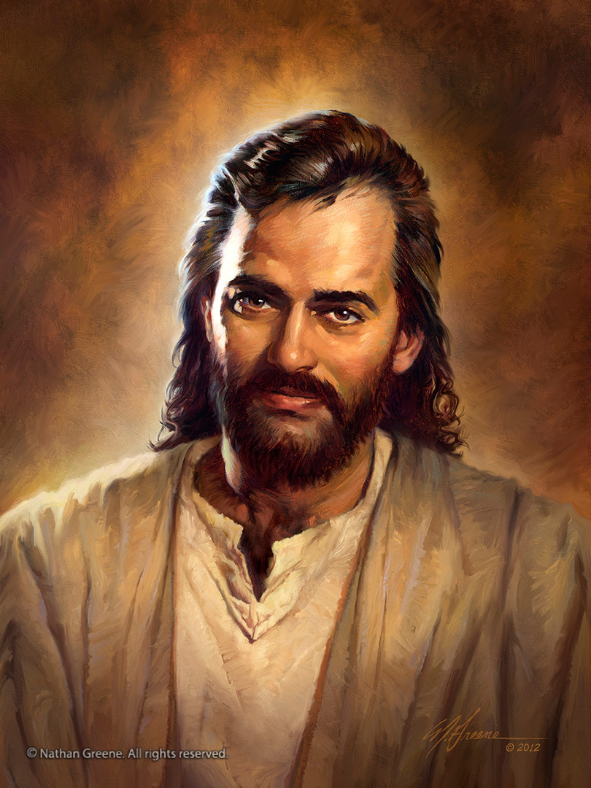
“ Therefore I say to you, whatever things you ask when you pray, believe that you receive them, and you will have them.”
Mark 11:24
そこで、あなたがたに言うが、なんでも祈り求めることは、すでにかなえられたと信じなさい。そうすれば、そのとおりになるであろう。
マルコ11:24

Slide 26
Prayer: A Divine Science 祈り：聖なる科学
“Prayer and faith are closely allied, and they need to be studied together. In the prayer of faith there is a divine science; it is a science that everyone who would make his lifework a success must understand.”
Education, 257.
祈りと信仰は密接に結びついていて、同時に学ぶ必要がある。信仰の祈りには聖なる科学がある、事業を成功させる人は誰でもそれを理解すべきです。
教育

Slide 27
Prayer: A Divine Science 祈り：聖なる科学
“Christ says, ‘What things soever ye desire, when ye pray, believe that ye receive them, and ye shall have them.’ Mark 11:24.
キリストは言う「なんでも祈り求めることは、すでにかなえられたと信じなさい。そうすれば、そのとおりになるであろう。」マルコ11:24

Slide 28
Prayer: A Divine Science 祈り：聖なる科学
“He makes it plain that our asking must be according to God's will; we must ask for the things that He has promised, and whatever we receive must be used in doing His will. The conditions met, the promise is unequivocal.
私たちの願いは神のみ旨によるべきであることは明確です。私たちは神の約束されたことを求めるべきで、受けたものは神のみ旨を行うために用いられるべきです。条件が満たされれば約束は明白です。

Slide 29
Prayer: A Divine Science 祈り：聖なる科学
“For the pardon of sin, for the Holy Spirit, for a Christlike temper, for wisdom and strength to do His work, for any gift He has promised, we may ask;
罪の許しを、聖霊を、キリストのような気質を、神の働きを為すための知恵と力を、神が約束されたどの賜物をも私たちは求める。

Slide 30
Prayer: A Divine Science 祈り：聖なる科学
“then we are to believe that we receive, and return thanks to God that we have received. We need look for no outward evidence of the blessing. The gift is in the promise.”
Education, 257, 258.
そうしたら、受け取ったと信じ、受け取ったことを神に感謝すべきです。祝福の表面的な証拠を求める必要はありません。賜物は約束だからです。
教育

Slide 31
What Is This Science? この科学とは？
Ask for the things He has promised (His will)—1 John 5:14
For example, those things He promised are:
神が約束したこと（み旨）を求めるーＩヨハネ5:14
  例えば、神が約束したことは：
  Pardon for sin (1 John 1:9; Matt 12:31, 32) 罪の赦し（Ｉヨハネ1:9, マタイ12:31,32)
  For the Holy Spirit (Luke 11:9-13) 聖霊 （ルカ11:9-13)

Slide 32
What Is This Science? この科学とは？
Ask for the things He has promised (His will)—1 John 5:14
For example, those things He promised are: 神が約束したこと（み旨）を求めるーＩヨハネ5:14
  例えば、神が約束したことは：
  For a Christlike character (Phil 1:6; Matt 11:28-30) キリストのような品性（ピリピ1:6; マタイ11:28-30)
  For wisdom and strength to do God’s work (Acts 1:4-8) 神の働きをする知恵と力（使徒1:4-8)
  For any gift He promised—Ed 258 神が約束した賜物（教育258)

Slide 33
What is This Science? この科学とは？
Claim God’s promises by faith—Mark 11:24 神の約束を信仰をもって要求する
  “The conditions met, the promise is unequivocal.”—Ed 258 条件が満たされれば、約束は明白
Believe you have received such promises—Ed 258/Mark 11:24 そのような約束をすでに受けとったと信じる-教育/マルコ11:24
Thank God ahead of time for what you’re about to receive. 受け取ろうとしているものを、先に神に感謝する

Slide 34
1
Ask for what He promised神が約束したものを求める

Slide 35
1
Ask for what He promised神が約束したものを求める
Pardon赦し
Wisdom and Strength 知恵と力
Any other gift 他の賜物
Holy Spirit 聖霊
Christ like
Ness キリストの品性

Slide 36
1
Ask for what He promised神が約束したものを求める
2
Claim the promise 約束を要求
Pardon赦し
Wisdom and Strength 知恵と力
Any other gift 他の賜物
Holy Spirit 聖霊
Christ like
Ness キリストの品性

Slide 37
1
Ask for what He promised神が約束したものを求める
2
Claim the promise 約束を要求
Pardon赦し
Wisdom and Strength 知恵と力
Any other gift 他の賜物
Holy Spirit 聖霊
Christ like
Ness
キリストの品性
3
Believe You Received 受け取ったと信じる

Slide 38
1
Ask for what He promised神の約束したものを求める
2
Claim the promise 約束を要求
Pardon赦し
Wisdom and Strength 知恵と力
Any other gift 他の賜物
Holy Spirit 聖霊
4
Thank God 神に感謝
Christ like
Ness キリストの品性
3
Believe You Received 受け取ったと信じる

Slide 39
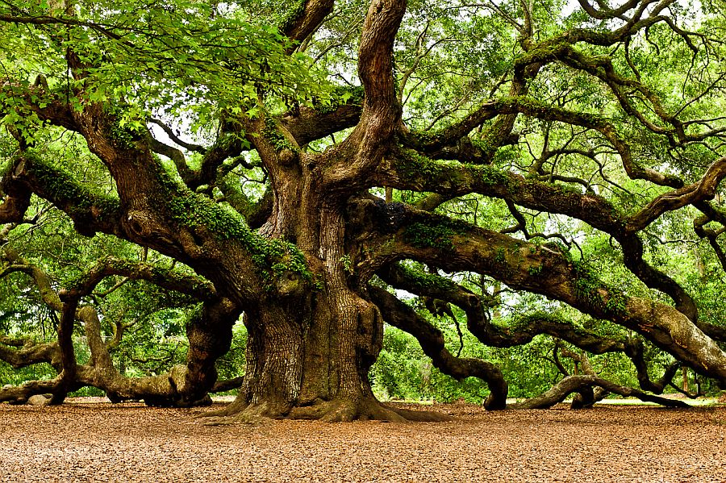
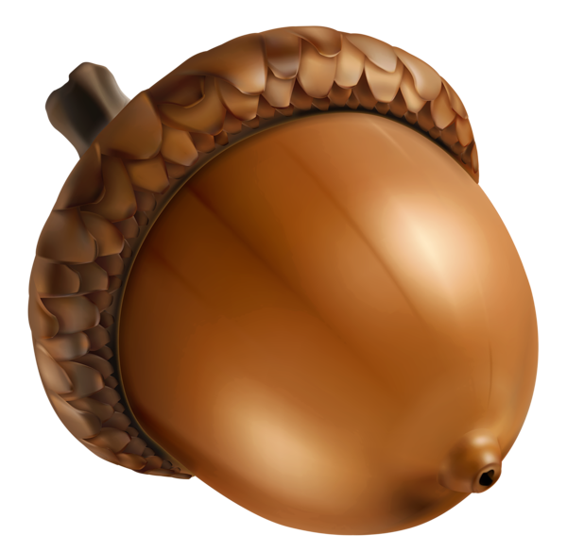
Notes:
The acorn, or oak nut, is the nut of the oaks and their close relatives. It usually contains a single seed, enclosed in a tough, leathery shell.

Slide 40
The Tree Is in the Acorn 樹はどんぐりの中に
“As surely as the oak is in the acorn, so surely is the gift of God in His promise. If we receive the promise, we have the gift.”
Education, 253.
樫の木がどんぐりの中にあるように、神の賜物は神の約束の中にある。約束を受け取ったなら賜物を受け取ったことになる。
教育

Slide 41
Prove God’s Word True! 神の言葉が正しいことを証明する
“When you do not feel the spirit of prayer, you should remember that feeling is not faith; you should seek to prove the pledged word of God…
祈る思いがないと感じるとき、感覚は信仰ではないことを思い出しなさい。あなたは約束された神の言葉を証明することを求めるべきです。

Slide 42
Prove God’s Word True! 神の言葉が正しいことを証明する
“If we had true faith, we could move the world; we could plead with God and with our friends, and many conversions would be the result.”
Signs of the Times, Dec.15, 1890
真の信仰を持っていたら、世界をも動かすことができるはず、そして神に嘆願できるはずです。そして多くの改心者を得るでしょう。
サインズ・オブ・ザ・タイムス 1890年１２月１５日

Slide 43
3.
Work Tirelessly on Behalf of Those You Benefit
あなたが役立ちたいと願う人々のために
疲れることなく働く

Slide 44
Think about it:
Why should God answer your prayers for people you don’t seem to care for?
考えてみて
あまり気にしていない人のための祈りになぜ神は応えるのだろう？

Slide 45
Prayer and Work
“God does not mean that any of us should become hermits or monks and retire from the world in order to devote ourselves to acts of worship.
神は、礼拝に専心するからといって、私たちがこの世から逃れて世捨て人となったり、修道僧になることを望んでおられません。

Slide 46
Prayer and Work 祈りと働き
The life must be like Christ's life—between the mountain and the multitude. He who does nothing but pray will soon cease to pray, or his prayers will become a formal routine.”
Steps to Christ, 101.
私たちの生涯はキリストの生涯のごとく、山と群衆の間でなければなりません、祈るばかりで働かない人は、まもなく祈ることをやめるか、その祈りはただ形式的な習慣になってしまいます。
キリストへの道

Slide 47
“ And the apostles said to the Lord, ‘Increase our faith.’ So the Lord said, ‘If you have faith as a mustard seed, you can say to this mulberry tree, ‘Be pulled up by the roots and be planted in the sea,’ and it would obey you.” Luke 17:5, 6
使徒たちは主に「わたしたちの信仰を増してください」と言った。 そこで主が言われた、「もし、からし種一粒ほどの信仰があるなら、この桑の木に、『抜け出して海に植われ』と言ったとしても、その言葉どおりになるであろう。 ルカ17:5, 6

Slide 48
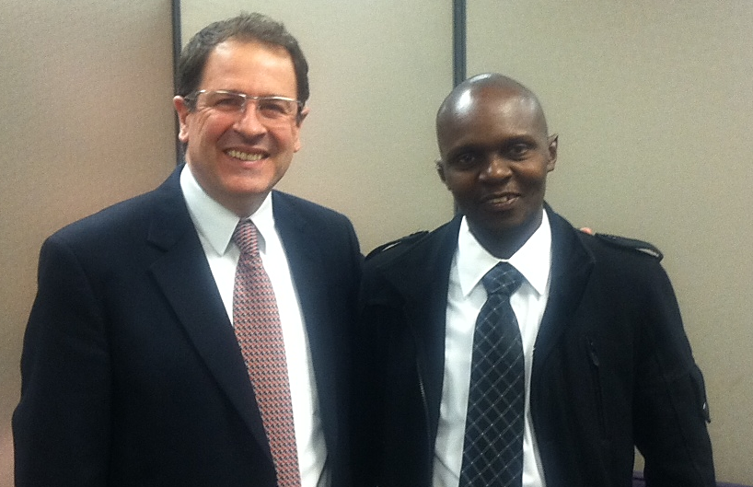
Reginald Sibanda レジナード・シバンダ

Slide 49
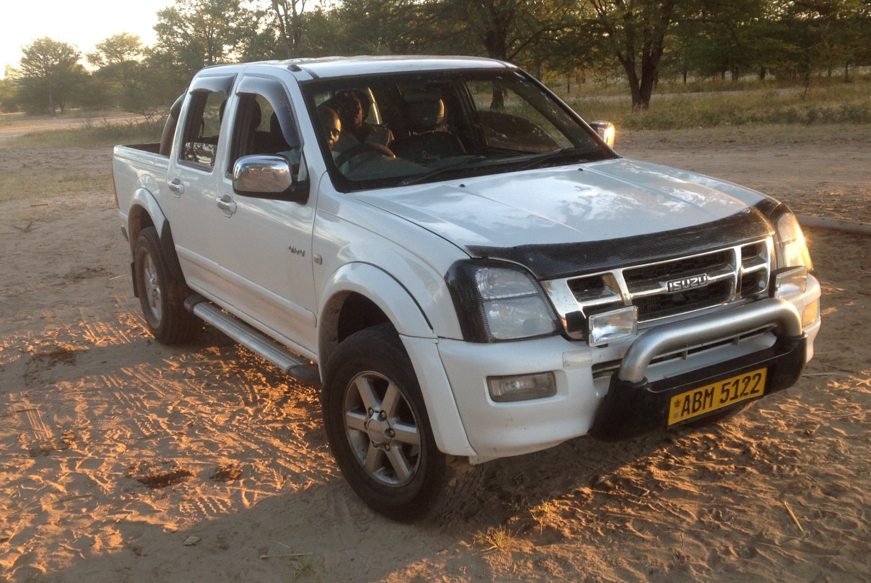
Reginald Sibanda レジナード・シバンダ

Slide 50
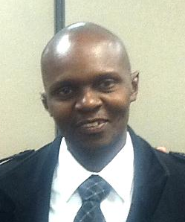
Reginald Sibanda レジナード・シバンダ
Took a tough district: two churches, no growth 困難な地域を担当：成長しない２つの教会
Taught members how to study their Bibles and how to share their faith 教会員に聖書研究の仕方と信仰を分かち合う方法を教えた
Befriended police, school personnel, hospital personnel 警官や学校職員、病院職員と親しくなった
Today, most of those people are Seventh-day Adventists! 現在それらのほとんどがセブンスデ―アドベンチストに
He had read his Bible from cover to cover many times 聖書を何度も通読した

Slide 51
Reginald Sibanda レジナード・シバンダ
Befriended police, school personnel, hospital personnel 警官や学校職員、病院職員と親しくなった
Today, most of those people are Seventh-day Adventists! 現在それらのほとんどがセブンスデ―アドベンチストに
He had read his Bible from cover to cover many times 聖書を何度も通読した

Slide 52
Reginald Sibanda レジナード・シバンダ
He has read his Bible from cover to cover many times 聖書を何度も通読した
Grew his district from 2 to 120 churches! 彼の地域で２つだった教会は１２０に！
Membership from 273 to 21,256 in three years!教会員は３年で273人から21,256人に！

Slide 53
Reginald Sibanda レジナード・シバンダ
Coordinated over 100 evangelistic campaigns at the same time 同時に１００以上の伝道集会を企画した
Gets up at 2 a.m. to pray for 4-6 hrs. He prays for hundreds of people to come to know Jesus every day, but he also works hard on their behalf ４～６時間祈るために２時に起床。彼はイエスを知ることになる何百もの人々のために毎日祈る、そして彼らのためによく働く。

Slide 54
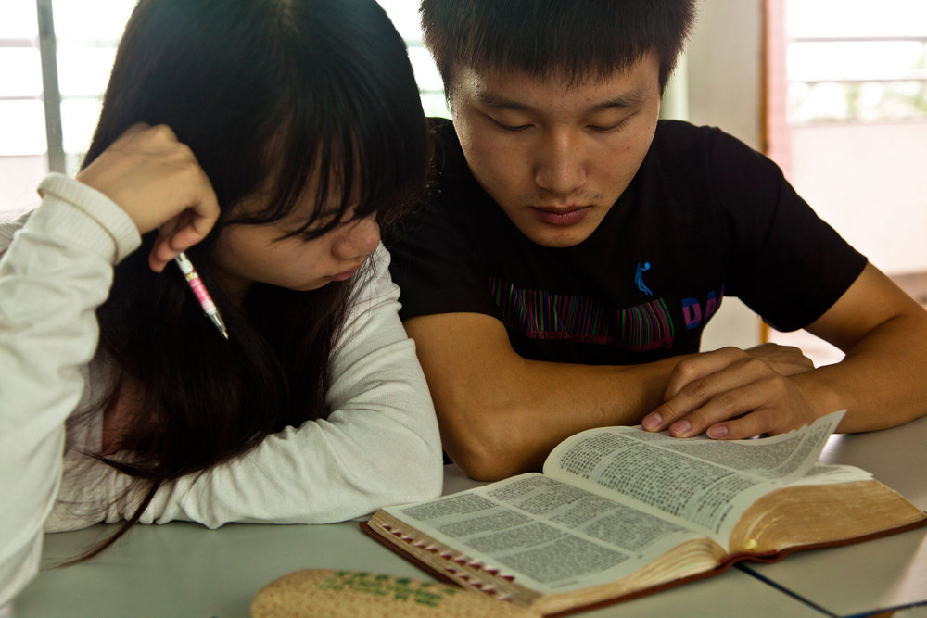
Expect Setbacks… 停滞もある・・・
Their schedule changes… スケジュールが変わる
They are under conviction…確信に至っていない

Slide 55

Expect Setbacks… 停滞もある・・・
The family interferes… 家族が妨害する
They get distracted and lose interest… 気が散って関心を失くす
彼らのために祈り
且つ働こう！

Slide 56
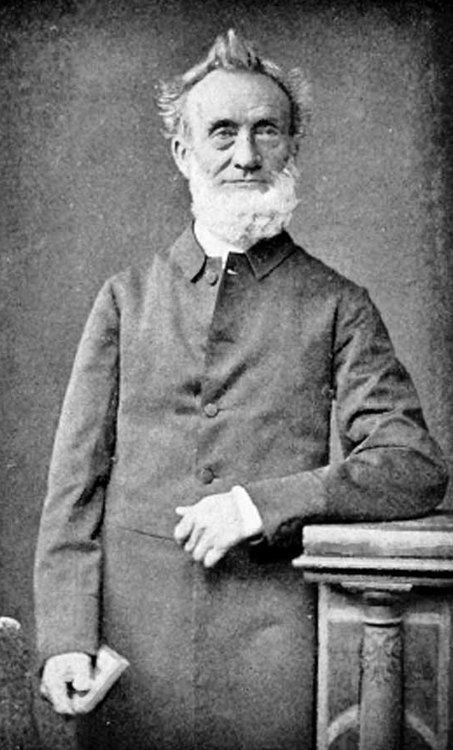
George Muller (1805-1898)
ジョージ ミュラー
Founded 117 Christian schools １１７のキリスト教学校を設立
Cared for over 10,000 orphans １万人以上の孤児を世話した
Raise over 150 million USD 1億５千万ドルの資金を調達
Distributed 285,000 Bibles/1.5 million NTs２８万５千冊の聖書/１５０万冊の新約聖書を配布

Slide 57
George Muller (1805-1898)
Sponsored hundreds of missionaries 何百もの宣教師に資金援助
Began preaching at age 70 ７０歳で説教を始めた
Prayed for all of this このすべてのために祈った
Prayed for five friends to come to the Lord ５人の友が主のもとに来るように祈った

Slide 58
George Muller (1805-1898)
“The man to whom God in the riches of his grace has given tens of thousands of answers to prayer in the self-same hour or day in which they were offered has been praying day by day for nearly 36 years for the conversion of these individuals,
神のその豊かな恵みにより何千もの祈りの応えがその日の内に与えられた人物が、３６年近くもこれらの人々の改心のために毎日祈っている、

Slide 59
George Muller (1805-1898)
“and yet they remain unconverted. But I hope in God, I pray on, and look yet for the answer. They are not converted yet, but they will be.”
Miller, George Muller: Delighted in God, 146.
まだ彼らは改心していない。しかし、神に希望をもち、祈り続け、答えを心待ちにしている。彼らはまだ改心していない、しかしいつかそうするだろう。
ミラー著 ジョージ ミュラー：神にある喜び

Slide 60
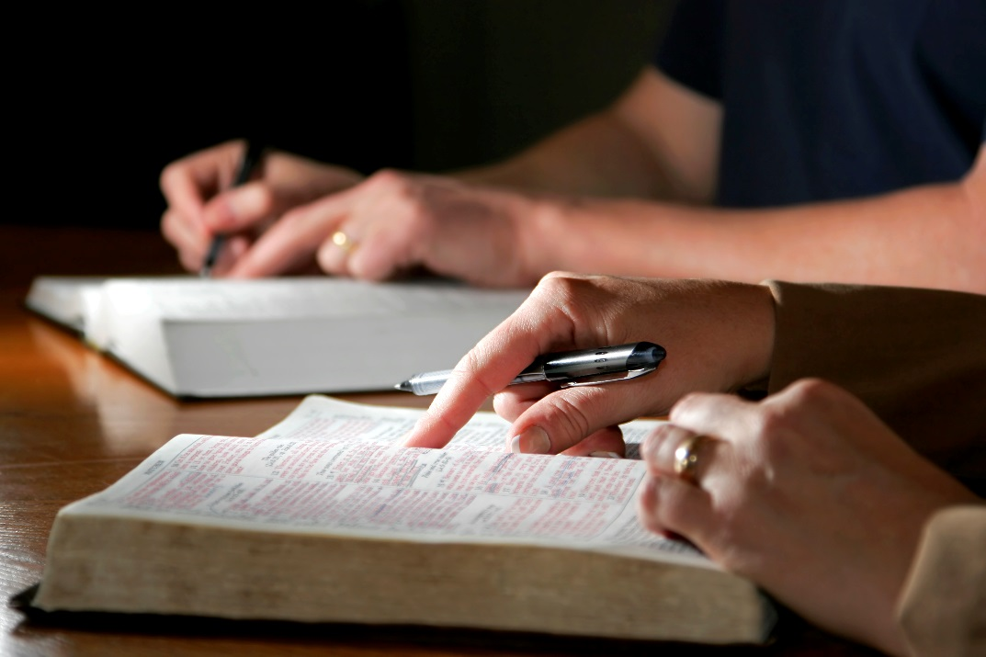
Be faithful. Be prayerful.
God will reward your efforts with souls in the Kingdom!
信仰を、祈りを
神は御国で出会う多くの魂をもって
あなたの努力に報いてくださる

