Slide 1
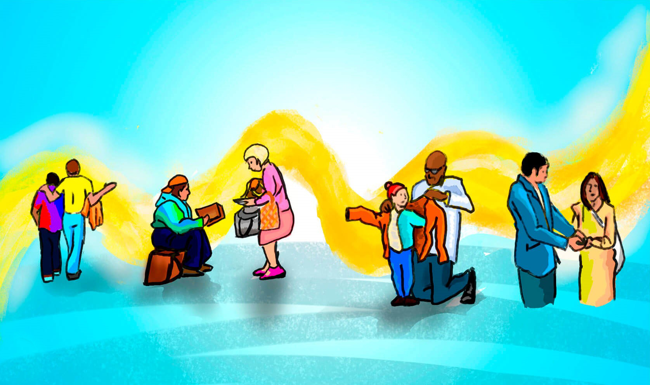
“THE STRANGER IN
YOUR GATES”
Lesson 5 for October 30, 2021

Slide 2

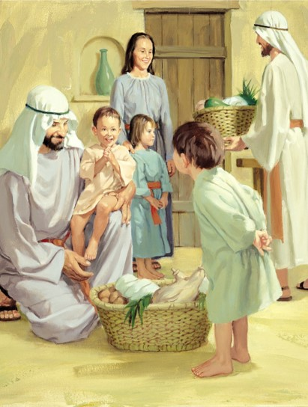
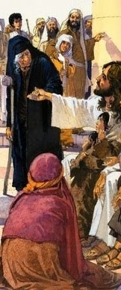







Jesus was asked about the most important commandment of the Law. He answered: “Love the Lord your God,” (Mr. 12:30; Dt. 6:5) and mentioned a second commandment: “Love your neighbor as yourself.” (Mr. 12:31; Lv. 19:18)
Deuteronomy addresses the love for the neighbor in need, especially the stranger
(Dt. 10:19). Fatherless and widows are often mentioned too (Dt. 10:18; 14:29; 16:11, 14; 24:17, 19-21; 26:12-13; 27:19).
What do we need to love the stranger?
Why should we love the stranger?
  Because God loves them
  Because we are strangers too
How should we treat the stranger?
  Treating them fairly
  Caring for them

Slide 3

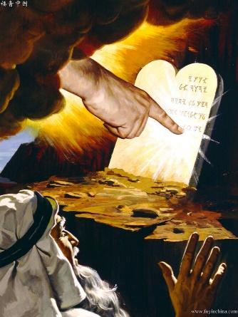
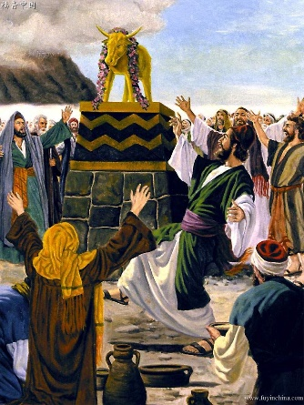
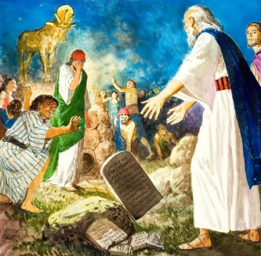
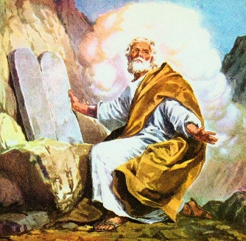
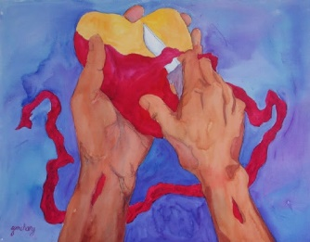
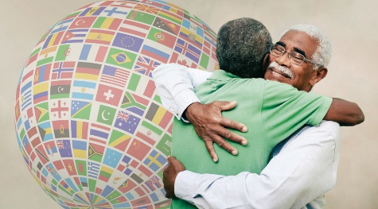
WHAT DO WE NEED TO LOVE THE STRANGER?
“Therefore circumcise the foreskin of your heart, and be stiff-necked no longer.” (Deuteronomy 10:16)
The Israelites were already transgressing the Law by making a golden idol while God was writing it on stone tablets
(Dt. 9:11-12).
Moses broke the tablets God had written because the people had broken the Covenant. However, God forgave them and ordered Moses to prepare new tablets, giving them a new chance (Dt. 10:1-2).
Nevertheless, they couldn’t be faithful to the Covenant if they only trusted external signs (like the physical circumcision).
They needed a circumcision of the heart (Dt. 10:16).
Only then they could “love the stranger.” (Dt. 10:19)

Slide 4

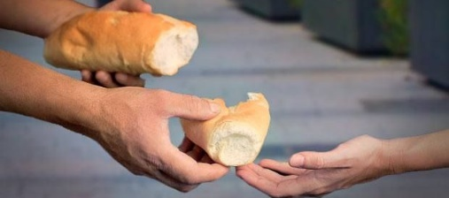
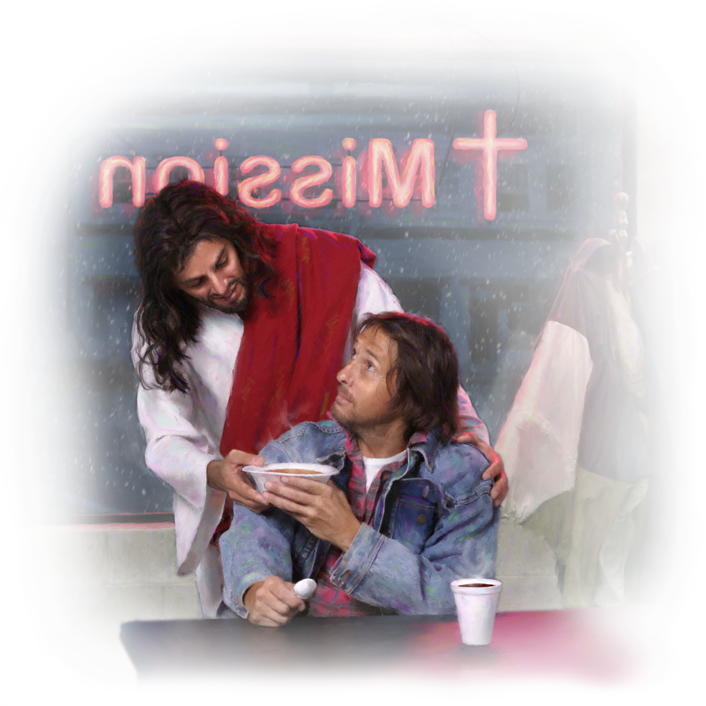
GOD LOVES THE STRANGER
“He administers justice for the fatherless and the widow, and loves the stranger, giving him food and clothing.” (Deuteronomy 10:18)
Deuteronomy 10:17-18 enumerates the reasons why we should love the stranger:
Because God is God of gods and Lord of lords
Because He is great, mighty, and awesome
Because He is not biased and
does not accept bribes
Because He defends the fatherless
and the widow
Because He loves the stranger,
giving them food and clothing
God is almighty. He does not need anything and can do anything He wants to. Still, He loves the stranger and helps them. He also invites us to love them and help them.

Slide 5

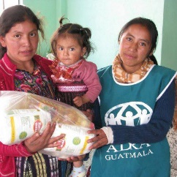
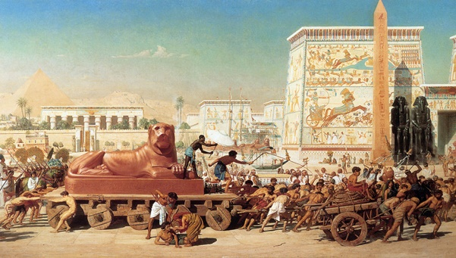
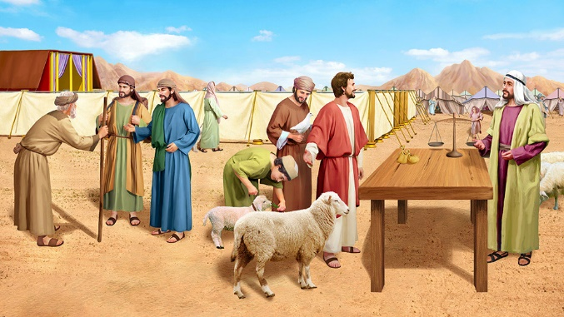
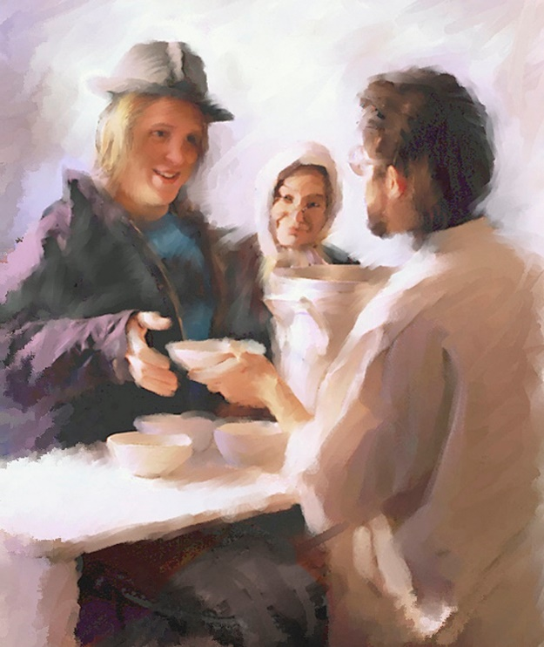
WE ARE STRANGERS TOO
“Therefore love the stranger, for you were strangers in the land of Egypt.” (Deuteronomy 10:19)
The people of Israel were enslaved in Egypt, as it was foretold to Abraham (Gn. 15:13). They experienced what is like to be stranger and marginalized firsthand.
God encouraged them to remember their own experience and to treat the stranger and the marginalized as a full citizens. The law should be the same for natives and foreigners.
We are also slaves. We’ve been enslaved by sin, and we are strangers on this Earth. We must be a light that shows the love of God through the way we lovingly treat others. We must treat others as we want to be treated (Mt. 7:12).

Slide 6

“In your association with others, put yourself in their place. Enter into their feelings, their difficulties, their disappointments, their joys, and their sorrows. Identify yourself with them, and then do to them as, were you to exchange places with them, you would wish them to deal with you. This is the true rule of honesty.”
E. G. W. (Thoughts From the Mount of Blessing, cp. 6, p. 134)

Slide 7
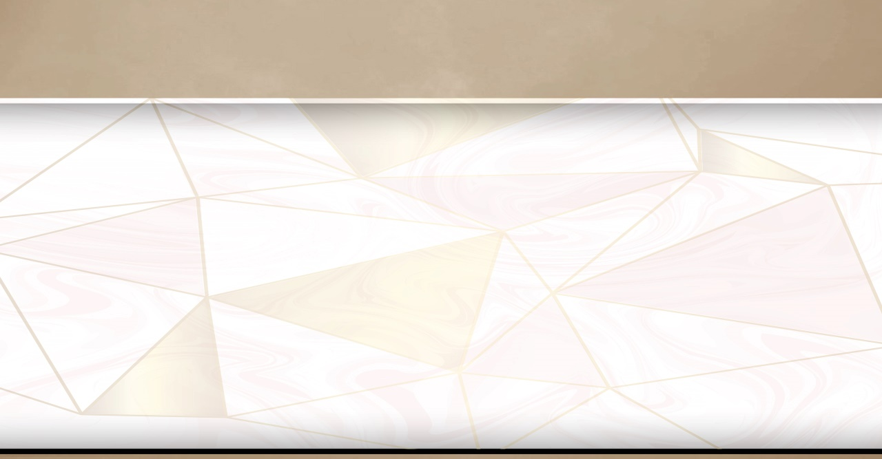
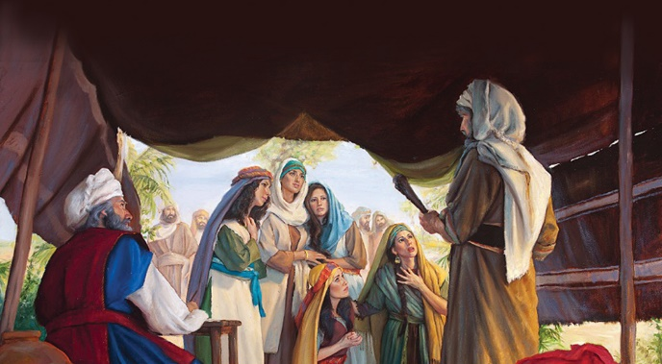
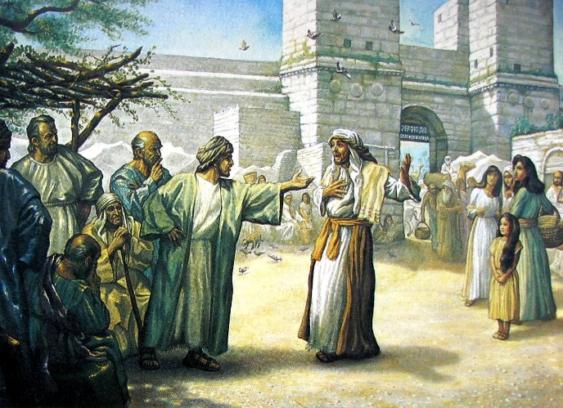
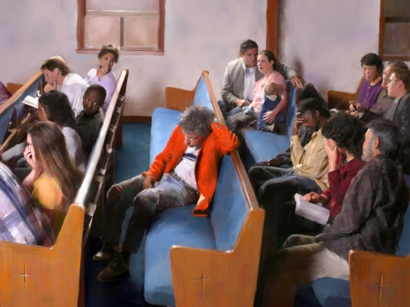
TREATING THE STRANGER FAIRLY
“Then I commanded your judges at that time, saying, ‘Hear the cases between your brethren, and judge righteously between a man and his brother or the stranger who is with him.’” (Deuteronomy 1:16)
God wants everyone to be treated fairly, no matter their social position: stranger or native, poor or rich (Dt. 16:19; 27:17; 27:19).
These rules are based in God’s own nature. He is fair and does not accept bribes (Dt. 10:17). The messages of the prophets are full of reprimands for subjecting the defenseless to the poor treatment (Jer. 22:3; Ez. 22:29; Zec. 7:10; Mal. 3:5).
We may not have legal authority to change the laws of our country or how they are applied. However, we can treat everyone we meet the same way regardless of their condition.

Slide 8

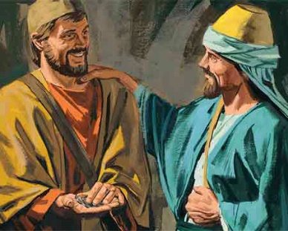
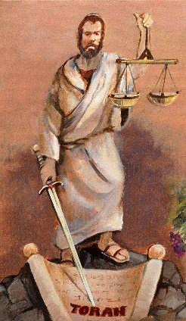
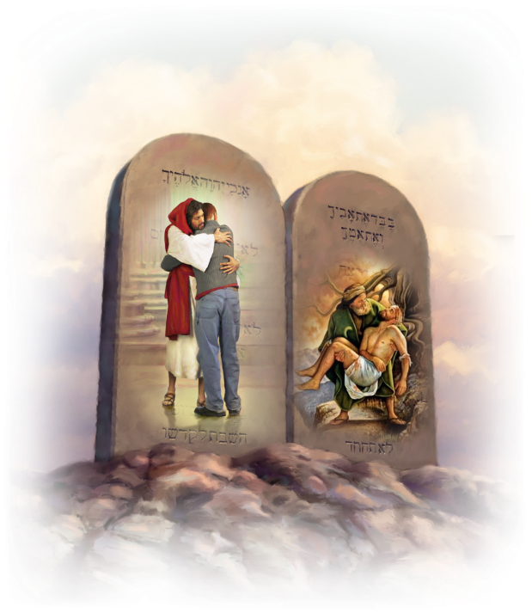
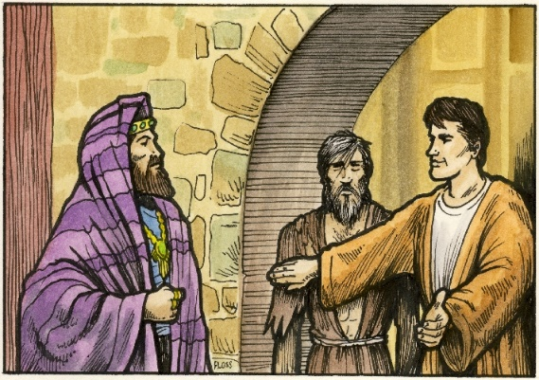
CARING FOR THE STRANGER
“You shall not oppress a hired servant who is poor and needy, whether one of your brethren or one of the aliens who is in your land within your gates.” (Deuteronomy 24:14)
Paying the wage of the workers promptly, returning the clothes borrowed from the poor, not going into someone’s house to collect the debt. These are ways to show respect and care for those in need and for the stranger (Dt. 24:10-15).
James wrote about the same respect and care for those in need within the Church, rejecting the privileges of the rich which are a detriment to the poor
(James 2:1-7).
James considered partiality a transgression of the Ten Commandments (James 2:8-11). Pure religion involves caring for others (James 1:27).

Slide 9

“Christ recognized no distinction of nationality or rank or creed. The scribes and Pharisees desired to make a local and a national benefit of the gifts of heaven and to exclude the rest of God’s family in the world. But Christ came to break down every wall of partition. He came to show that His gift of mercy and love is as unconfined as the air, the light, or the showers of rain that refresh the earth.”
E. G. W. (The Ministry of Healing, cp. 1, p. 25)

