Slide 1
THE EVERLASTING COVENANT
Lesson 3 for October 16, 2021

Slide 2
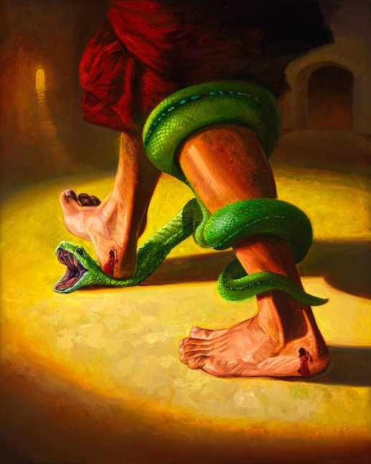
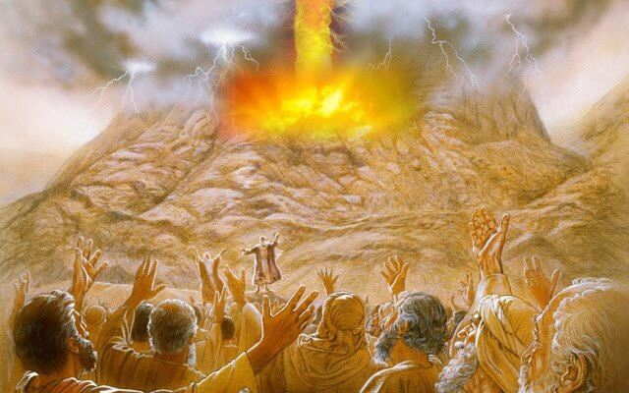
When sin entered our world, God committed to save humanity with the Plan of Salvation He had designed “before the foundation of the world.” (1P. 1:20)
God’s covenant covers all human beings, but He chose a specific nation—the people of Israel—as its custodian.
The book of Deuteronomy details the terms of that covenant in that specific moment in time. It is known as “the book of the covenant.”
The foundation of the covenant
The people of the covenant
The book of the covenant
The commitment to the covenant
Images of the covenant

Slide 3
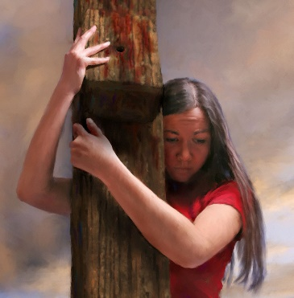
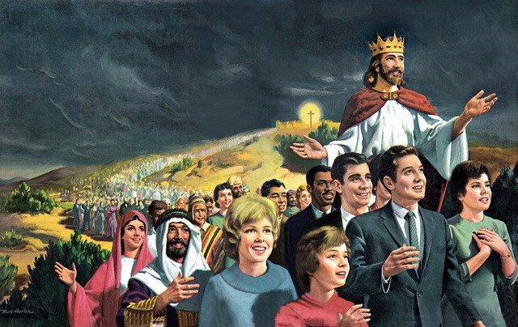
THE FOUNDATION OF THE COVENANT
“And he believed in the Lord, and He accounted it to him for righteousness.” (Genesis 15:6)
The everlasting covenant is built on three pillars:
In summary, salvation is by faith alone which is given to us by grace. As a result of salvation, we live according to the stipulations of the covenant.
Grace
Faith
Obedience
God’s attribute which moves Him to offer salvation to everyone
The way we can accept the covenant. God accepts it
Our response to the requirements of the covenant
That was the experience of Abraham. Although the covenant was confirmed to his descendants, every human being (both Jews and Gentiles) can embrace it, since “those who are of faith are sons of Abraham.” (Gal. 3:7)

Slide 4
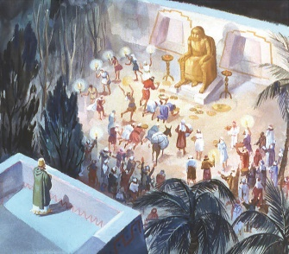
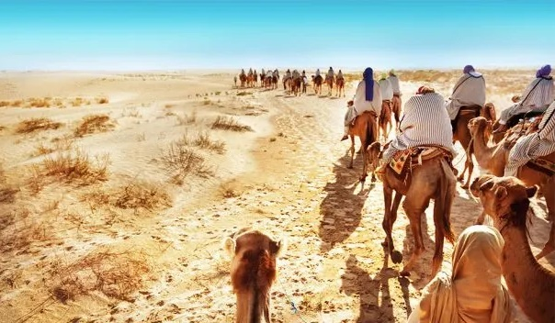
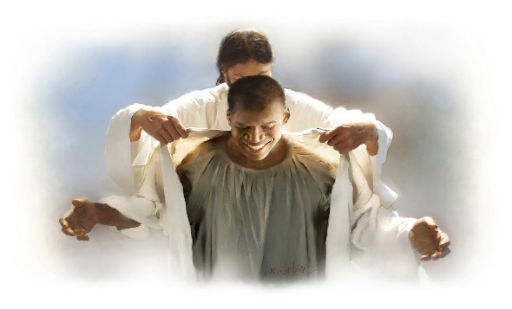
THE PEOPLE OF THE COVENANT
“It is not because of your righteousness or the uprightness of your heart that you go in to possess their land, but because of the wickedness of these nations that the Lord your God drives them out from before you, and that He may fulfill the word which the Lord swore to your fathers, to Abraham, Isaac, and Jacob.” (Dt. 9:5)
If the covenant had been based on the righteousness or “the uprightness of the heart” of Israel, they couldn’t have confirmed it because of their lack of faith (Exodus 14:11; 16:3; 17:3).
The covenant is based on God’s grace. There’s nothing humans can do to deserve it, either individually or collectively. God chose Israel by grace, thus fulfilling the promises He had made to Abraham, Isaac, and Jacob.
The same is true today. We cannot do enough to deserve God’s favor or to live according to the stipulations of the covenant (the Ten Commandments).
God gives us His covenant by His grace. He forgives us when we break it and helps us to be faithful to it.

Slide 5
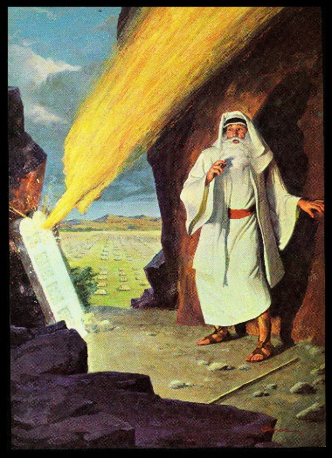
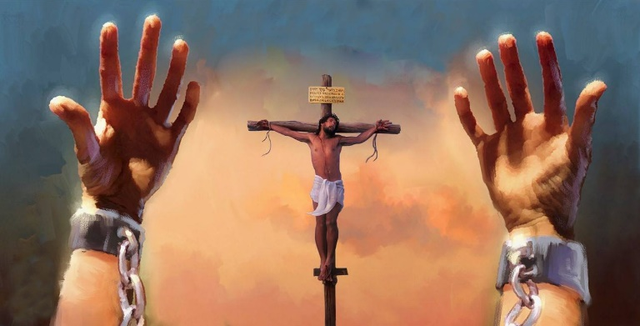
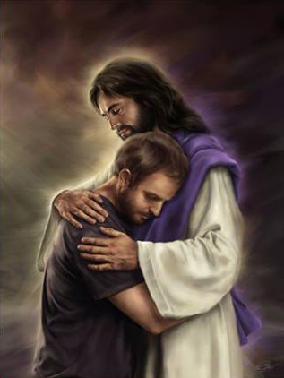
THE BOOK OF THE COVENANT
“So He declared to you His covenant which He commanded you to perform, the Ten Commandments; and He wrote them on two tablets of stone.” (Deuteronomy 4:13)
Deuteronomy is known as “the book of the covenant.” Moses reminds the new generation about the covenant God made with Israel at Mount Horeb (Sinai).
He described the covenant in a straightforward way: to keep the Ten Commandments. That was their part of the covenant. God’s part was decided even before the creation of our world: Jesus had offered Himself to die in the sinners’ place.
Before listing the commandments, Moses encouraged the people to personally commit to the covenant (Dt. 5:3). The Covenant was signed by their fathers (Abraham, Isaac, Jacob). Now it was their turn. Each person had to sign it themselves.
The Covenant is personal, it’s a covenant between God and you.

Slide 6
“The salvation of the human race has ever been the object of the councils of heaven. The covenant of mercy was made before the foundation of the world. It has existed from all eternity, and is called the everlasting covenant. So surely as there never was a time when God was not, so surely there never was a moment when it was not the delight of the eternal mind to manifest His grace to humanity.”
E. G. W. (Our Father Cares, March 6)

Slide 7
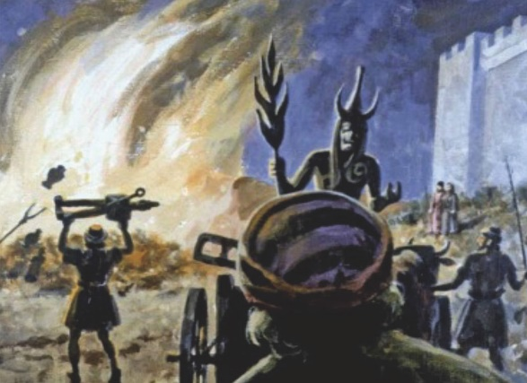
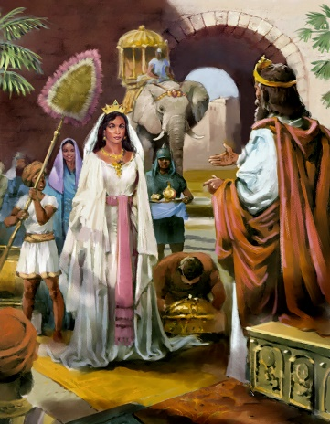
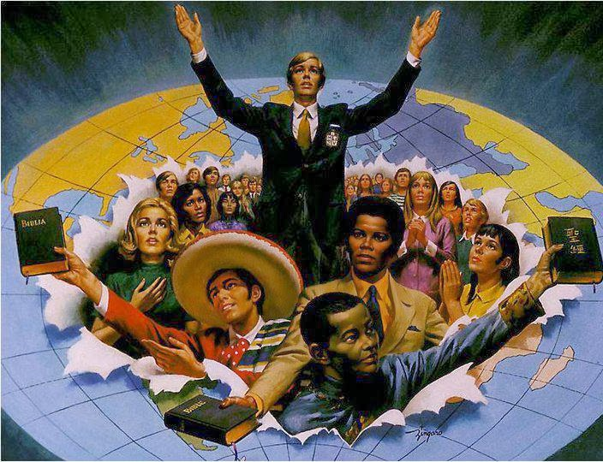
THE COMMITMENT TO THE COVENANT
“and that He will set you high above all nations which He has made, in praise, in name, and in honor, and that you may be a holy people to the Lord your God, just as He has spoken.” (Deuteronomy 26:19)
God would set Israel above other nations, how were those nations? (Dt. 18:9-14)
Israel had to make a strong commitment to God. They would undoubtedly be drawn to the corrupted traditions of the nations in Canaan. They should keep away from them and be perfect before God (v. 13).
They were made a light to enlighten other nations and to lead them to the truth.
We must commit to God’s Covenant in the same way. We are lights that must lead others to the Truth (Jn. 14:6).

Slide 8
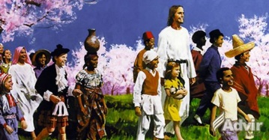
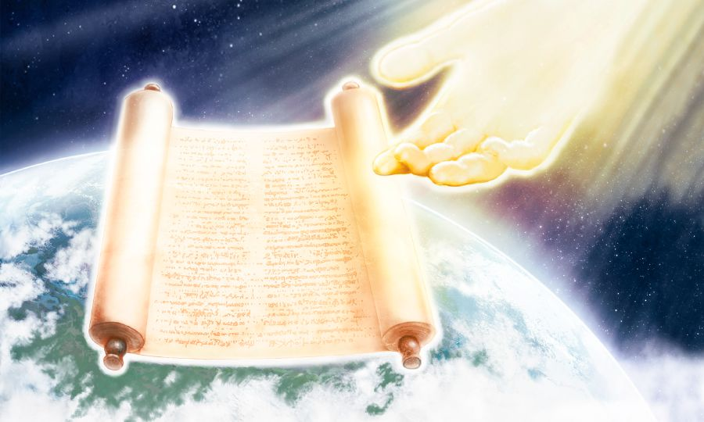
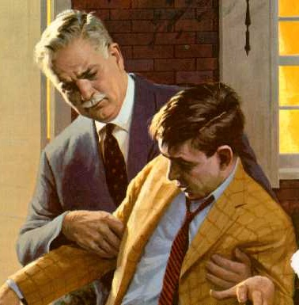
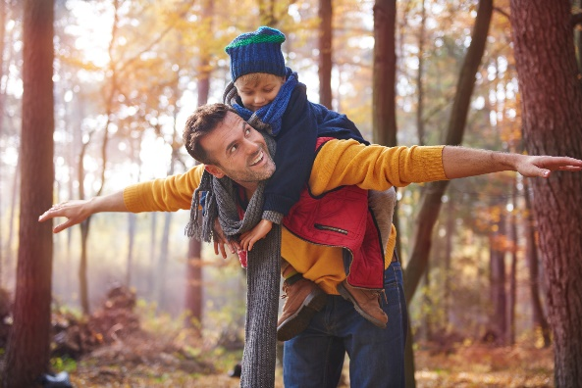
IMAGES OF THE COVENANT
“You are the children of the Lord your God;” (Deuteronomy 14:1)
The Covenant was introduced as a legal agreement between two parties. As we studied in previous lessons, the book of Deuteronomy is written in the form of the legal agreements that Egyptians and Hittites used.
This way, the covenant may feel too formal, cold, distant, and lifeless. Therefore, God also used images that represent His relationship with us: undeserved grace and love.
God cares for us and loves us like an (ideal) father and his child (Dt. 8:5; 14:1; 32:6).
He delivers us from “the iron furnace” (Dt. 4:20). We are His portion, the place of His inheritance (Dt. 32:9).

Slide 9
“We ourselves owe everything to God’s free grace. Grace in the covenant ordained our adoption. Grace in the Saviour effected our redemption, our regeneration, and our exaltation to heirship with Christ. Let this grace be revealed to others.”
E. G. W. (Christ’s Object Lessons, cp. 19, p. 250)

