Slide 1
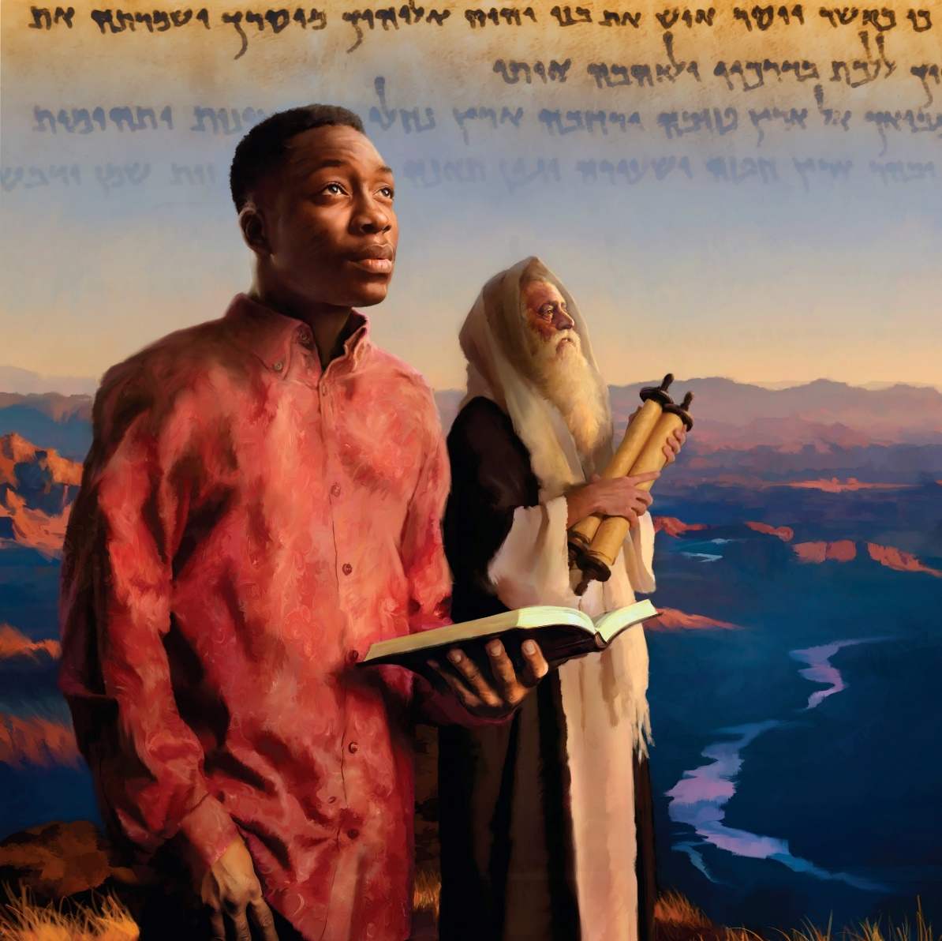
PREAMBLE TO DEUTERONOMY
Lesson 1 for October 2, 2021

Slide 2
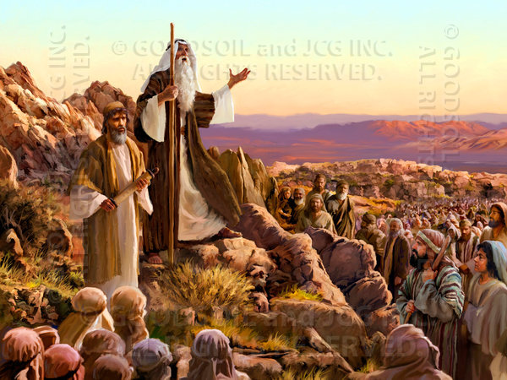
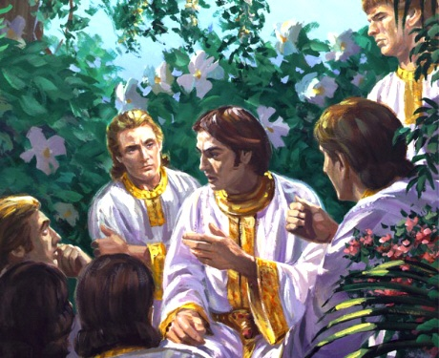
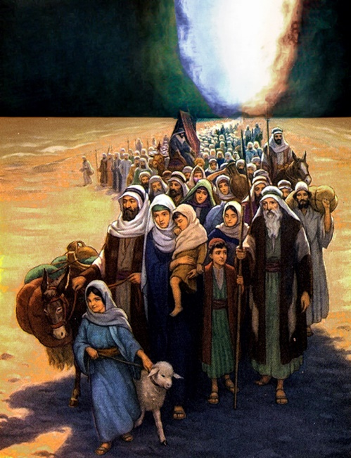
The book of Deuteronomy contains the farewell speeches of Moses to the people of Israel before his death.
In order to properly understand them, we should review the broader context: from Lucifer’s rebellion to Israel’s forty years in the desert.
The Great Controversy
Rebel humanity
The seed of Abraham
The covenant at Sinai
40 years in the desert

Slide 3
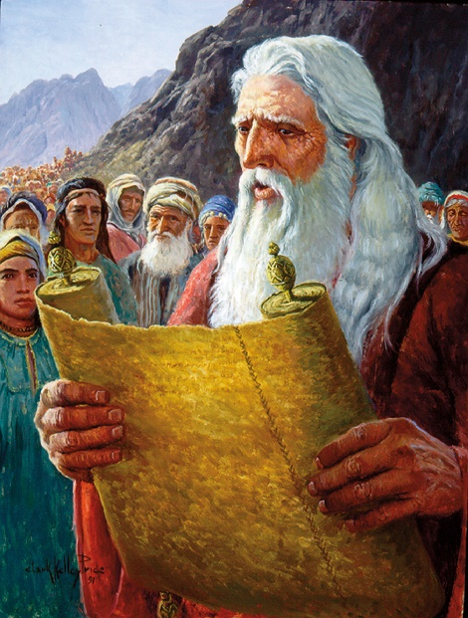
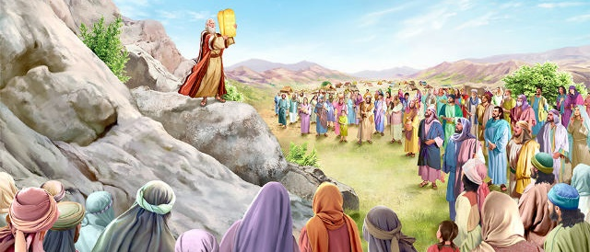
DEUTERONOMY
“These are the words which Moses spoke to all Israel on this side of the Jordan in the wilderness.” (Deuteronomy 1:1)
The word “Deuteronomy,” the title of the book, is derived from the Greek translation (the Septuagint) of a phrase found in Deuteronomy 17:18, “a copy of this law,” which means literally “a second [i.e., a repetition] of this law.” The title indicates both a repetition of the law they had received at Sinai, and a review of God’s teachings.
The Hebrew title of the book, Debarim, “words” refers to the prophetic words of Moses in verse 3. This echoes the last words of the book of Numbers, which read “these are the commandments” (Num. 36:13). These “words” are the commandments of God.

Slide 4
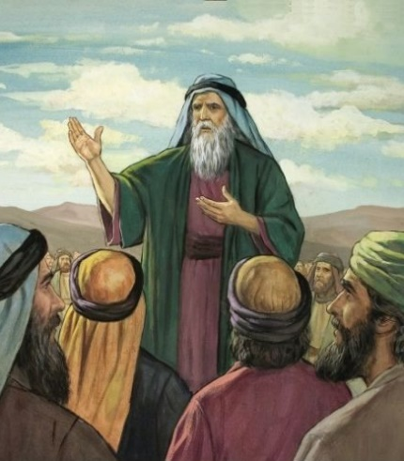
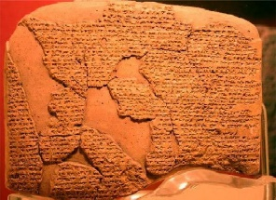
DEUTERONOMY
This book contains four speeches:
Dt. 1:1-4:43
Dt. 4:44-28:6
Dt. 29-30
Dt. 31-34
A historical prologue
A review of the Law
An appeal to keep the covenant
A final call to read and remember the Law, the Song of Moses, his blessing, and farewell before he dies
The overall structure of the book is found in the first three speeches. It follows the structure of the old covenants between vassals and their masters (Egyptians and Hittites):
Preamble (Dt. 1:1-5)
Historical prologue (Dt. 1:6-4:49)
Stipulations: general (Dt. 5-11)
Stipulations: specific (Dt. 12-26)
Blessings and curses (Dt. 27-28)
Covenant loyalty and witnesses (Dt. 29-30)

Slide 5
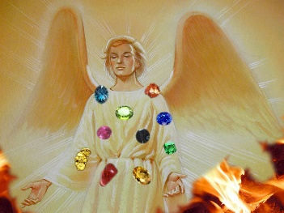
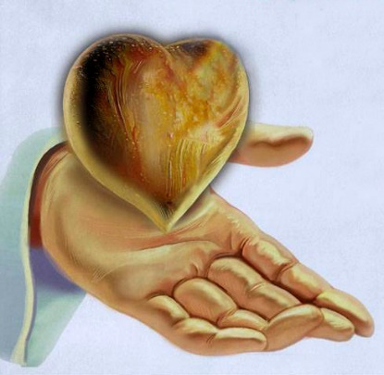
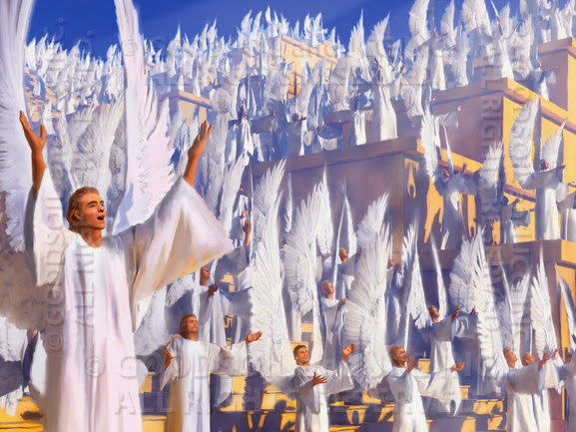
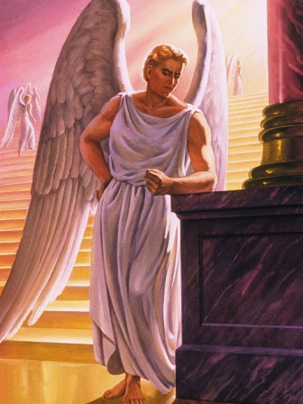
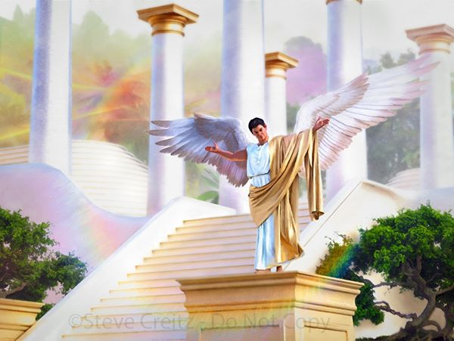
THE GREAT CONTROVERSY
“You were perfect in your ways from the day you were created, till iniquity was found in you.” (Ezekiel 28:15)
God is love. Everything coming from Him is love. He wants His creatures to love Him with all their heart (Dt. 6:5).
However, only voluntarily loving is love. Therefore, God created free and rational beings who could understand and choose.
Freedom came with a risk. A free perfect being could decide to stop loving God, to question God’s sovereignty, and to rebel against his Creator.
That is how Lucifer’s rebellion began. He was a perfect and beautiful angel in an elevated position, but he coveted an even higher position (Ezekiel 28:11-19; Isaiah 14:12-15).

Slide 6
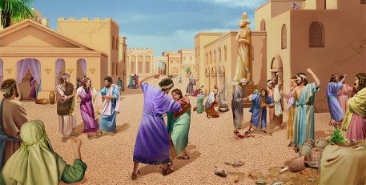
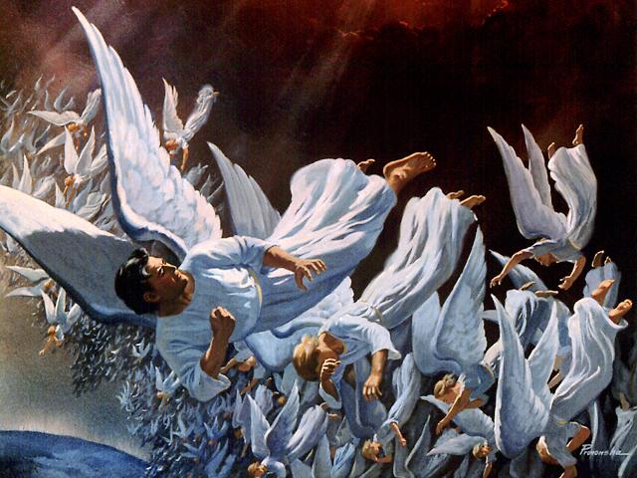
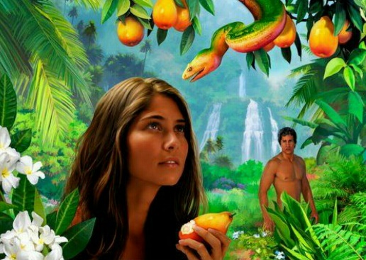
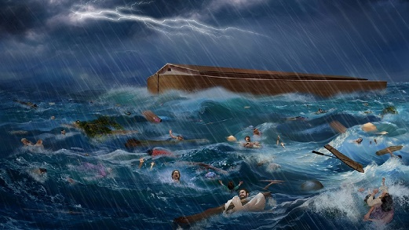
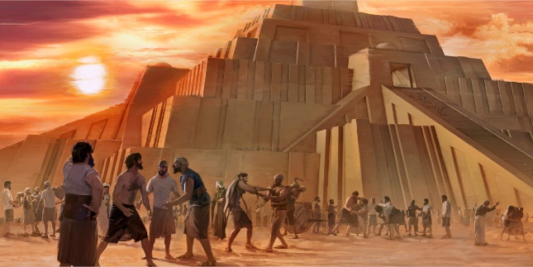
REBEL HUMANITY
“So God looked upon the earth, and indeed it was corrupt; for all flesh had corrupted their way on the earth.” (Genesis 6:12)
One third of the angels supported Lucifer’s rebellion (Rev. 12:4). Unfortunately, Adam and Eve also decided to believe him instead of trusting God (Gn. 3:4-6). In that moment, Earth got deeply involved in the Great Controversy.
Earth was quickly imbued with hate (Gn. 4:8). Almost all human beings stopped loving and honoring God, and perverted increasingly. Then, God decided to destroy the rebel beings with a flood (Gn. 6:13).
However, they began to worship their idols and to feel proud of their own works soon after the Flood. God had to intervene again. He destroyed the Tower of Babel, made their communication difficult through different languages, and scattered them (Gn. 11:5-8).

Slide 7
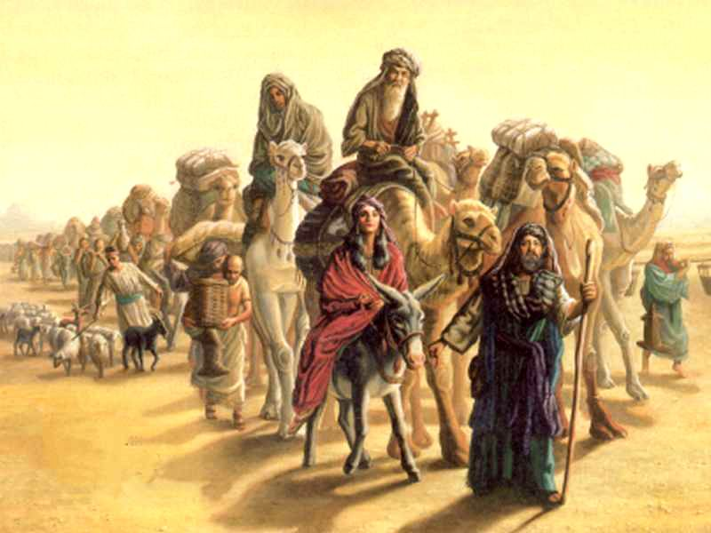
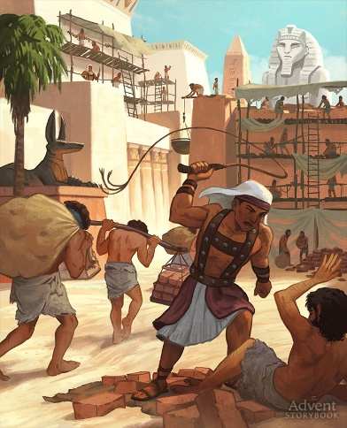
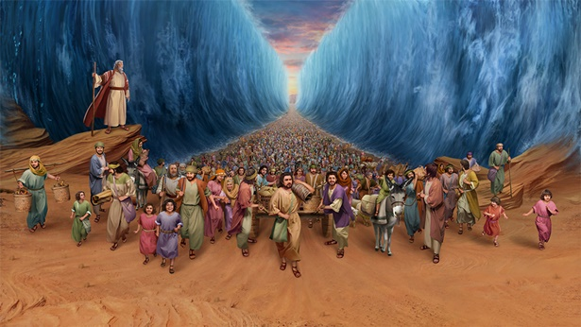
THE SEED OF ABRAHAM
“in you all the families of the earth shall be blessed.” (Genesis 12:3)
After the scattering at Babel, God called a man—Abram, i.e. Abraham—so he and his descendants would preserve the knowledge about God and share the Plan of Salvation with everyone else.
Abraham’s family was not a perfect one, and they were enslaved in Egypt. However, God was still in control.
The seed of Abraham (the people of Israel) lived far from the truth amid ignorance and mistakes. However, God liberated them from Egypt with His powerful hand through His servant Moses. Their mission was to inherit the Promised Land and to be a light that should bless all the other nations.

Slide 8
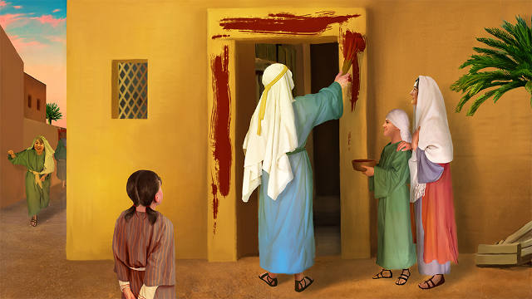
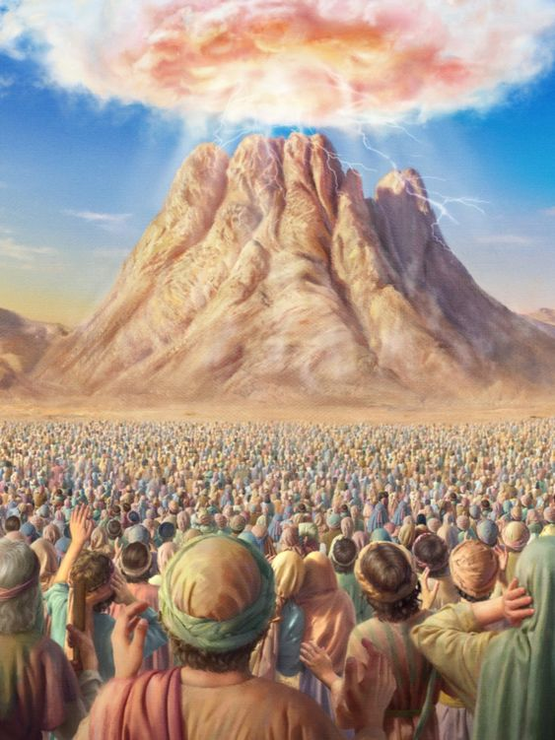
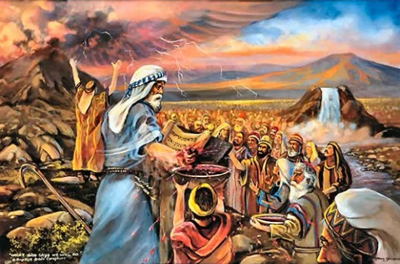
THE COVENANT AT SINAI
“Now therefore, if you will indeed obey My voice and keep My covenant, then you shall be a special treasure to Me above all people; for all the earth is Mine.” (Exodus 19:5)
The liberation from Egypt was absolutely wonderful. The blood of the lambs on the lintels marked the beginning of their freedom. Then, the sea was divided. God led His people to Mount Sinai, miracle after miracle. He made a special covenant with them there.
The covenant stipulated the commitment to obey the Ten Commandments and the rest of the laws, but it was a covenant of grace. The people of Israel were special because God had chosen them, not because they had unique qualities or could offer something special (Dt. 7:7-8).
The people of Israel solemnly committed to keep the covenant. God used blood again to seal the covenant again by spraying them with it (Exodus 24:7-8).

Slide 9
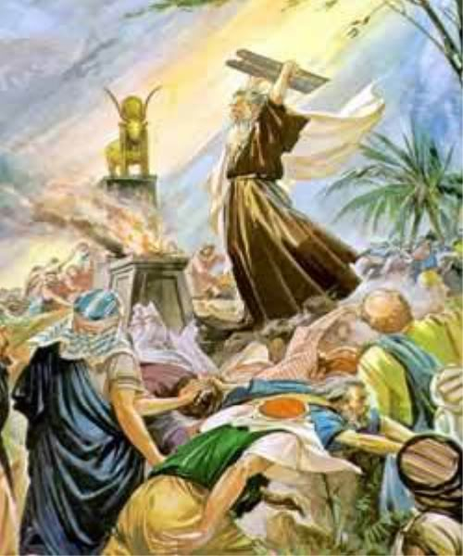
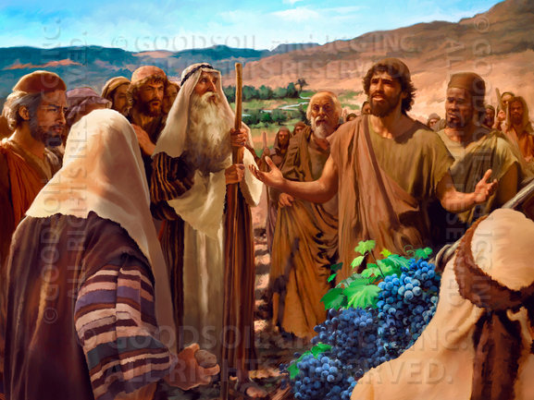
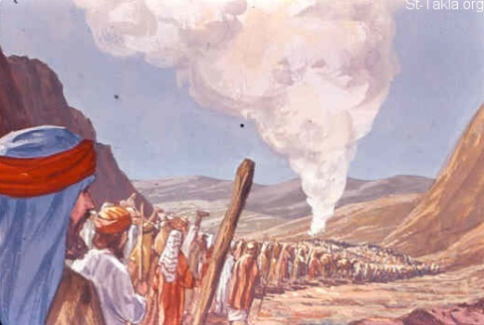
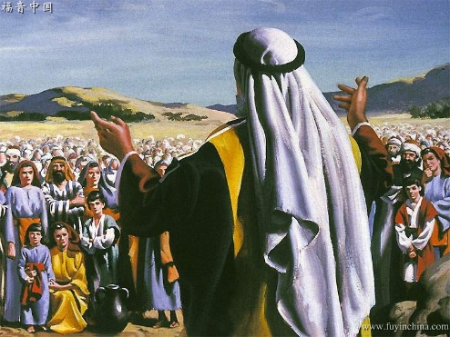
40 YEARS IN THE DESERT
“For the Lord your God has blessed you in all the work of your hand. He knows your trudging through this great wilderness. These forty years the Lord your God has been with you; you have lacked nothing.” (Deuteronomy 2:7)
Although the people had good intentions, they were unable to keep the covenant. The first time Moses was away, they built an idol and worshipped it (Ex. 32:1).
When they were about to enter Canaan, they lost faith (Nm. 14:3-4). Despite all the marvelous things they had seen, they refused to obey God.
God kept them in the desert for 40 years as a punishment, until a new generation was ready to inherit the Promised Land.
Moses was in charge of encouraging the new generation and to renew the covenant with them. This is what Deuteronomy is about.

Slide 10
“The principles set forth in Deuteronomy for the instruction of Israel are to be followed by God’s people to the end of time. True prosperity is dependent on the continuance of our covenant relationship with God.”
E. G. W. (Prophets and Kings, cp. 46, p. 570)

