Slide 1
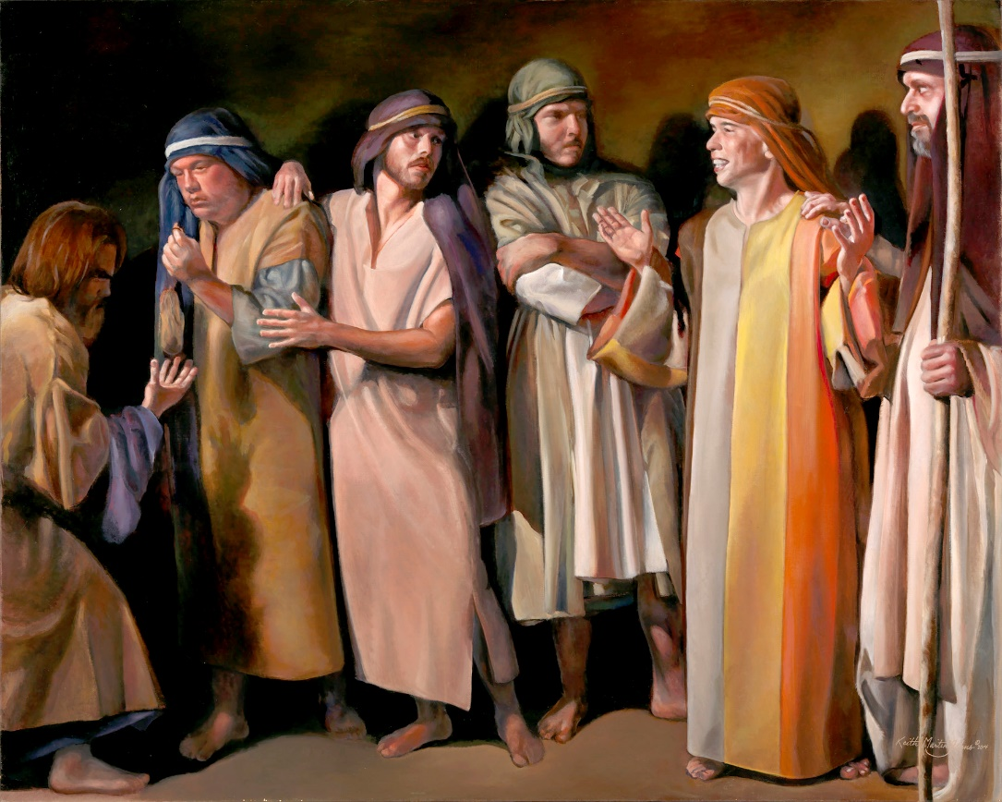
FINDING
REST
IN
FAMILY
TIES
Lesson 6 for August 7, 2021

Slide 2

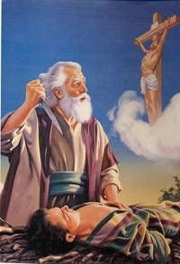
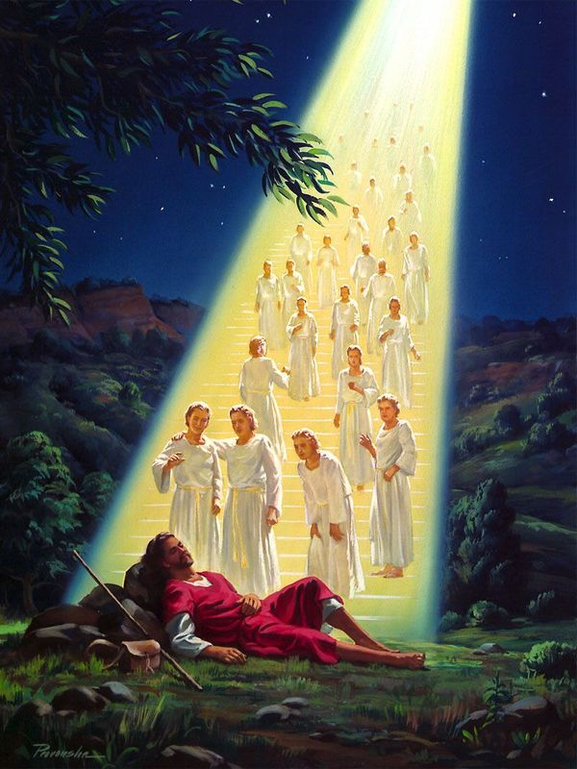
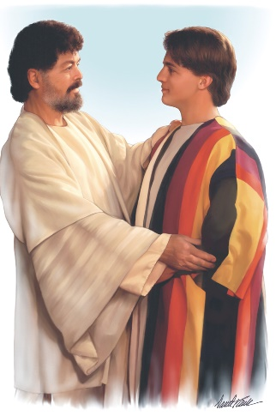
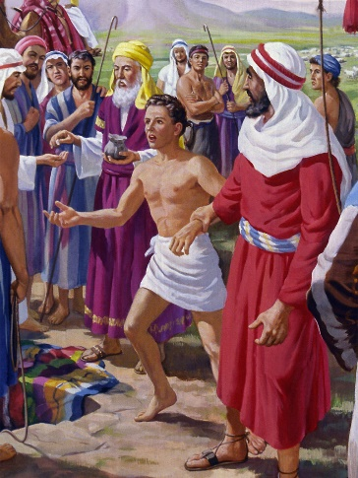
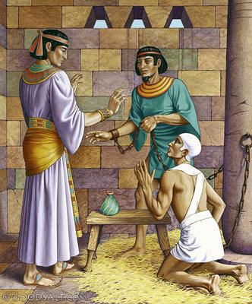





Joseph was born in the bosom of a religious family, but his family it was far from perfect (do perfect families even exist?). Everything he learned about God thanks to his family was key to make the right decisions in both tough and easy times.
He was spoiled, abandoned, humiliated, exalted, defamed... His life was in constant change. However, the circumstances did not shape his destiny, but his decisions did. What happens when...?
When your family is not perfect
When you begin from scratch
When you are a nobody
When your relationships are troublesome
When you are facing new challenges

Slide 3

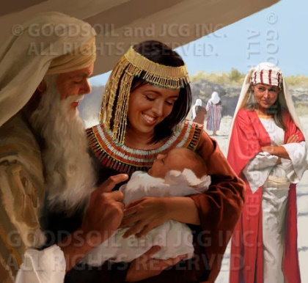
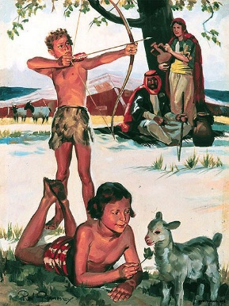
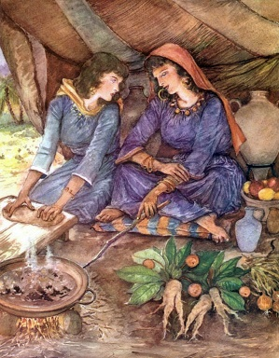
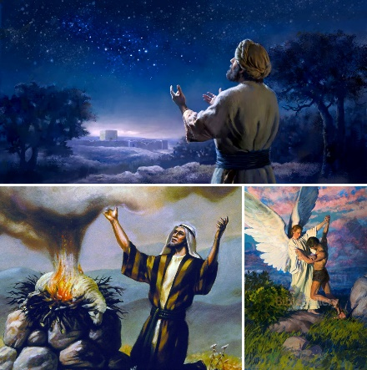
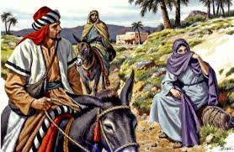
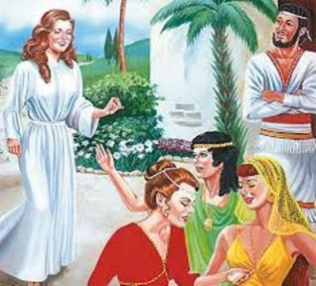
WHEN YOUR FAMILY IS NOT PERFECT
“This is the history of Jacob. Joseph, being seventeen years old, was feeding the flock with his brothers. And the lad was with the sons of Bilhah and the sons of Zilpah, his father’s wives; and Joseph brought a bad report of them to his father.” (Genesis 37:2)
Conflicts had been common at Joseph’s family for generations. In his grand-father’s time (Abraham), there was conflict between Sarah and Hagar. Isaac favored Esau but Rebecca favored Jacob. Jacob married two women who were rivals for the rest of his life.
About Joseph’s brothers... Ruben slept with his stepmother, Judah with his daughter-in-law, and Simeon and Levi killed everyone at a village.
However, Abraham, Isaac, and Jacob were heroes of faith (Heb. 11:8, 20, 21). They struggled with their family issues, but they learned about faith, love, and trust in God.

Slide 4

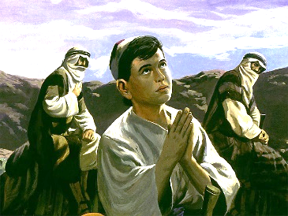
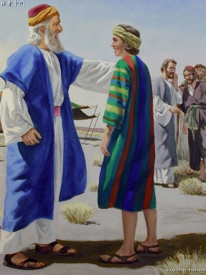
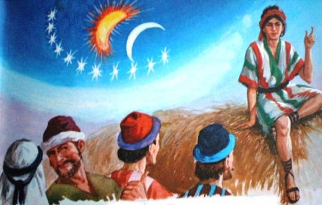
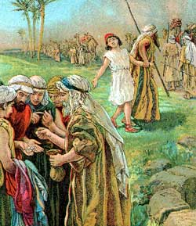
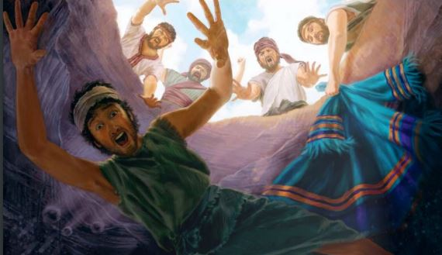
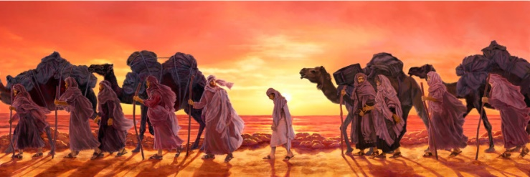
WHEN YOU BEGIN FROM SCRATCH
“But from there you will seek the Lord your God, and you will find Him if you seek Him with all your heart and with all your soul.” (Deuteronomy 4:29)
Joseph was the favorite son of Jacob (Gn. 37:3). After some time, his brothers hated him so much that they wanted him dead (Gn. 37:4-5, 19-20).
When he was 17 years old, his brothers sold him as a slave. He could only watch the tents of his family growing smaller as he was beginning his travel to Egypt.
However, he recalled the lessons he had learned from his family about trusting God. He did not lose heart. He decided to fully trust God and to do His will.
Since that moment, that decision led every subsequent decision in his life. We might have learned about God at home, but trusting Him and remaining faithful is a personal decision.

Slide 5

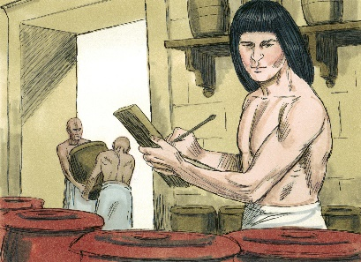
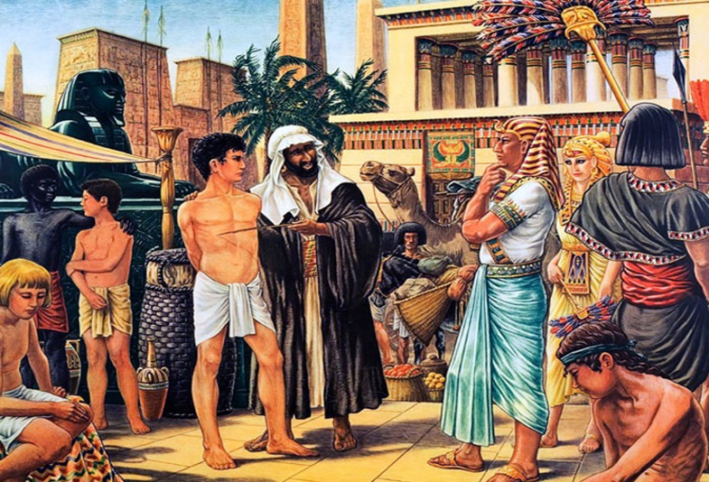
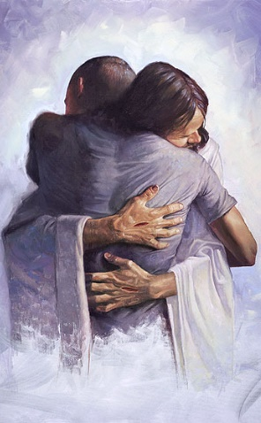
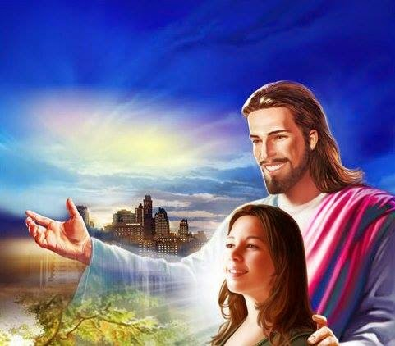
WHEN YOU ARE A NOBODY
“Now the Midianites had sold him in Egypt to Potiphar, an officer of Pharaoh and captain of the guard.” (Genesis 37:36)
Joseph was not the favorite one anymore. He was a nobody, an invisible slave. His self-esteem could have plummeted easily.
Joseph’s self-esteem was not based on what others thought about him, but on his worth to God.
How does God look at us?
God looks at each of us with glasses tinted with grace. He sees us now like we will be when live forever with Him.
“Fear not, for I have redeemed you; I have called you by your name; you are Mine.” (Is. 43:1). “Behold what manner of love the Father has bestowed on us, that we should be called children of God!” (1Jn. 3:1).

Slide 6

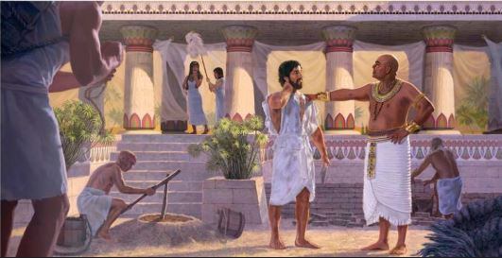
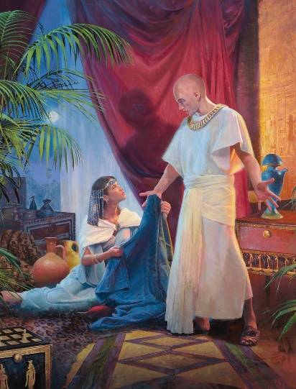
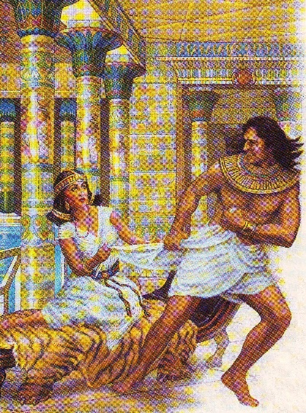
WHEN YOUR RELATIONSHIPS ARE TROUBLESOME
“There is no one greater in this house than I, nor has he kept back anything from me but you, because you are his wife. How then can I do this great wickedness, and sin against God?” (Genesis 39:9)
God blessed Joseph so he could find favor in Potiphar’s sight. After some time, he was overseeing all the properties of his master.
Everything went smoothly, but a conflict between Joseph and the wife of his master arose.
Potiphar’s wife used to get everything she wanted, and she wanted Joseph. If Joseph did not satisfy her craving, he could be in big trouble.
He always applied the biblical principles he had learned (Gn. 39:9). He treated everyone with love and kindness, but God was always first. We must never please someone if that involves transgressing one of God’s commandments.

Slide 7

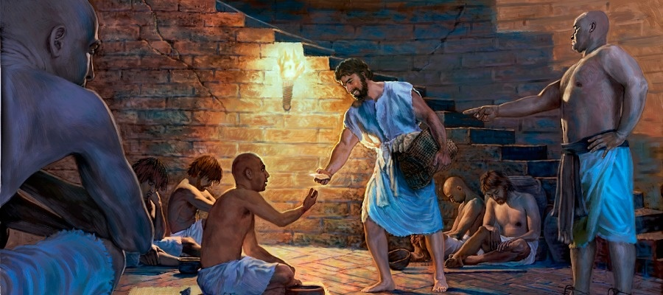
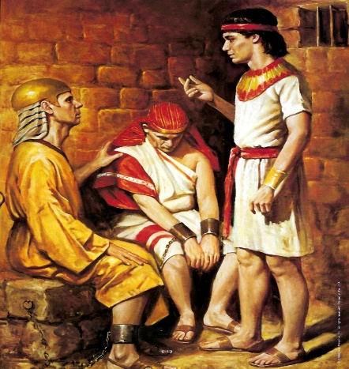
WHEN YOU ARE FACING NEW CHALLENGES
“And the keeper of the prison committed to Joseph’s hand all the prisoners who were in the prison; whatever they did there, it was his doing.” (Genesis 39:22)
Potiphar could have killed Joseph, but he decided to imprison him instead (maybe he did not believe his wife’s lie). There, Joseph still trusted God and applied God’s principles to his relationships. Soon, all the prisoners were under his care.
Relationships at prison were not easy, but Joseph took care of everyone. He immediately noticed two prisoners were quite uneasy: the butler and the baker (Gn. 40:6-7). He also took advantage of the opportunity and asked the butler for help.
We live in a cosmic conflict. Satan is trying to break our relationship with God and our neighbors. We must cling to God even more when our relationships with others become complicated.

Slide 8

“The home that is beautified by love, sympathy, and tenderness is a place that angels love to visit, and where God is glorified. The influence of a carefully guarded Christian home in the years of childhood and youth is the surest safeguard against the corruptions of the world. In the atmosphere of such a home the children will learn to love both their earthly parents and their heavenly Father.”
E. G. W. (The Adventist Home, cp. 1, p. 19)

