Slide 1
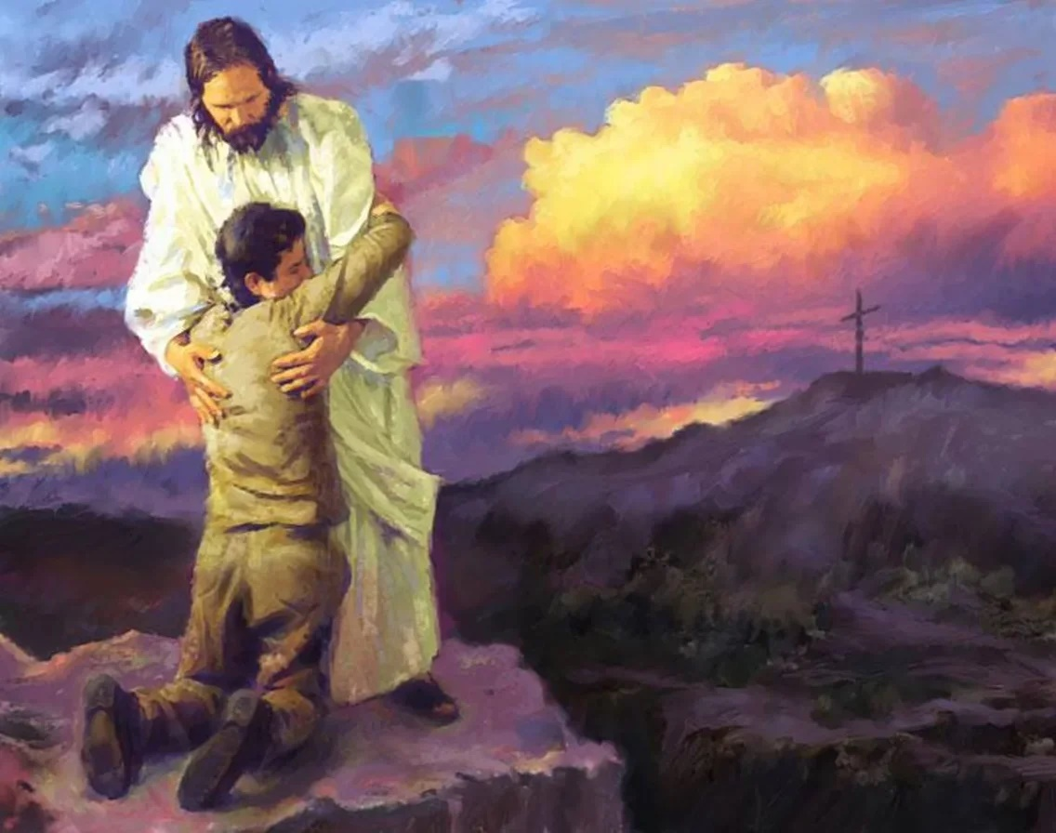
“COME TO ME…”
Lesson 5 for July 31, 2021

Slide 2
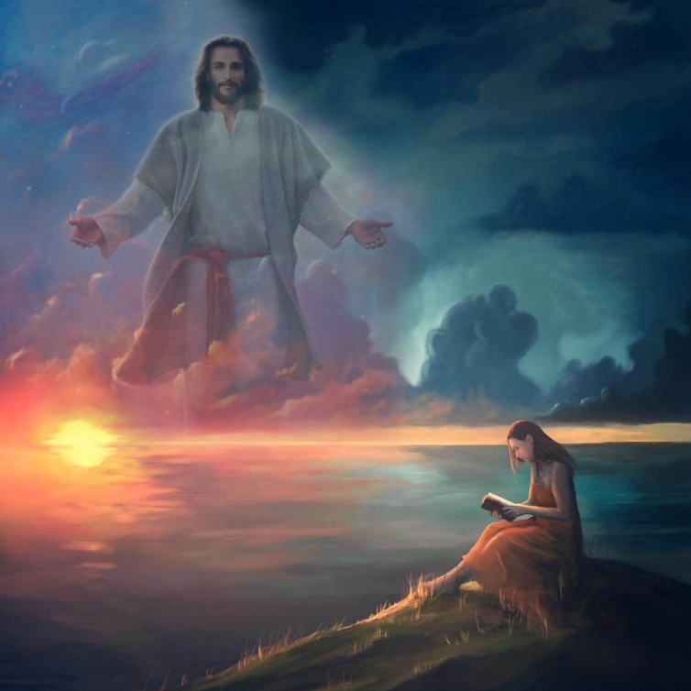
Matthew 11:28-30 is an essential passage about rest in Christ.
We can better understand the depth of the rest that Jesus offers by studying this passage.
“Come to Me, all you who labor and are heavy laden, and I will give you rest.”
“Take My yoke upon you and learn from Me,”
“for I am gentle and lowly in heart, and you will find rest for your souls.”
“For My yoke is easy”
“and My burden is light.”

Slide 3
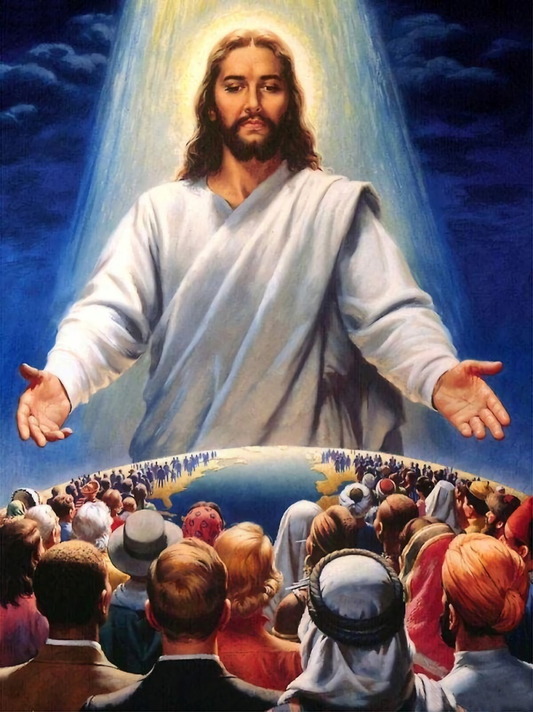
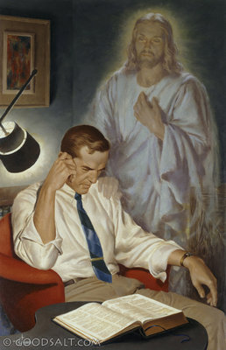
“COME TO ME, ALL YOU WHO LABOR AND ARE HEAVY LADEN, AND I WILL GIVE YOU REST.”
According to the immediate context of this verse (Mt. 11:27), we may deduce that Jesus can give us rest because He is God, and He is one with the Father.
Jesus does not give automatic and unconditional rest. There is a simple condition: “Come.”
We must do two things to come to Jesus. The first one is the easiest: to be tired and laden, and to feel the need for rest.
The second one is to refuse to control our burdens ourselves, and to bring them to Jesus so He can take care of them.

Slide 4
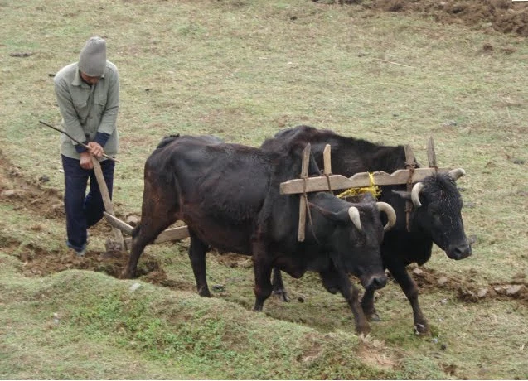
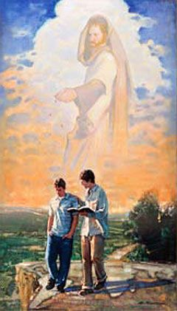
“TAKE MY YOKE UPON YOU AND LEARN FROM ME,”
A yoke was usually placed on the shoulders of the animals to ease their work (e.g. plowing).
However, the yoke was a limitation too. The animal was not free but had to do whatever its overseer wanted them to do.
Jesus places HIS yoke on us, so our burdens are easier to carry. On the other hand, we submit to His will by accepting his yoke, and therefore we learn to work the way He wants us to.
We become Christ’s collaborators by taking His yoke. We have a work to do with Him and for Him.

Slide 5
“You are safe only as, in perfect submission and obedience, you connect yourselves with Christ. The yoke is easy, for Christ carries the weight. As you lift the burden of the cross, it will become light; and that cross is to you a pledge of eternal life. It is the privilege of each to follow gladly after Christ.”
E. G. W. (Sons and Daughters of God, March 15)

Slide 6
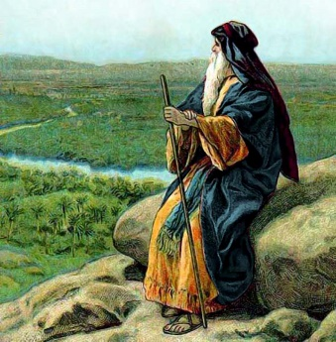
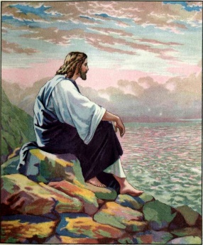
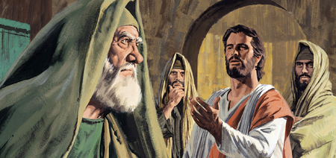
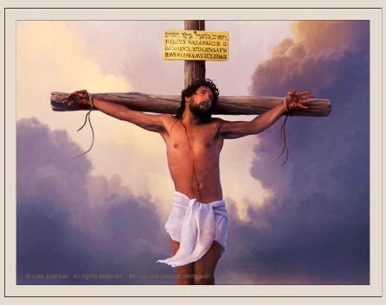
“FOR I AM GENTLE AND LOWLY IN HEART, AND YOU WILL FIND REST FOR YOUR SOULS.”
Paul wrote that Jesus is meek (2Co. 10:1), like Moses (Nm. 12:3). Meekness is a fruit of the Holy Spirit (Gal. 5:22-23). Every believer should act meekly (Col. 3:12; 1Tim. 6:11; Tit. 3:2).
Jesus’ meekness and humbleness did not mean that He could not reply bluntly to His opponents. He acted kindly and did not impose His will by force.
His humbleness was clearly shown when He offered to be crucified (Phil. 2:8). He became our Savior then. He was the only One who could free us from the burden of sin, alleviate our suffering, and give us rest for our souls.

Slide 7
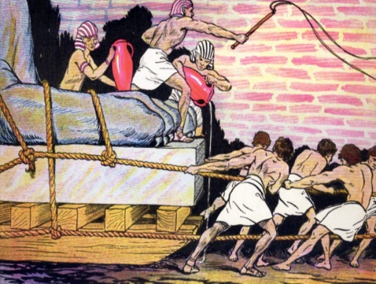
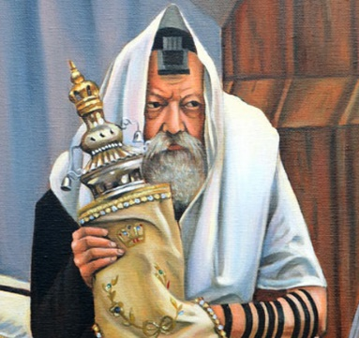
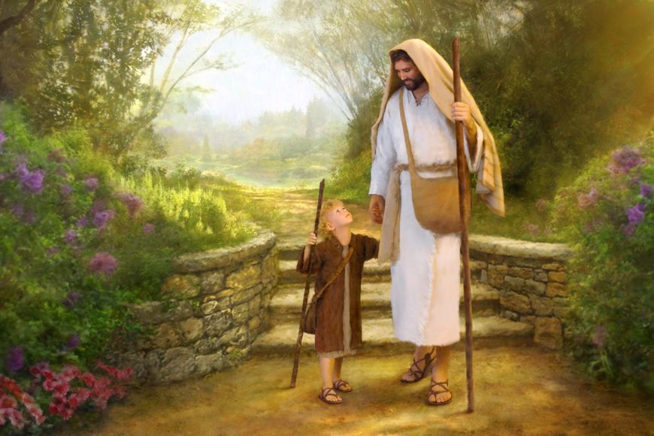
“FOR MY YOKE IS EASY”
Yokes have been used as an image of slavery or submission.
In this context, we may find yokes that are heavy and enslaving. For example, circumcision (Acts 15:10) or salvation by works (Gal. 5:1).
Unlike those yokes, Jesus’ is easy to carry. His yoke is a symbol of “the law of liberty” (James 2:12). When we understand the purpose God’s commandments, they “are not burdensome.” (1Jn. 5:3).
Jesus holds us when we are covered by His righteousness and walk with Him. He lifts us when we fall and leads us to righteousness.

Slide 8
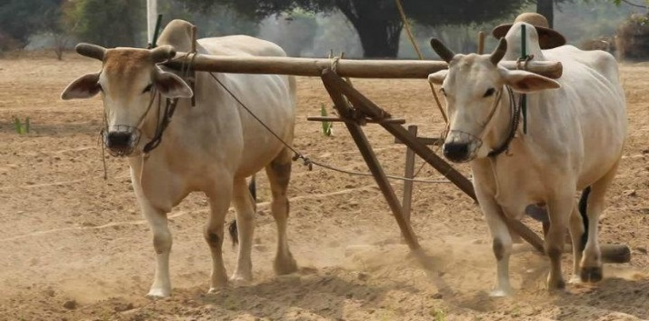
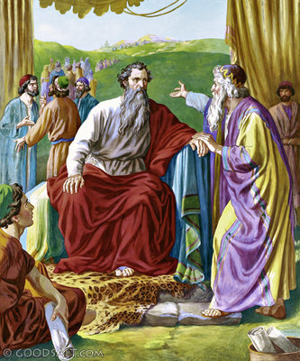
“AND MY BURDEN IS LIGHT.”
Yokes were usually worn by two animals, so the individual effort was reduced. If one of the animals was weak, the other could help with its strength.
Jesus is the strong part, and we can trust Him. He makes the burden light for us.
Jesus is our example. Jethro taught Moses to share the burden with others (Ex. 18:13-22), and we should also help others: “Bear one another’s burdens, and so fulfill the law of Christ.” (Gal. 6:2)
Bearing other’s burdens means to restore those who fall, to help one another in tough times, to support one another... Sharing our burdens is something God commanded us to do as a Church. It requires meekness and produces compassion.

Slide 9
E. G. W. (SDA Bible Commentary, book 5, on Matthew 12:29, p. 1092)
“Wearing the yoke with Christ, means to work in His lines, to be a copartner with Him in His sufferings and toils for lost humanity. It means to be a wise instructor of souls. We shall be what we are willing to be made by Christ in these precious hours of probation. We shall be the sort of a vessel that we allow ourselves to be molded into. We must unite with God in the molding and fashioning work, having our wills submitted to the divine will.”

