Slide 1
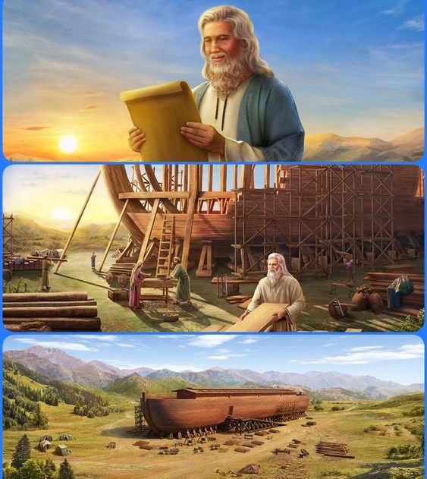
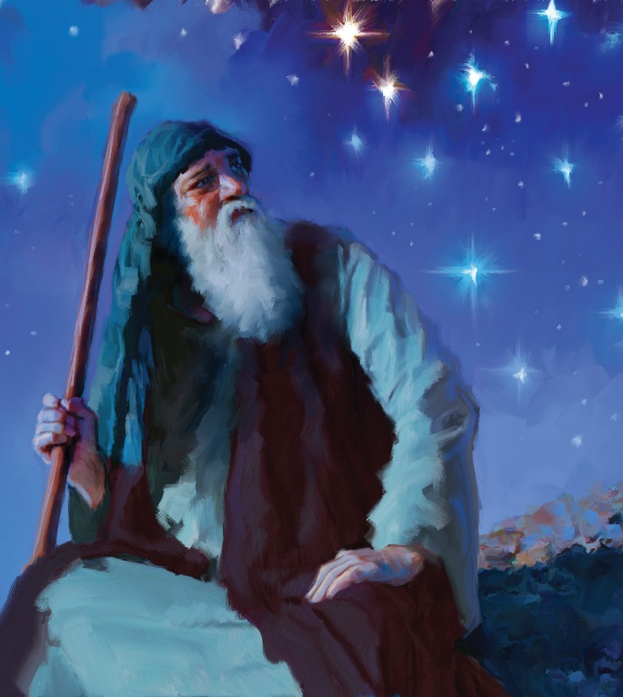
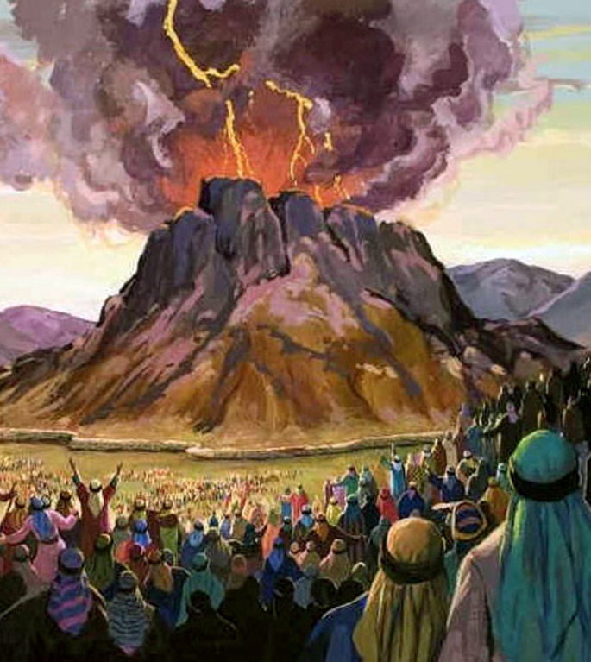
COVENANT PRIMER
Lesson 2 for April 10, 2021

Slide 2
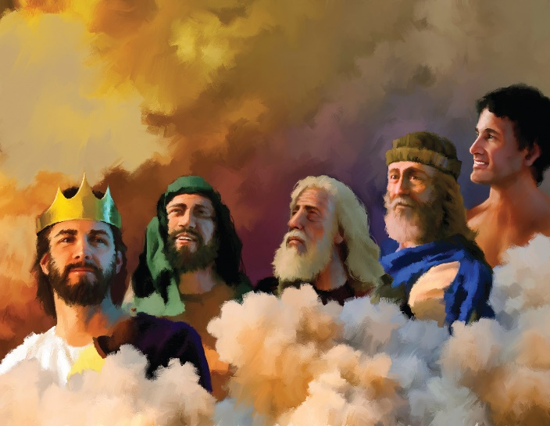
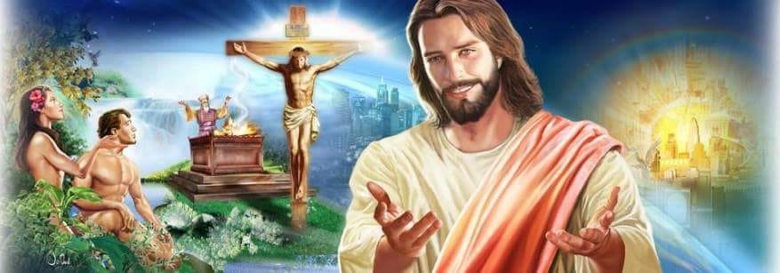
After sin entered the world, God explained the rudiments of the plan of salvation to Adam and Eve. Since then, He’s been gradually revealing more aspects of the plan.
God explained salvation as an eternal covenant between humanity and Him. This covenant has been revealed in different ways in different moments of our history. The last one is known as “the New Covenant.”
The Eternal Covenant
Covenant with Noah
Covenant with Abram
Covenant with Moses
The New Covenant

Slide 3
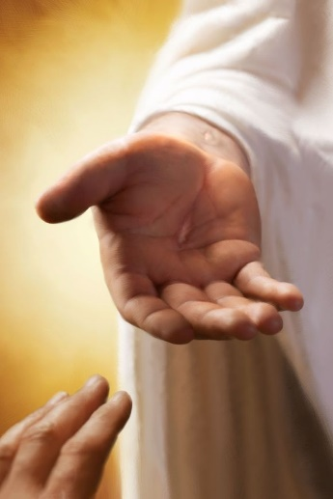
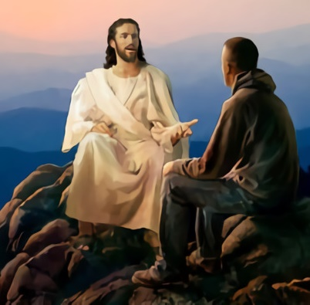
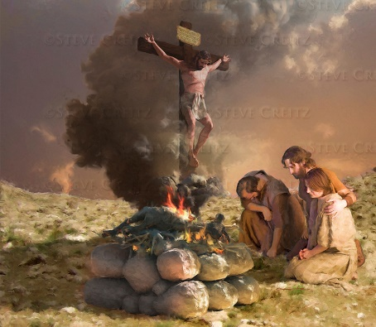
THE ETERNAL COVENANT
“Now therefore, if you will indeed obey My voice and keep My covenant, then you shall be a special treasure to Me above all people; for all the earth is Mine.” (Exodus 19:5)
God invites everyone to have a relationship with Him as a covenant. God has adapted this covenant to the epoch, place, and people involved.
“Covenant”–berith in Hebrew, διαθήκη in Greek– may be also translated as “testament” or “last will.” It lays the foundation of a relationship or an agreement between two people. The eternal covenant contains three basic elements:
1. God affirmed the covenant promises with an oath (Heb. 6:17)
2. The individual commits to obey God (Dt. 4:13)
3. The means by which the covenant is fulfill: Salvation through Jesus (Is. 42:6)
In the Old Testament, the plan of salvation was shown through the sacrificial system that pointed at Christ.

Slide 4
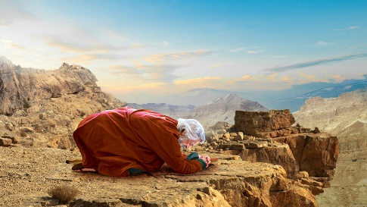
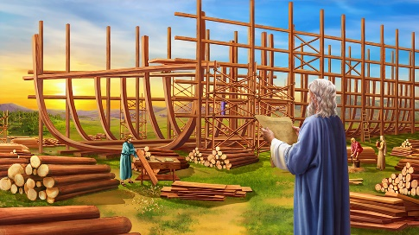
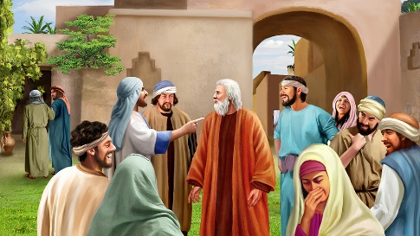
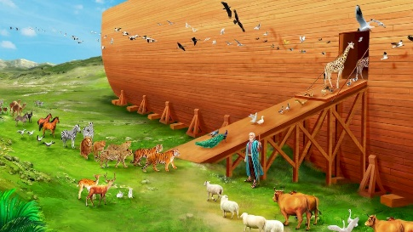
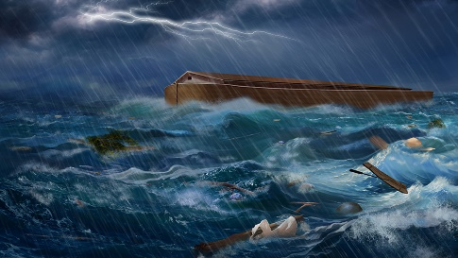
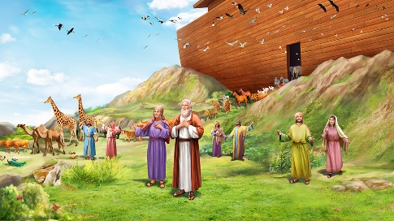
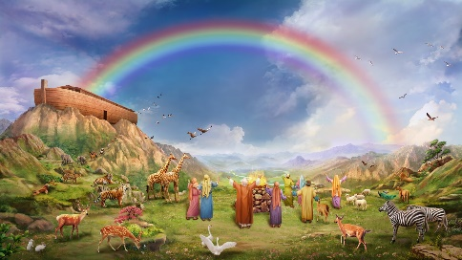
COVENANT WITH NOAH
“But I will establish My covenant with you; and you shall go into the ark—you, your sons, your wife, and your sons’ wives with you.” (Genesis 6:18)
The word “covenant” is used in the above verse for the first time in the Bible. Its context is the announcement of the Flood that would destroy the world.
It’s a bilateral covenant. God promised to save Noah and his family (and actually anyone who would have wanted to enter the ark with them).
Noah had to build an ark and enter it. If Noah had not fulfilled his part of the covenant, God could not have fulfilled His.
God is always true to His word. He can only be prevented from fulfilling His promises if we stubbornly reject His help.

Slide 5
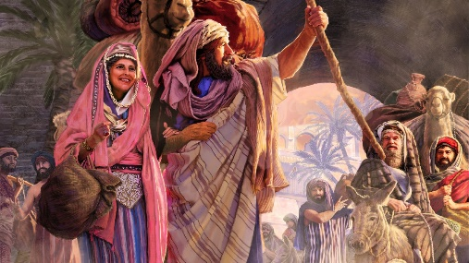
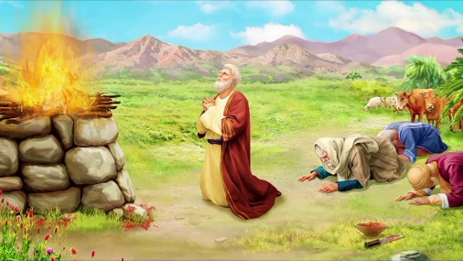
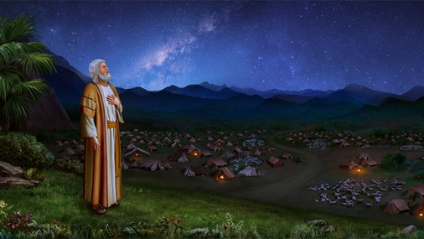
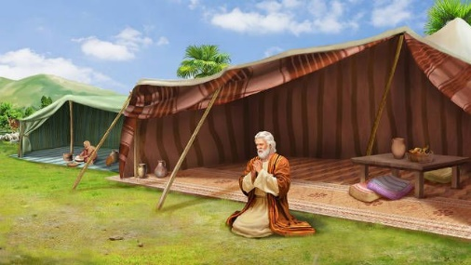
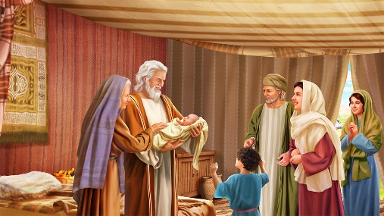
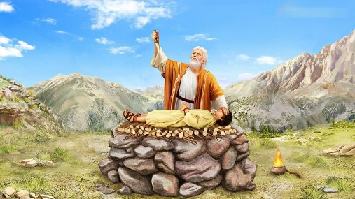
COVENANT WITH ABRAM
“On the same day the Lord made a covenant with Abram, saying: ‘To your descendants I have given this land, from the river of Egypt to the great river, the River Euphrates.’” (Genesis 15:18)
Before His formal covenant with Abraham, God promised to bless him and to bless all the nations of the Earth through him (Genesis 12:1-3). That is, He promised him that the Savior of the world would be one of his descendants (Galatians 3:16).
Once the relationship between them was established, God formalized His covenant with him (Genesis 15). Abram believed in God’s promises and was justified (v. 6), and therefore prepared to obey and fulfill the terms of the covenant (Genesis 18:19).
Our obedience to God is a response of faith to everything He has already done for us (1Jn. 4:19).

Slide 6
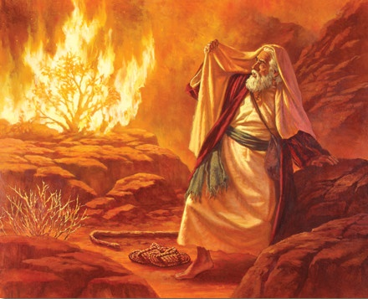
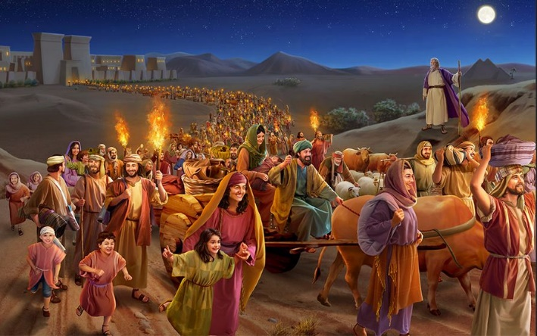
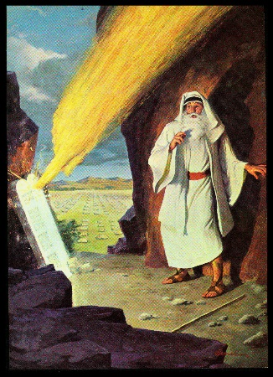
COVENANT WITH MOSES
“Now therefore, if you will indeed obey My voice and keep My covenant, then you shall be a special treasure to Me above all people; for all the earth is Mine.” (Exodus 19:5)
The covenant of God with Israel through Moses is the continuation of the covenant with Abraham, Isaac, and Jacob (Exodus 6:4-5).
A special relationship with God is established (Gn. 17:7-8; Ex. 19:5)
They are promised that they would become a great nation (Gn. 12:2; Ex. 19:6)
Obedience is required (Gn. 17:9-10; Ex. 19:7-8)
It was a covenant of grace. God took the first step by saving Israel. Then, He gave them the Law so they would keep it as a natural response to the covenant.
The Gospel is the same. First, Christ saves us from sin. Then, He helps us to obey Him (1P. 2:24).

Slide 7
E.G.W. (Our High Calling, January 18)
“This pledge [Exodus 19:5] was given not only to Israel but to all who are obedient to God’s Word. Those who live amid the perils of the last days may realize that just as at the beginning of their experience the truth united them to the Saviour, so He who is the author and finisher of their faith will perfect the work He has begun for them. God is faithful, by whom we are called to fellowship with His Son.”

Slide 8
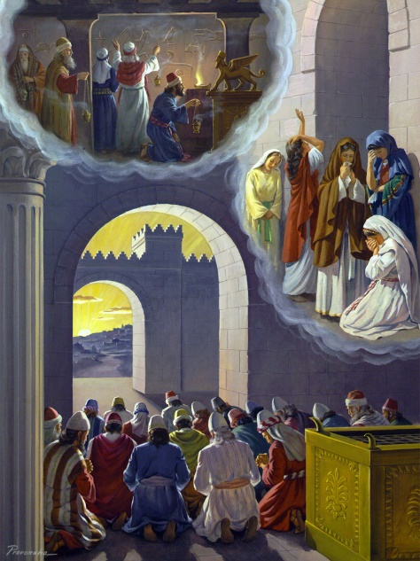
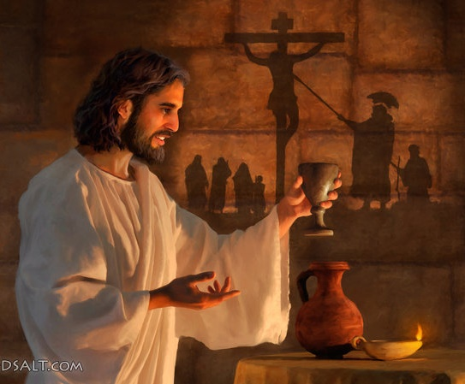
THE NEW COVENANT
“Behold, the days are coming, says the Lord, when I will make a new covenant with the house of Israel and with the house of Judah.” (Jeremiah 31:31)
Why was a new covenant necessary? How is it different from the old one?
God had taken care of Israel as if He was their husband, but they had been unfaithful and had disobeyed Him. They had invalidated the first covenant (Jeremiah 31:32).
However, the new covenant is still a continuation of the old one. The only difference is that God promised a closer relationship between humans and Himself (v. 33).
“They all shall know Me […] For I will forgive their iniquity.” (v. 34). Again, God took the first step and saved us. Our natural response should be to obey the Law He’s placed in our hearts (v. 33).

Slide 9
“In the Bible the sacred and enduring character of the relation that exists between Christ and His church is represented by the union of marriage. The Lord has joined His people to Himself by a solemn covenant, He promising to be their God, and they pledging themselves to be His and His alone.”
E.G.W. (The Great Controversy, cp. 21, p. 381)

