Slide 1
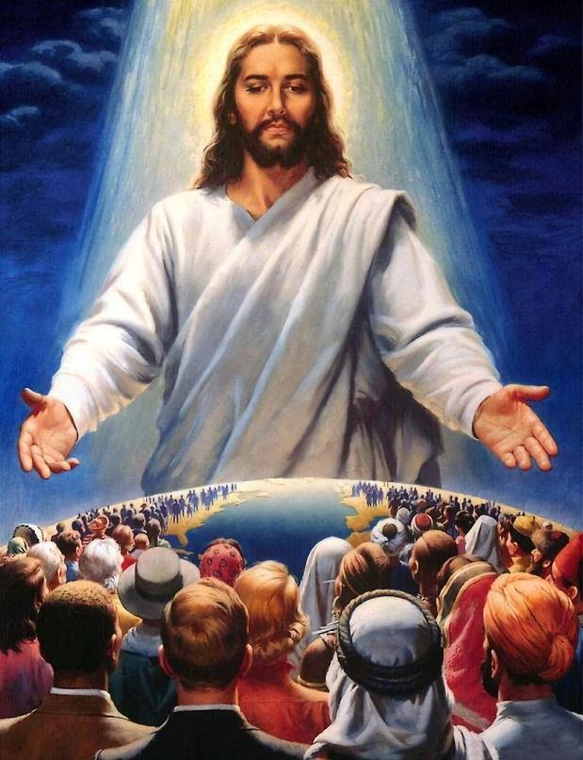
DESIRE
OF NATIONS
Lesson 12 for March 20, 2021

Slide 2

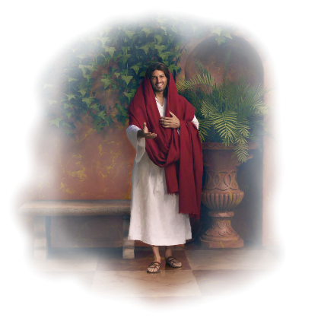
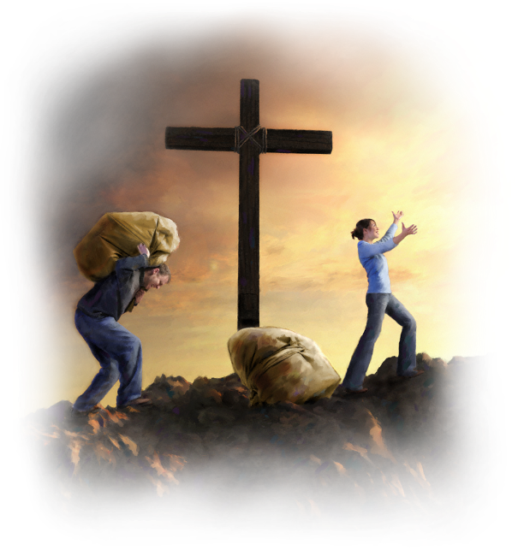







Isaiah chapters 59 to 61 address the human inclination to sin and its consequences.
They also address God’s inclination to forgiveness and the plan of salvation.
In these chapters there’s also a universal call to repentance–both from God and from His people–, and the consequences of rejecting it are explained.
Personal salvation:
  The nature of sin. Isaiah 59:1-15
  Forgiveness is offered. Isaiah 59:16-21
  The work of the redeemed. Isaiah 60
Universal salvation:
  The year of the Lord’s favor. Isaiah 61:1-3
  The day of vengeance. Isaiah 61:2

Slide 3

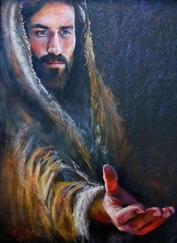


THE NATURE OF SIN
“But your iniquities have separated you from your God; and your sins have hidden His face from you, so that He will not hear.” (Isaiah 59:2)
Faced with the question “Why […] have You not seen; […] and why did You take no notice?” (Isaiah 58:3), God’s response was: “The Lord’s hand is not shortened, that it cannot save; nor His ear heavy, that it cannot hear.” (Isaiah 59:1)
Then (in v. 2), He explained that the problem is not God, but humanity. Sin separates humanity from God. Humanity’s response to this separation is to run away from God and to surrender to sin (Genesis 3:8).
If we keep giving in to sin and we don’t want to come to God (that is, we silence the voice of the Holy Spirit), then the impassable breach between God and us will never go away.

Slide 4

“Do not listen to the enemy’s suggestion to stay away from Christ until you have made yourself better; until you are good enough to come to God. If you wait until then, you will never come. When Satan points to your filthy garments, repeat the promise of Jesus, ‘Him that cometh to Me I will in no wise cast out.’ John 6:37. Tell the enemy that the blood of Jesus Christ cleanses from all sin.”
E.G.W. (Christ’s Object Lessons, cp. 16, p. 205)

Slide 5
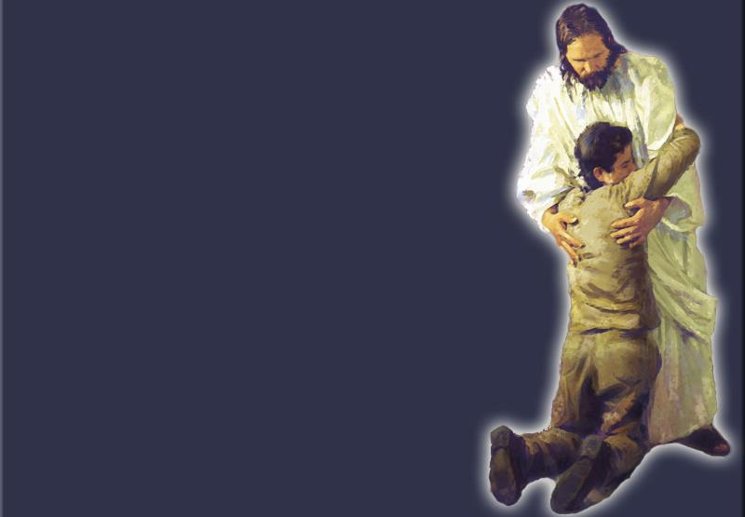
FORGIVENESS IS OFFERED
“‘The Redeemer will come to Zion, and to those who turn from transgression in Jacob,’ says the Lord.” (Isaiah 59:20)
What’s the key to Redemption?
If it was to stop sinning for good, then we’d have a serious problem because “there is none who does good.” (Romans 3:12)
It is to accept the forgiveness that God offers. This is the right way (Isaiah 1:18; Jeremiah 31:34). And we can get it for free! (Romans 3:24).
What does “to turn from transgression” mean?
Repentance and a desire to abandon sin are necessary for true repentance (Acts 3:19). The faith that we are saved by is shown by our works
(James 2:18).

Slide 6

“Grace is unmerited favor, and the believer is justified without any merit of his own, without any claim to offer to God. He is justified through the redemption that is in Christ Jesus, who stands in the courts of heaven as the sinner’s substitute and surety […] Faith works by love and purifies the soul. Faith buds and blossoms and bears a harvest of precious fruit. Where faith is, good works appear.”
E.G.W. (Selected Messages, book 1, cp. 62, p. 398)

Slide 7

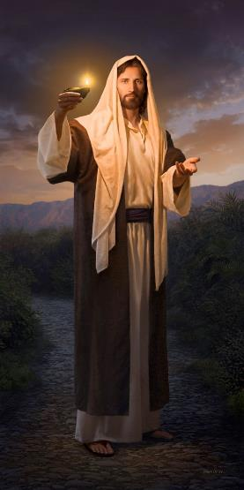
THE WORK OF THE REDEMEED
“The Gentiles shall come to your light, and kings to the brightness of your rising.” (Isaiah 60:3)
Those who have received the light of Redemption should reflect that light and light up the world with it (Matthew 5:14).
Noah was “a preacher of righteousness” in the antediluvian world (2P. 2:5)
God’s covenant with Abraham included a blessing for all the nations (Gn. 22:18)
Jesus commissioned the Church to spread the Gospel “to the end of the earth” (Acts 1:8)
God promised the following to everyone who accepts Redemption: “The sun shall no longer be your light by day, nor for brightness shall the moon give light to you; but the Lord will be to you an everlasting light, and your God your glory.” (Isaiah 60:19)

Slide 8

“It is our privilege to open our hearts and let the Saviour in. Let us praise Him for the brightness of His presence. Let us carry the sunshine of His love on our countenances and bring it into our words. Then His joy will be in us, and our joy will be full.”
E.G.W. (The Upward Look, May 8)

Slide 9

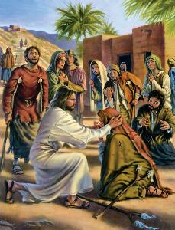
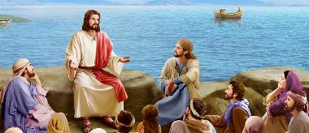
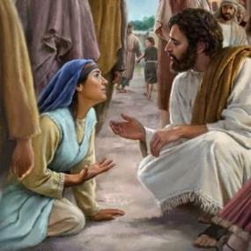
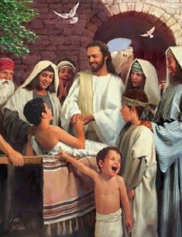

THE YEAR OF THE LORD’S FAVOR
“The Spirit of the Lord God is upon Me”
(Isaiah 61:1)
What was the Messiah’s work during
“the year of the Lord’s favor”?
To preach good tidings to the poor
To heal the brokenhearted
To proclaim liberty to the captives
To proclaim the opening of the prison to the prisoners
To comfort all who mourn
To give those who mourn in Zion:
  Beauty for ashes
  The oil of joy for mourning
  The garment of praise for the spirit of heaviness
Is this only Jesus’ work (Luke 4:16-21)? Or is it also our work to announce “the year of the Lord’s favor”?

Slide 10

“Walk humbly with God, and ask Him to make your course of duty plain. When He speaks to His representatives and asks them to be laborers together with Him, they will do the same kind of work that Jesus announced as His work when He stood up to read in the synagogue at Nazareth.”
E.G.W. (Testimonies for the Church, book 9, cp. 22, p. 202)

Slide 11

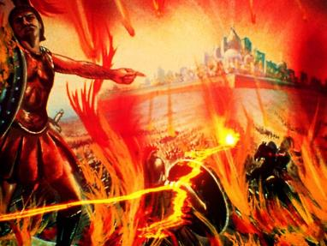
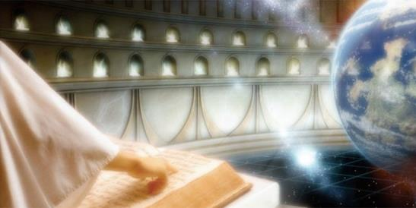
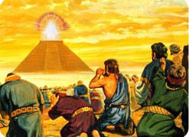
THE DAY OF VENGEANCE
“To proclaim the acceptable year of the Lord, and the day of vengeance of our God.” (Isaiah 61:2)
When Jesus was reading from Isaiah while in Nazareth, He stopped just before “the day of vengeance.” Why?
The work of Jesus in that moment was not to judge the world (John 12:47). Vengeance could wait.
Today is not the moment to expect God’s ultimate justice yet. We’re encouraged to leave vengeance to God
(Romans 12:20).
One day God will take vengeance on His enemies and will do justice (Is. 63:4; Nah. 1:9; 2Ths. 1:8; Rev. 19:15). He will do so with equity, then every knee will bow before His perfect justice (Is. 45:23; Phil. 2:9-11).

Slide 12

“Could those whose hearts are filled with hatred of God, of truth and holiness, mingle with the heavenly throng and join their songs of praise? Could they endure the glory of God and the Lamb? No, no […] A life of rebellion against God has unfitted them for heaven. Its purity, holiness, and peace would be torture to them […] The destiny of the wicked is fixed by their own choice. Their exclusion from heaven is voluntary with themselves, and just and merciful on the part of God.”
E.G.W. (The Great Controversy, cp. 33, p. 542)

