Slide 1
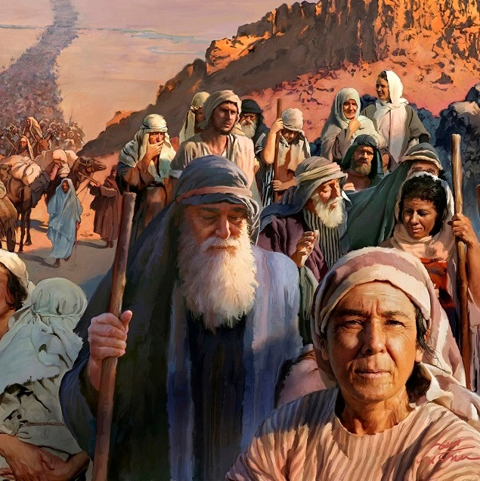
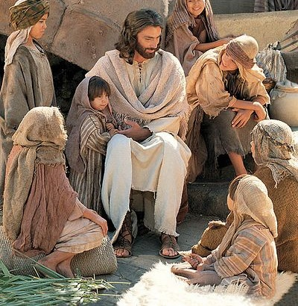
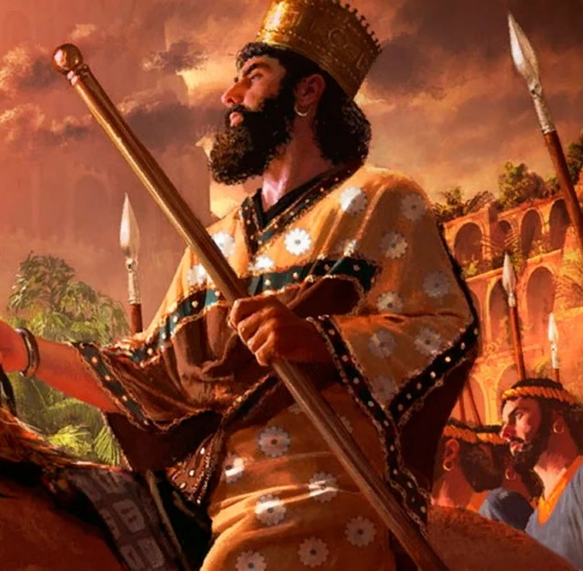
TO SERVE AND TO SAVE
Lesson 9 for February 27, 2021

Slide 2
There are three main characters in Isaiah chapters 41 to 45.
A servant that represented the people of Israel
An anointed (Messiah) servant who would have a difficult mission (chapter 49)
An anointed (messiah) liberator who was predicted by name: Cyrus.
1
A servant people. Isaiah 41
A servant Messiah. Isaiah 42:1-7
3
A liberator messiah. Isaiah 44:26-45:6
A difficult mission for the servant. Isaiah 49:1-12
2
4

Slide 3
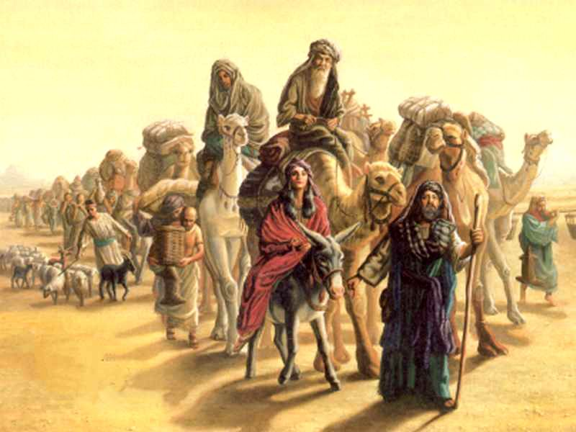
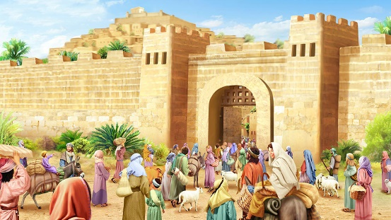
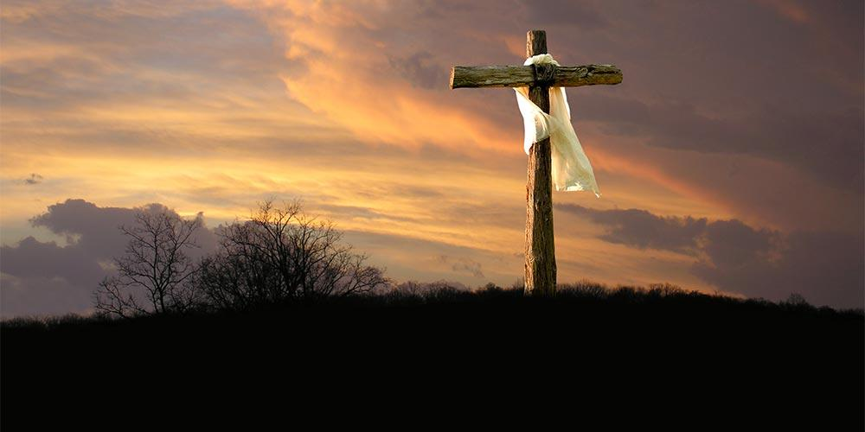
A SERVANT PEOPLE
“But you, Israel, are My servant, Jacob whom I have chosen, the descendants of Abraham My friend. You whom I have taken from the ends of the earth, and called from its farthest regions, and said to you, ‘You are My servant, I have chosen you and have not cast you away’” (Isaiah 41:8-9)
This servant undoubtedly represents the people of God (at that time, Israel and Judah).
We might well conclude that the next references to the servant in Isaiah also represent Israel.
However, the other mentions refer to an anonymous messiah who would free Israel and would die as a sacrifice (Isaiah 49:6-7; 52:13-53:12).
So there are two servants in Isaiah. The first one is the people of God who are saved and redeemed. The second one is anonymous, and He is the Redeeming Messiah.

Slide 4
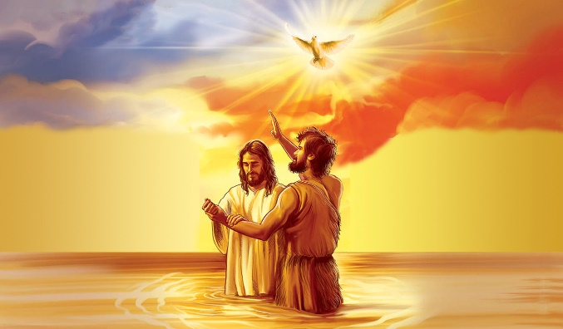
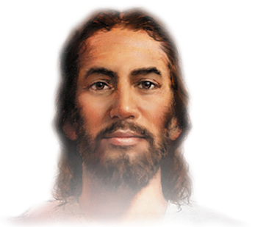
A SERVANT MESSIAH
“Behold! My Servant whom I uphold, my Elect One in whom My soul delights! I have put My Spirit upon Him; He will bring forth justice to the Gentiles.” (Isaiah 42:1)
Who is this anonymous servant? What is His mission?
Isaiah 42:1
Isaiah 42:2-4
Isaiah 42:5-6
Isaiah 42:7
He brings justice to the Gentiles
He fulfills His goals with silence and meekness
He acts as a covenant between God and His people
He brings light and hope to heal the blindness and to free the prisoners
This servant does a similar work to that of the “Rod from the stem of Jesse” and the promised son (Isaiah 11:1-5; 9:6-7).
Therefore, this servant is the Messiah, Jesus of Nazareth (Matthew 12:15-21).

Slide 5
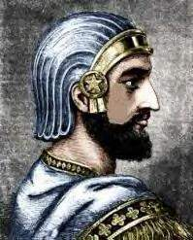
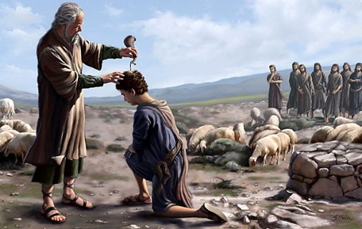
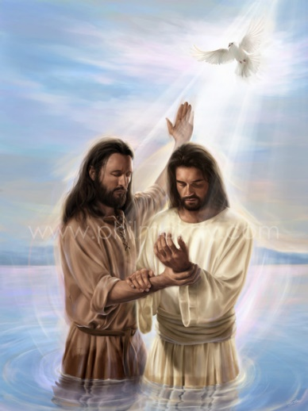
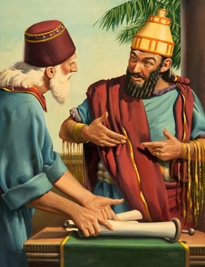
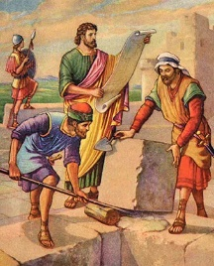
A LIBERATOR MESSIAH (1)
“Thus says the Lord to His anointed, to Cyrus, whose right hand I have held—to subdue nations before him and loose the armor of kings, to open before him the double doors, so that the gates will not be shut.” (Isaiah 45:1)
Why did God call Cyrus (a Persian king) “messiah” (anointed)?
In Israel, two types of people were anointed: priests and kings (Ex. 28:41; 1K. 1:34). In addition, prophets were also sometimes anointed (1K. 19:16).
The Messiah is the Anointed par excellence. He is Prophet, King, and Priest (Heb. 6:20; Rev. 17:14; Lk. 13:33).
However, Cyrus was anointed to fulfill only one of those roles. He is an anointed king called by God to carry out a specific mission: to free His people.

Slide 6
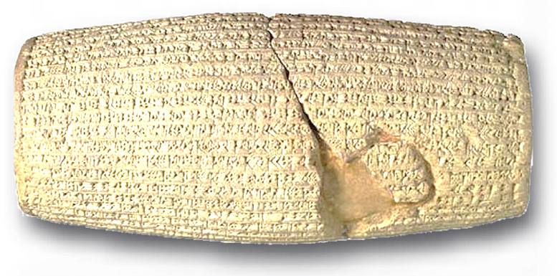
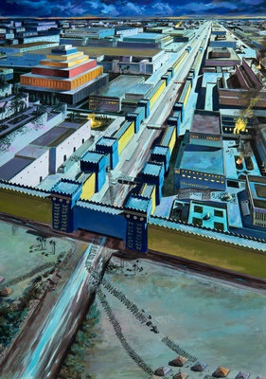
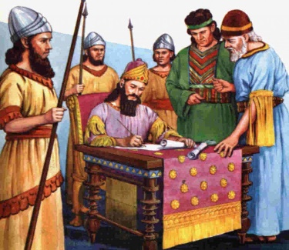
A LIBERATOR MESSIAH (2)
“Who says of Cyrus, ‘He is My shepherd, and he shall perform all My pleasure, saying to Jerusalem, “You shall be built,” and to the temple, “Your foundation shall be laid.”’” (Isaiah 44:28)
Both the Bible and archaeology confirm the fulfillment of Isaiah’s prophecies about Cyrus (1Chr. 36:22-23; Ezra 1; Dn. 6:28).
Cyrus dried up the Euphrates to conquer the city of Babylon (Is. 44:27). He also authorized the return of the Jews to Jerusalem, and gave them everything they needed to rebuild the temple (Is. 44:28).
All this was foretold 150 years before It happened! This has led some people to deny that these chapters were written by Isaiah.
Cyrus Cylinder
Nevertheless, the Dead Sea Scrolls confirm that the book of Isaiah has only one author: Isaiah, the prophet who was inspired by God and lived in the 7th century BC.

Slide 7
E.G.W. (Conflict and Courage, September 8)
“As the king saw the words foretelling, more than a hundred years before his birth, the manner in which Babylon should be taken; as he read the message addressed to him by the Ruler of the universe, ... his heart was profoundly moved, and he determined to fulfill his divinely appointed mission. He would let the Judean captives go free; he would help them restore the temple of Jehovah. In a written proclamation published ‘throughout all his kingdom,’ Cyrus made known his desire to provide for the return of the Hebrews and for the rebuilding of their temple.”

Slide 8
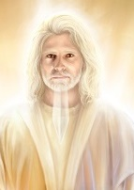
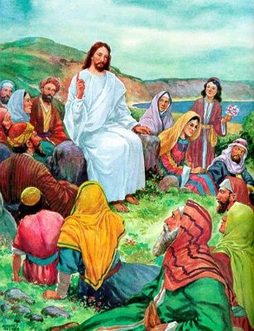
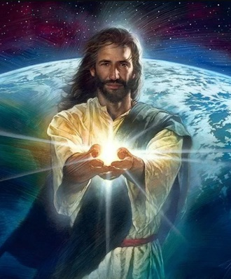
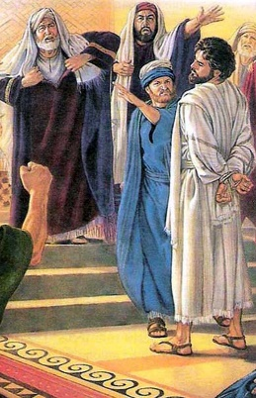
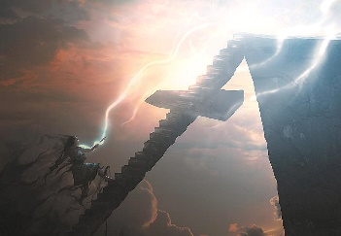
A DIFFICULT MISSION FOR THE SERVANT
“It is too small a thing that You should be My Servant to raise up the tribes of Jacob, and to restore the preserved ones of Israel; I will also give You as a light to the Gentiles, that You should be My salvation to the ends of the earth.” (Isaiah 49:6)
It is relatively easy to identify this servant:
He was called from the womb
Lk. 1:31
He has a sharp sword in His mouth
Rev. 1:16
God would be glorified in Him
Lk. 3:22
His message would not be accepted
Lk. 9:22
He would gather the tribes of Israel
Jn. 12:32
He would be a light to the Gentiles
Jn. 8:12; 9:5
He would be despised and abhorred
Mt. 26:67
v. 1
v. 2
v. 3
v. 4
v. 5
v. 6
v. 7
Despite His difficult mission and the rejection, Jesus didn’t give up. Thanks to His perseverance, He can give us everlasting Redemption today.

Slide 9
“In the heart of Christ, where reigned perfect harmony with God, there was perfect peace. He was never elated by applause, nor dejected by censure or disappointment. Amid the greatest opposition and the most cruel treatment, He was still of good courage…
When we are born from above, the same mind will be in us that was in Jesus, the mind that led Him to humble Himself that we might be saved.”
E.G.W. (Lift Him Up, May 28)

