Slide 1
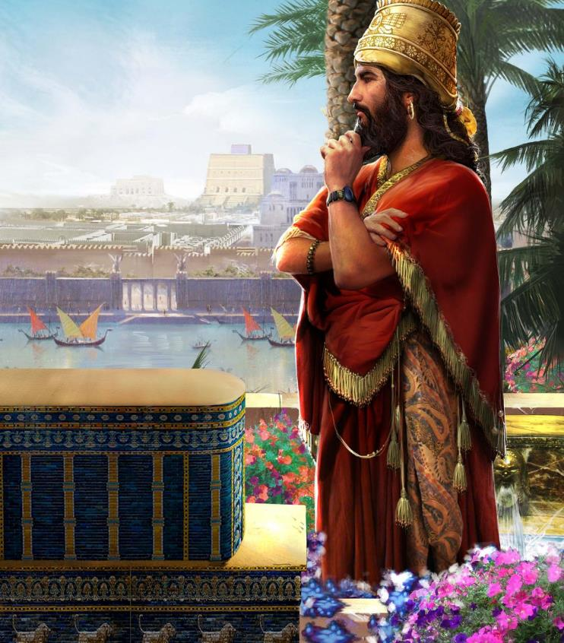
PLAYING GOD
Lesson 6 for February 6, 2021

Slide 2

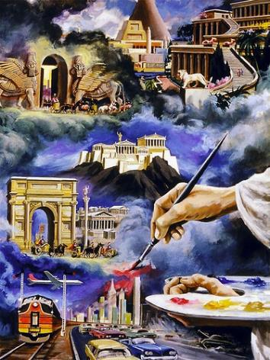
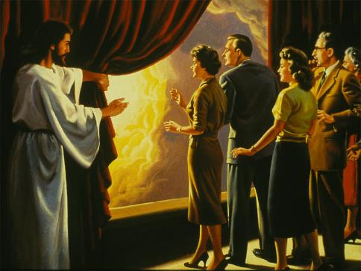





God unveiled the conflict between good and evil in the spiritual realm before Isaiah. Both factions are fighting to control each human soul.
Sometimes it may seem that “the prince of this world” is taking control of the nations, but God is the One in control. The Lord is victorious. Everyone who joins His side will achieve victory, while the kingdoms of this world and their glory will be destroyed.
Doom of the nations. Isaiah 13-23
The fate of Babylon is foretold. Isaiah 13
The Star that wanted to become God. Isaiah 14:12-14
The end of Babylon. Isaiah 14:15-23
Final triumph. Isaiah 24-27

Slide 3

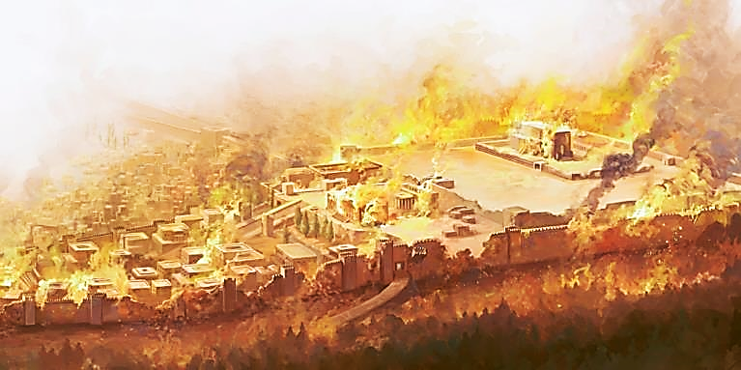
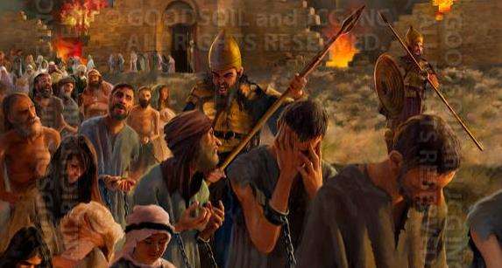
DOOM OF THE NATIONS
“This is the purpose that is purposed against the whole earth, and this is the hand that is stretched out over all the nations.” (Isaiah 14:26)
God condemned the nations that were [or would be] in contact with His people:
Babylon
Is. 13:1-14:23; 21:1-17
Assyria
Is. 14:24-27
Philistia
Is. 14:28-32
Moab
Is. 15:1-6:14
Syria
Is. 17:1-14
Ethiopia
Is. 18:1-7
Egypt
Is. 19:1-20:6
Jerusalem
Is. 22:1-25
Tyre
Is. 23:1-18
Some of them got a hopeful message that punishment would be alleviated (Is. 19:16-25). Others would suffer all the consequences of their acts.
The list began with the only nation that had not been in touch with God's people yet. This nation would eventually become a symbol of every rebellion: BABYLON (Revelation 17:5).

Slide 4

“In the annals of human history, the growth of nations, the rise and fall of empires, appear as if dependent on the will and prowess of man; the shaping of events seems, to a great degree, to be determined by his power, ambition, or caprice. But in the word of God the curtain is drawn aside, and we behold, above, behind, and through all the play and counterplay of human interest and power and passions, the agencies of the All-merciful One, silently, patiently working out the counsels of His own will.”
E.G.W. (Prophets and Kings, cp. 40, p. 499)

Slide 5

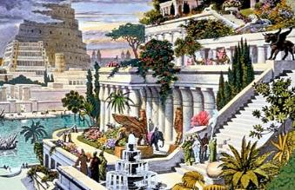
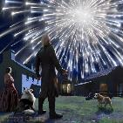
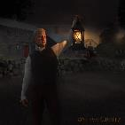
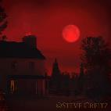
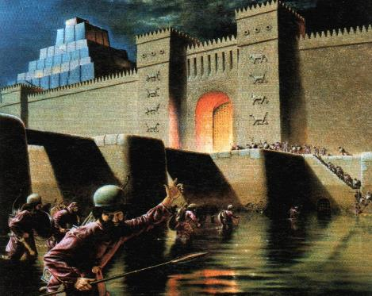
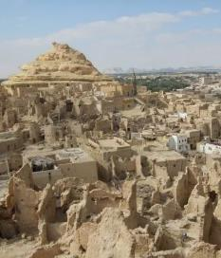
THE FATE OF BABYLON IS FORETOLD
“Behold, I will stir up the Medes against them, who will not regard silver; and as for gold, they will not delight in it.” (Isaiah 13:17)
Babylon was not an important nation when this verse was written.
Isaiah explained the future fall of Babylon by comparing it to the Second Coming (v. 9-11), like Jesus did when He foretold the destruction of Jerusalem and mixed it with events of the Second Coming.
God was in control of those events, but He let the men involved do their own will (v. 15-18).
Babylon became one of the capital cities of the Medo-Persian Empire. When Alexander the Great entered Babylon, it already was in a deteriorated state. It gradually sank into the oblivion and abandonment (v. 20).

Slide 6

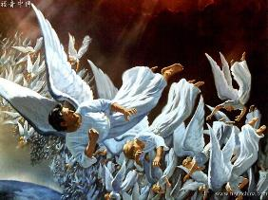
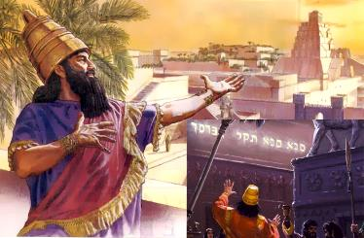
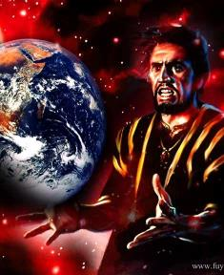
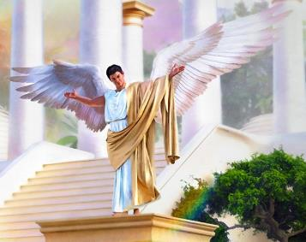
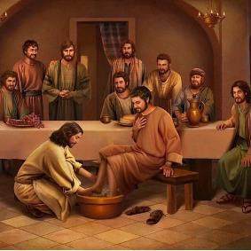
THE STAR THAT WANTED TO BECOME GOD
“How you are fallen from heaven, O Lucifer, son of the morning! How you are cut down to the ground, you who weakened
the nations!” (Isaiah 14:12)
The king of Babylon is described as proud and self-sufficient. Many Babylonian kings were like this (see Daniel 2:5; 3:7; 4:30; 5:2).
However, this section of Isaiah is quite poetic and allegorical. It is showing the actual root of the problem, the true king of Babylon: Lucifer, “that serpent of old, called the Devil and Satan.”
(Revelation 12:9)
Lucifer wanted to be “like the Most High,” (v. 14) and stated: “I am a god.” (Ezekiel 28:2). His attitude contrasts God's because God “humbled Himself” (Philippians 2:8).

Slide 7

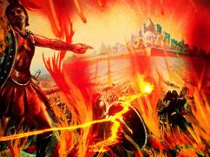
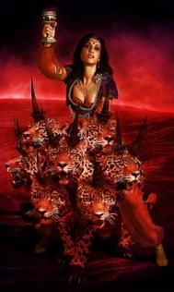
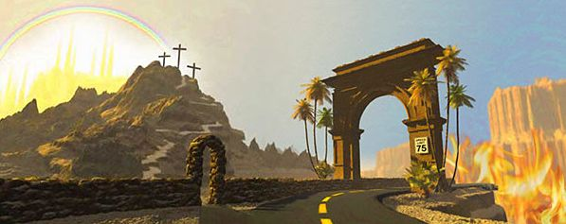

THE END OF BABYLON
“Let the offspring of the wicked never be mentioned again.”
(Isaiah 14:20 NIV)
The fate of this "king" of Babylon is foretold in Isaiah 14:18-20: Destruction and everlasting oblivion. The fate of those who humbly serve God will be very different.
Nevertheless, Babylon has not disappeared yet. It is still working through proud and ruthless powers that oppress God's people (see Rev. 17).
Babylon means “confusion,” but it could also mean “Gate of gods” in Chaldean language. It is the wide gate that leads to destruction, an attempt to achieve salvation on one's own merit.
The Bible encourages us to choose the “Gate of Heaven”, Bethel. Those who follow Jesus and accept Him as their personal Savior by faith will enter this gate.

Slide 8

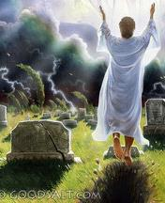
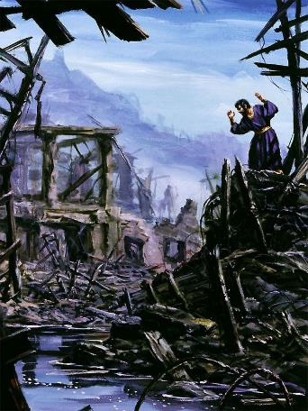
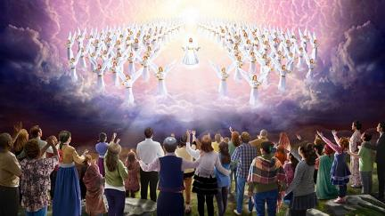
FINAL TRIUMPH (1)
“Behold, the Lord makes the earth empty and makes it waste, distorts its surface and scatters abroad its inhabitants.” (Isaiah 24:1)
God will put an end to this world, and He will tell some people: “Your dead shall live; together with my dead body they shall arise.” And He will tell the rest of the people: “They are dead, they will not live; they are deceased, they will not rise.” (Is. 26:19, 14)
The day God will come to set His people free, the redeemed will express their triumphal joy: “Behold, this is our God; we have waited for Him, and He will save us.” Then “He will swallow up death forever, and the Lord God will wipe away tears from all faces.” (Is. 25:8-9)
Before God ends "His unusual act" and renews the Earth, it will remain ravaged for some time
(Is. 24; Ap. 20; Is. 28:21).

Slide 9

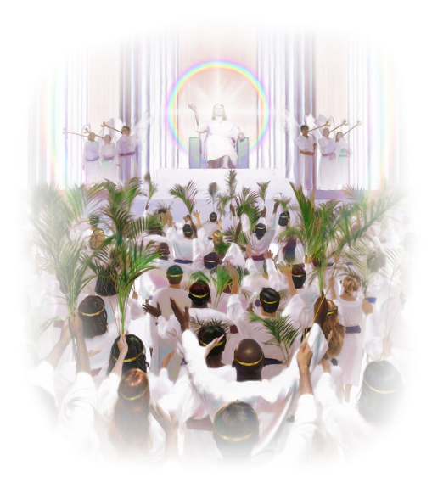
FINAL TRIUMPH (2)
“And in this mountain shall the LORD of hosts make unto all people a feast of fat things, a feast of wines on the lees, of fat things full of marrow, of wines on the lees well refined” (Isaiah 25:6)
Isaiah 25 is a song of praise to God in the eschatological Day of the Lord. This song consists of three sections:
V. 1-5. God is praised because He's mediated for His people
V. 6-8. God holds a feast for His people
V. 9-12. God is praised for what He's about to do
Isaiah 26 introduces the redeemed:
V. 2, 7. They're righteous, upright, and keepers of the truth
V. 3-4. They fully trust God
V. 9. They seek God
This is God's promise to those who will live in the New Earth: “I, the Lord, keep it, I water it every moment; lest any hurt it, I keep it night and day.” (Isaiah 27:3)

Slide 10

“Those who take Christ at His word, and surrender their souls to His keeping, their lives to His ordering, will find peace and quietude… The Lord says, ‘Thou wilt keep him in perfect peace, whose mind is stayed on Thee: because he trusteth in Thee.’ (Isaiah 26:3). Our lives may seem a tangle; but as we commit ourselves to the wise Master Worker, He will bring out the pattern of life and character that will be to His own glory. And that character which expresses the glory—character—of Christ will be received into the Paradise of God. A renovated race shall walk with Him in white, for they are worthy.”
E.G.W. (The Desire of Ages, cp. 34, p. 331)

