Slide 1
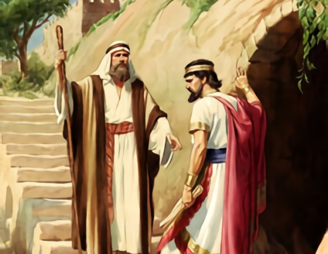
THE HARD WAY
Lesson 4 for January 23, 2021

Slide 2

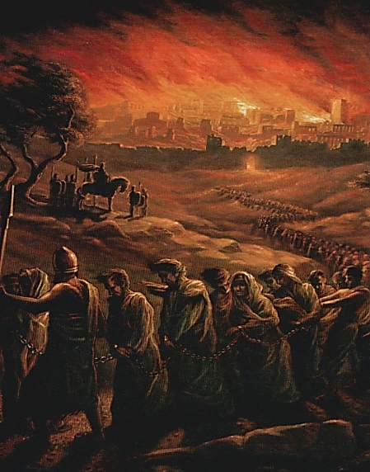
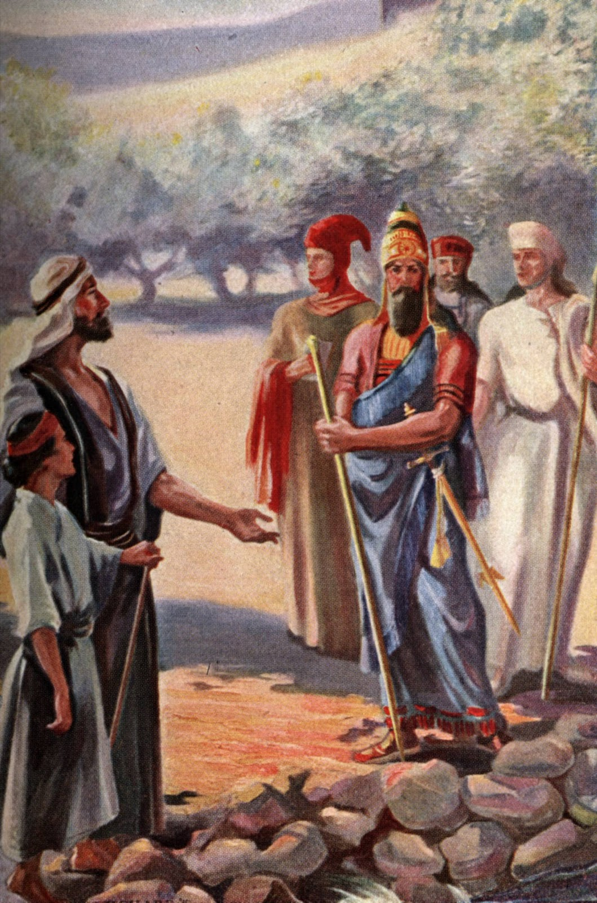







Ahaz rejected God’s help to overcome his enemies.
The people of Israel suffered because of the king’s bad decision.
They didn’t want to listen, so they had to learn the lesson the hard way.
What will happen?
  The Word of God is fulfilled. Isaiah 7:15-16
  The consequences of disobedience. Isaiah 7:17-25
  Beaten, but not destroyed. Isaiah 8:1-10
What should we do?
  Fear the Lord. Isaiah 8:11-15
  Don’t believe the lies. Isaiah 8:16-22

Slide 3

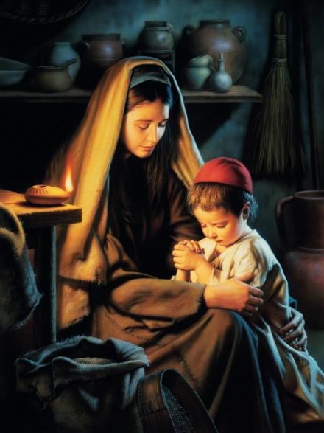
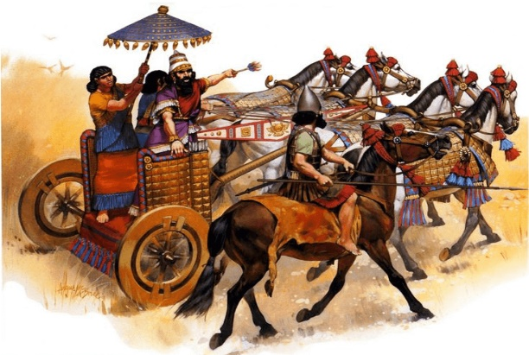
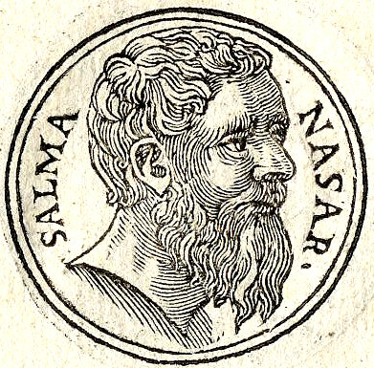
THE WORD OF GOD IS FULFILLED
“For before the Child shall know to refuse the evil and choose the good, the land that you dread will be forsaken by both her kings.” (Isaiah 7:16)
In 734 BC, the Word of God foretold that before the child would be able to speak clearly and to distinguish between good and evil, the kingdoms of Israel and Syria would no longer exist (Isaiah 8:4; 7:16).
Two years later, in 732 BC, Syria was conquered by the Assyrian Empire. In that moment, Isaiah’s son was less than one year old, and he could only babble.
Twelve years later, in 722 BC, Isaiah’s son was able to make decisions. Then the kingdom of Israel was destroyed by Shalmaneser V. The Israelites were deported to Mesopotamia and Media
(2K. 17:3-6).

Slide 4

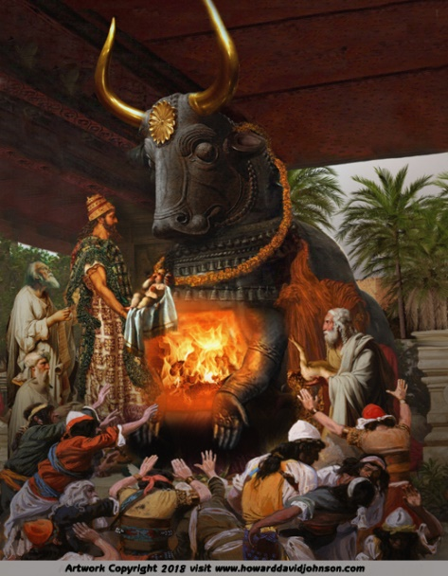
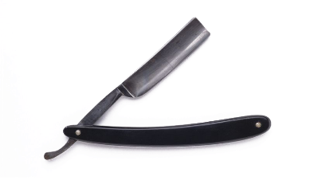
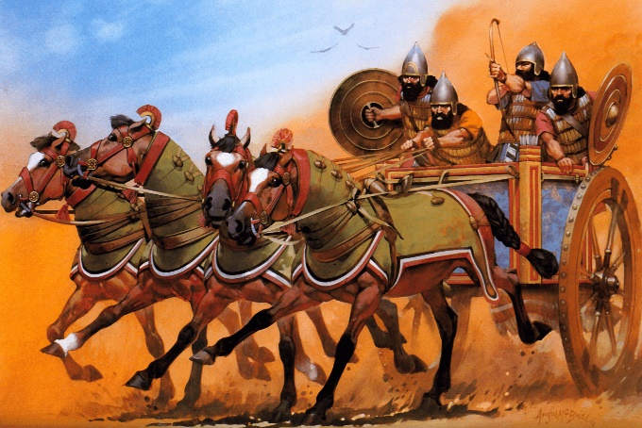
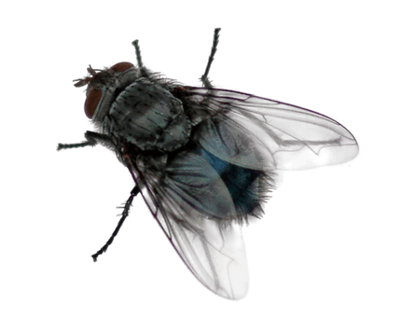

THE CONSEQUENCES OF DISOBEDIENCE
“The Lord will bring the king of Assyria upon you and your people and your father’s house—days that have not come since the day that Ephraim departed from Judah.” (Isaiah 7:17)
God had promised that He would destroy the kingdoms of Israel and Syria Himself, so Ahaz didn’t have to do anything about it.
However, Ahaz disobeyed Him and formed an alliance with Assyria. He also worshipped Syria’s gods because he believed they were more powerful than God (2 Chronicles 28:22-23).
Therefore, God sent Egypt and Assyria (the fly and the bee, v. 18) against Judah. He used Assyria as a “hired razor” to destroy the kingdom of Judah (v. 20).
We should always trust God. Bad consequences inevitably come when we reject God and rely in people alone (Psalm 146:3).

Slide 5

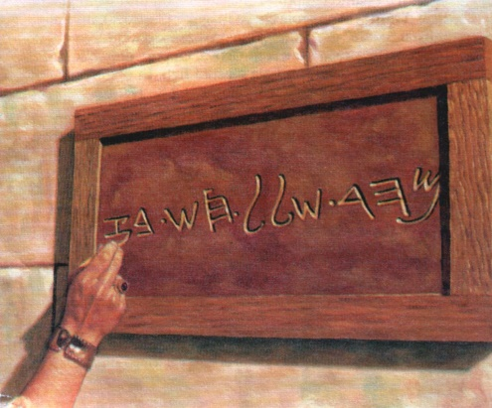

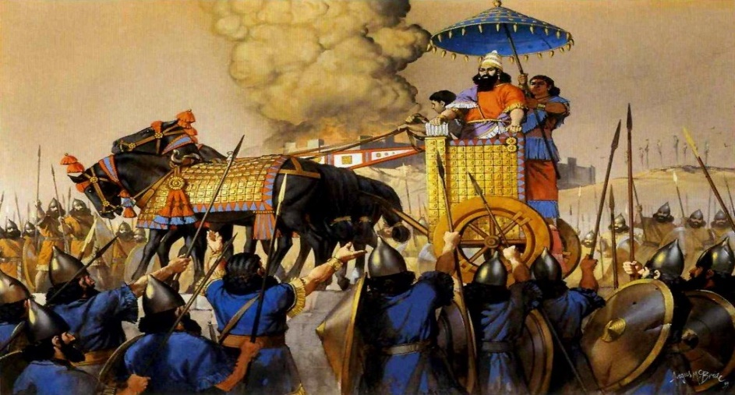

BEATEN, BUT NOT DESTROYED
“He will pass through Judah, He will overflow and pass over, He will reach up to the neck; and the stretching out of his wings will fill the breadth of Your land, O Immanuel.” (Isaiah 8:8)
God asked Isaiah to write down the name of his next son before witnesses, although her wife had not conceived yet (v. 1-2). This son would be a sign (v. 18) like the previous one [Shear-Jashub], because his name [Maher-shalal-hash-baz] meant “Speed the spoil, hasten the booty.”
It was a warning. Assyria would conquer the lands of Syria and Israel. However, Tiglath-Pileser III came like “the waters of the River” and went further. He destroyed the land of Judah too.
God was merciful. He let him “reach up to the neck” only, so Judah was not completely destroyed.
The remnant was saved.

Slide 6

“But in Judah there dwelt some who maintained their allegiance to Jehovah, steadfastly refusing to be led into idolatry. It was to these that Isaiah and Micah and their associates looked in hope as they surveyed the ruin wrought during the last years of Ahaz. Their sanctuary was closed, but the faithful ones were assured: ‘God is with us.’ ‘Sanctify the Lord of hosts Himself; and let Him be your fear, and let Him be your dread. And He shall be for a sanctuary.’ Isaiah 8:10, 13, 14”
E.G.W. (Prophets and Kings, cp. 27, p. 330)

Slide 7

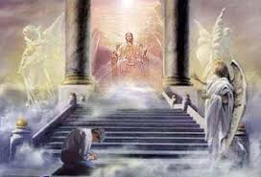
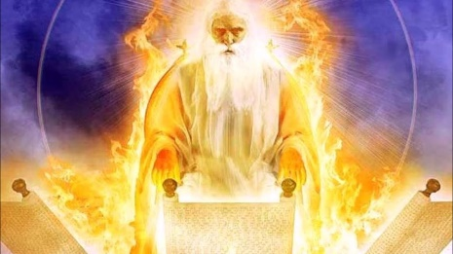
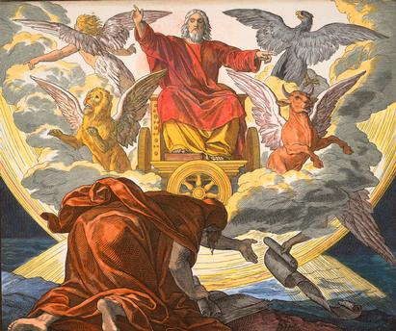
FEAR THE LORD
“The Lord of hosts, Him you shall hallow; let Him be your fear, and let Him be your dread.” (Isaiah 8:13)
God advised Isaiah not to do what most people do, not to be afraid of what most people are, and not to fear what most people fear (v. 11-12).
God is the only one we should hallow [obey], fear [respect], and even be afraid of (v. 13).
We truly fear God by acknowledging that He is the supreme Power of the Universe. If He is with you, nobody can hurt you without His permission. If God is against you because you have rebelled against Him, then you should be afraid of Him.

Slide 8

“Our minds must be stayed upon God, and we must not fear the fear of the wicked, that is, fear what they fear, and reverence what they reverence, but be bold and valiant for the truth. Could our eyes be opened, we should see forms of evil angels around us, trying to invent some new way to annoy and destroy us. And we should also see angels of God guarding us from their power; for God’s watchful eye is ever over Israel for good, and He will protect and save His people, if they put their trust in Him.”
E.G.W. (Early Writings, p. 60)

Slide 9

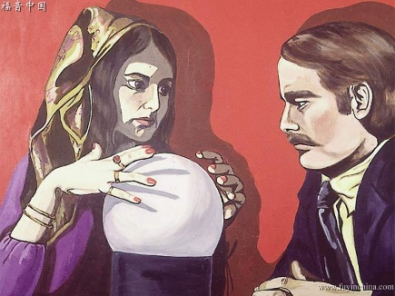
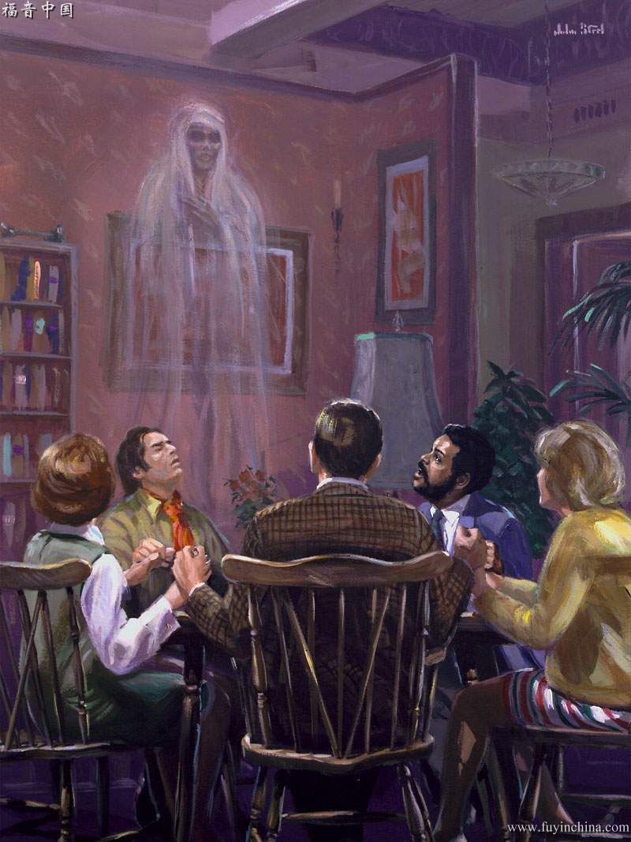
DON’T BELIEVE THE LIES
“And when they say to you, ‘Seek those who are mediums and wizards, who whisper and mutter,’ should not a people seek their God? Should they seek the dead on behalf of the living?” (Isaiah 8:19)
Most people in Judah and Ahaz himself followed a religion based on idolatry, divination, and worshipping the dead. All this went against “the Law and the testimony” of God (v. 20).
This kind of beliefs are still around today. Idols may not be worshipped openly, but our culture is full of beliefs about the dead communicating with the living and deciding or foretelling their future. Spiritualism, modern sorcery, and the New Age spread this message all around.
We must base our beliefs on the Bible alone and reject those subtle lies firmly. Rejecting them is a matter of loyalty to God.

Slide 10

“Every individual must seek by earnest prayer
to know the Word of God for himself, and then to do it […] In all your temporal concerns, in all your cares and anxieties, wait upon the Lord. Put not your trust in princes, nor in the sons of man because they may be in positions of trust. The Lord has united your heart with Him. If you love Him, and are accepted in His service, bring all your burdens, both public and private, to the Lord and wait upon Him.”
E.G.W. (This Day With God, March 14)

