Slide 1
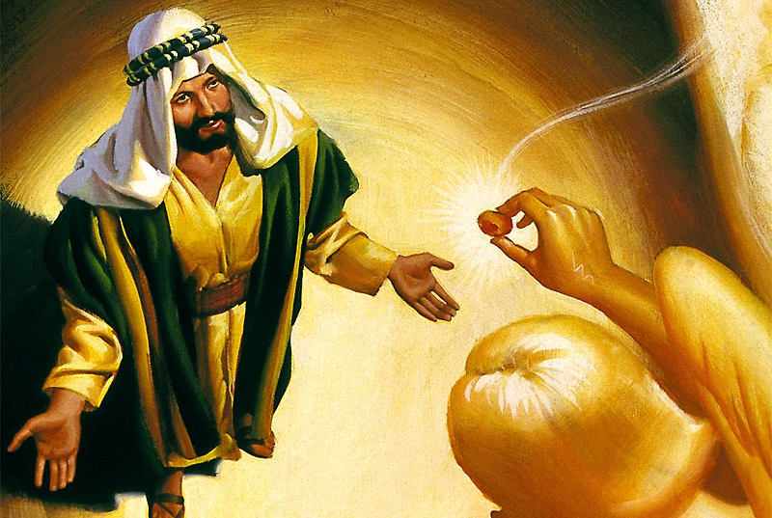
CRISIS
OF
LEADERSHIP
Lesson 2 for January 9, 2021

Slide 2

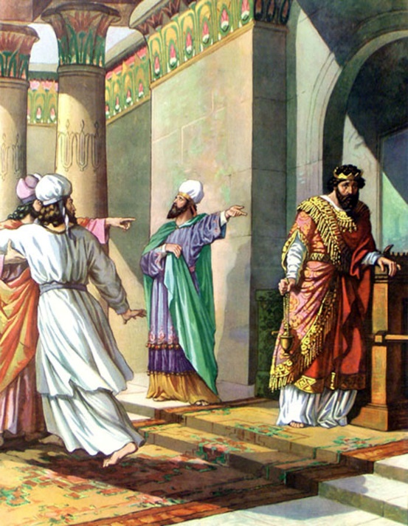
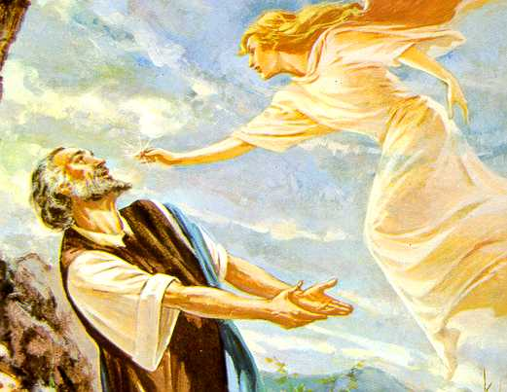





King Uzziah “did what was right in the sight of the Lord.” (2Chr. 26:4). However, “his heart was lifted up to his destruction” (2Chr. 26:16), so he had to share the reign with his son Jotham during his later years.
Isaiah was called as a prophet to denounce the sins of Israel amid that crisis. When Uzziah died, God decided to renew Isaiah’s prophetic call with a vision that marked a new stage in his mission as a prophet.
The context of the vision
The holiness of God. Isaiah 6:1-4
The transformation of Isaiah. Isaiah 6:5-7
The commission. Isaiah 6:8
The message. Isaiah 6:9-13

Slide 3

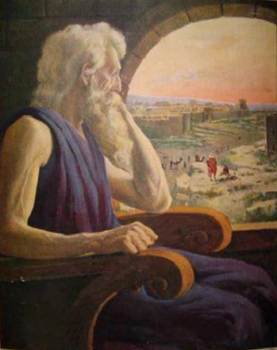
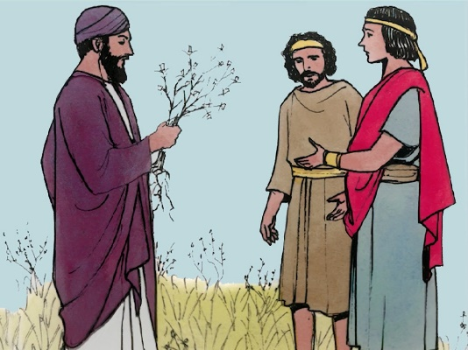
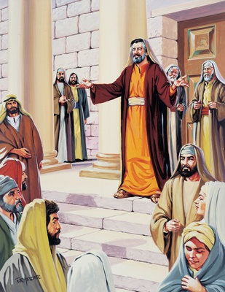
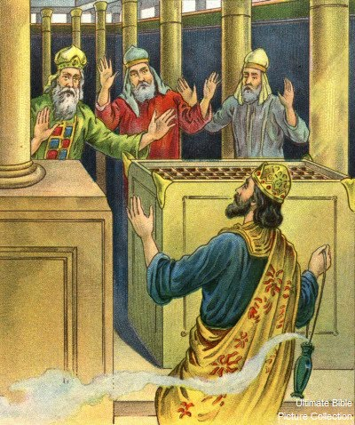
THE CONTEXT OF THE VISION
“Now the rest of the acts of Uzziah, from first to last, the prophet Isaiah the son of Amoz wrote.” (2 Chronicles 26:22)
Isaiah was part of the royal family, so he was in close contact with Uzziah.
Uzziah was a faithful servant of God. He was given great skills. He was a good strategist, builder, and farmer (2Chr. 26:5-7, 9-10, 15).
Nevertheless, he wanted to be more than God had made him. He wanted to do priestly tasks, and God punished him with leprosy (2Chr. 26:16, 19, 21).
The rest of the people seemed to be infected by a moral “leprosy”. They needed Isaiah to lead them to the only holy, pure, immortal, and perfect King.

Slide 4

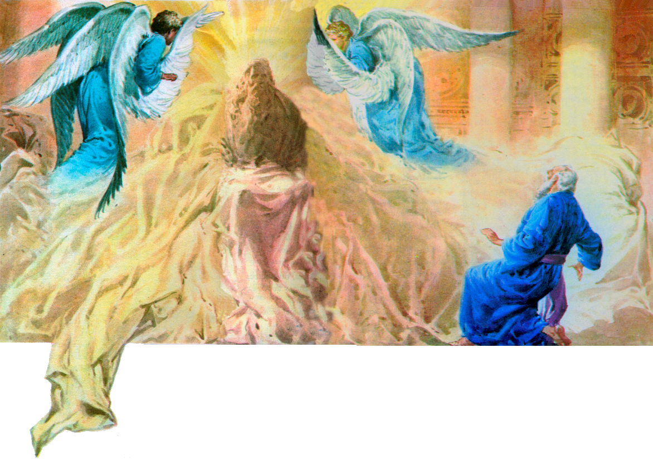
Uzziah wanted to come before God, and he was hurt by His holiness. God came before Isaiah, and he was transformed by His holiness.
God was seated on a high and sublime throne; His presence covered everything. The doors were shaking, and the temple was filled with smoke. There were flaming beings (seraph means “the burning one”) around Him that praised Him and proclaimed His holiness.
THE HOLINESS OF GOD
The message of the vision was clear, God is holy and demands holiness (Lv. 11:45; 19:2; 20:26; 1P. 1:16). Isaiah’s faith was strengthened like Ezekiel’s, Daniel’s, and John’s (Ez. 1; Dn. 10; Rev. 1).
“And one cried to another and said: ‘Holy, holy, holy is the Lord of hosts; the whole earth is full of His glory!’” (Isaiah 6:3)

Slide 5

“What though earthly powers should be arrayed against Judah? What though Isaiah should meet with opposition and resistance in his mission? He had seen the King, the Lord of hosts; he had heard the song of the seraphim, ‘The whole earth is full of His glory;’ and the prophet was nerved for the work before him. The memory of this vision was carried with him throughout his long and arduous mission.”
E.G.W. (Testimonies for the Church, book 5, cp. 91, p. 751)

Slide 6

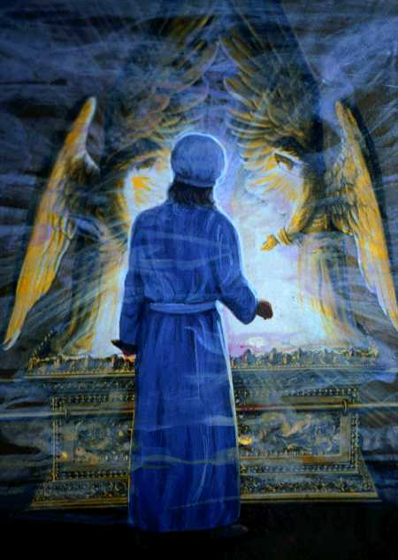
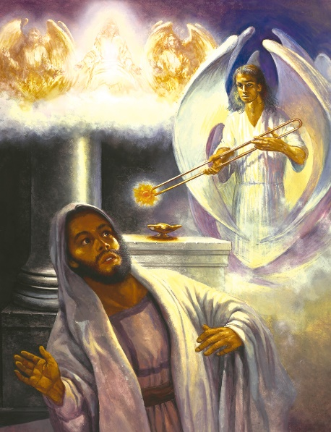
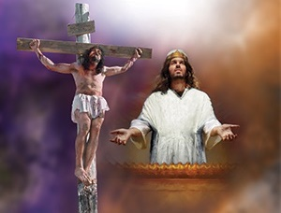
THE TRANSFORMATION OF ISAIAH
“And he touched my mouth with it, and said: ‘Behold, this has touched your lips; your iniquity is taken away, and your sin purged.’” (Isaiah 6:7)
Smoke filled the Most Holy Place every Day of Atonement, so the priest was hidden from God’s glory. The vision was remarkably similar, so Isaiah felt judged… and condemned!
The live coal was taken from the golden altar where interceding incense was burning. This represented Jesus’ intercession. He’s the only One who can forgive our sins and transform us.
Uzziah wanted to offer incense himself, and he paid for his sin. When Isaiah was touched by the live coal, God made him incense, and his sin was forgiven.

Slide 7

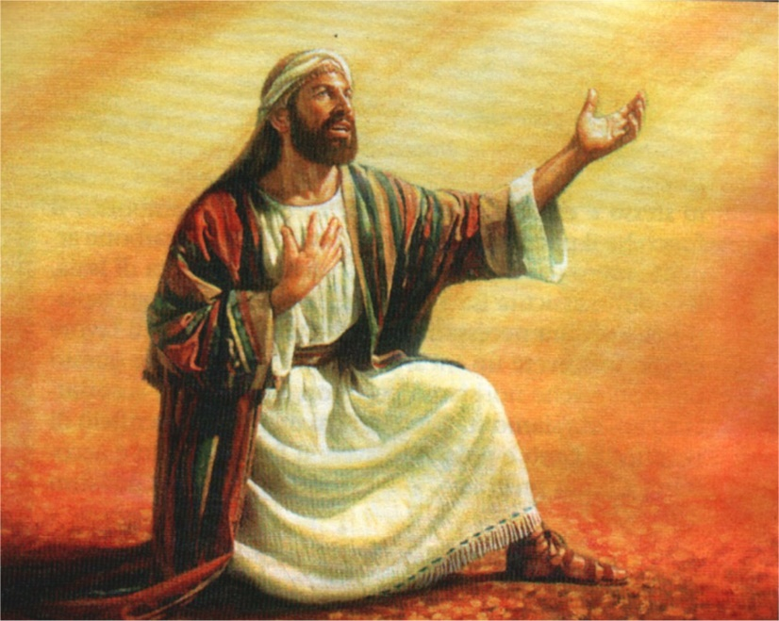
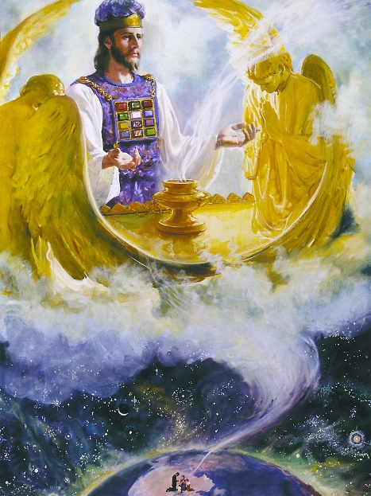
THE COMMISSION
“Also I heard the voice of the Lord, saying: ‘Whom shall I send, and who will go for Us?’ Then I said, ‘Here am I! Send me.’” (Isaiah 6:8)
After being comforted by God’s forgiveness, Isaiah offered to fulfill any mission God would call him to fulfill.
Paul encouraged us to confidently come to the Sanctuary before the throne of God. There we’ll find grace because Jesus is interceding for us (Hebrews 4:14-16).
After all, we’ll find comfort and strength in the Heavenly Sanctuary that will help us overcome our afflictions and carry out our mission (Psalm 73:17; Revelation 5:4-6).

Slide 8

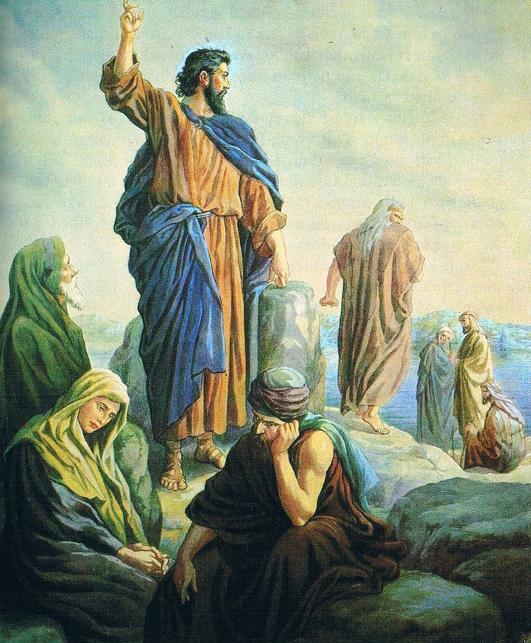
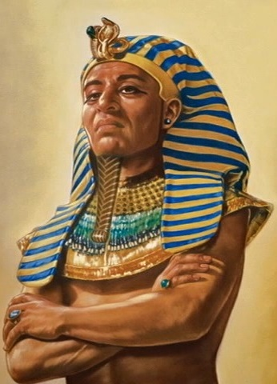
THE MESSAGE
“Make the heart of this people dull, and their ears heavy, and shut their eyes; lest they see with their eyes, and hear with their ears, and understand with their heart, and return and be healed.” (Isaiah 6:10)
God wants everyone to repent and be saved (Jn. 3:16; 2P. 3:9). He is constantly sending reprimanding messages through His messengers (and every believer may be a messenger).
There are two types of response to these messages: acceptance or rejection. The more we reject these messages, the more our heart hardens like Pharaoh’s. Our ears and eyes gradually shut as we refuse to listen.
Those who accept the message are called “holy seed” (Isaiah 6:13).

Slide 9

“To everyone who becomes a partaker of His grace the Lord appoints a work for others. Individually we are to stand in our lot and place, saying, ‘Here am I; send me.’ Isaiah 6:8. Upon the minister of the word, the missionary nurse, the Christian physician, the individual Christian, whether he be merchant or farmer, professional man or mechanic—the responsibility rests upon all. It is our work to reveal to men the gospel of their salvation. Every enterprise in which we engage should be a means to this end.”
E.G.W. (The Ministry of Healing, cp. 9, p. 148)

