Slide 1
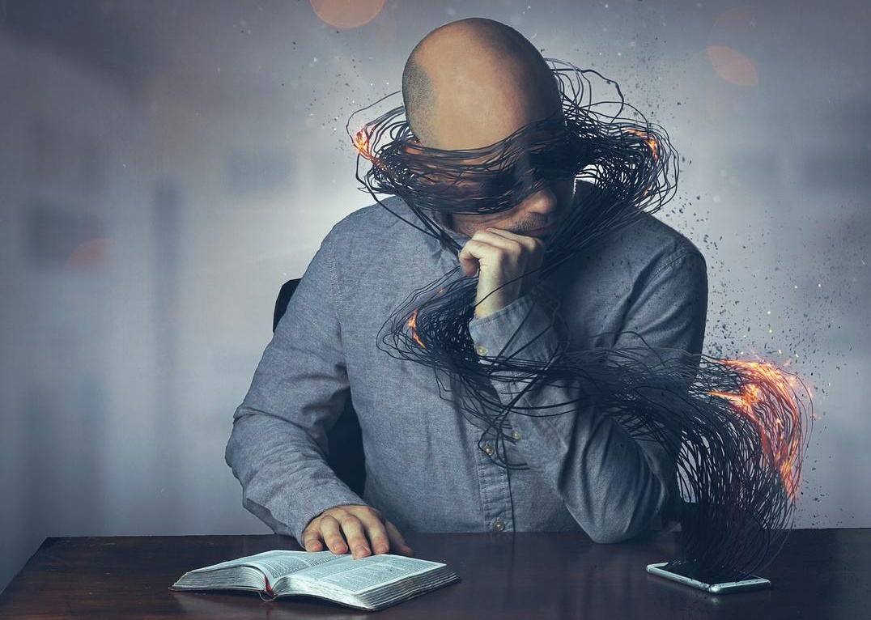
CRISIS OF IDENTITY
Lesson 1 for January 2, 2021

Slide 2

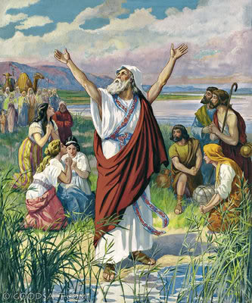
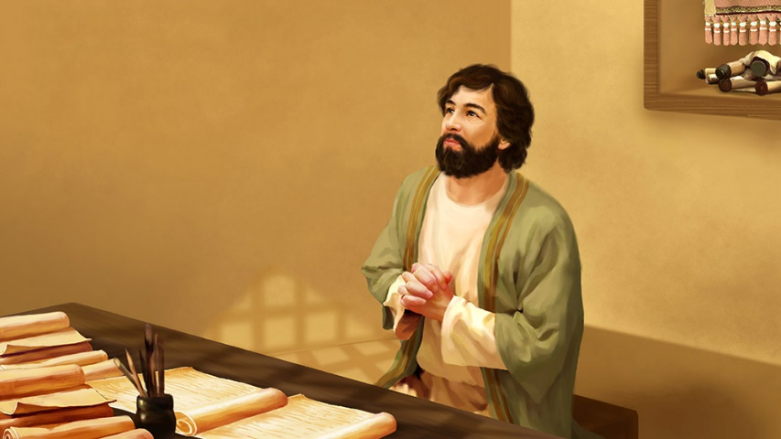





Isaiah was the son of Amoz and was descended from royalty. He was called to be a prophet when he was young by the end of Uzziah's reign (790-739 BC), during the coregency of Jotham (approx. 750-739 BC). His ministry lasted for at least 60 years, and covered the reigns of Uzziah, Jotham, Ahaz, and Hezekiah.
The book of Isaiah begins explaining the crisis of identity of God's people, a call to change, and an offer of forgiveness from God.
A crisis of identity. Isaiah 1:1-9
A form of godliness. Isaiah 1:10-17
An offer of forgiveness. Isaiah 1:18
An opportunity to choose. Isaiah 1:19-31
A point of no return. Isaiah 5:1-7

Slide 3

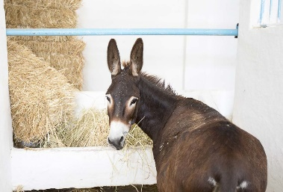
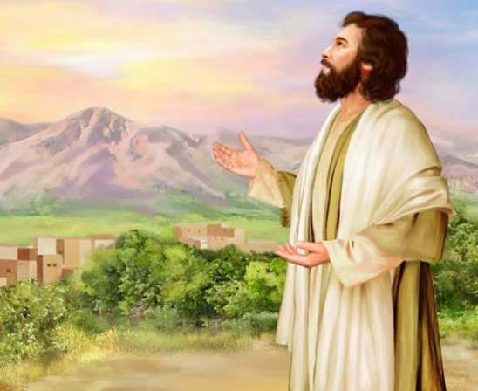
A CRISIS OF IDENTITY
“The ox knows its owner and the donkey its master’s crib; but Israel does not know, my people do not consider.” (Isaiah 1:3)
2 Kings 15-20 and 2 Chronicles 26-32 cover the time window during which Isaiah carried out his ministry.
By the end of Uzziah’s reign, God proclaimed something (v. 2-4): Israel had forgotten who their Lord was, and they had lost their identity.
As a result of their separation from God, they were suffering serious losses
(v. 5-8). However, a remnant still remained faithful (v. 9).

Slide 4

A CRISIS OF IDENTITY
“The ox knows its owner and the donkey its master’s crib; but Israel does not know, my people do not consider.” (Isaiah 1:3)
Forsaking the Lord
Provoking the Holy One
Depravity
Wickedness and sin
Not knowing
Not understanding the Lord
Rebelling against God
What were they doing?
What was going on with them?
What was God doing?
Physical wounds
A destroyed country
Burning cities
Sacked by their enemies
Keeping Zion standing
Keeping a remnant

Slide 5

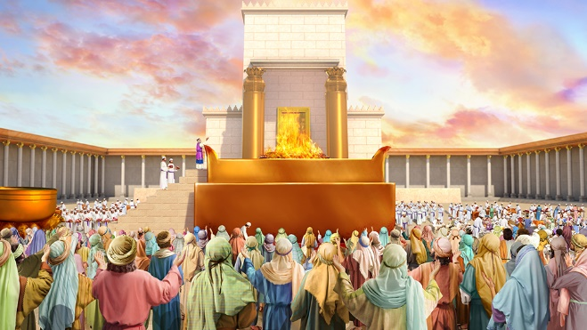
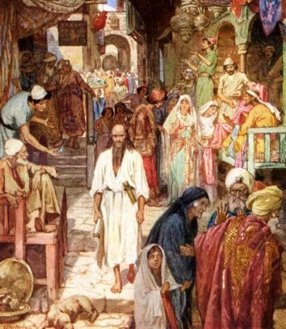
A FORM OF GODLINESS
“Bring no more futile sacrifices; incense is an abomination to Me. The New Moons, the Sabbaths, and the calling of assemblies—I cannot endure iniquity and the sacred meeting.” (Isaiah 1:13)
How could something that God had ordered become sin (iniquity)?
They were offering sacrifices and praying to God with lifted hands, but they were only keeping up appearances. Their hands were bloodstained (v. 16) because they were violent and unfair to the weak (v. 17).
Their rites were void of repentance. God considered them sin because they were shallow.
The people of God repeated the same mistakes several times (Mt. 23:23-28). We should be aware of repeating the same mistake ourselves.

Slide 6

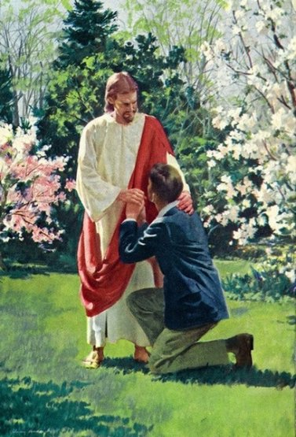
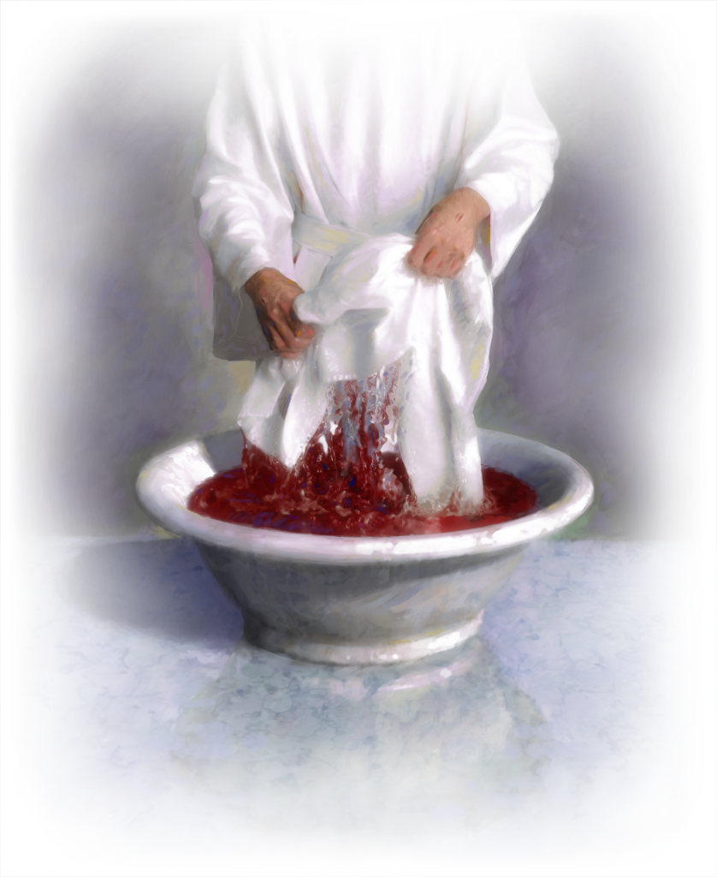
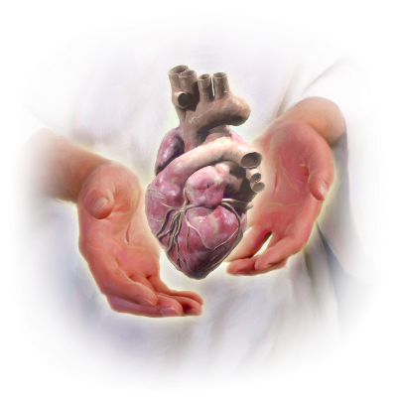
AN OFFER OF FORGIVENESS
“‘Come now, and let us reason together,’ says the Lord, ‘though your sins are like scarlet, they shall be as white as snow; though they are red like crimson, they shall be as wool.’” (Isaiah 1:18)
God wants to turn the bloody red on the hands of the Israelites into the white of His purity. He wants to forgive our sins and to purify our hearts.
He asks us to just come to Him with the intention of settling accounts with Him (repentance).
Our heart changes when we truly accept forgiveness (Jeremiah 31:31-34). Once we acknowledge our need for forgiveness, we’re ready to accept everything God has for us.

Slide 7

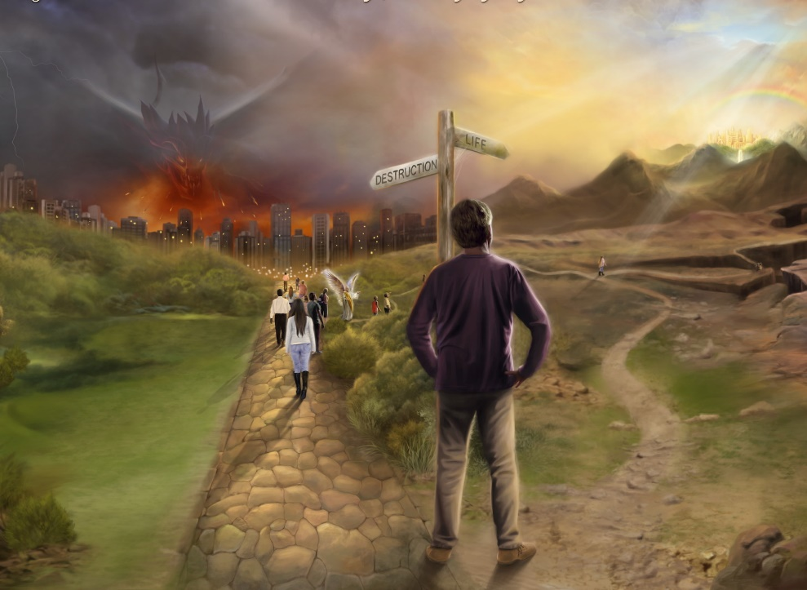
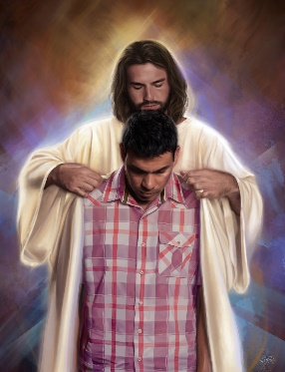
AN OPPORTUNITY TO CHOOSE
“If you are willing and obedient, you shall eat the good of the land;” (Isaiah 1:19)
God offers a covenant in Isaiah 1 which is similar to others He had previously made and to the usual covenants in that time:
v. 19
If you are willing and obedient
You shall eat the good
v. 20
If you refuse and rebel
You shall be devoured
What God has done
The terms of the covenant
Mention of the witnesses
Blessings and curses
No matter how much we’ve sinned or how far we’re from God. God’s grace has no limits. He’s always willing to forgive us.
God brings a solution, but the choice is ours (Dt. 30:19).

Slide 8

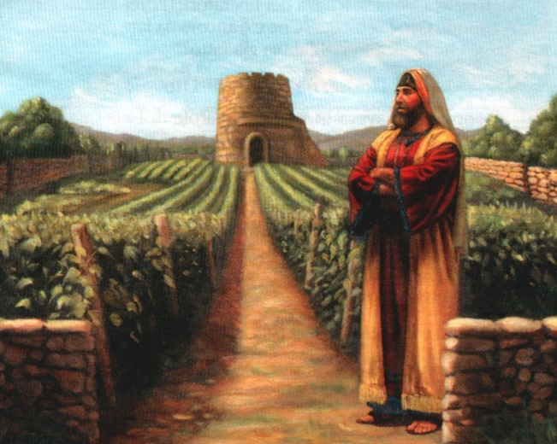
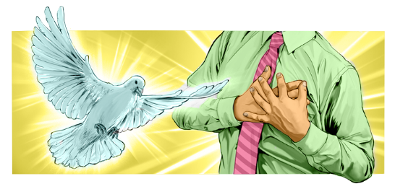

A POINT OF NO RETURN
“And now, please let Me tell you what I will do to My vineyard: I will take away its hedge, and it shall be burned; and break down its wall, and it shall be trampled down.” (Isaiah 5:5)
“What more could have been done to My vineyard that I have not done in it?” (v. 4). God’s forgiveness is boundless, but we might reject it to a point of no return: the sin against the Holy Spirit (Mt. 12:31-32; Heb. 6:4-6).
It’s extremely hard to get to the point of not hearing the plea of the Holy Spirit. God’s patience is relentless (2P. 3:9). His call is unceasing. God will do everything possible to persuade us to accept Him before we reach that point.
Our souls can “be laid wasted” (v. 6) only if we stubbornly decide not to listen to Him.

Slide 9

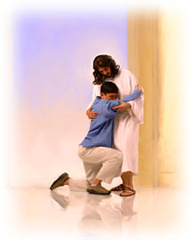
“The whole heart must be yielded to God, or the change can never be wrought in us by which we are to be restored to His likeness. By nature we are alienated from God.”
E.G.W. (Steps to Christ, cp. 5, p. 43)
“Confession will not be acceptable to God without sincere repentance and reformation. There must be decided changes in the life; everything offensive to God must be put away. This will be the result of genuine sorrow for sin.”
E.G.W. (Steps to Christ, cp. 4, p. 39)

