Slide 1

Lesson 13 for December 26, 2020
HEAVEN, EDUCATION, AND ETERNAL LEARNING

Slide 2

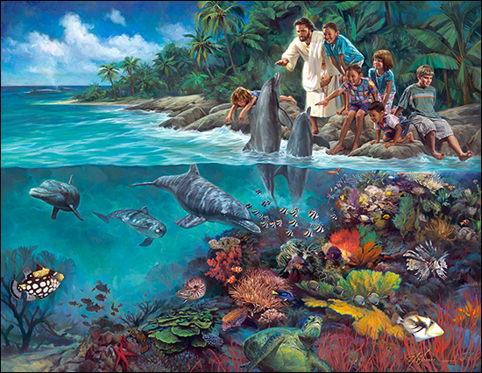
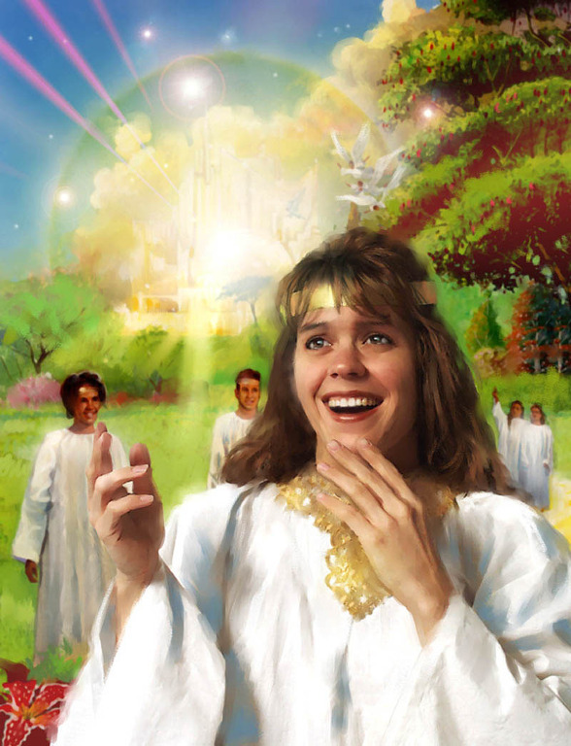







We never stop learning. Only death can put an end to our learning process.
Or can it?
We learn from the Bible that we will be still learning long after our death. We’ll have the chance to take a “postgraduate course” or “Master’s degree.”
A new and exciting learning phase will begin after our resurrection: the school in the hereafter.
Learning in the hereafter:
  How long will we keep learning?
  What will life be like?
The school in the hereafter:
  Enrollment
  The study program
  The Teacher

Slide 3

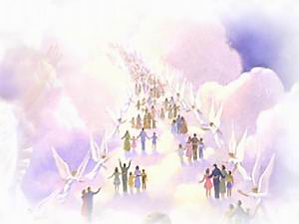
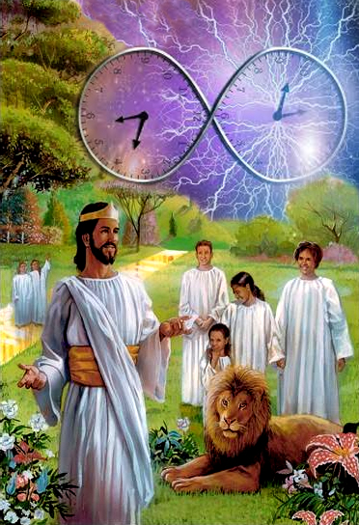
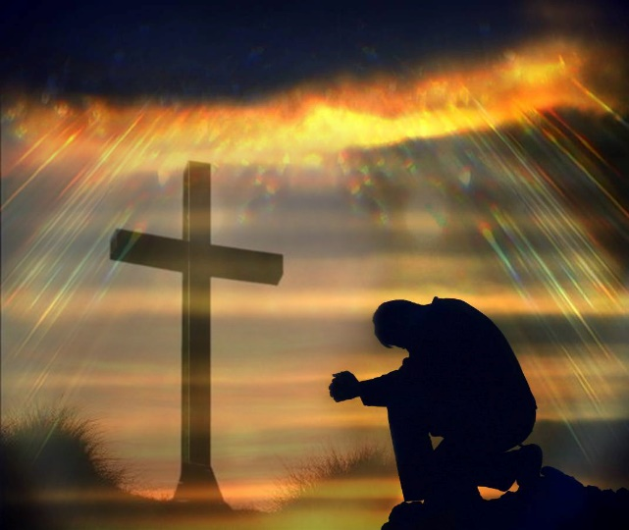
HOW LONG WILL WE KEEP LEARNING?
“Whoever eats My flesh and drinks My blood has eternal life, and I will raise him up at the last day.” (John 6:54)
The last stage in our learning path will begin with our resurrection. There is one requirement to fulfill in order to be part of “the resurrection of life.” (John 5:29)
Jesus made it clear: eating His flesh and drinking His blood. That is, accepting His redeeming sacrifice on the cross (John 3:16).
In that moment, we will receive a gift that will last as long as our learning in the hereafter will: ETERNAL life (1Jn. 5:13; 1Tim. 1:16; Jn. 4:14; 6:40; Jud. 1:21; Tit. 3:7).
Now we have limited time in this life. Then, Jesus will give us unlimited time for limitless learning with Him.

Slide 4

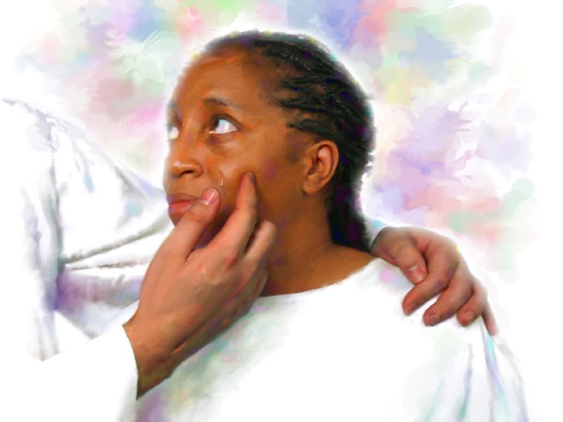
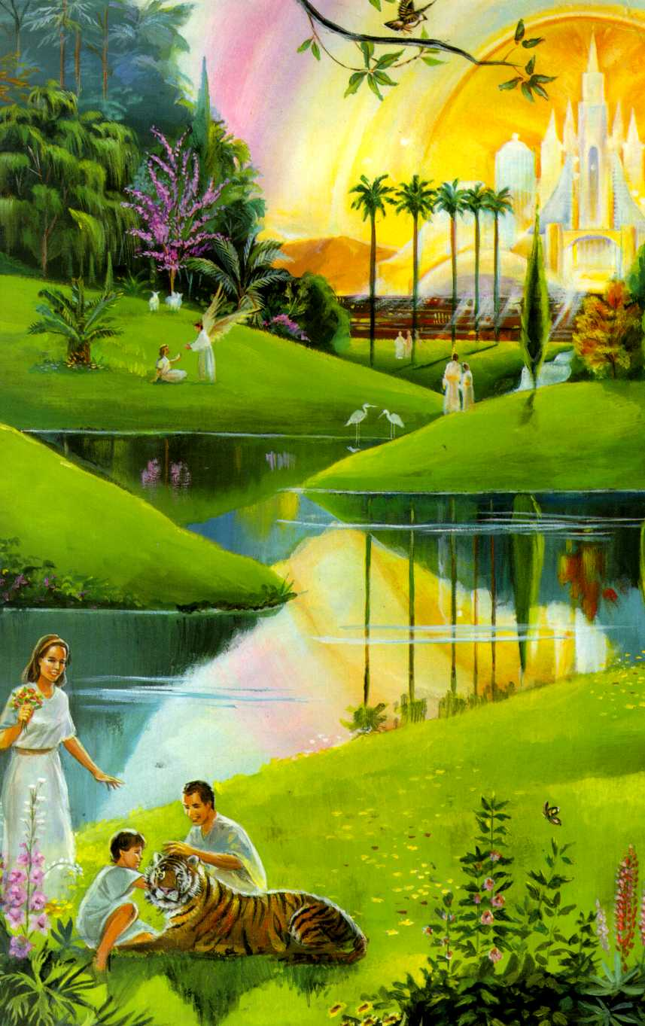
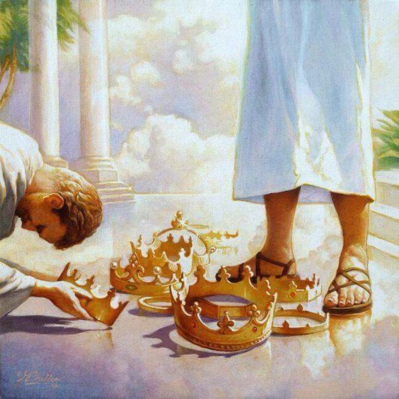
WHAT WILL LIFE BE LIKE?
“And God will wipe away every tear from their eyes; there shall be no more death, nor sorrow, nor crying. There shall be no more pain, for the former things have passed away.” (Revelation 21:4)
There are many obstacles to successful learning today: imperfect teachers, flawed programs, limited intellectual ability, personal and family issues…
All these obstacles will vanish in the “new heavens and [the] new earth in which righteousness dwells.” (2P. 3:13).
Sin and death will be no more, so life will be perfect. There will be no flaws in our new learning path. We will also be transformed and made perfect by God. Our intellectual ability will be incomparably superior to our current one (1Co. 15:42-49).
“Now thanks be to God for His indescribable gift [which is precious beyond words]!”
(2 Corinthians 9:15 AMP)

Slide 5


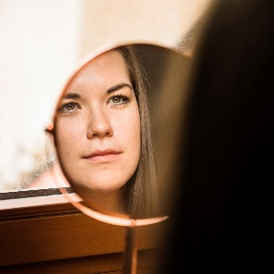
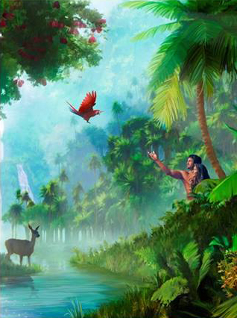
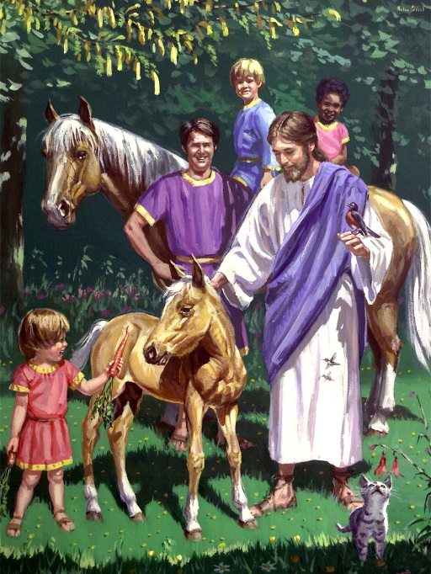
ENROLLMENT
“For now we see in a mirror, dimly, but then face to face. Now I know in part, but then I shall know just as I also am known.” (1 Corinthians 13:12)
God founded the first school in Eden so that Adam and his descendants would learn everything about God, the world around them, the universe, and any other topic they could think of.
God wants to reopen Eden’s school once this pause that sin caused ends for good. Everyone is encouraged to enroll
(John 3:16).
Accept Jesus as our Savior by faith (Acts 16:13)
Trust in His promises (Hebrews 10:23)
Live up to the light that we have (James 1:21-22)
Endure unto the end (Matthew 24:13)
How can we enroll and get accepted into this school?

Slide 6

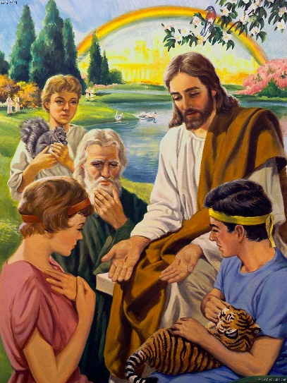
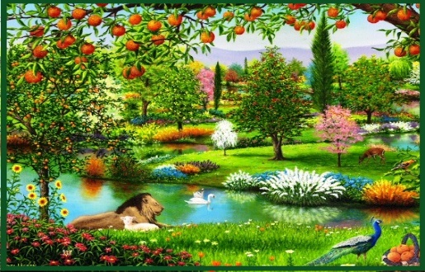
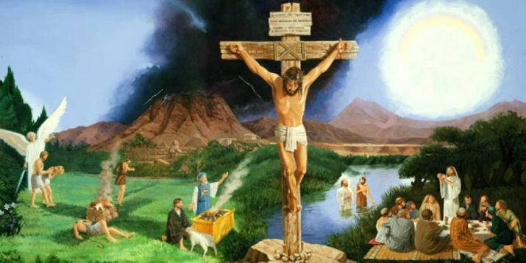
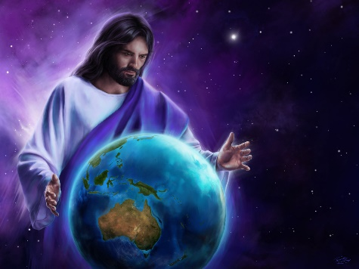
THE STUDY PROGRAM
“And one will say to him, ‘What are these wounds between your arms?’ Then he will answer, ‘Those with which I was wounded in the house of my friends.’” (Zechariah 13:6)
The learning program and the content of our “textbooks” will be quite different in a world free of the effects of sin. For example:
Biology. There will be no death, illness, or pain. We’ll learn how all the wonders in all organisms—even the smallest ones—work.
Zoology. Animals will no longer attack and kill each other. We’ll be able to learn from them with no fear whatsoever.
Astronomy. We will not need telescopes anymore. We’ll be able to travel to any planet we want to study!
Above all, the most important subject in our curriculum will be the plan of Redemption and the great love of God (Zechariah 13:6).

Slide 7

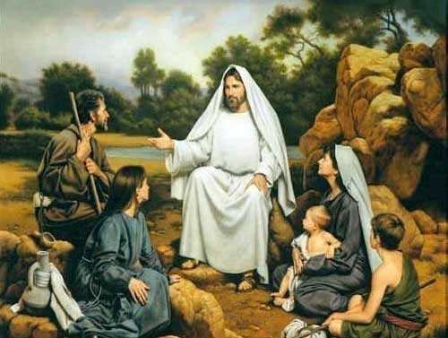
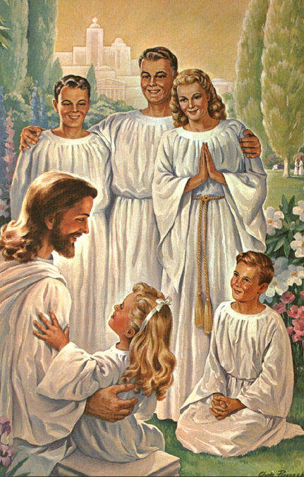
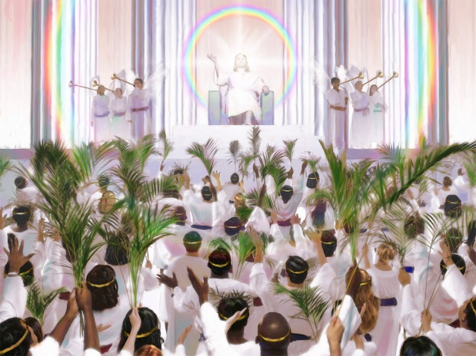
“for the Lamb who is in the midst of the throne will shepherd them and lead them to living fountains of waters. And God will wipe away every tear from their eyes.”
(Revelation 7:17)
THE TEACHER
Teaching was one of the main activities of Jesus during His ministry on Earth (Mat. 5:2; Mar. 4:2; Luke 19:47; Jn. 6:59).
Jesus will still be our Teacher in our school in the hereafter. He will be our tutor and will lead us to better understand His character and His Creation (Isaiah 54:13).
We’ll have unlimited time to learn, so God will gradually reveal to us more deeply and gloriously. The more we’ll learn about His character, the more we’ll admire Him and the more intense our songs of praise will be.
Then, “From the minutest atom to the greatest world, all things, animate and inanimate, in their unshadowed beauty and perfect joy, [will] declare that God is love.”
(Ellen G. White, The Great Controversy, p. 678)

Slide 8

“There immortal minds will study with never-failing delight the wonders of creative power, the mysteries of redeeming love […] Every faculty will be developed, every capacity increased. The acquirement of knowledge will not weary the mind or exhaust the energies. There the grandest enterprises may be carried forward, the loftiest aspirations reached, the highest ambitions realized; and still there will arise new heights to surmount, new wonders to admire, new truths to comprehend, fresh objects to call forth the powers of mind and soul and body.”
E.G.W. (The Story of Redemption, cp. 67, p. 432)

