Slide 1
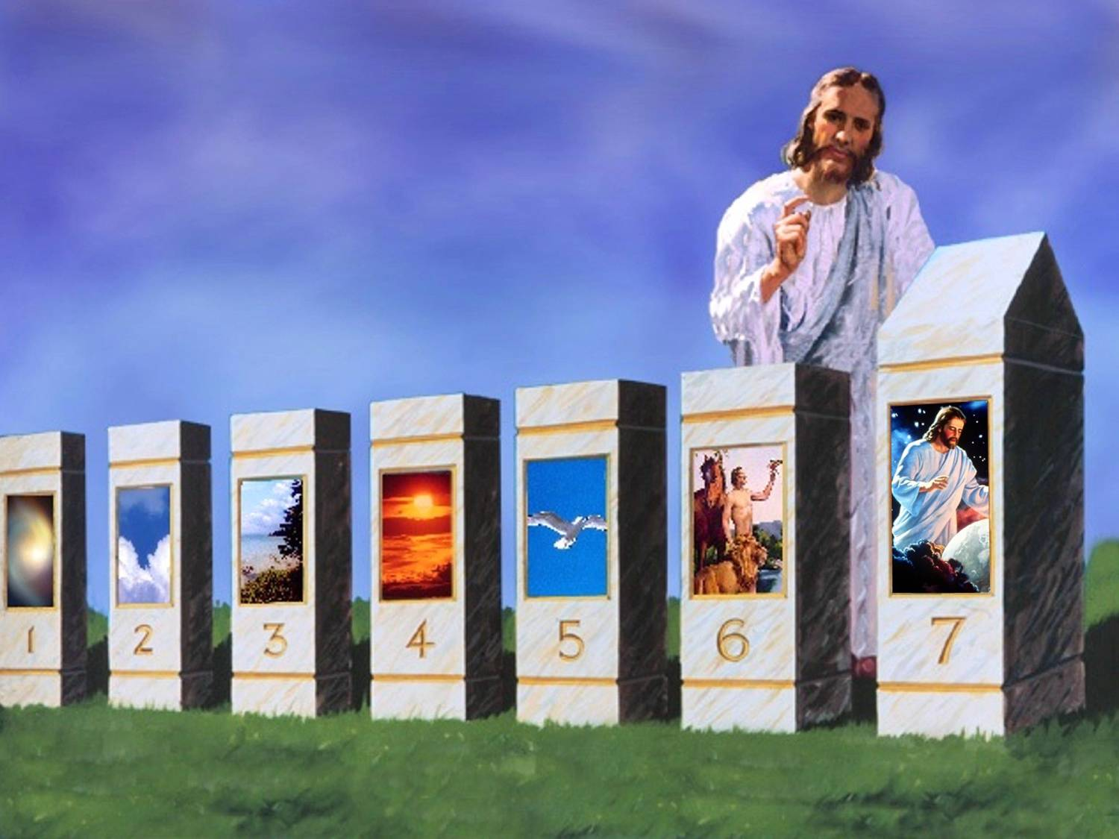
SABBATH: EXPERIENCING AND LIVING THE CHARACTER OF GOD
Lesson 12 for December 19, 2020

Slide 2

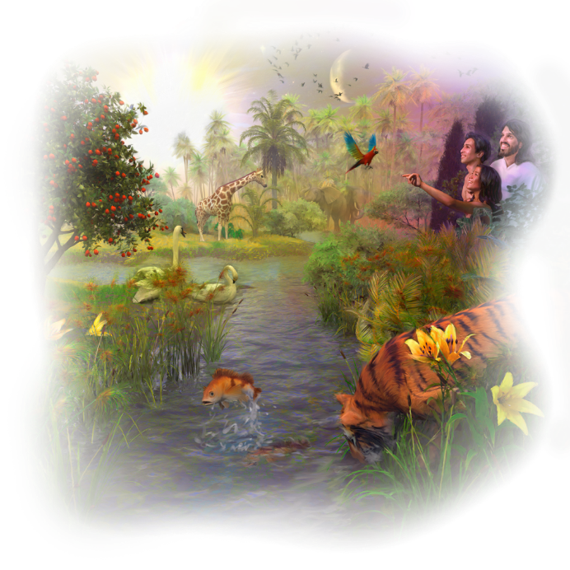
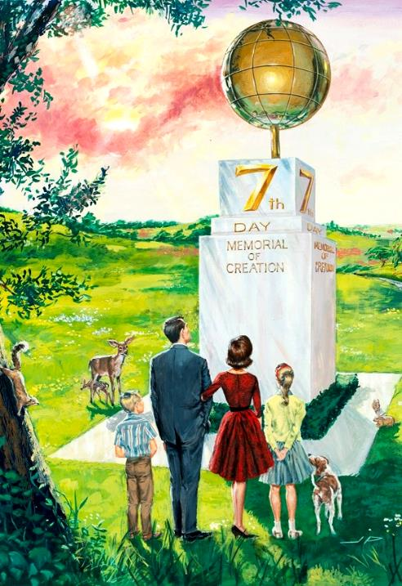





Humankind has been enjoying the Sabbath since Creation, and we’ll keep it for all eternity (Genesis 2:1-3; Isaiah 66:22-23).
It is a monument in time. It’s a milestone in the path that reminds us where we come from, where we are, and where we’re going to.
Let’s study how we can use this blessed gift from God.
A time to learn
A time to rediscover
A time to prioritize
A time to know Him
A time to share

Slide 3

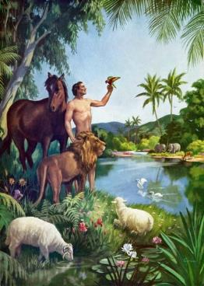

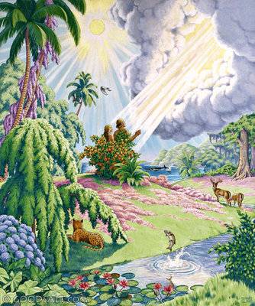
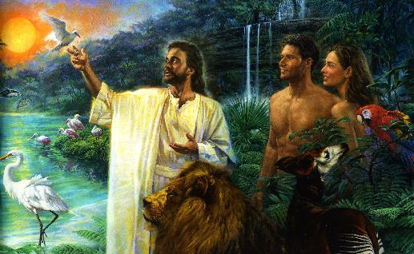
A TIME TO LEARN
“Then God blessed the seventh day and sanctified it, because in it He rested from all His work which God had created and made.” (Genesis 2:3)
The account of Creation ends with these words.
Adam was quite busy on Friday. On the other hand, Eve only enjoyed some hours of Friday with her husband.
Their first full day together was an especially blessed day. The Creator Himself sanctified the seventh day with His presence.
On that day, they learnt more about their Creator and the creation around them. By the end of the day, they were invited to spend another full
day with God on the next
Sabbath (in addition to their
daily evening meetings).
We still receive the same invitation every Sabbath. An invitation to spend a full day learning about our wonderful Creator.

Slide 4

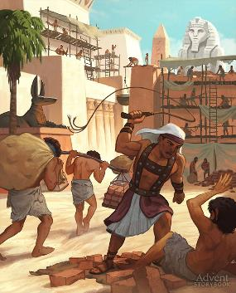
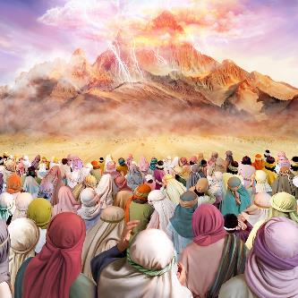
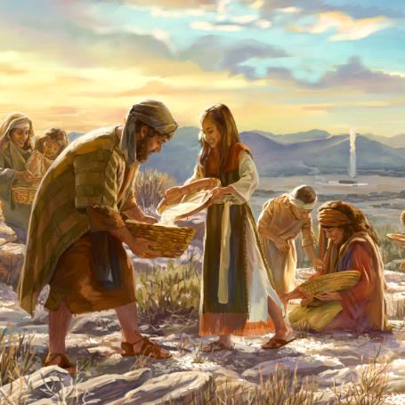
A TIME TO REDISCOVER
“See! For the Lord has given you the Sabbath; therefore He gives you on the sixth day bread for two days. Let every man remain in his place; let no man go out of his place on the seventh day.” (Exodus 16:29)
The people of Israel had been forced to work on Sabbath under the yoke of Egypt.
After liberating them, God wanted them to rediscover the Sabbath. He wanted them to rediscover who He is, how much He loved them, and the plans He had for them.
God used manna to teach them about the Sabbath. He performed a weekly double miracle:
1
He sent twice the usual amount of manna on Friday, and nothing at all on Sabbath
The manna that the people cooked on Friday was still good on Sabbath. However, the manna they tried to keep other days bred worms and stank
2
God is inviting us today to rediscover Him every Sabbath, to understand His character better, and to have a stronger relationship with Him.

Slide 5

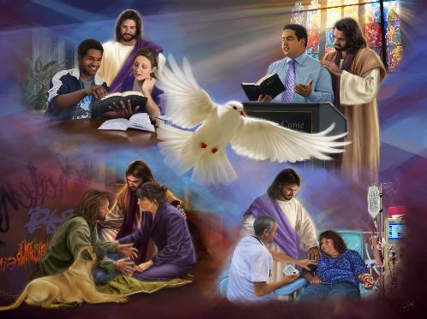
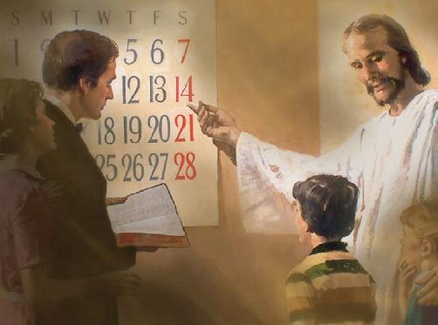
A TIME TO PRIORITIZE
“If you turn away your foot from the Sabbath, from doing your pleasure on My holy day, and call the Sabbath a delight, the holy day of the Lord honorable, and shall honor Him, not doing your own ways, nor finding your own pleasure, nor speaking your own words, then you shall delight yourself in the Lord; and I will cause you to ride on the high hills of the earth, and feed you with the heritage of Jacob your father.
The mouth of the Lord has spoken.” (Isaiah 58:13-14)
In Isaiah 58, God called His people to reconsider their priorities. They fasted and asked God to make them prosper, but they were also exploiting their workers and oppressing the defenseless (v. 1-5).
God explained that the right approach is the opposite. We should take care of others and help those in need first, then we will prosper (v. 6-12).
This comes with a call to enjoy the Sabbath in the company of God, leaving our self and our business aside (v. 13-14).
The Sabbath helps us to put God first and to give everything else its right priority.

Slide 6

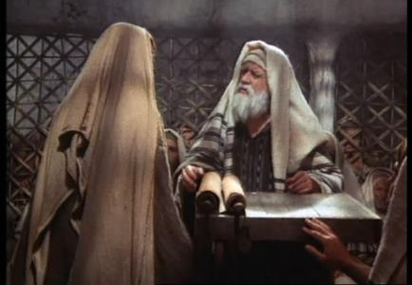
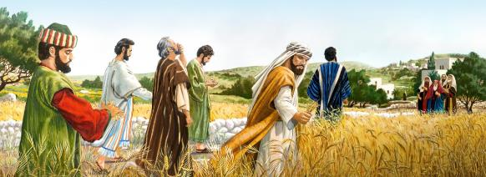
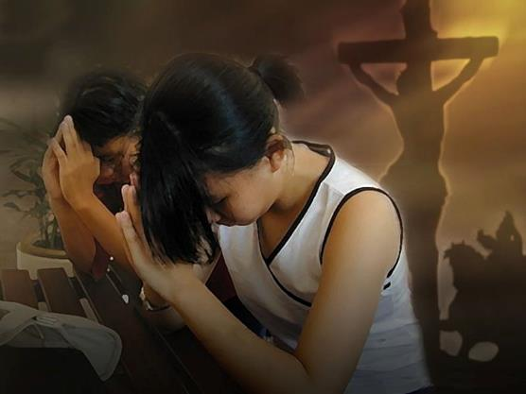
A TIME TO KNOW HIM
“And He said to them, ‘The Sabbath was made for man, and not man for the Sabbath. Therefore the Son of Man is also Lord of the Sabbath.’” (Mark 2:27-28)
The Law was read and interpreted every Sabbath in the synagogues. They wanted to understand the will of God better.
However, they tried to describe in detail what could and couldn’t be done on Sabbath in order to fulfill the Law. This way they turned the Sabbath in a burden.
Jesus used His actions and words to remind them of the true purpose of the Sabbath. It was made to become a blessing for us and for those around us.
We are encouraged to meet the Lord of the Sabbath more intimately on Sabbath. Our obedience should be the result of our gratitude for all He has done for us.

Slide 7

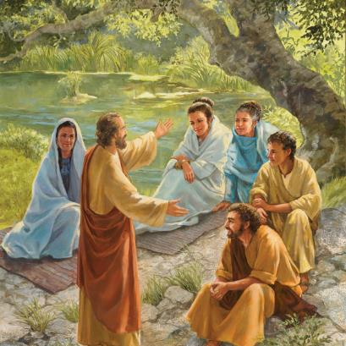
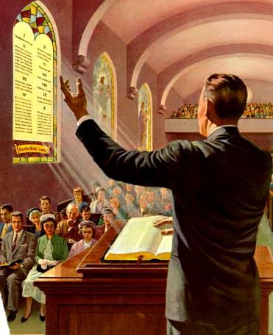
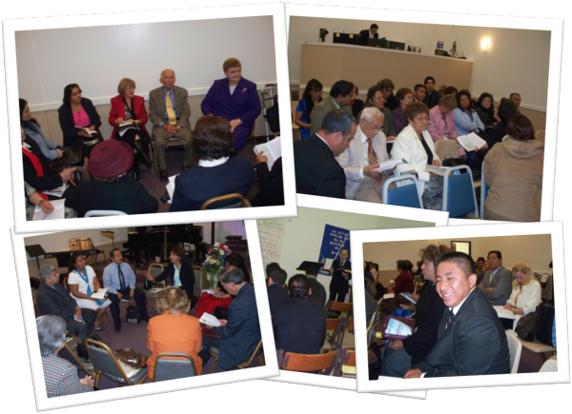
A TIME TO SHARE
“So when the Jews went out of the synagogue, the Gentiles begged that these words might be preached to them the next Sabbath.” (Acts 13:42)
The first Christians shared the gospel in their Sabbath meetings. They proved that Jesus was the Messiah with the Scriptures and their personal testimony
(Acts 13:14-45; 16:13-14; 17:1-5; 18:4).
We have the opportunity to share what we know about the Scriptures and Jesus during the Bible Study in our Sabbath School classes.
Besides, the fundamental truths of our faith can also be shared during the public biblical preaching on Sabbath.

Slide 8

E.G.W. (Testimonies for the Church, book 6, cp. 44, p. 368)
“God teaches that we should assemble in His house to cultivate the attributes of perfect love. This will fit the dwellers of earth for the mansions that Christ has gone to prepare for all who love Him. There they will assemble in the sanctuary from Sabbath to Sabbath, from one new moon to another, to unite in loftiest strains of song, in praise and thanksgiving to Him who sits upon the throne, and to the Lamb for ever and ever.”

