Slide 1
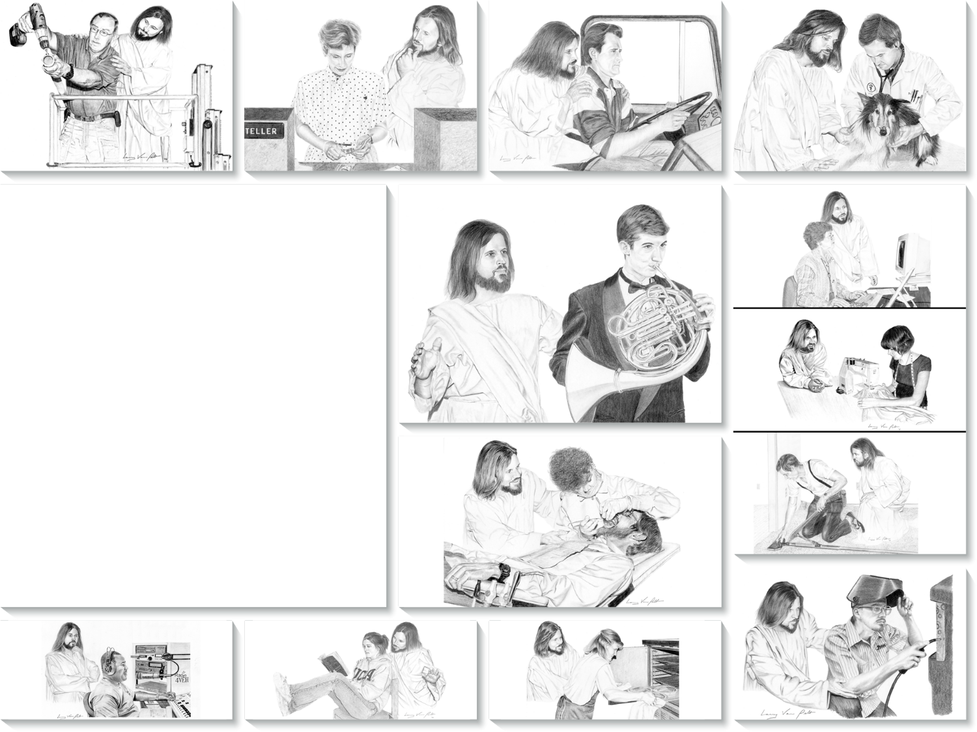
THE CHRISTIAN AND WORK
Lesson 11 for
December 12, 2020

Slide 2
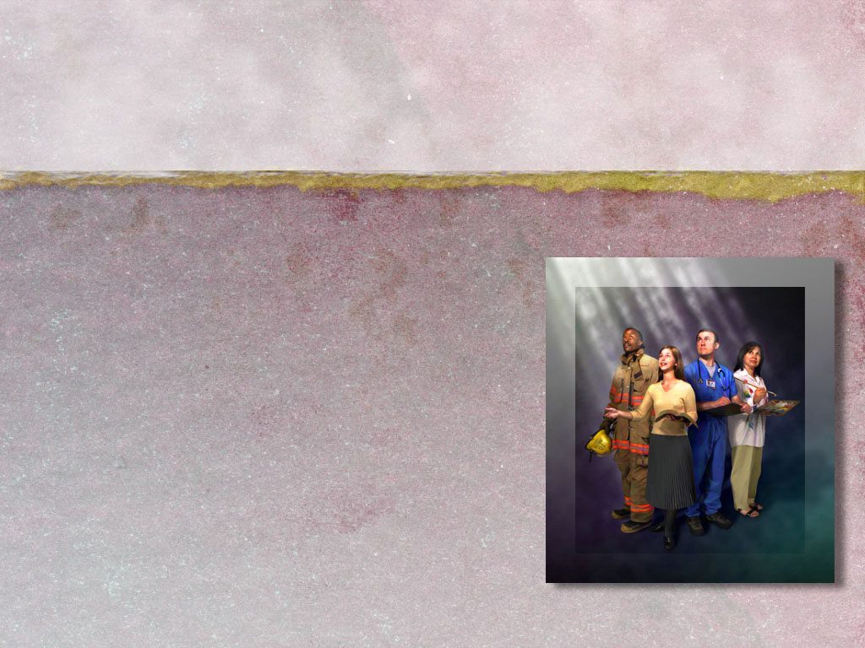
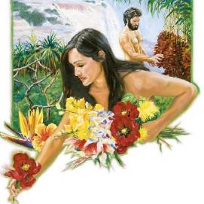
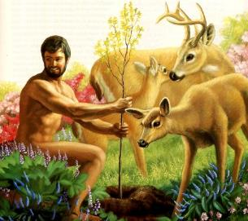







Work may be seen as a curse, a consequence of sin (Genesis 3:19).
However, according to Genesis 2:15, work is not a curse. It already existed prior to sin.
So, when we work, we should work for the Lord’s glory and honor, we should exercise and reinforce the skills He has given us, and we should do all our work with a willing spirit and passionate heart.
Work:
What is it?
How to do it?
Christians and work:
Seeking excellence
Work and faith
Responsible work

Slide 3

E.G.W. (The Adventist Home, cp. 3, p. 27)
“To Adam was given the work of caring for the garden. The Creator knew that Adam could not be happy without employment. The beauty of the garden delighted him, but this was not enough. He must have labor to call into exercise the wonderful organs of the body. Had happiness consisted in doing nothing, man, in his state of holy innocence, would have been left unemployed. But He who created man knew what would be for his happiness; and no sooner had He created him than He gave him his appointed work.”

Slide 4



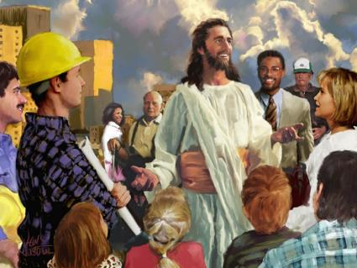
WHAT IS WORK?
“and also that every man should eat and drink and enjoy the good of all his labor—it is the gift of God.” (Ecclesiastes 3:13)
We usually answer to the question “What do you do?” by explaining what our job is: “I’m a farmer”, “I’m a baker”, “I am a housekeeper”, “I am a lawyer”…
For some people, their work is just a job to make a living. For other people, their work is their calling, or a chance to use their skills in a beneficial way.
An important task in education is to help the students to find out which is the most suitable profession for them according to their skills.
For Christians, work is more than just a job. It’s a way to receive God’s blessings, and an opportunity to be a blessing in this world and to testify of His love.

Slide 5

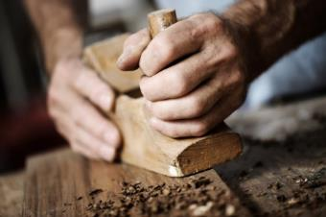
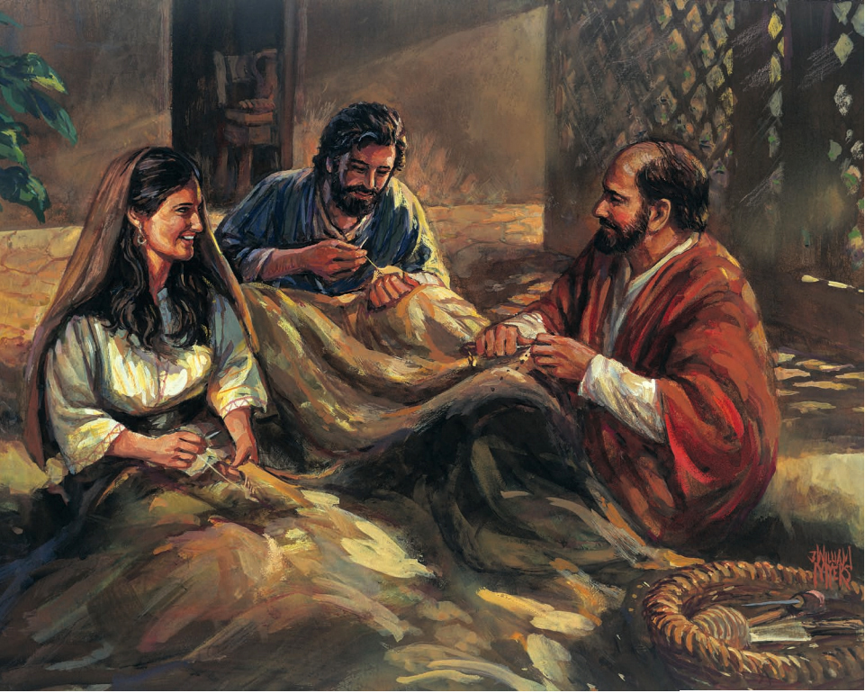

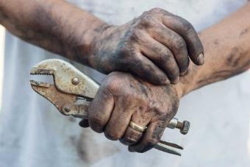

HOW TO DO OUR WORK?
“Whatever your hand finds to do, do it with your might;” (Ecclesiastes 9:10)
In the Bible, work is connected to the hands. Actually, hands are used even in the most intellectual work. Replace “hands” with “work” when reading the following texts.
Deuteronomy 16:15
Nehemiah 6:9
Proverbs 10:4
Proverbs 21:25
Ecclesiastes 9:10
Jeremiah 1:16
Ephesians 4:28
2 Thessalonians 3:10
God blesses our work
God gives us strength and health to carry out our work
Diligent workers prosper
Lazy people are annoyed by work
We should work according to our strength
We should avoid work that may incite us to sin
Work gives us the chance to help those in need
Work is a moral obligation

Slide 6

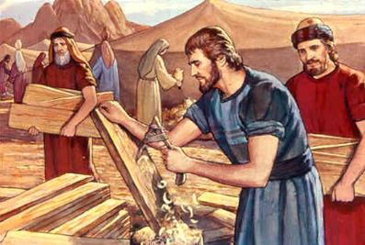
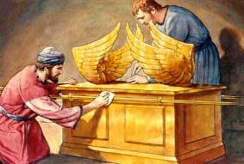
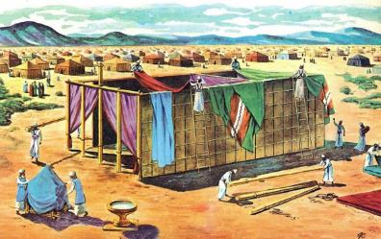
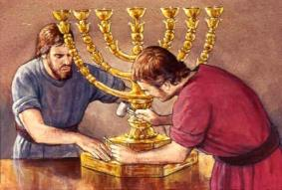
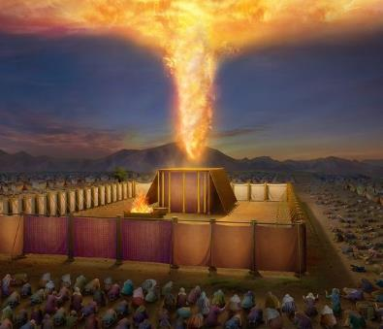
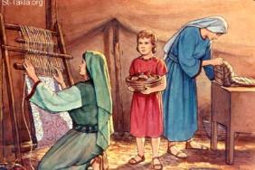
SEEKING EXCELLENCE
“All the skilled artisans among those doing the work made
the tabernacle.” (Exodus 36:8 CSB)
God planned the construction of a tent to meet with Israel. He would not be happy with anything but excellent work.
God gave Moses instructions on the structure of the Sanctuary, the materials to use, and the exact shape of every piece of furniture–about 150 detailed descriptions.
God also filled skillful people with the Holy Spirit, so they could carry out the work and also teach others (Exodus 31:3; 35:34; 36:2).
This shows that God likes it when we do our work excellently, always according to our possibilities.
He expects us to do our best work by making the most of our talents, skills, time, and education.

Slide 7

“The skillful touch of the physician’s hand, his power over nerve and muscle, his knowledge of the delicate organism of the body, is the wisdom of divine power, to be used in behalf of the suffering. The skill with which the carpenter uses the hammer, the strength with which the blacksmith makes the anvil ring, comes from God. He has entrusted men with talents, and He expects them to look to Him for counsel. Whatever we do, in whatever department of the work we are placed, He desires to control our minds that we may do perfect work.”
E.G.W. (Palabras de vida del Gran Maestro, pg. 283)

Slide 8

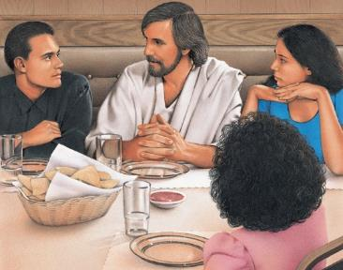
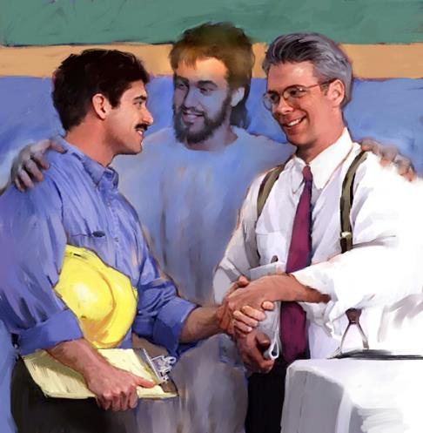
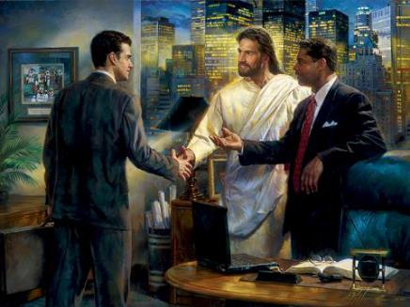
WORK AND FAITH
“And whatever you do, do it heartily, as to the Lord
and not to men,” (Colossians 3:23)
We are new creatures in Christ (2 Corinthians 5:17). This is reflected in all the aspects of our lives, including our work.
Faith cannot be left aside while working.
The fruit of the Spirit in us will help us to do our work diligently, and to treat everyone with kindness and respect (Galatians 5:22-23).
Then, those around us will see something special in the way we do our daily work. This will be an opportunity to share our faith.

Slide 9

E.G.W. (Christ’s Object Lessons, cp. 25, p. 349)
“Religion and business are not two separate things; they are one. Bible religion is to be interwoven with all we do or say. Divine and human agencies are to combine in temporal as well as in spiritual achievements. They are to be united in all human pursuits, in mechanical and agricultural labors, in mercantile and scientific enterprises. There must be co-operation in everything embraced in Christian activity.”

Slide 10



RESPONSIBLE WORK
“Nothing is better for a man than that he should eat and drink, and that his soul should enjoy good in his labor. This also, I saw, was from the hand of God.” (Ecclesiastes 2:24)
Christians are called to be good stewards in every aspect of life. Temperance is key.
No matter our current situation, work should always have the right priority in our lives.
There must be a healthy balance between work, family, spiritual life, and leisure. It’s important to remember that God must be present in all the aspects of our lives.
Therefore, work must not become an idol. It cannot be separated from our spiritual life either. Our relationship with God must not be interrupted by our work, our relatives, or leisure.

Slide 11

E.G.W. (Christ’s Object Lessons, cp. 25, p. 346)
“Whatever the line of work in which we engage, the word of God teaches us to be ‘not slothful in business; fervent in spirit; serving the Lord.’ ‘Whatsoever thy hand findeth to do, do it with thy might,’ ‘knowing that of the Lord ye shall receive the reward of the inheritance; for ye serve the Lord Christ.’ Romans 12:11;
Ecclesiastes 9:10; Colossians 3:24.”

