Slide 1
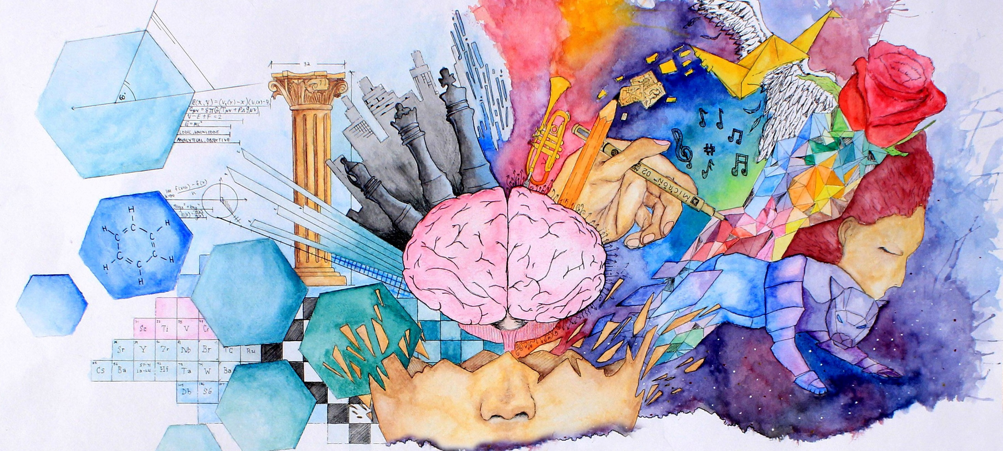
EDUCATION IN ARTS
AND SCIENCES
Lesson 10 for December 5, 2020

Slide 2


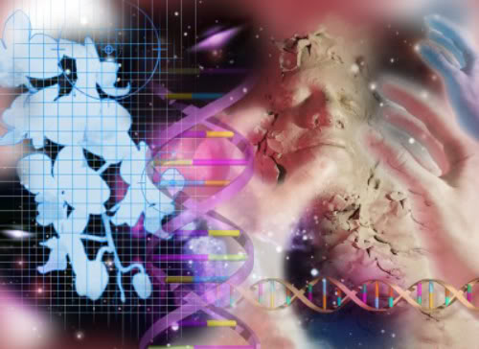







Present-day education assumes that God does not exist or does not take part in the natural processes.
This assumption rejects any supernatural phenomenon, the idea of a past without death, or that the Universe was created suddenly by an almighty God.
As Christians, our education must include those concepts. They will help us to make the most of our education in arts and sciences.
The foundation of education:
  God and education in sciences
  God and education in arts
Education in arts and sciences:
  Avoiding common mistakes
  Seeking excellence
Conflicts between faith and science

Slide 3


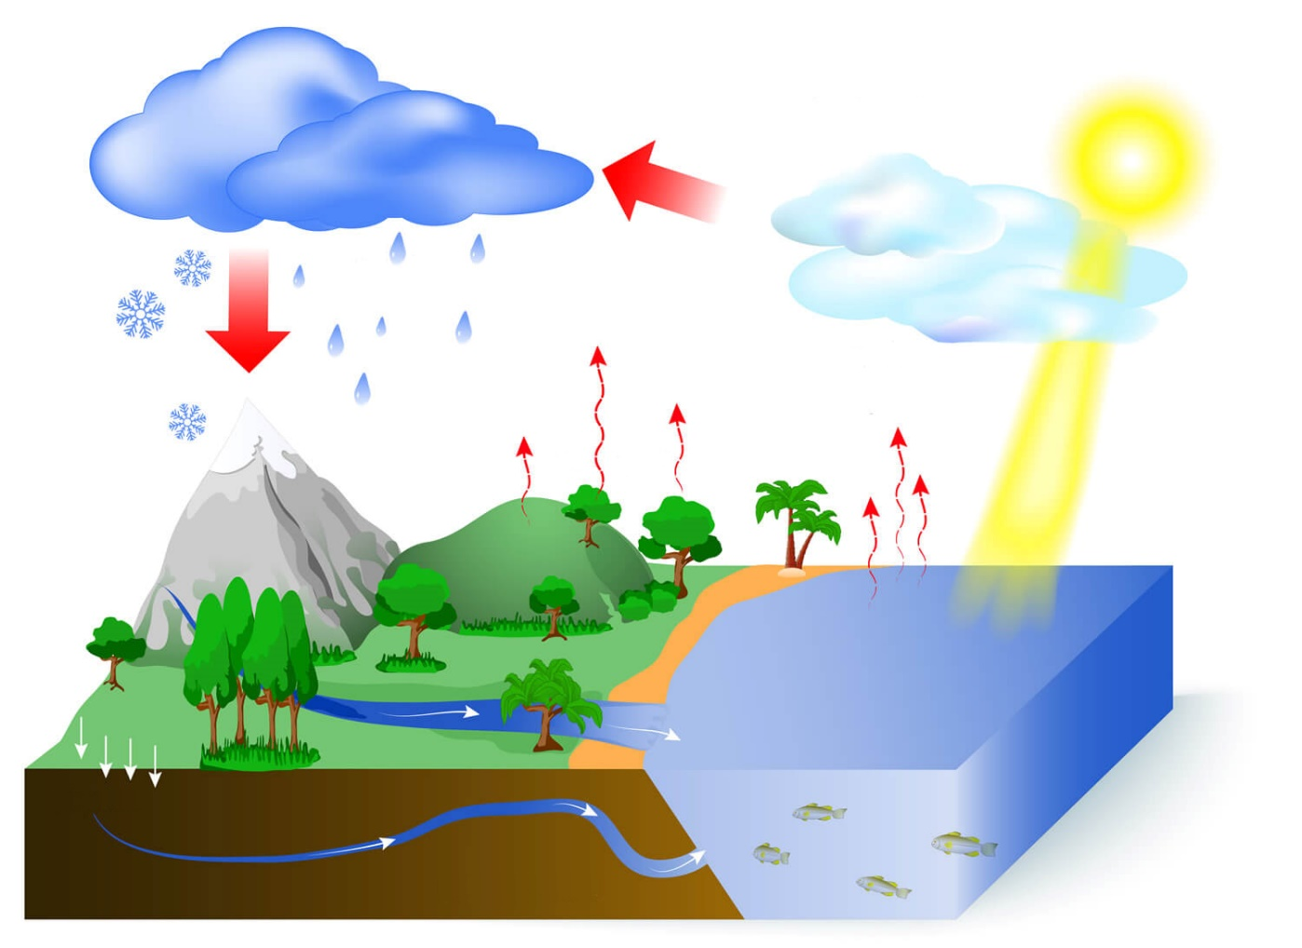
GOD AND EDUCATION IN SCIENCES
“For You formed my inward parts; You covered me in my mother’s womb. I will praise You, for I am fearfully and wonderfully made; marvelous are Your works, and that my soul knows very well.” (Psalm 139:13-14)
When we study how God designed life in genetics and the conception process, we see the wonders of His kind love. For example, He decided that the fetus would grow close to their mother's heart, and that the mother would be able to see how the baby grows within her (it's impossible for her to ignore them).
The more we learn about the laws of nature God established, the more reasons we have to praise Him for His wisdom.
As Paul said, we “are without excuse” to deny the existence of God after having studied nature (Romans 1:20).

Slide 4

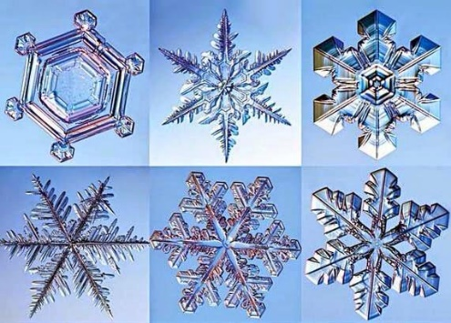


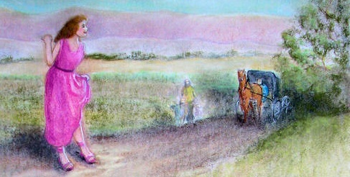
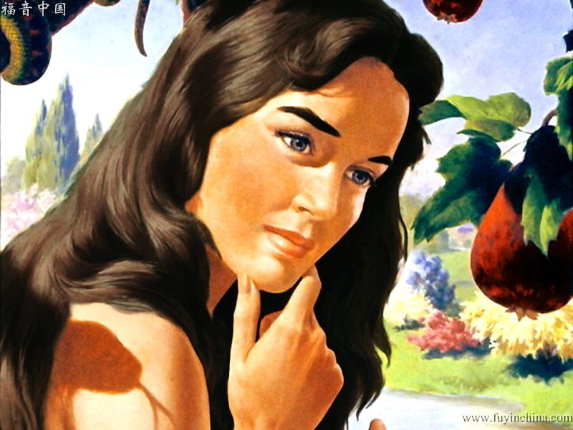
GOD AND EDUCATION IN ARTS
“He has made everything beautiful in its time.” (Ecclesiastes 3:11)
Sin entered the world thousands of years ago. However, we can still find beauty in nature. Even in the microscopic world, like in the symmetry of a snowflake.
God is the source of beauty. He loves physical and spiritual beauty. He values the beauty of a converted character, and He wants to be worshipped “in the beauty of holiness.” (Salmo 96:9)
Nevertheless, not everything beautiful is also good. Solomon warned us about sinful people: “Do not lust after her beauty in your heart”, because he/she will drag you to sin (Proverbs 6:25).
Eve learnt this the hard way. Not all that is “pleasant to the eyes” and “desirable” is also good (Genesis 3:6).

Slide 5

“He who placed the pearls in the ocean and the amethyst and the chrysolite among the rocks is a lover of the beautiful. The sun rising in the heavens is the representative of Him who is the light and life of all that He has made. All the brightness and beauty that adorn the earth and light up the heavens speak of God.”
E.G.W. (My Life Today, June 20)

Slide 6



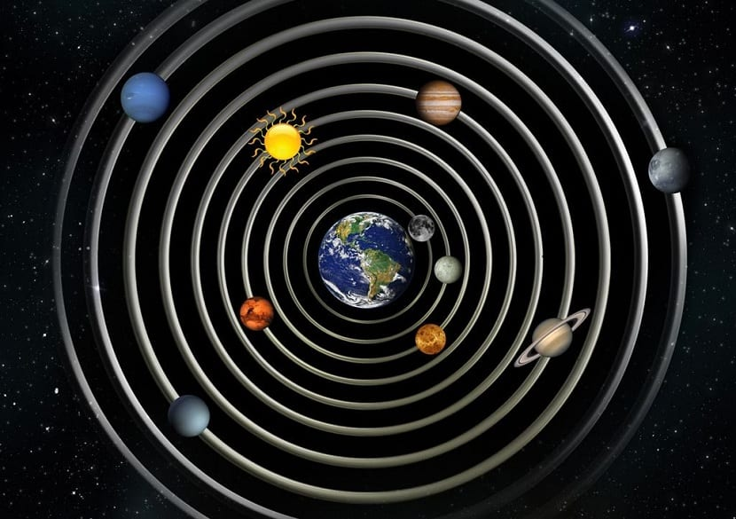

AVOIDING COMMON MISTAKES
“O Timothy! Guard what was committed to your trust, avoiding […] contradictions of what is falsely called knowledge.” (1 Timothy 6:20)
Because of the innate evil in sinful humans, science and art have been used for wicked purposes too frequently.
The scientific discoveries that make our lives easier have also been used for warlike purposes. Art forms like painting, photography, or cinema have been corrupted by avarice, the love of money, or self-satisfaction.
On the other hand, science has not always been completely right. For example, the experts believed the Earth was the center of our universe many years ago.
Therefore, Paul warned us from having unquestioning faith in our knowledge, but to pursue “righteousness, godliness, faith, love, patience, gentleness.” (1Tim. 6:11)

Slide 7

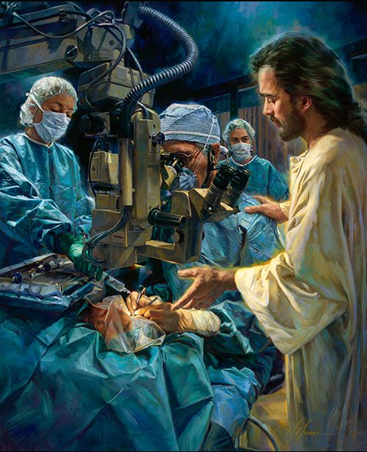
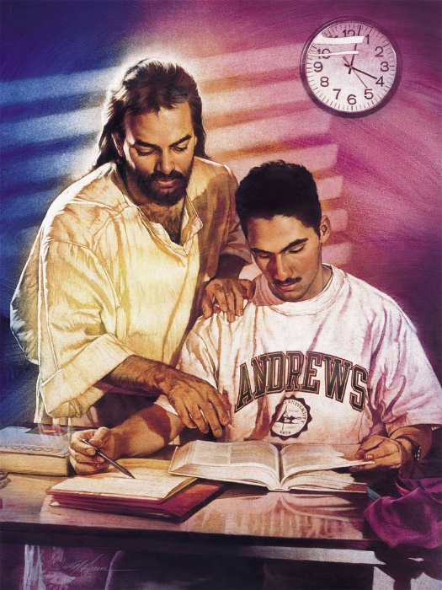
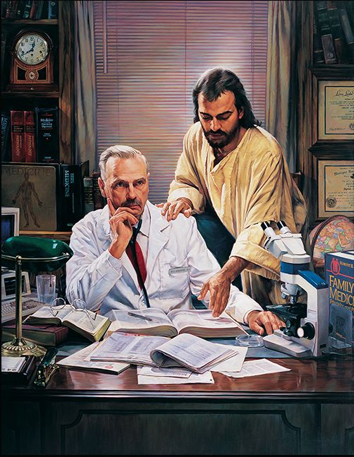
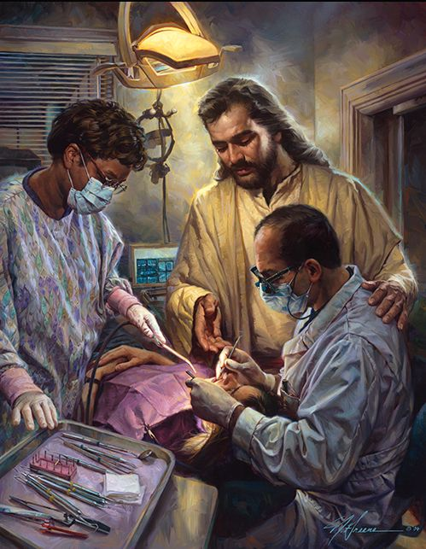
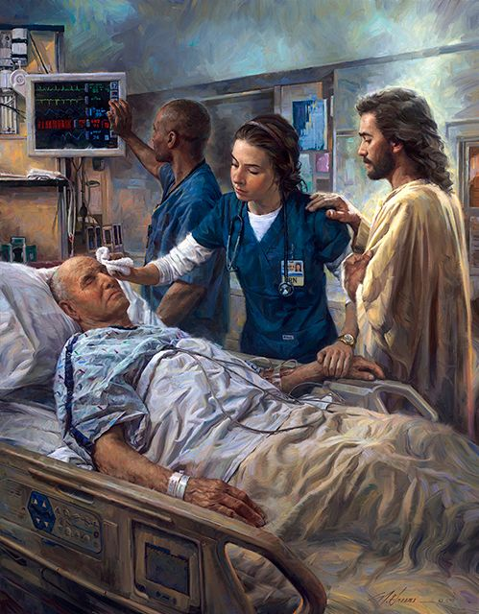
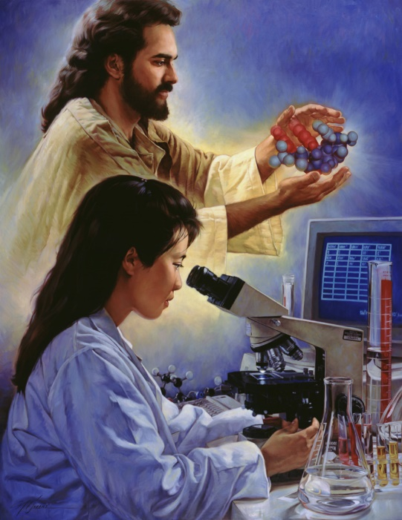
SEEKING EXCELLENCE
“But earnestly desire the best gifts. And yet I show you a more excellent way.” (1 Corinthians 12:31)
Students of the arts and sciences utilize their talents to gain knowledge and to pursue excellence in their studies. We can be capable of artistic brilliance and scientific breakthroughs because of knowledge and ability.
True excellence can be achieved by using all that knowledge in a wise way. And “the fear of the Lord is the beginning of knowledge.”
(Proverbs 1:7)
God gives us the Holy Spirit so we can achieve wisdom, knowledge, and artistry (Exodus 35:31).
This way we’ll be able to distinguish good from evil, and to apply our scientific and artistic knowledge correctly.

Slide 8

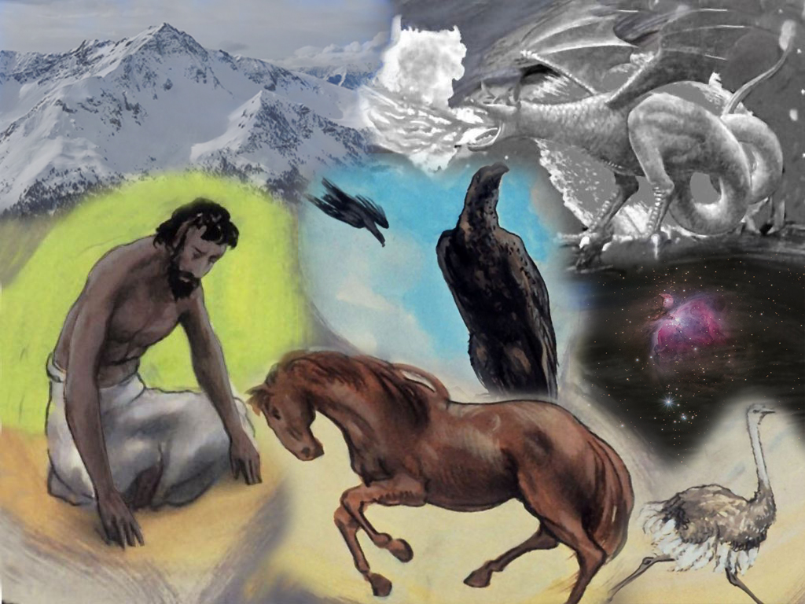
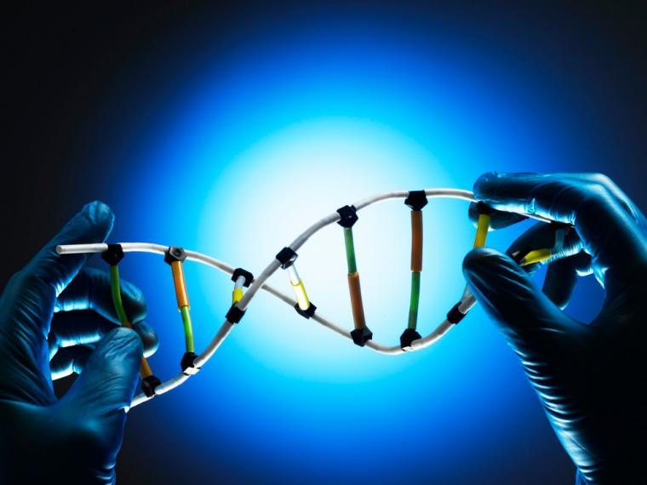
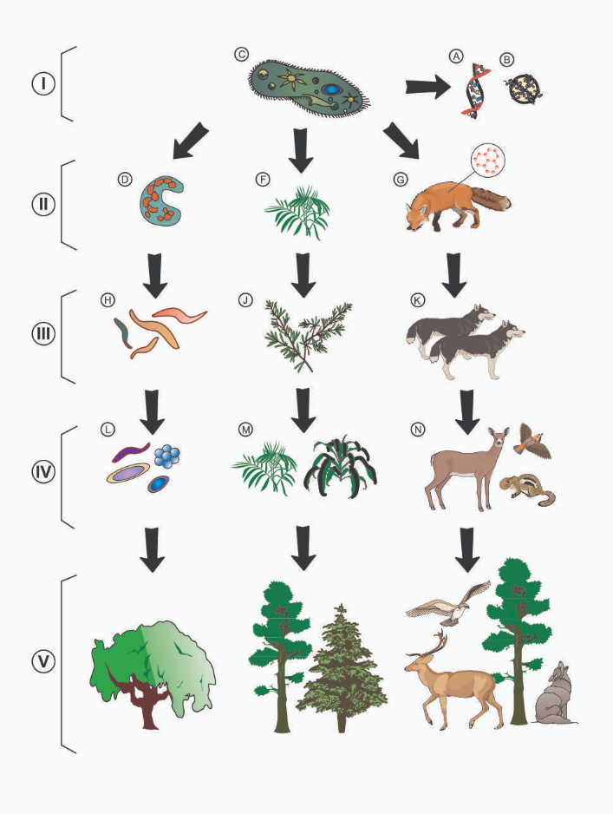
CONFLICTS BETWEEN FAITH AND SCIENCE
“Where were you when I laid the foundations of the earth? Tell Me, if you have understanding.” (Job 38:4)
The current scientific discoveries show that there’s an intelligent design in us and in everything around us. This is a clear sign of God’s creative hand for those who want to accept it.
However, the current philosophy of science rules out the existence of God. Therefore, many scientists believe that the beautiful masterworks of nature were made by chance.
This philosophy tries to build a wall between faith and science that doesn’t exist. Christians believe that God created all things, and that He sustains everything. This belief is compatible with every scientific discovery that is interpreted correctly.

Slide 9

“In true science there can be nothing contrary to the teaching of the word of God, for both have the same Author. A correct understanding of both will always prove them to be in harmony. Truth, whether in nature or in revelation, is harmonious with itself in all its manifestations. But the mind not enlightened by God’s Spirit will ever be in darkness in regard to His power. This is why human ideas in regard to science so often contradict the teaching of God’s word.”
E.G.W. (Testimonies for the Church, book 8, cp. 42, p. 258)

