Slide 1
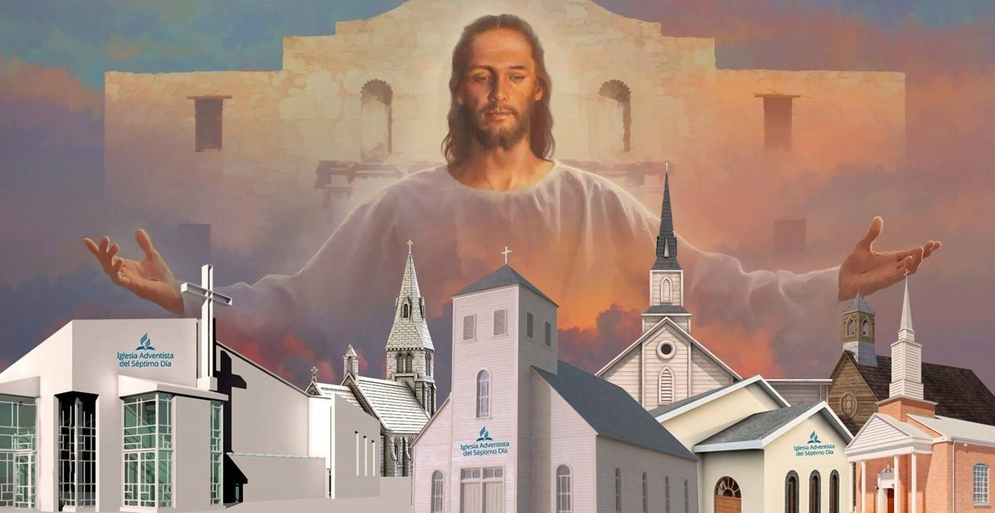
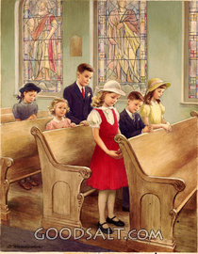
THE CHURCH AND EDUCATION
Lesson 9 for
November 28, 2020

Slide 2

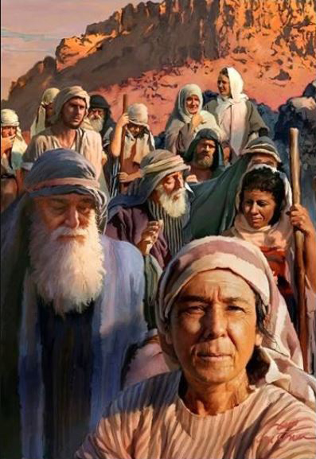
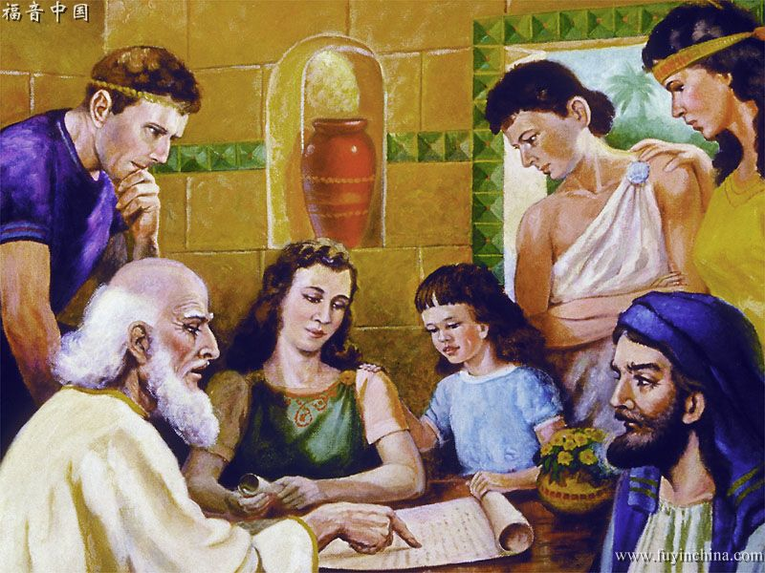
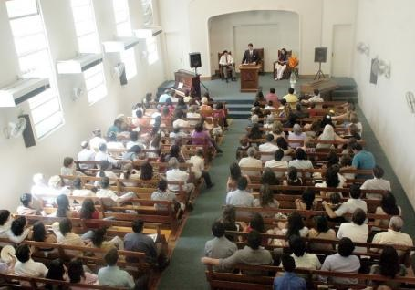





Before Jesus came to Earth, the people of God was made up of mainly one ethnic group, the people of Israel.
Jesus established a new model of God’s people, the Church. The church gathered in small groups at home initially.
The church is a university for those perishing in ignorance and spiritual darkness, a university in which we are all called to enroll as lifelong scholars-in-residence, learning from Jesus of Nazareth, the Master Teacher.
Seeing as Jesus does
Living as Jesus taught us to
Caring as Jesus did
Seeking the truth which is Jesus
Sharing Jesus

Slide 3

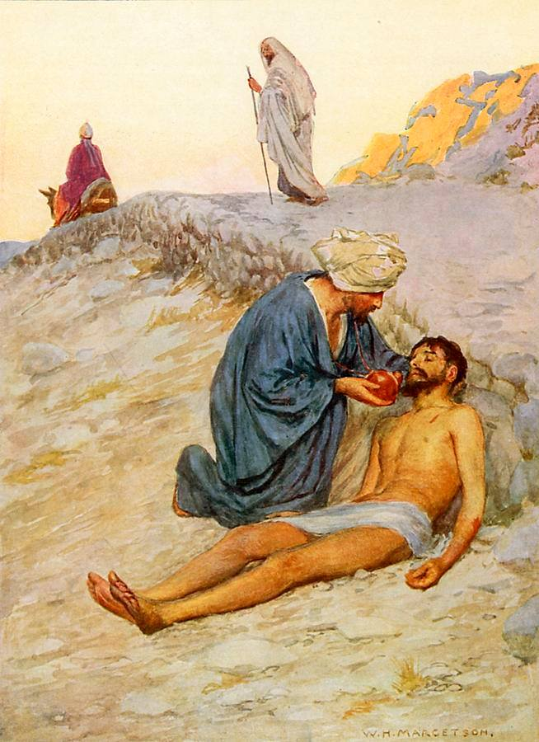
SEEING AS JESUS DOES
“But a certain Samaritan, as he journeyed, came where he was. And when he saw him, he had compassion.” (Luke 10:33)
What can make us “have compassion” of others?
Jesus sees the needs in the people around us, and He encourages us to help them.
The church has been blessed with great doctrinal truths that help us to better understand the promises and will of God. However, just knowing those truths is not enough to treat others kindly and without any prejudice.
Seeing as Jesus does involves fixing our eyes on the Cross and not on ourselves. This perspective will help us to see the value that God sees in every human being (Philippians 2:3-4).

Slide 4

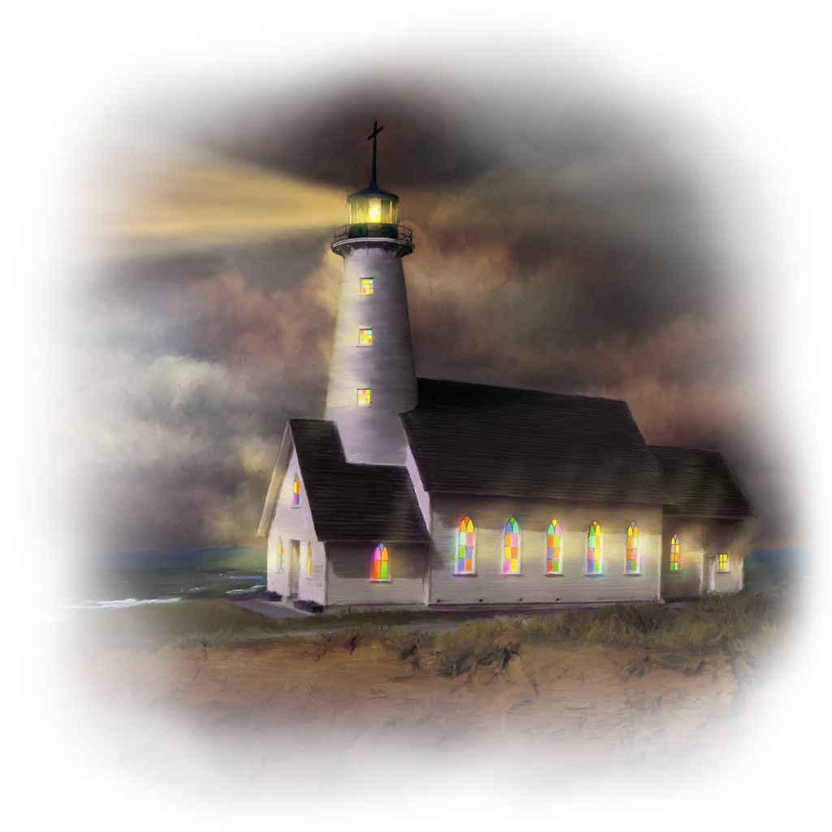
LIVING AS JESUS TAUGHT US TO
“Let your light so shine before men, that they may see your good works and glorify your Father in heaven.” (Matthew 5:16)
Jesus encouraged us to shine like a city on a hill in the darkness of the night.
We live in a world that has been obscured by sin, moral decline, and spiritual darkness. The mission of the church is to bring light and hope to every corner of the world.
How should the members of the body of Christ be in order to reflect God’s kindness like an effective light (see Matthew 5:3-12)?
Humble
Sensitive
Meek
Righteous
Merciful
Pure
Peacemakers
Upright
Resilient

Slide 5

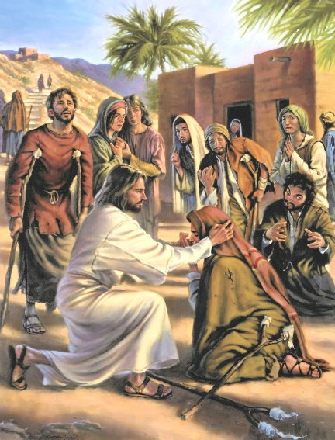
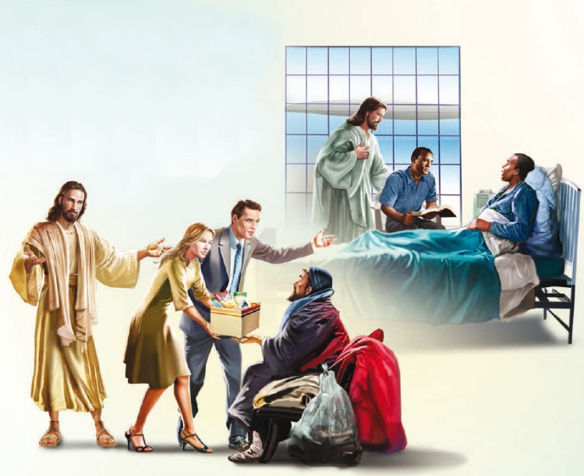

CARING AS JESUS DID
“A new commandment I give to you, that you love one another; as I have loved you, that you also love one another.” (John 13:34)
The mission of Jesus–which is outlined in Luke 4:18-19–consisted of caring for the poor, helping the heartbroken, healing the sick, and liberating the captives from sin.
We are called to follow His example and to love each other. We are also called to put that love into practice, caring for others and providing for their physical and spiritual needs to the best of our ability.
We are disciples of the Teacher, and we should constantly show the same empathy He showed, always working for their salvation.

Slide 6

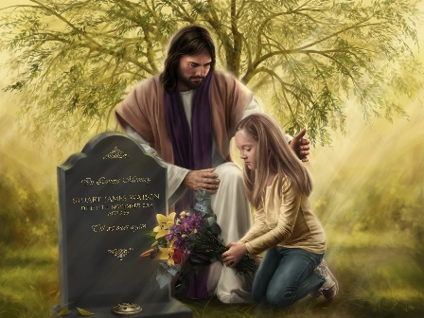

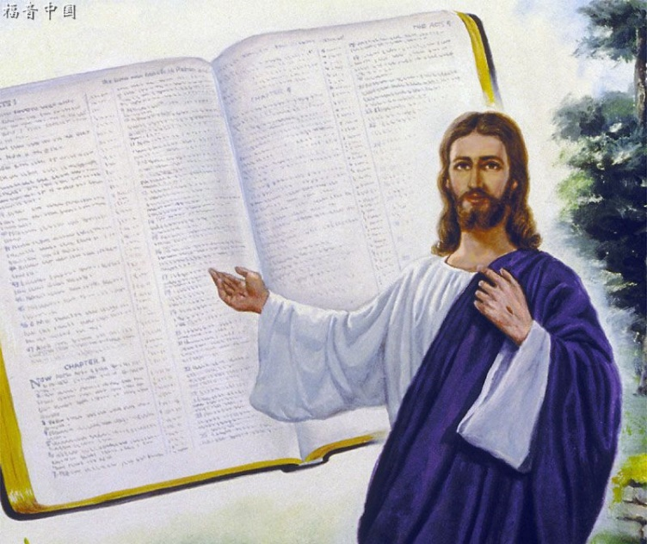
SEEKING THE TRUTH WHICH IS JESUS
“Lead me in Your truth and teach me, for You are the God of my salvation; on You I wait all the day.” (Psalm 25:5)
God created us with an innate sense of curiosity, and an insatiable desire for learning more. “The eye is not satisfied with seeing, nor the ear filled with hearing.” (Ecclesiastes 1:8; 3:11)
We seek answers to the most transcendental questions: Who are we? Why are we here? How should we live? What happens when we die? Why is there evil and suffering?
There’s no better source of information to answer these questions than He who is the absolute truth. “Jesus said to him, ‘I am the way, the truth, and the life. No one comes to the Father except through Me.’” (John 14:6).
Christian education involves leading people to the truth by looking for answers in the Bible, the book that contains the truth that Jesus shared.

Slide 7

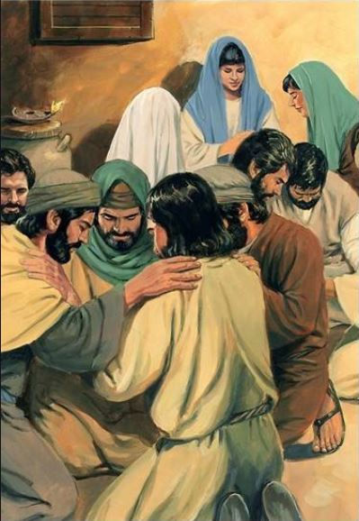
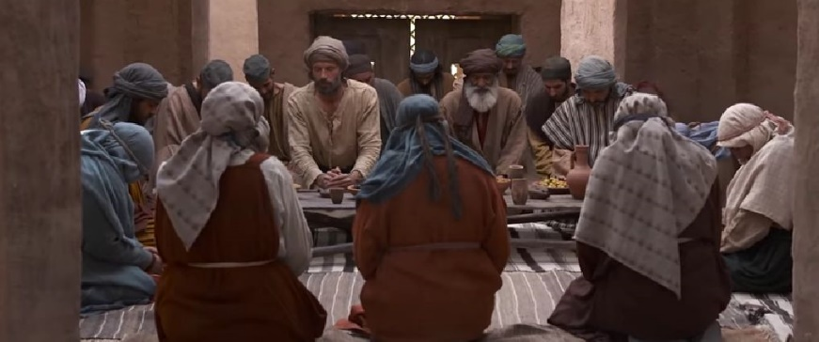
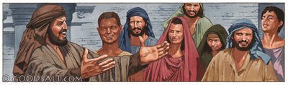
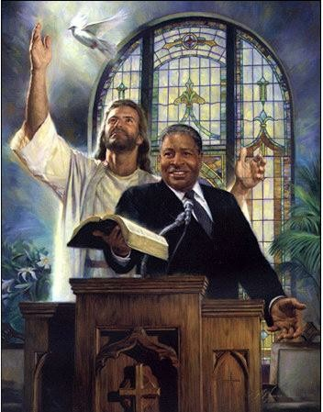
SHARING JESUS
“For where two or three are gathered together in My name, I am there in the midst of them.” (Matthew 18:20)
The first Christians gathered in small groups at home.
All or some of the groups in a city gathered occasionally for combined events (for example, to listen to Paul’s preaching
[Acts 20:7]).
Christians shared their faith, grew together in the truth, and put the Gospel into practice in those groups. Those were open groups, and they were eager to share the truth with whoever was willing to accept it.
The purpose of every church is to share Jesus, no matter its size. Every church is an educational center where everyone can learn and teach about Jesus.

Slide 8

E.G.W. (This Day With God, January 3)
“Let little companies meet together
to study the Scriptures. You will lose nothing by this, but will gain much. Angels of God will be in your gathering, and as you feed upon the Bread of Life, you will receive spiritual sinew and muscle. You will be feeding, as it were, upon the leaves of the tree of life. By this means only can you maintain your integrity.”

Slide 9

“We may claim to be followers of Christ, we may claim to believe every truth in the word of God; but this will do our neighbor no good unless our belief is carried into our daily life. Our profession may be as high as heaven, but it will save neither ourselves nor our fellow men unless we are Christians. A right example will do more to benefit the world than all our profession.”
E.G.W. (Christ’s Object Lessons, cp. 2, p. 383)

