Slide 1

EDUCATION AND REDEMPTION
Lesson 8 for November 21, 2020

Slide 2

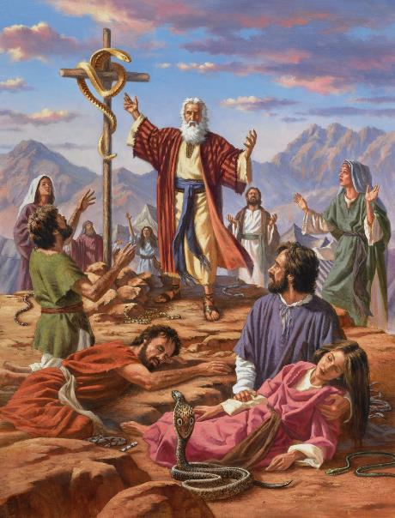
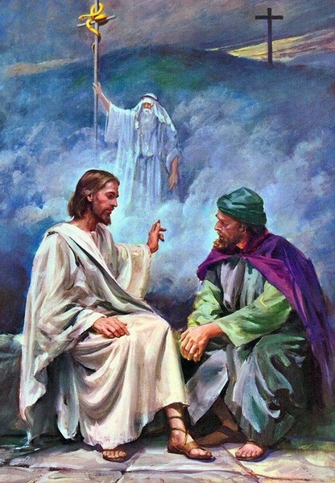
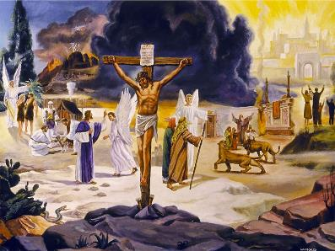





The Bible tells the story of humankind from God’s perspective.
In the Bible we see how God educated His people and taught them about His grace and His plan to redeem them.
Redeeming education
Jesus as Teacher
The Bible as teacher
Humans as teachers
The Holy Spirit as Teacher

Slide 3

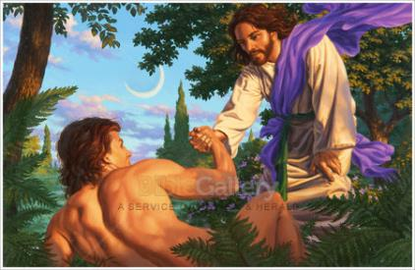

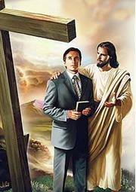

REDEEMING EDUCATION
“In the day that God created man, He made him in the likeness of God.” (Genesis 5:1)
Human beings are the only creatures on Earth that were created in the image of God (Genesis 1:27).
Adam and Eve were supposed to transmit this image to their children. However, sin made their children to be born “in their likeness” and not in God’s likeness (Genesis 5:3).
The image of God has been gradually distorted with each human generation. The purpose of God’s education is to restore the image of God in us thanks to the Redemption plan.
This plan covers the whole human history, since sin entered the world to the new Creation, including Jesus’ incarnation. We’ll keep studying the plan of Redemption for all eternity.

Slide 4

“To restore in man the image of his Maker, to bring him back to the perfection in which he was created, to promote the development of body, mind, and soul, that the divine purpose in his creation might be realized—this was to be the work of redemption. This is the object of education, the great object of life.”
E.G.W. (Education, cp. 1, p. 15)

Slide 5
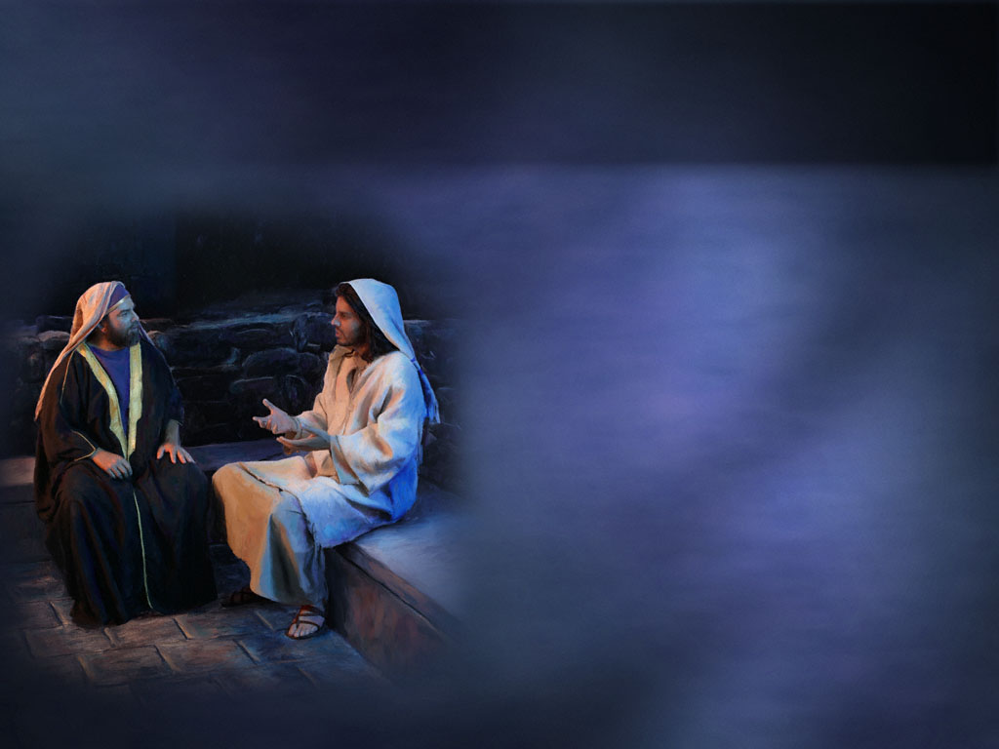
JESUS AS TEACHER
Isaiah 11:1-9 contains a surprising prophecy about the Messiah. Jesus is introduced as Teacher in this passage:
“Rabbi, we know that You are a teacher come from God;” (John 3:2)
He will have Spirit of wisdom
He will have Spirit of counsel
He will have Spirit of knowledge
He will judge with righteousness
He will decide with equity
This will be the final result of His work as Teacher: “the earth shall be full of the knowledge of the Lord.”
Nicodemus was one of the first people that acknowledged Jesus as Teacher (Rabbi).
Jesus explained him that His gift of teaching was a gift from God
(John 3:11-12). God prepares the teachers to carry out His work.

Slide 6

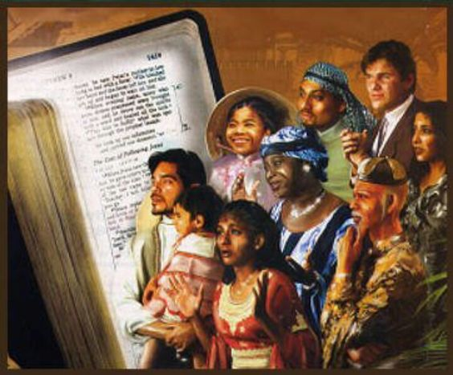

THE BIBLE AS TEACHER
“They have Moses and the prophets; let them hear them.” (Luke 16:29)
Paul introduced the Bible to Timothy as the textbook par excellence: “[it] is profitable for doctrine, for reproof, for correction, for instruction in righteousness.” (2 Timothy 3:16). Each one of its parts has something we can learn from.
THE OLD TESTAMENT
Pentateuch
How to live according to God’s plan for us
First prophets
Latter prophets
How Israel practiced these principles
Writings
The mistakes of Israel and how to avoid them
THE NEW TESTAMENT
Good and bad practical examples of education
Historical books
Paul’s and others’ letters
They contain much educational content, and explain how to teach it
Revelation
Practical applications of the teachings
An overview of the educational development and its ultimate goal

Slide 7

E.G.W. (This Day With God, April 28)
“The Bible is the textbook, and it is to be searched diligently—not as we would read a book among many books. It must be to us the book that meets the wants of the soul. This book will make the man who studies and obeys it wise unto salvation.”

Slide 8

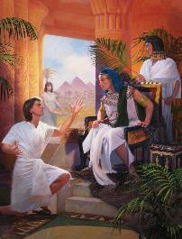
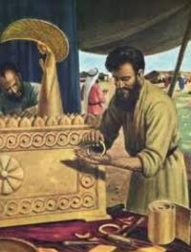
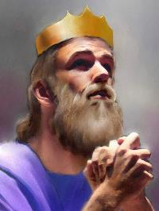
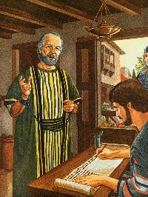
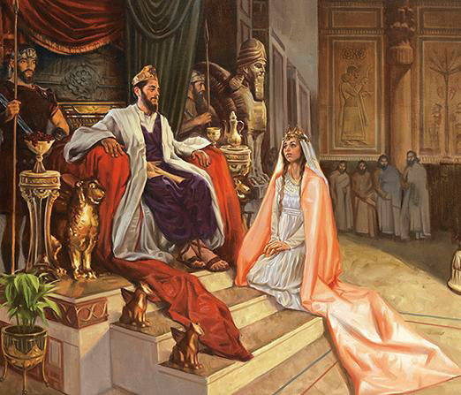

HUMANS AS TEACHERS
There are many people in the Bible who lived in a responsible way and worked to help others. Some of those wise people were Joseph, Aholiab, David, Ethan, Ahithophel, Hushai, Agur, Lemuel, Gamaliel, and Paul.
“The heart of the wise teaches his mouth, and adds learning to his lips.” (Proverbs 16:23)
Without a doubt, the most outstanding of them was Solomon. He wrote about plants and animals, and composed proverbs and songs. His writings explain how to put all knowledge into practice (that is, to be wise).
He encouraged us to pursue wisdom and to use it to teach others. This way we’ll be agents that God will use to teach His people (Proverbs 9:9-10).

Slide 9


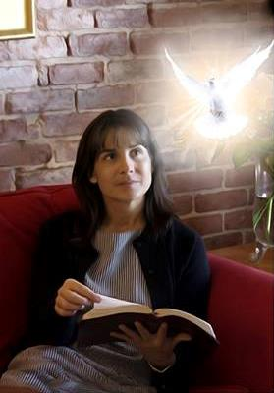
THE HOLY SPIRIT AS TEACHER
“But the Helper, the Holy Spirit, whom the Father will send in My name, He will teach you all things, and bring to your remembrance all things that I said to you.” (John 14:26)
Before Jesus ascended, He promised that He would send the Holy Spirit to continue His teaching work.
He leads us to all truth, and teaches us what we should say, when and how.
His education does not rely “on human wisdom, but on God’s power.” It does not follow “the wisdom of this age” but teaches “God’s wisdom”
(1 Corinthians 2:5-7 NIV).
The Holy Spirit can teach us “even the deep things of God.” (v. 10)
How deep will that education be? How much knowledge will those who are guided by the Spirit acquire?

Slide 10

“The youth should be learners for the next world. Perseverance in the acquisition of knowledge, controlled by the fear and love of God, will give them an increased power for good in this life, and those who have made the most of their privileges to reach the highest attainments here, will take these valuable acquisitions with them into the future life. They have sought and obtained that which is imperishable.”
E.G.W. (Fundamentals of Christian Education, cp. 2, p. 49)

