Slide 1
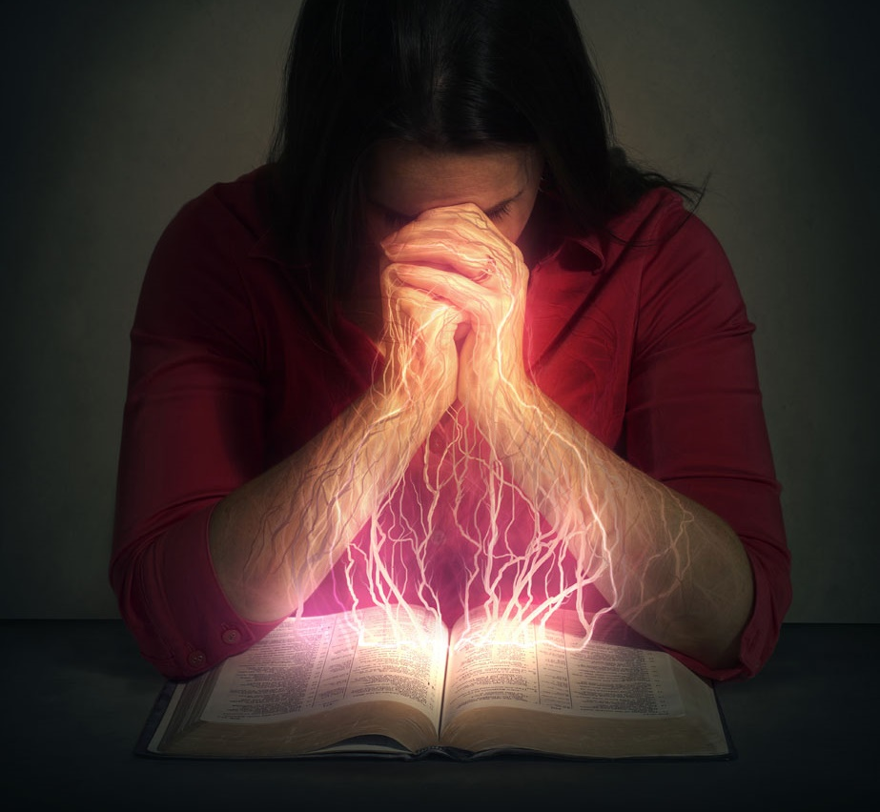
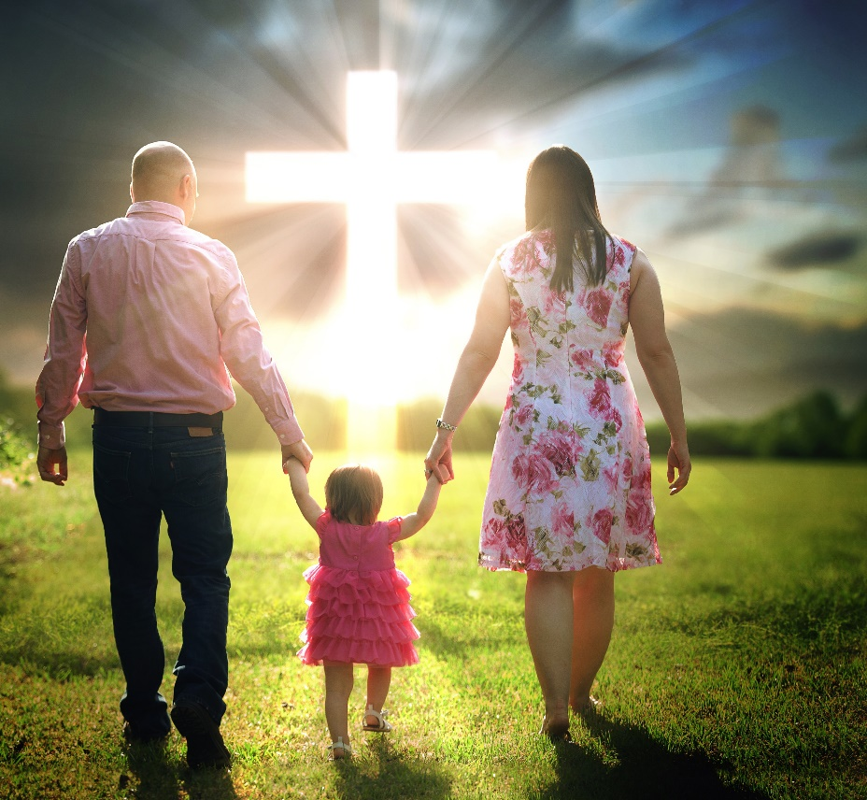
WORSHIP IN EDUCATION
Lesson 7 for November 14, 2020

Slide 2

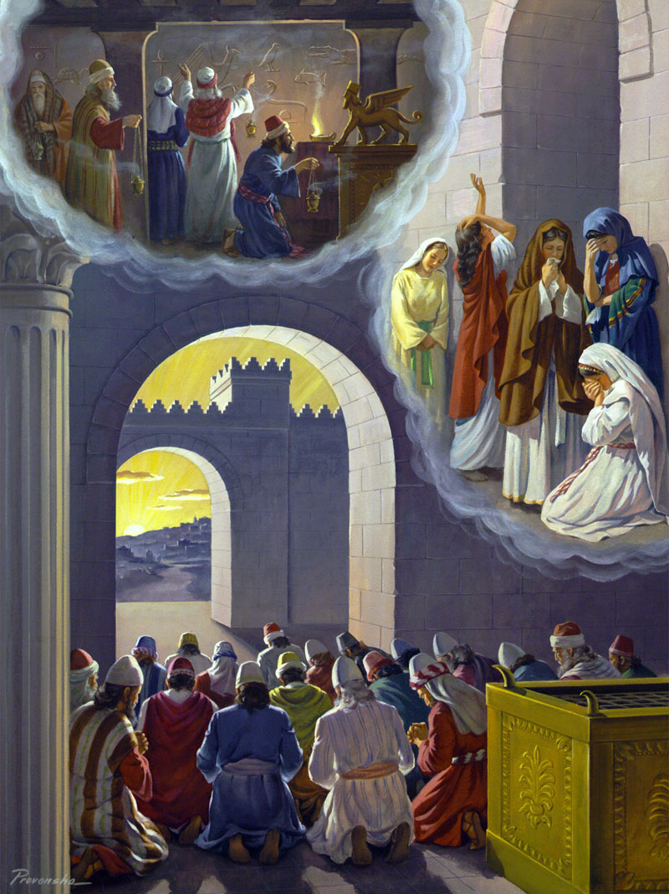
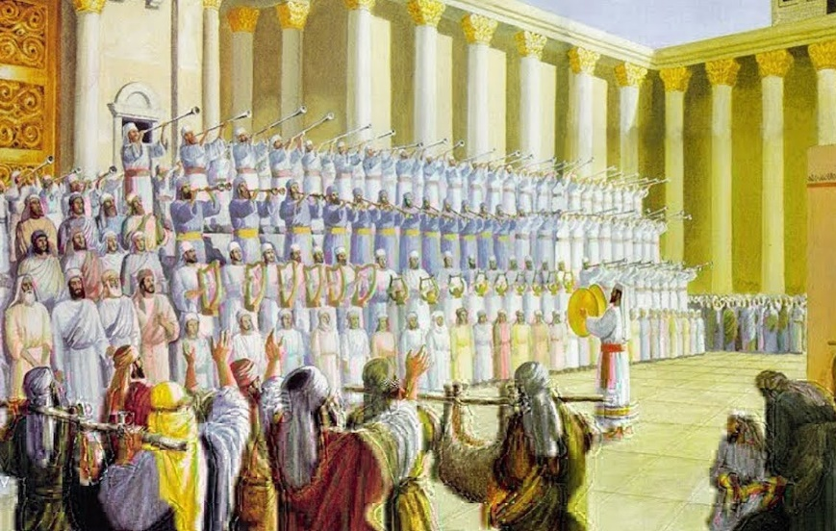





God once showed Ezekiel the elders of Israel worshipping images of reptiles, women worshipping Tammuz, and the priests worshipping the sun (Ezekiel 8).
God called those false acts of worship “abominations.” He even condemned some acts of worship that seemed right by saying, “I cannot endure them.” (Isaiah 1:13)
God cares about what we worship, how we worship, and why we worship. Therefore, it’s important to know the foundation of true worship.
Reasons to worship
Worship in education
How to worship
The contents of our worship
False worship

Slide 3
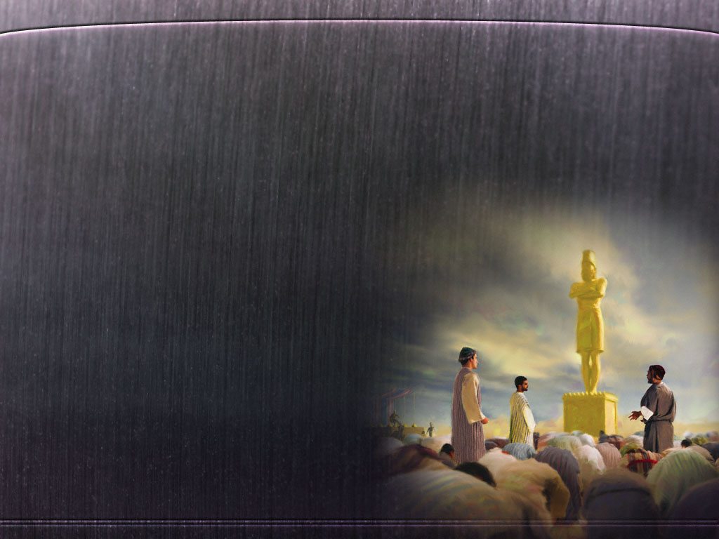
REASONS TO WORSHIP
“My soul longs, yes, even faints for the courts of the Lord; my heart and my flesh cry out for the living God.” (Psalm 84:2)
God put a desire for eternity in our hearts (Ecclesiastes 3:11), and He also put a desire for worship.
Human beings wandered away from God and looked for other ways to fulfill that desire. In antiquity, they usually ended up worshipping objects or even created beings (like the sun, the stars, birds, reptiles…).
Nowadays, people worship subtler things: money, power, sex, athletes, singers, politicians, spiritual leaders, themselves…
The story of Shadrach, Meshach and Abed-Nego in Daniel 3 is a good example of how God cares for a correct worship: “You shall worship the Lord your God, and Him only you shall serve.” (Luke 4:8)

Slide 4

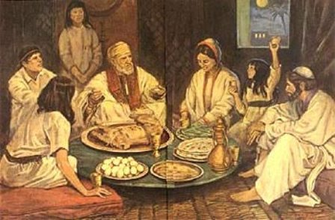
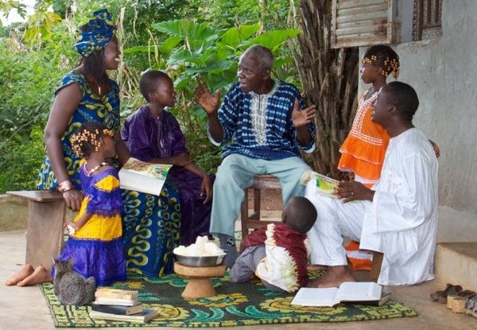
WORSHIP IN EDUCATION
“We will not hide them from their children, telling to the generation to come the praises of the Lord, and His strength and His wonderful works that He has done.” (Psalm 78:4)
God gave the people of Israel a special book to teach them how to worship; the Psalms.
Psalm 78 is a good example:
How to worship
By telling the power, wonders and laws of God
Reasons to worship
So that the next generations may know God and praise Him
What worship brings
Trust in God
Obedience to His Commandments
Avoidance of rebelliousness
Faithfulness
Keeping the covenant
Remaining connected to God
By singing this in praise
So that they don’t repeat the mistakes of their ancestors

Slide 5

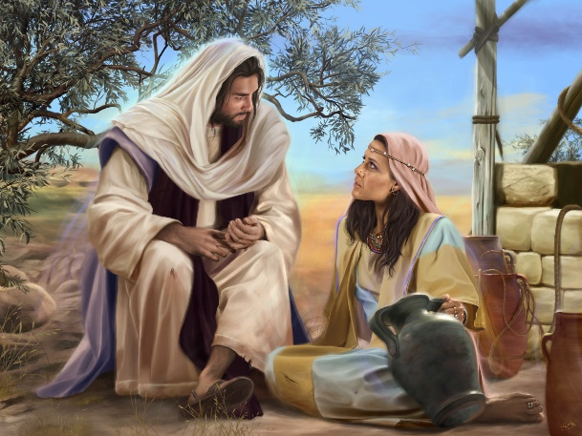
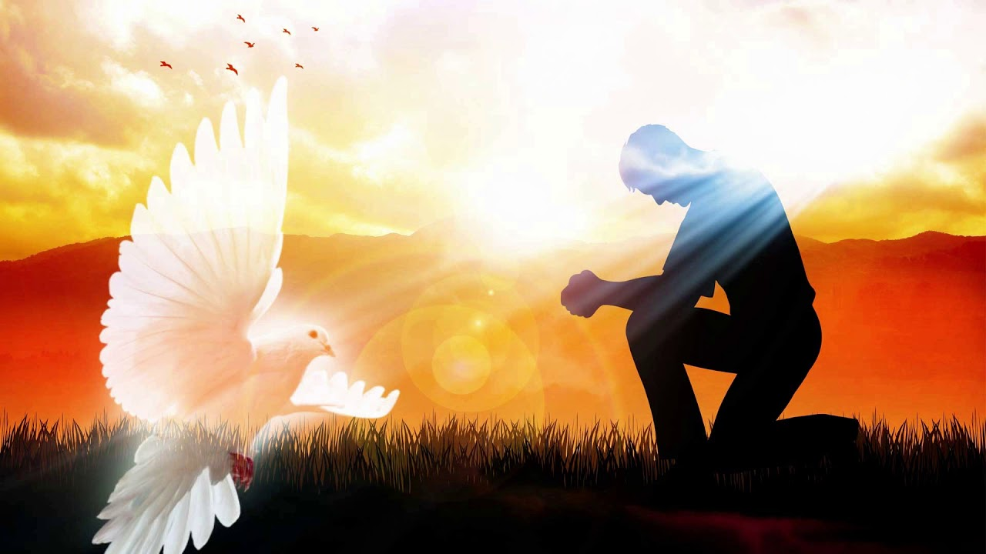
HOW TO WORSHIP
“God is Spirit, and those who worship Him must worship in spirit and truth.” (John 4:24)
In His conversation with the Samaritan woman, Jesus mentioned two main and necessary ways to worship God:
True worship is a result of knowing and obeying God and studying the truths that have been revealed about Him.
In spirit
Our worship is a result of our love for God and a personal experience with Him. It’s the fruit of the Holy Spirit’s work (Ephesians 2:18)
In truth
Properly knowing God and what He wants from us (John 4:22)

Slide 6

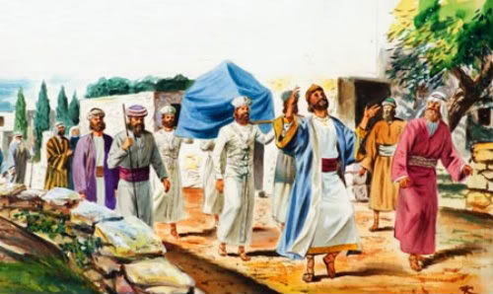
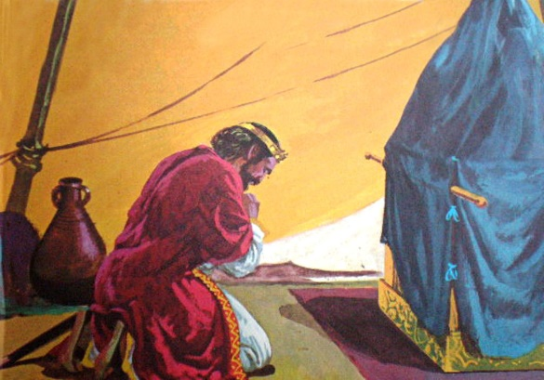
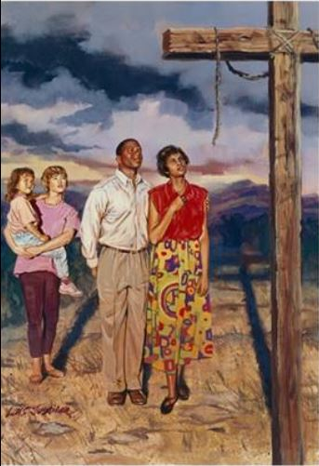
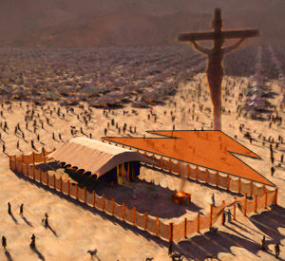
THE CONTENTS OF OUR WORSHIP
“Give unto the Lord the glory due to His name; worship the Lord in the beauty of holiness.” (Psalm 29:2)
One of the more joyful scenes of worship is found in 1 Chronicles 16. David was joyfully dancing before the ark and giving food to the people!
David found the greatest reason for joy in worshipping God in His Sanctuary (Psalm 84:2).
The Sanctuary contains the true reason of our worship. The plan of Salvation is prefigured in every inch of it.
We are a holy people that worships a Holy God (1 Peter 2:9). The sacrifice of Christ makes this holiness possible. This is the main contents of our worship, meditating in God’s redeeming love.

Slide 7

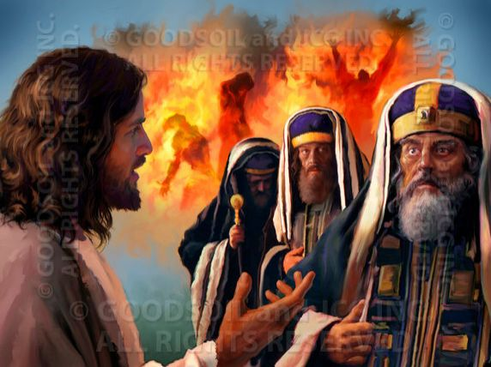
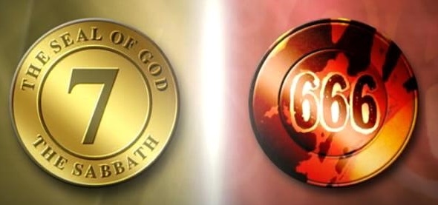
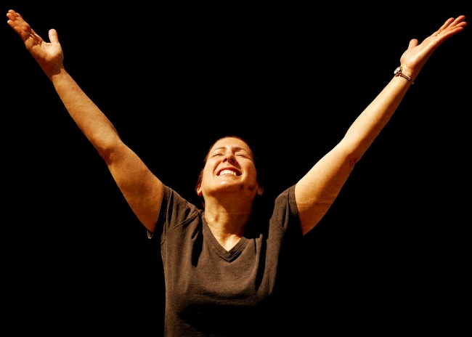
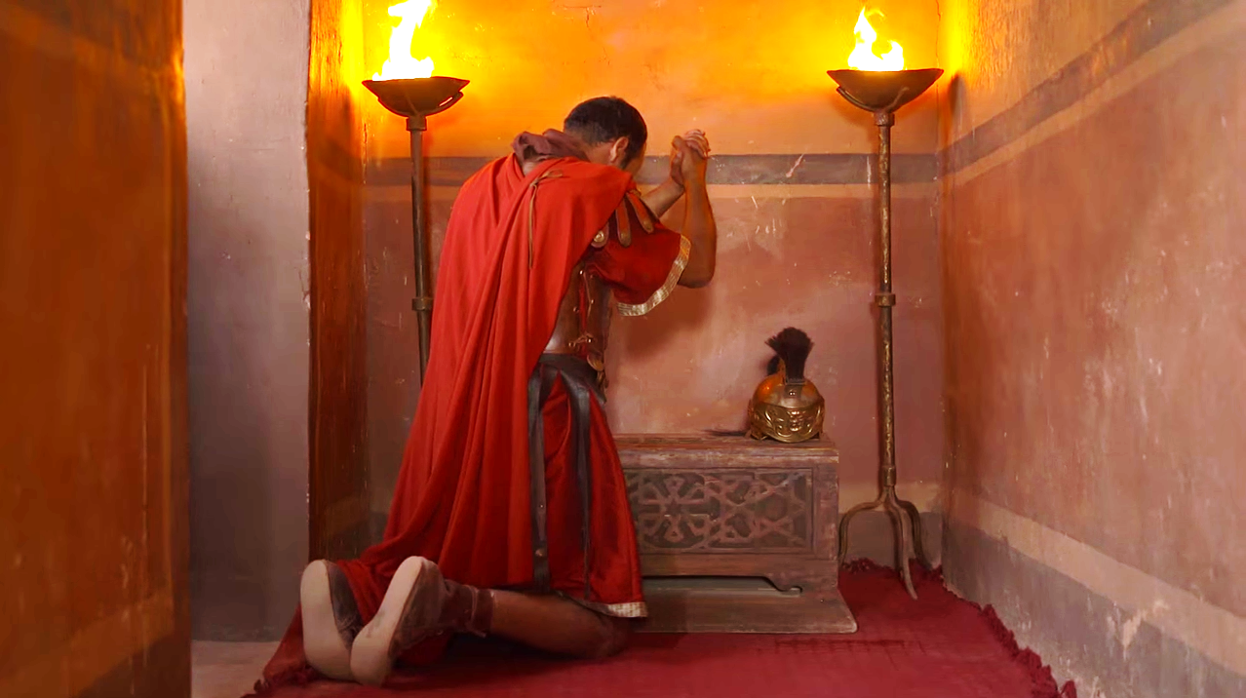
FALSE WORSHIP
“If anyone worships the beast and his image […] He shall be tormented with fire and brimstone in the presence of the holy angels and in the presence of the Lamb.” (Revelation 14:9-10)
Many people are seeking subtle ways of worship that are based on human philosophies, as the Pharisees did of old (Mark 7:1-13).
This is not a petty matter. Worship will divide the world in two sides before the Second Coming of Jesus: those who will worship God as He wants us to, and those who will not (Revelation 13).
Obviously, God accepts every sincere worship as long as the worshipper offers it according to their knowledge (Acts 10:34-35).
However, God is worthy of the best worship we can offer. Therefore, it’s important to never stop learning about true worship.

Slide 8

“Our house of worship may be very humble, but it is none the less acknowledged by God. If we worship in spirit and in truth and in the beauty of holiness, it will be to us the very gate of heaven. As lessons of the wondrous works of God are repeated, and as the heart’s gratitude is expressed in prayer and song, angels from heaven take up
the strain and unite in praise and thanksgiving to God.”
E.G.W. (In Heavenly Places, October 8)

