Slide 1
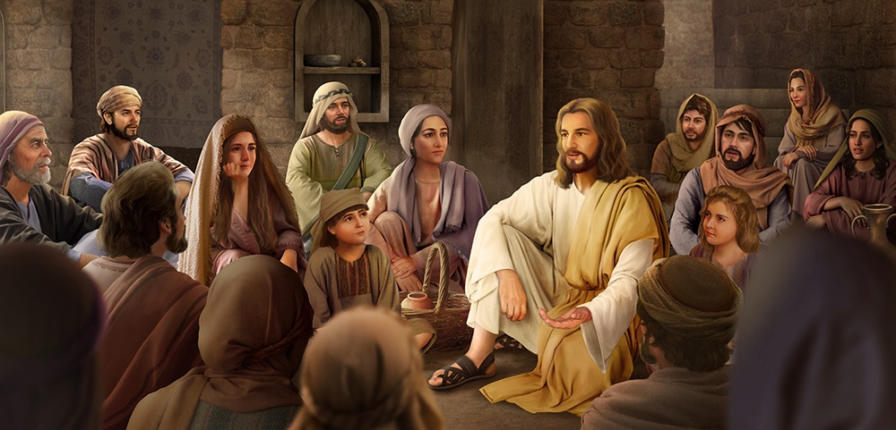
MORE LESSONS FROM THE MASTER TEACHER
Lesson 6 for
November 7, 2020

Slide 2
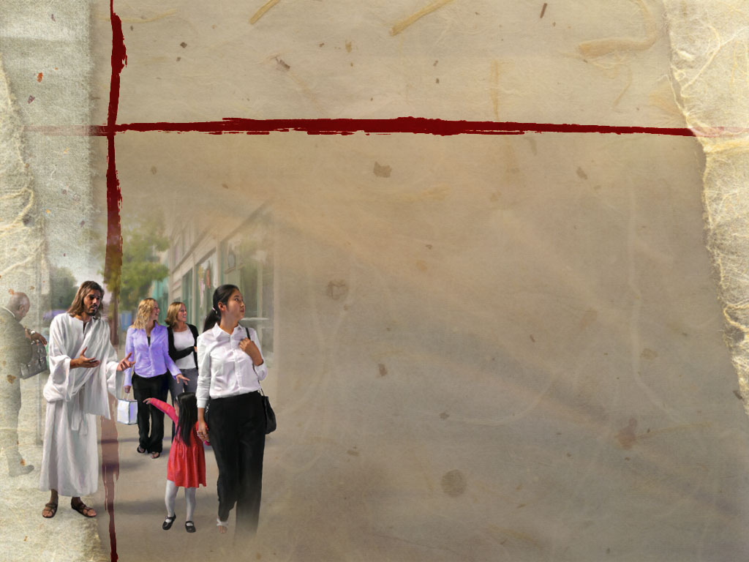





The Master Teacher didn’t wait in His classroom for the students to arrive, so He could taught master classes there.
Jesus has been looking for students since the classroom of Eden was closed because of the sin virus to teach them beautiful lessons of eternal life.
Meeting the rebellious student
Meeting the disheartened student
Meeting the lost student
Meeting the despised student
Meeting the advanced student

Slide 3

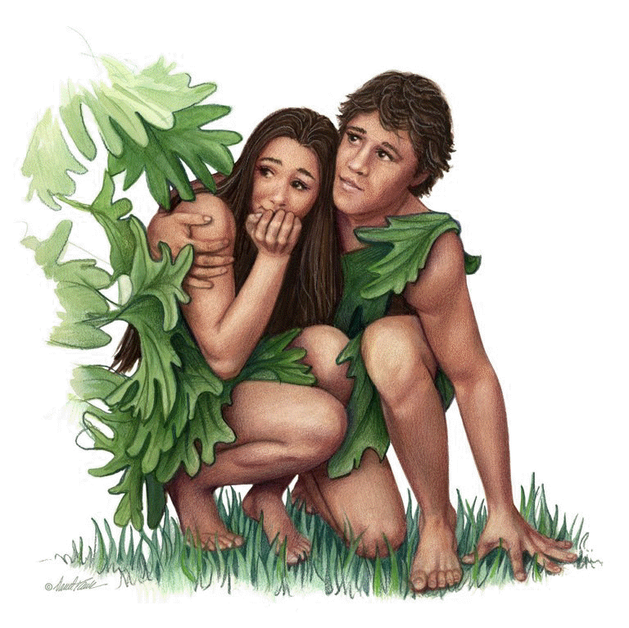
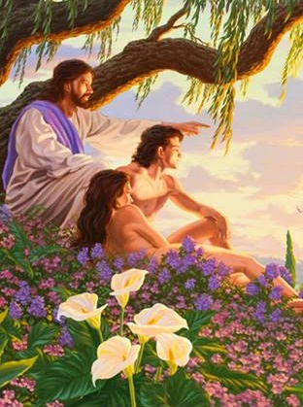


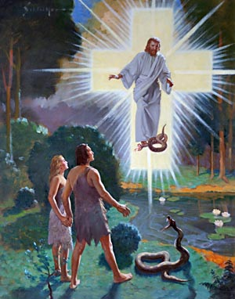
MEETING THE REBELLIOUS STUDENT
“Then the Lord God called to Adam and said to him, ‘Where are you?’” (Genesis 3:9)
Until that tragic day, Adam and Eve had been meeting the Teacher in a daily basis to learn His lessons.
However, they rebelled. They mistrusted God and wanted to gain “superior knowledge” by themselves.
The result of their rebellion was not happiness but fear. They were afraid of the punishment and tried to hide from God’s presence.
However, Jesus came to them and called them. Yes, a punishment was coming, but they’d have another chance because a ransom was going to be paid (Genesis 3:15).
The same Teacher would paid for their rebellion: “For if by the one man’s offense death reigned through the one, much more those who receive abundance of grace and of the gift of righteousness will reign in life through the One, Jesus Christ.” (Romans 5:17)

Slide 4
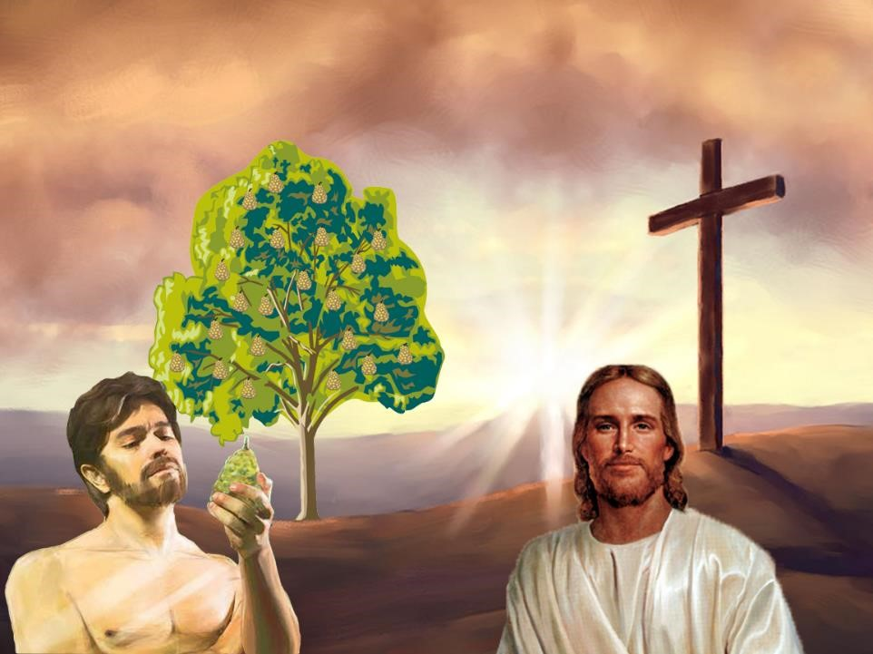
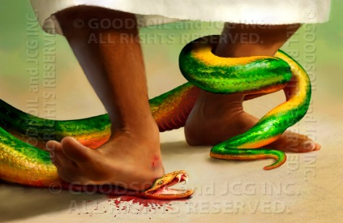
As Paul explains in Romans 5, Jesus—the divine Teacher—corrects and repairs the flaws that rebellion causes in His students.
ADAM
JESUS CHRIST
Many died (v. 15)
Grace abounded (v. 15)
The judgment that came resulted in condemnation (v. 16)
Resulted in justification (v. 16)
Death reigned (v. 17)
We’ll reign in life (v. 17)
Condemnation came
(v. 18)
Justification of life came (v. 18)
Many were made sinners (v. 19)
Many will be made righteous (v. 19)

Slide 5

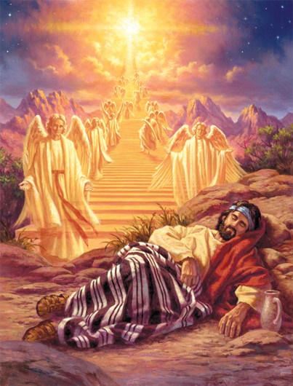
MEETING THE DISHEARTENED STUDENT
“When Jacob awoke from his sleep, he thought, ‘Surely the Lord is in this place, and I was not aware of it.’” (Genesis 28:16 NIV)
Jacob had enough time to think about the terrible consequences of letting his mother influence him to fool his father and to make his brother angry.
He was disheartened and lonely, and his future was uncertain. Then God came to him and encouraged him to stand strong during the years he’d spend in exile.
How many times have you been disheartened because of your own sins?
God comes to you as He did with Jacob. He assures you that you’ve been forgiven, He strengthens you, and He encourages you to walk with Him hand in hand
(Isaiah 42:16).

Slide 6

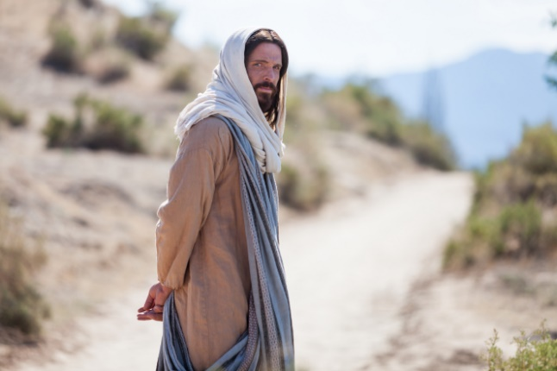
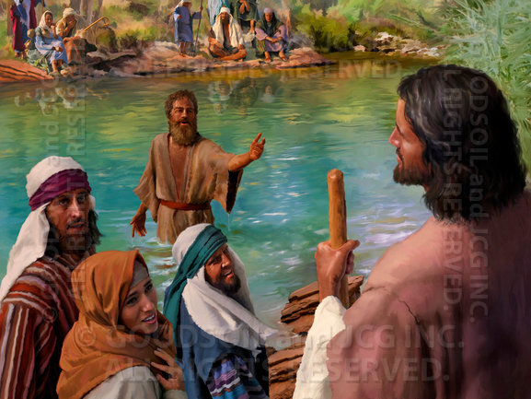
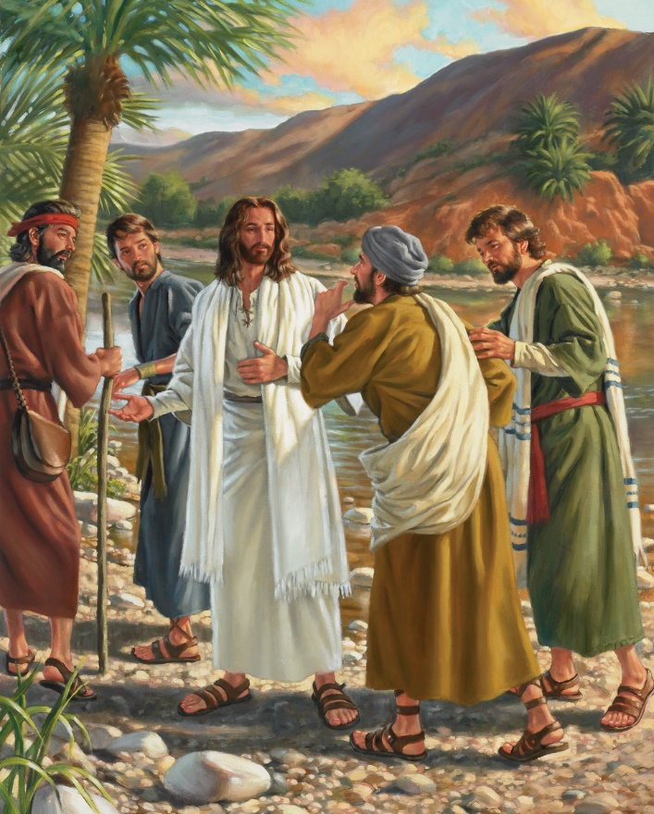
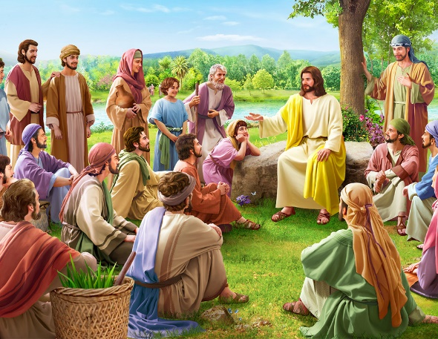
MEETING THE LOST STUDENT
“He came to the world that was His own, but his own people
did not receive Him.” (John 1:11 EXB)
The Creator and divine Teacher came to rescue the lost—that is, all of us. He became one of us to do so (John 1:14).
John—as a prophet—recognized Jesus as “the Lamb of God” and “the Son of God” in His first public appearance (John 1:29, 34).
Two of John’s disciples that heard those words began to follow Jesus. They called Him “Rabbi” because they had accepted Him as their teacher (John 1:37-38).
Jesus was undoubtedly “the greatest teacher the world has ever seen.” (Ellen G. White,
Signs of the Times, June 10, 1886)
Notes:
“the greatest teacher the world has ever seen”

Slide 7

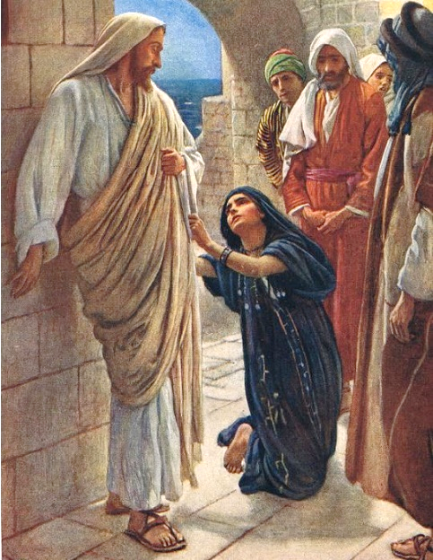
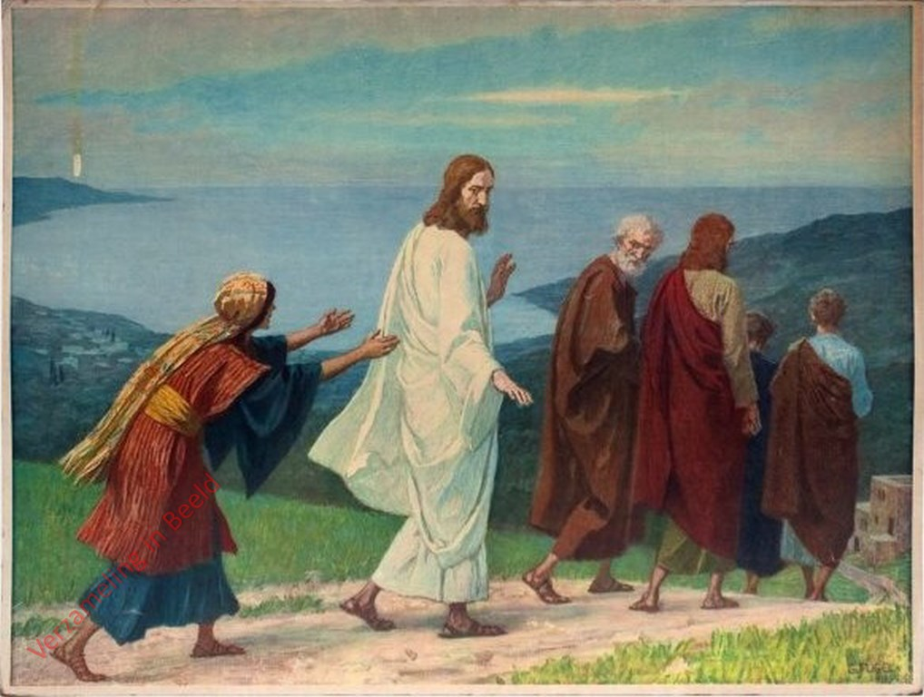
MEETING THE DESPISED STUDENT
“And she said, ‘Yes, Lord, yet even the little dogs eat the crumbs which fall from their masters’ table.’” (Matthew 15:27)
Jesus went to preach to the Jews that lived in the land between Tyre and Sidon which were non-Jewish cities.
He met a student that was not part of His classroom. She was despised by the students of the Teacher. Even Jesus treated her with coldness.
However, that student was also argumentative. She was bold and brought arguments to the table to fight back Jesus’ reasoning.
The student convinced the Teacher and got what she needed. Jesus likes His students—us—to express their doubts or complaints.
This way we’ll let Him solve our problems, heal our wounds, and lead us to the path of eternal life.

Slide 8

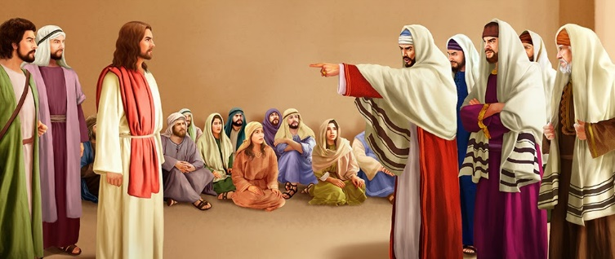
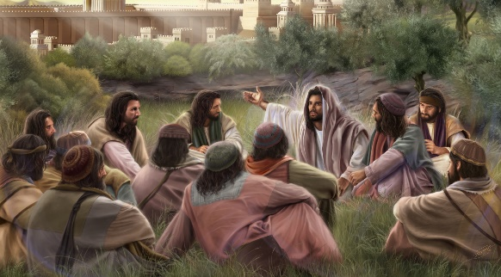
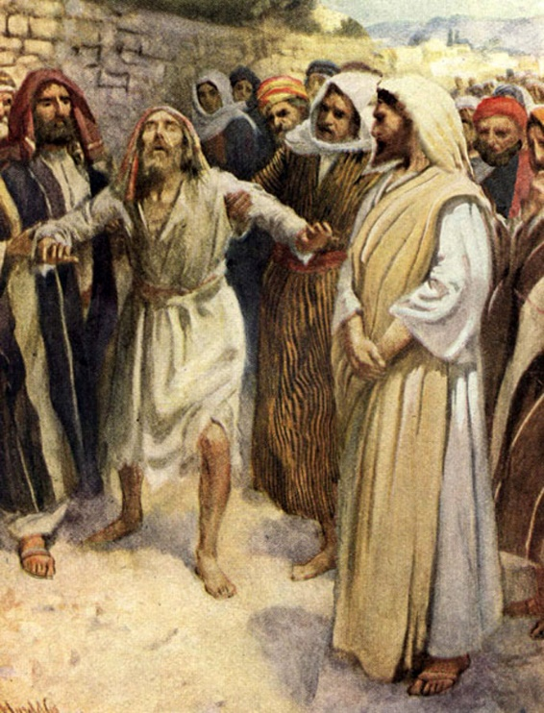
MEETING THE ADVANCED STUDENT
“And when he heard that it was Jesus of Nazareth, he began to cry out and say, ‘Jesus, Son of David, have mercy on me!’” (Mark 10:47)
The students that had studied the Scriptures the most were better prepared to accept Jesus’ teachings. However, they decided to reject Him because they were spiritually blind (John 9:40-41).
Even the students who lived closer to Jesus seemed to suffer spiritual shortsightedness, because they couldn’t fully understand His teachings (Mark 8:17-21).
Nevertheless, Bartimaeus was physically blind but had great spiritual sight. He saw Jesus as the promised Messiah very clearly. He was an advanced student.
Some students need “spiritual milk.” Other students are more advanced and can have “solid food.” (Hebrews 5:12-14)
The more time we spend with Jesus, the better we’ll understand His teachings.

Slide 9

“We are not always to remain children in our knowledge and experience in spiritual things. We are not always to express ourselves in the language of one who has just received Christ; but our prayers and exhortations are to grow in intelligence as we advance in experience in the truth.”
E.G.W. (Sons and Daughters of God, November 19)

Slide 10

E.G.W. (In Heavenly Places, September 25)
“When the enemy tells you that the Lord has forsaken you, tell him that you know He has not; for He declares, ‘I will never leave thee, nor forsake thee.’ (Hebrews 13:5) […]
There is no limit to the help that the Saviour is willing to bestow on us. He asks us to bring into our lives the grace that will keep us from sin. From the cross of Calvary there comes to us liberty, hope, and strength. Do not dishonor your Redeemer by doubting His power. Trust Him all the time.”

