Slide 1
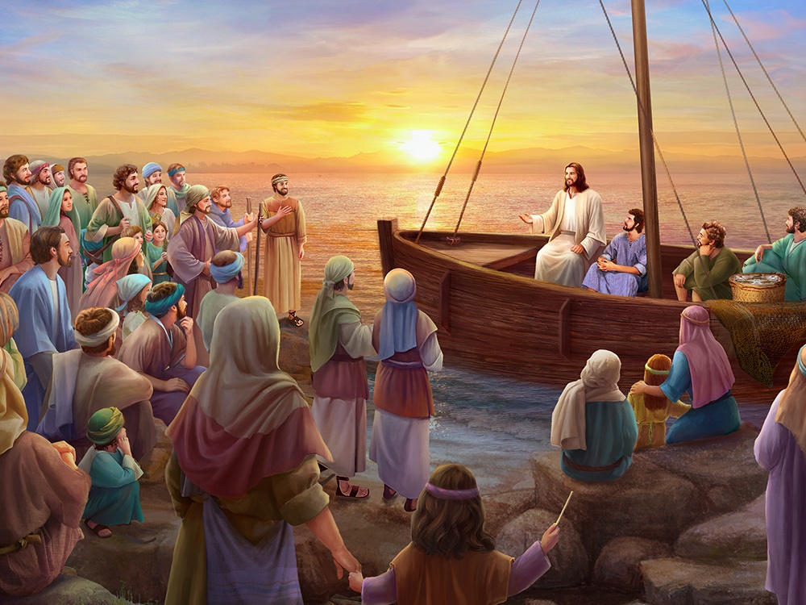
JESUS AS THE MASTER TEACHER
Lesson 5 for October 31, 2020

Slide 2
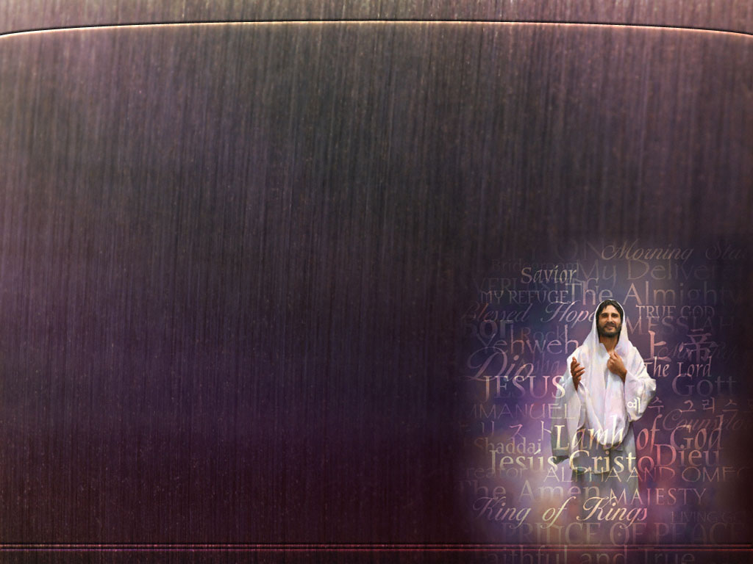




Jesus is the best teacher ever. Who is Jesus?
He teaches us how God is [“He who has seen Me has seen the Father.” (John 14:9)]; He set an example of how we should live [“For I have given you an example, that you should do as I have done to you.” (John 13:15)]; he paid the price for our sins and reconciled us with God [“God was in Christ reconciling the world to Himself, not imputing their trespasses to them, and has committed to us the word of reconciliation.” (2 Corinthians 5:19)].
Without a shadow of doubt, Jesus is the Great Teacher who we should worship.
The glory of the Father
The example
The reconciler
Worthy of worship

Slide 3

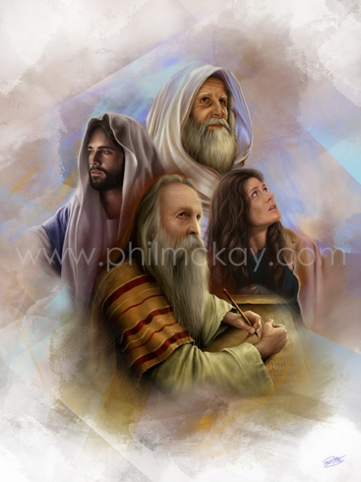
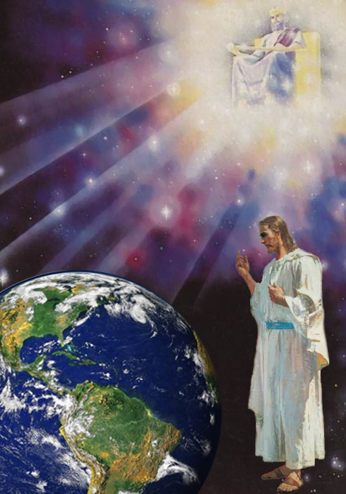
THE GLORY OF THE FATHER (I)
“Jesus said to him, ‘Have I been with you so long, and yet you have not known Me, Philip? He who has seen Me has seen the Father; so how can you say, ‘Show us the Father’?’” (John 14:9)
Hebrews 1:1-3 explains that God couldn’t meet humans face to face after sin entered the world. Therefore, He revealed through prophets (v. 1).
That revelation was imperfect. Only Jesus can perfectly reveal God (v. 2), because He is God (v. 3):
He is the brightness of His glory
He is the express image of His person
He upholds all things
He has purged our sins
He sits down at the right hand of God
Jesus came to reach the truth about God and to show us “the glory of God in the face of Jesus Christ.” (2 Corinthians 4:6)

Slide 4

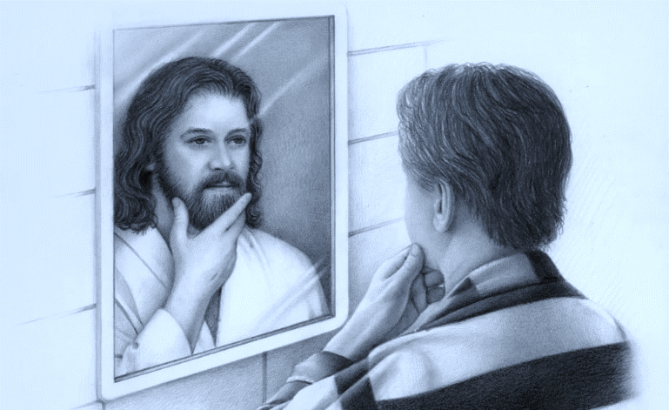
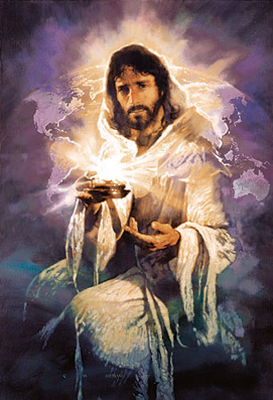
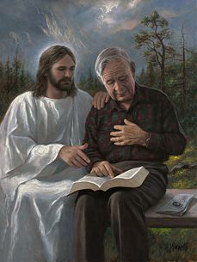
THE GLORY OF THE FATHER (II)
“Jesus said to him, ‘Have I been with you so long, and yet you have not known Me, Philip? He who has seen Me has seen the Father; so how can you say, ‘Show us the Father’?’” (John 14:9)
Jesus revealed the glory and the character of the Father. People could see God in Him.
Jesus is the image of God (Hebrew 1:3), and we are transformed to the image of Jesus
(Romans 8:29) so we can reveal the glory and the character of the Father to this world.
Jesus is the light of the world (John 8:12), and we’ve been made light (Matthew 5:14) to light up the world with the knowledge of His character.
The more time we spend with Jesus, the more we’ll reflect His glory. “But we all, with unveiled face, beholding as in a mirror the glory of the Lord, are being transformed into the same image from glory to glory, just as by the Spirit of the Lord.” (2 Corinthians 3:18)

Slide 5

“Taking humanity upon Him, Christ came to be one with humanity, and at the same time to reveal our heavenly Father to sinful human beings. He who had been in the presence of the Father from the beginning, He who was the express image of the invisible God, was alone able to reveal the character of the Deity to mankind […] Tender, compassionate, sympathetic, ever considerate of others, He represented the character of God, and was constantly engaged in service for God and man.”
E.G.W. (The Ministry of Healing, cp. 35, p. 422)

Slide 6

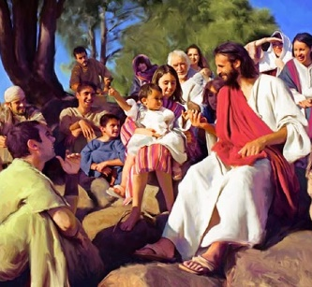
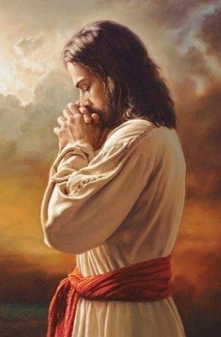
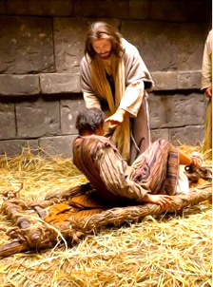
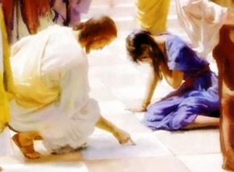
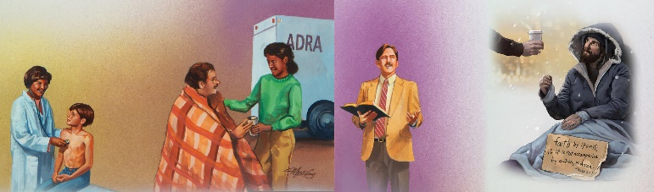
THE EXAMPLE
“For I have given you an example, that you should do as I have done to you.” (John 13:15)
In order to follow Jesus’ example, we should learn about how He lived when He was on Earth.
Paul masterfully described the character of Jesus and how we should imitate Him in Philippians 2:3-11.
Humble (see Matthew 11:29; Isaiah 66:2)
Obedient (see Luke 22:42; Matthew 7:21)
Obliging (see Mark 10:45; 3 John 1:5)
God’s great work of education and salvation is accomplished, not by exalting ourselves but by humbling ourselves before God, obeying Him, and becoming servants to others.

Slide 7

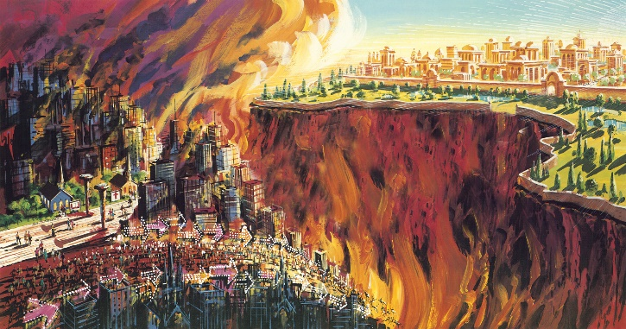
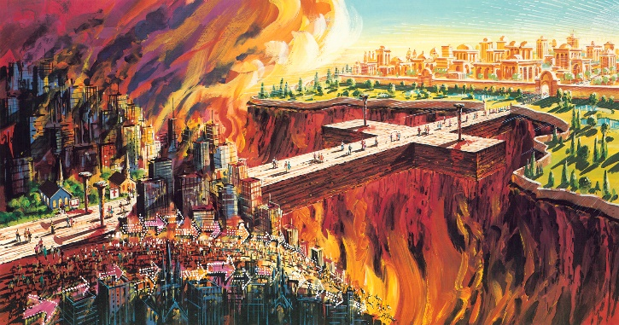
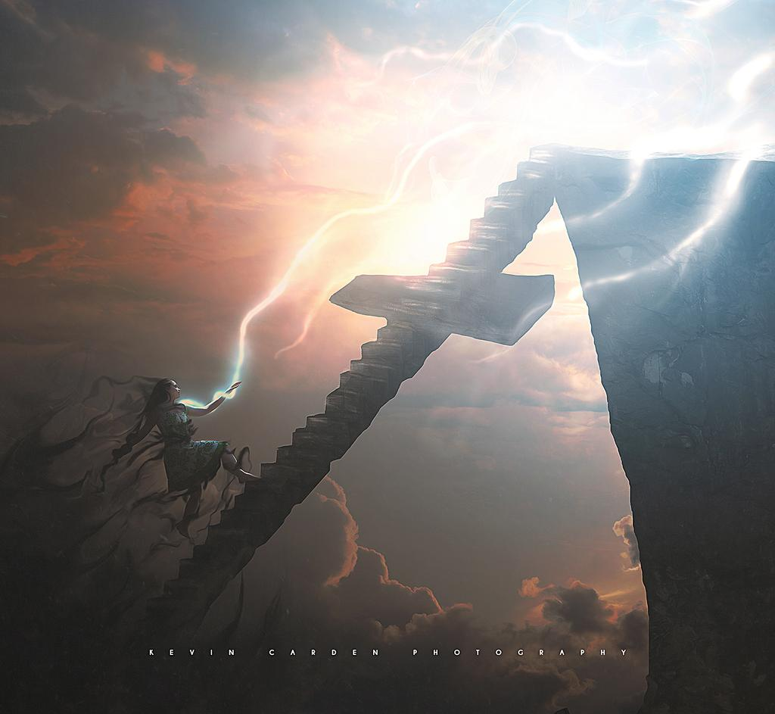
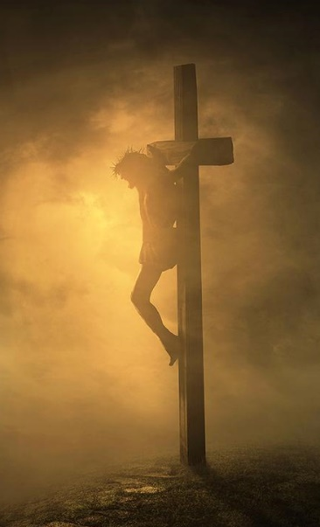
THE RECONCILER
“that is, that God was in Christ reconciling the world to Himself, not imputing their trespasses to them, and has committed to us the word of reconciliation.” (2 Corinthians 5:19)
Sin created a breach between God and humankind.
We cannot close this breach by ourselves. What is more, the sin in us prevents us from truly desiring to close it.
God took the first step. He gave His Son to reconcile us with Him. He also puts the desire to repent in our hearts (Romans 2:4).
Jesus is the Creator and sustainer of life, and He redeemed us at the cross. He forgives our sins and reconciles us with God. He also makes us part of His redeeming work in our social spheres (Colossians 1:15-20).

Slide 8
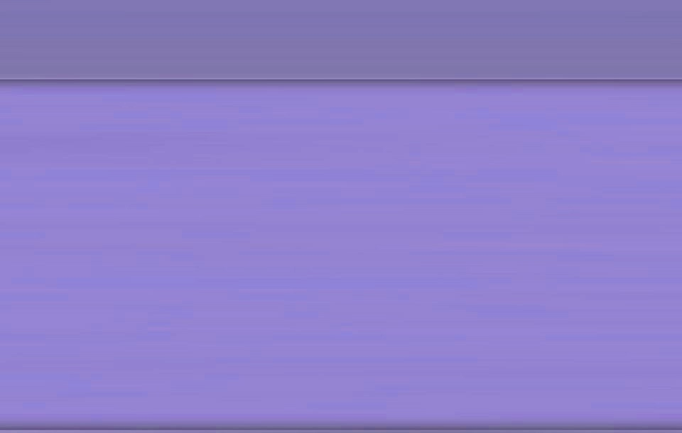
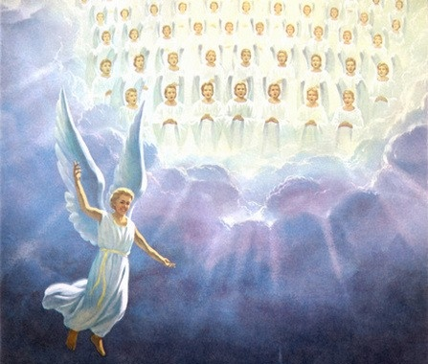
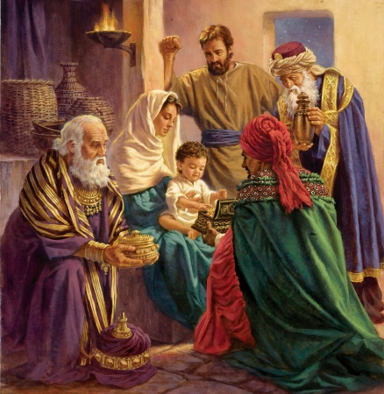
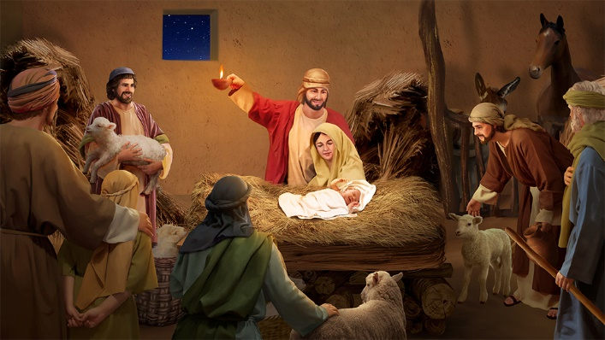
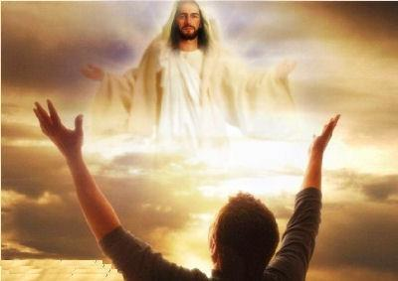
WORTHY OF WORSHIP
“Worthy is the Lamb who was slain to receive power and riches and wisdom, and strength and honor and glory and blessing!” (Revelation 5:12)
Humanity has been encouraged to worship Jesus since He became man. A group of angels in the shape of a bright star came to announce the coming of the Savior, Messiah, and King of kings.
That announcement was heard at the hills of Bethlehem, and it was seen from Mesopotamia.
The shepherds ran to the manger as soon as they heard the news. They understood that the newborn was the Savior, so they worshipped Him and shared the news (Luke 2:8-20).
The wise men from the East understood that the angel star was a fulfillment of the prophecies that foretold the coming of the Savior. They got ready to meet Him, then travelled to the manger to worship Him and give Him presents (Matthew 2:1-12).
Like them, we are also called to worship Christ (Revelation 5:13).

Slide 9

“The work of God’s dear Son in undertaking to link the created with the Uncreated, the finite with the Infinite, in His own divine person, is a subject that may well employ our thoughts for a lifetime. This work of Christ was to confirm the beings of other worlds in their innocency and loyalty, as well as to save the lost and perishing of this world. He opened a way for the disobedient to return to their allegiance to God, while by the same act He placed a safeguard around those who were already pure, that they might not become polluted.”
E.G.W. (Messages to Young People, cp. 81, p. 253)

