Slide 1
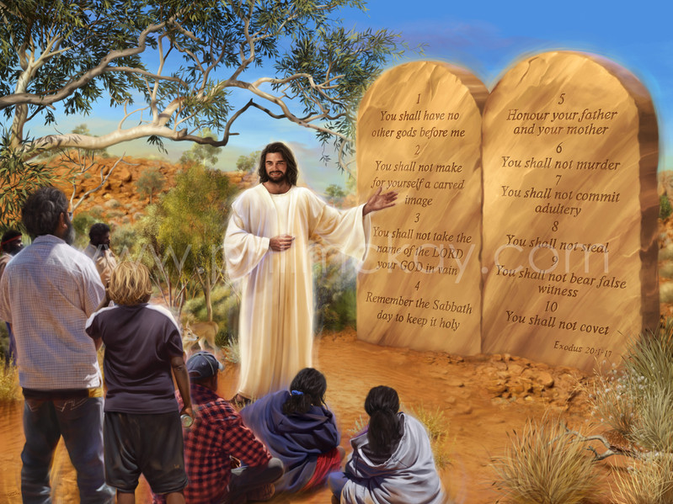
THE LAW
AS TEACHER
Lesson 3 for
October 17, 2020

Slide 2
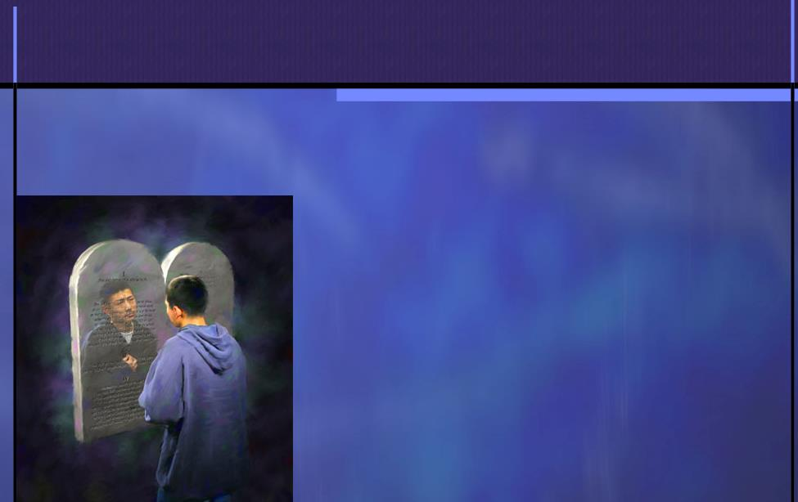







One of the functions of the Law is to point out sin (Romans 7:7). Another is to lead us to Christ (Galatians 3:24). The Law has other functions too.
The Law teaches us how to live. It is the rule of life that God wants us to achieve.
God gave us an example in the life of Jesus. He fulfilled the Law during his entire life on Earth (John 15:10).
The purpose of the Law:
  Teaching us how to fear God
  Testifying against us
  Making us prosperous
Those who keep the Law:
  Their struggles
  Their ideal

Slide 3

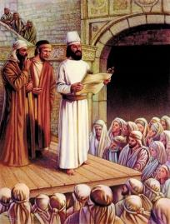
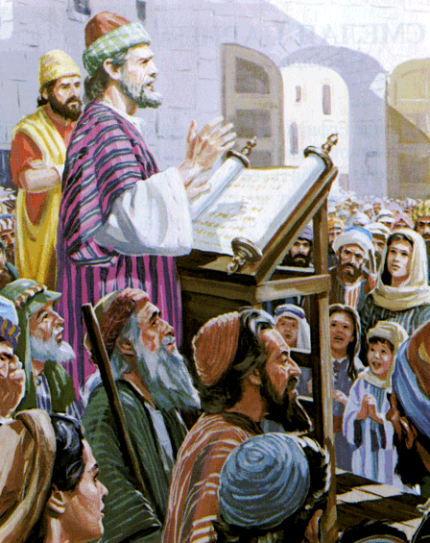
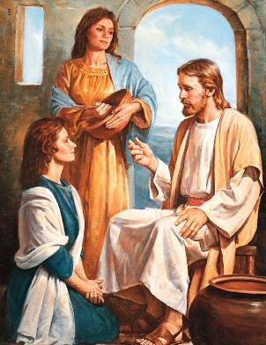
TEACHING US HOW TO FEAR GOD
“Gather the people together, men and women and little ones, and the stranger who is within your gates, that they may hear and that they may learn to fear the Lord your God and carefully observe all the words of this law.” (Deuteronomy 31:12)
God commanded the Israelites to read the Law before all the people during the Feast of Tabernacles. There was a process to follow:
HEAR
LEARN
FEAR
This was a simple learning system that let both children and adults learn about the beginning of wisdom: the fear of the Lord (Psalm 111:10).
We do not have a natural tendency towards fearing God, we must learn to do so. Respecting our teachers is essential to learn efficiently, so we must respect the Greatest Teacher to learn from Him.
Of course this fear must come with love. That is why the Law includes this command: “Love the Lord your God with all your heart and with all your soul and with all your strength.” (Dt. 6:5 NIV)

Slide 4

“A reverential spirit realizes that the heart must be kept by the power of God. Ministering angels open the eyes of the mind and heart to see wonderful things in the divine law, in the natural world, and in the eternal things revealed by the Holy Spirit.”
E.G.W. (My life today, October 14)

Slide 5

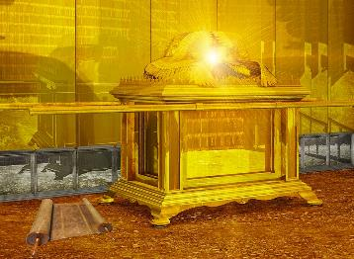
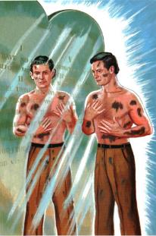
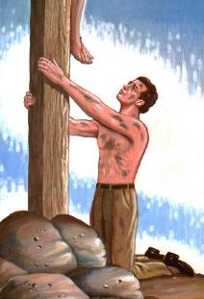
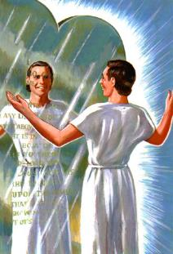
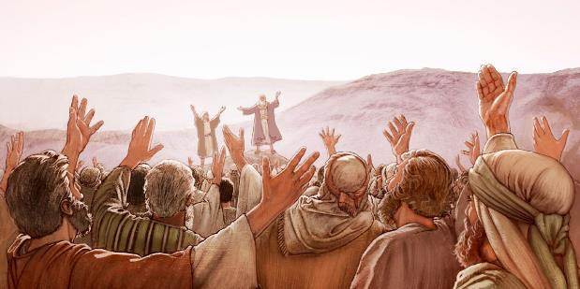
TESTIFYING AGAINST US
“Take this Book of the Law, and put it beside the ark of the covenant of the Lord your God, that it may be there as a witness against you.” (Deuteronomy 31:26)
Witnesses tell what they have heard and seen. The Law "tells" what it sees in us: our sin.
The Law testifies AGAINST us (Romans 3:23). It reprimands our hearts, but it also leads us to the solution: Jesus Christ (Galatians 3:26).
God commanded Moses to prepare another "witness" against the people: a song (Deuteronomy 31:19). If they ever disobeyed the Law, that song would remind them of the wonders God had done in their favor.
One day the Law and the song of Moses will never be a witness against us anymore. They will instead testify of our victory thanks to the blood of the Lamb (Revelation 15:3).

Slide 6

“When the judgment shall sit, and everyone shall be judged by the things written in the books, the authority of God’s law will be looked upon in a light altogether different from that in which it is now regarded by the Christian world. Satan has blinded their eyes and confused their understanding, as he blinded and confused Adam and Eve, and led them into transgression. The law of Jehovah is great, even as its Author is great. In the judgment it will be recognized as holy, just, and good in all its requirements. Those who transgress this law will find that they have a serious account to settle with God; for His claims are decisive.”
E.G.W. (SDA Bible Commentary, on Revelation 20:12-13, vol. 7, p. 986)

Slide 7

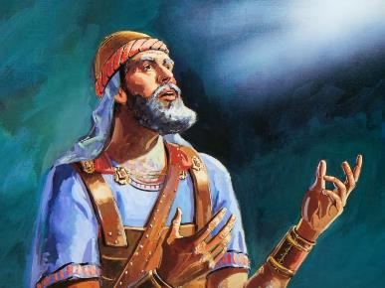

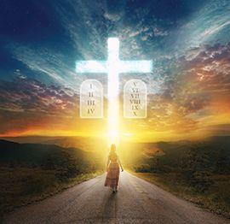
MAKING US PROSPEROUS
“Only be strong and very courageous, that you may observe to do according to all the law which Moses My servant commanded you; do not turn from it to the right hand or to the left, that you may prosper wherever you go.” (Joshua 1:7)
One of the most important functions of the Law is to make us prosperous. That is, that we may be successful in our enterprises.
The Law teaches us how to live according to God’s instructions. Therefore, God supports those who want to do His will in a special way
(Deuteronomy 30:9-10; Psalm 1).
Keeping the Law of God is part of Christian education. It is an essential part of living by faith and trusting God’s grace
(Revelation 14:12;
James 2:10-12).

Slide 8

“Temporal and spiritual prosperity are made conditional upon obedience to the law of God. But we do not read God’s Word, and thus become familiar with the terms of the blessing that is to be given to all who hearken diligently to God’s law and teach it diligently in their families. Obedience to God’s Word is our life, our happiness.”
E.G.W. (Child Guidance, cp. 10, p. 80)

Slide 9

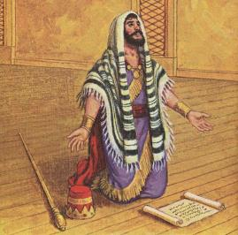

THEIR STRUGGLES
“And in every work that he began in the service of the house of God, in the law and in the commandment, to seek his God, he did it with all his heart. So he prospered.” (2 Chronicles 31:21)
Joshua and Hezekiah prospered because they obeyed God’s Law. Nevertheless, other people who obeyed the Law did not share the same fate:
John the Baptist
Job
Paul
He was beheaded in prison
He lost everything he had
He was flogged, incarcerated, shipwrecked…
They were stoned, sawn, killed by the sword…
Others
Those who keep the Law do not always prosper. After all, we live in a sinful world. Besides, the prince of this world is constantly fighting to keep us from prospering
(Revelation 12:17; John 16:33).

Slide 10

“Think you not that Christ values those who live wholly for Him? Think you not that He visits those who, like the beloved John in exile, are for His sake in hard and trying places? God will not suffer one of His truehearted workers to be left alone, to struggle against great odds and be overcome. He preserves as a precious jewel everyone whose life is hid with Christ in Him. Of every such one He says: ’I ... will make thee as a signet: for I have chosen thee.’ Haggai 2:23”
E.G.W. (The Ministry of Healing, cp. 41, p. 488)

Slide 11

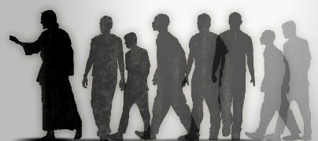
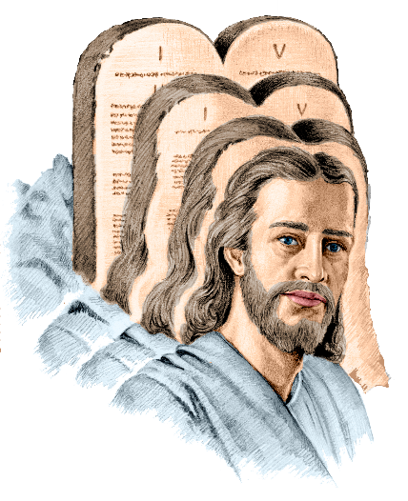






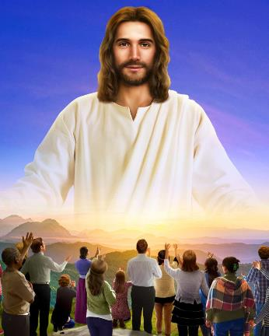

THEIR IDEAL
“Whoever claims to live in him must live as Jesus did.” (1 John 2:6)
How did Jesus relate to God’s Law while He was living on Earth?
He was obedient in everything (Philippians 2:8)
He kept the Law since He was a child (Luke 2:51-52)
He learnt from the Law (Hebrews 5:8)
He obeyed the Law to please God (John 8:29)
He delighted in obeying the Law (Psalm 40:8)
He kept the Law for love’s sake (John 15:10)
It is obvious that we cannot keep the Law as perfectly as Jesus did. But we are called to “walk as He walked.”
Obeying the Law is a sign of our faith (James 2:17) and our love for Jesus
(John 14:15).

Slide 12

“In His life and lessons, Christ has given a perfect exemplification of the unselfish ministry which has its origin in God. […] His whole life was under a law of service. He served all, ministered to all. Thus He lived the law of God, and by His example showed how we are to obey it.”
E.G.W. (The Desire of Ages, cp. 71, p. 649)

