Slide 1

EDUCATION IN THE GARDEN OF EDEN
Lesson 1 for October 3, 2020

Slide 2






God founded the first school for humanity. Its conditions were perfect: the best classroom, the best textbook, the best Teacher, and the best students.
However, an external agent caused a crisis that led to crucial decisions from all the participants.
We can learn from Adam and Eve’s mistake, so we get the most from what our Teacher and Savior wants to teach us.
A promising beginning
An external influence
The decision of the students
The decision of the Teacher
Keep learning

Slide 3

THE FIRST SCHOOL
How was the first school of humanity organized?
THE CLASSROOM
The Garden of Eden
THE TEXTBOOK
Nature
THE TEACHER
The Creator
THE STUDENTS
Adam and Eve

Slide 4


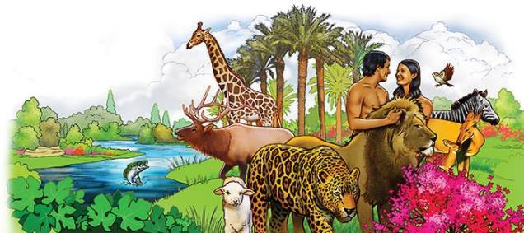
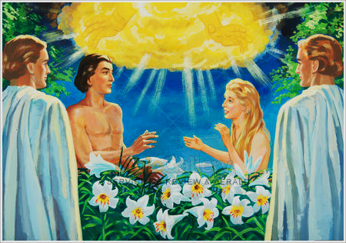


A PROMISING BEGINNING
“The Lord God planted a garden eastward in Eden, and there He put the man whom He had formed.” (Genesis 2:8)
God used a theoretical-practical method to teach Adam and Eve.
They were assigned practical responsibilities: to look after the animals (Gn. 1:28; 2:19) and to take care of the garden (Gn. 2:15).
The angels played an important role in their theoretical education. Besides, God met with them every afternoon to teach them personally
(Gn. 3:8).
The students helped each other and collaborated harmoniously (Gn. 2:18, 22).
Everything in that cozy garden augured a fruitful and gratifying learning.

Slide 5

“On every leaf of the forest or stone of the mountains, in every shining star, in earth and air and sky, God’s name was written. The order and harmony of creation spoke to them of infinite wisdom and power. They were ever discovering some attraction that filled their hearts with deeper love and called forth fresh expressions of gratitude.
So long as they remained loyal to the divine law, their capacity to know, to enjoy, and to love would continually increase. They would be constantly gaining new treasures of knowledge, discovering fresh springs of happiness, and obtaining clearer and yet clearer conceptions of the immeasurable, unfailing love of God.”
E.G.W. (Patriarchs and Prophets, cp. 2, p. 50-51)

Slide 6

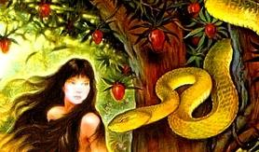


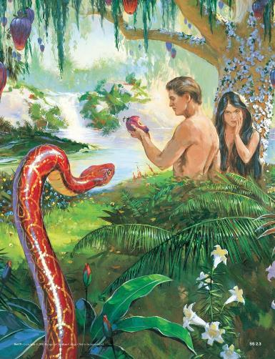
AN EXTERNAL INFLUENCE
“Then the serpent said to the woman, ‘You will not surely die.’” (Genesis 3:4)
God created an environment that was “very good” (Gn. 1:31) and filled with “every tree that is pleasant to the sight” (Gn. 2:9). The students “were not ashamed” (Gn. 2:25).
Nevertheless, a “cunning” being came to Eve and denied God’s clear statements. It encouraged her to doubt of God’s intention (Gn. 3:1-5). He introduced God as:
Restrictive, prohibiting good things
Afraid of Adam and Eve reaching a superior level of knowledge
A liar, lying about the consequences of eating from that tree
God gave Adam and Eve free will. Eve chose to believe the enemy and to doubt God. Adam chose to join Eve’s disobedience.

Slide 7
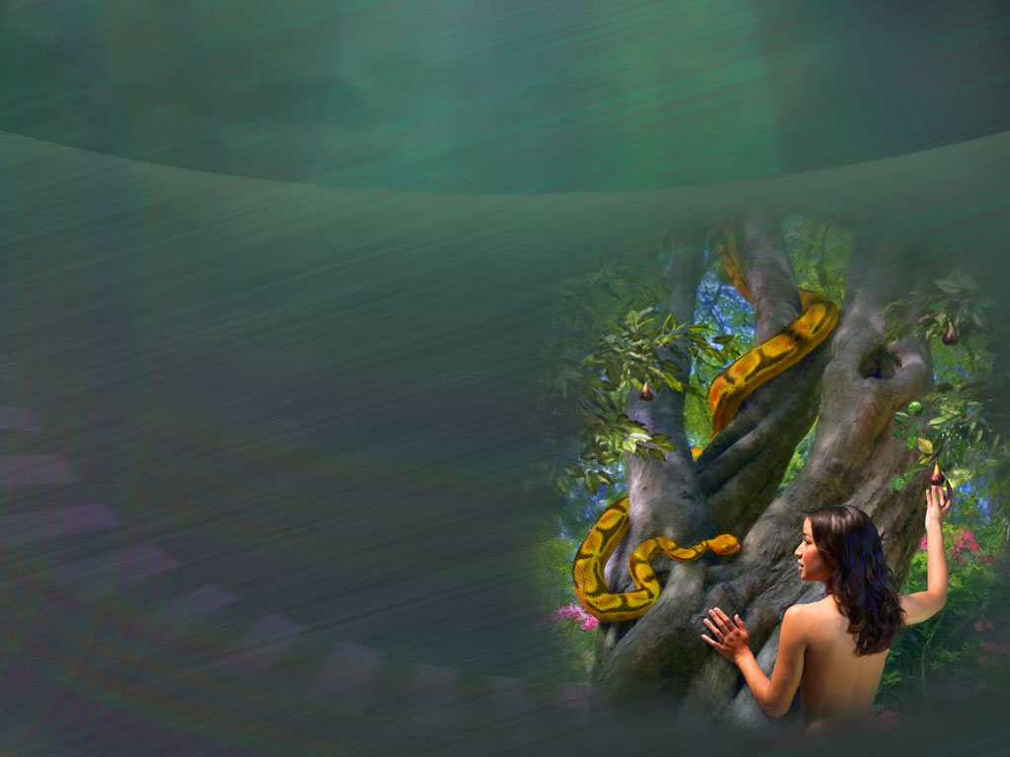

THE DECISION OF THE STUDENTS
“So when the woman saw that the tree was good for food, that it was pleasant to the eyes, and a tree desirable to make one wise, she took of its fruit and ate. She also gave to her husband with her, and he ate.” (Genesis 3:6)
Eve wasn’t drawn by the forbidden tree’s fruit before being tempted. She didn’t find it pleasant. She didn’t covet the fruit or the wisdom it could give. And of course she didn’t even think of taking the fruit and eating it.
What could have Eve done when doubt came to her mind?
It was reasonable to talk to God about it because she could talk to Him directly. She could ask Him about the serpent’s accusations. She could also ask Adam for help. But she didn’t.
Adam didn’t even think about the tree. He just decided to share Eve’s fate. Both used their free will badly.

Slide 8

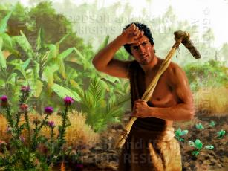
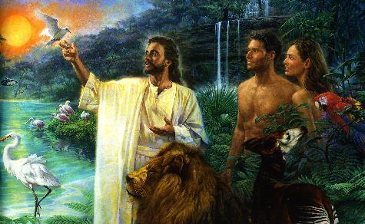
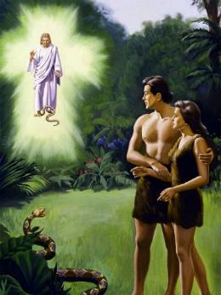
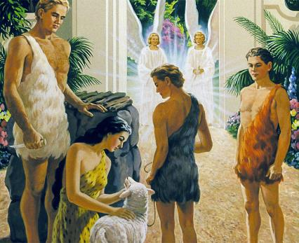
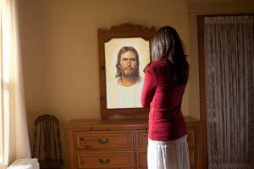

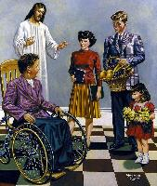

THE DECISION OF THE TEACHER
“therefore the Lord God sent him out of the garden of Eden to till the ground from which he was taken.” (Genesis 3:23)
The Divine Teacher had been close to His students. He wanted to teach them about His character, kindness, and love.
Then the students could no longer remain in His presence. Before expelling them, God assured them that Redemption would come (Genesis 3:15).
He assigned new tasks to them, so they could keep learning. He also gave them new ways to communicate with Him.
We are descendants of Adam and Eve. We can learn as they did through prayer, service, and Bible study.
Our learning goal is to rebuild God’s image in our lives, growing in the Christian virtues
(2 Peter 1:3-11).

Slide 9

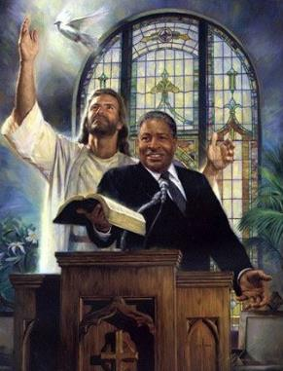
KEEP LEARNING
“Obey those who rule over you, and be submissive, for they watch out for your souls, as those who must give account […]” (Hebews 13:17)
Those learning must submit to the teacher’s authority. This authority is necessary and must be respected.
As Christians, we learn from pastors and teachers, and we should acknowledge their authority. But they must be assessed so they don’t introduce heresy to the flock
(2 Peter 2:1).
After all, those with the authority to teach should remind that they must submit to God. They will be held accountable before Him.
Adam and Eve disregarded God’s authority and submitted to a deceitful one.
In order to keep learning, we must submit to God’s Word and to those authorized by it.

Slide 10

“Adam did not consider all the consequences resulting from his disobedience. He did not set his mind in defiance against God, nor did he in any way speak against God; he simply went directly contrary to His express command. And how many today are doing the very same thing, and their guilt is of much greater magnitude because they have the example of Adam’s experience in disobedience, and its terrible results, to warn them of the consequences of transgressing the law of God. So they have clear light upon this subject, and no excuse for their guilt in denying and disobeying God’s authority.”
E.G.W. (Christ Triumphant, January 19)

