Slide 1
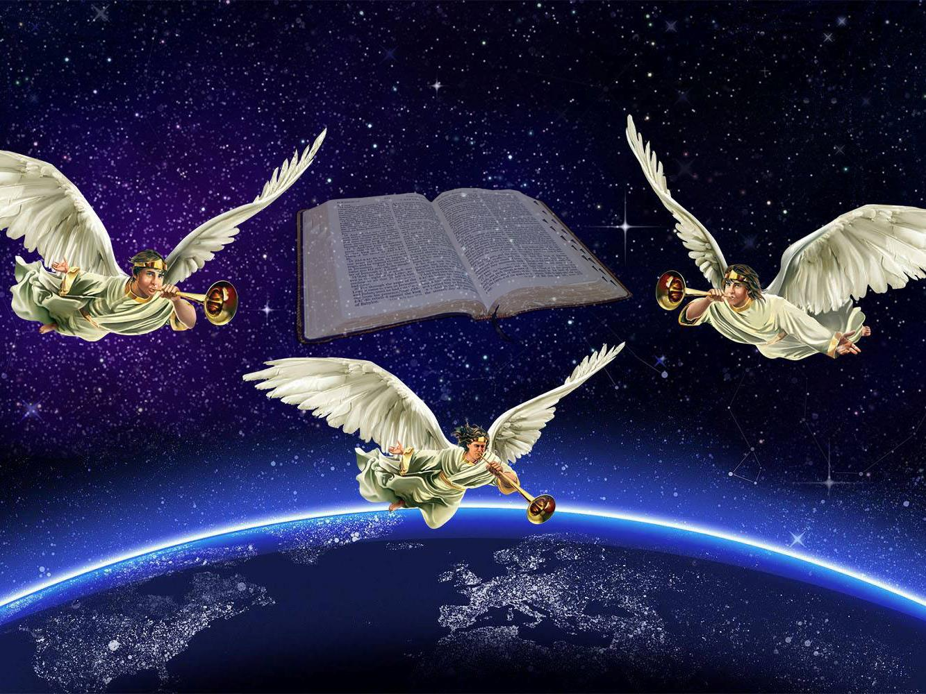
A MESSAGE WORTH SHARING
Lesson 12 for September 19, 2020

Slide 2

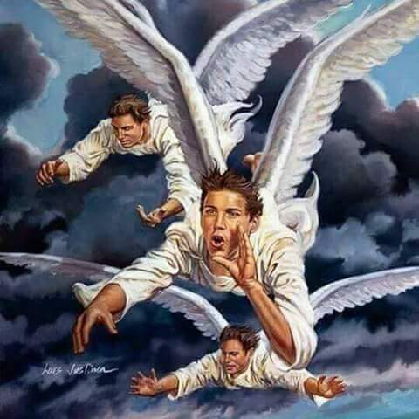









Revelation 14:6-12 depicts the final message that will be proclaimed in this world just before the Second Coming of Jesus.
We are called to preach this message, because the Second Coming is near. This is our “present truth.”
Let’s study this apocalyptic prophecy known as “the message of the three angels.”
The present truth
The context of the message
The first angel:
  The everlasting Gospel
  Fear, glory, judgment, and Creation
The second angel:
  The last call
The third angel:
  True worship

Slide 3

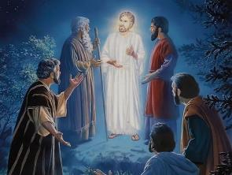
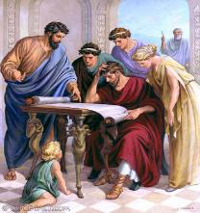
THE PRESENT TRUTH
“For this reason I will not be negligent to remind you always of these things, though you know and are established in the present truth.” (2 Peter 1:12)
God knows the future and is in control of history. He can send special messages for specific moments in human history (Isaiah 46:10; Amos 3:7). This is known as “the present truth.”
What was the present truth for the following people?
Noah
The Flood
Jeremiah
Surrender to Babylon to survive
John the Baptist
Prepare the way for the Messiah
Peter
The life, death, and resurrection of Jesus
When Peter shared his present truth, he also encouraged his audience to keep studying the previously revealed truth (2P. 1:16-21). God’s revelation is progressive, never contradictory.

Slide 4

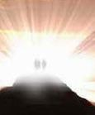
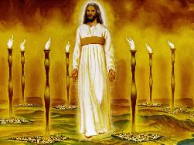
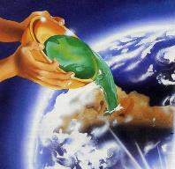
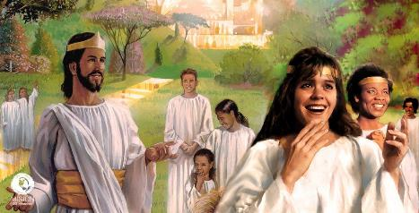
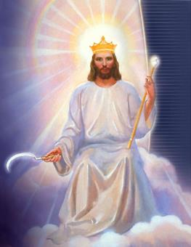
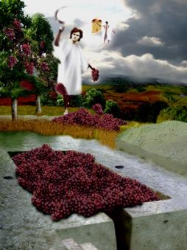
THE CONTEXT OF THE MESSAGE
“Then I looked, and behold, a Lamb standing on Mount Zion, and with Him one hundred and forty-four thousand, having His Father’s name written on their foreheads.” (Revelation 14:1)
In Revelation, the Lamb (Jesus) is seen through the Church’s history (c. 1-12). The moments prior to His Coming are revealed (c. 13-18), and we’re encouraged to look forward to that event–“I am coming quickly” (22:7)–and our future life (c. 19-22).
Chapter 13 depicts the final crisis, then chapter 14 introduces the last call and its consequences:
The bearers of the last call (v. 1-5)
The message of the last call (v. 6-12)
The consequence of accepting the call (v. 13-16)
The consequence of rejecting the call (v. 17-20)
The harvest represents the redemption of the righteous. Reaping the grapes represents the death of the impious. Both will take place in the Second Coming, after the last message has been preached (Matthew 24:14).

Slide 5

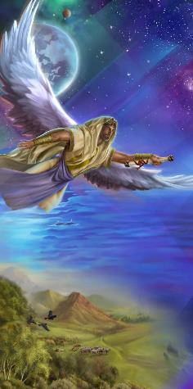
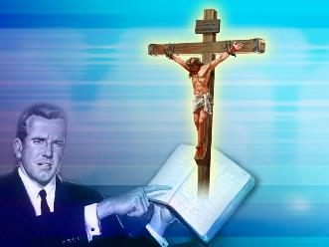
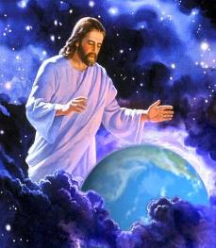
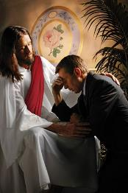
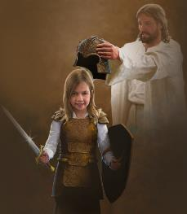

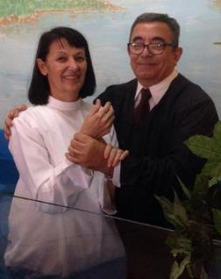
THE EVERLASTING GOSPEL
“Then I saw another angel flying in the midst of heaven, having the everlasting gospel to preach to those who dwell on the earth—to every nation, tribe, tongue, and people.” (Revelation 14:6)
The present truth that must be preached in the End Time has specific nuances, but its main foundation is the everlasting Gospel.
The Gospel is the good news of God’s Grace, His sacrifice, His creative and redeeming power, His forgiveness, His power to make us victors, His infinite love…
Everyone must receive this message. No matter their nationality, ethnic group, caste, faith, or social status. Everyone must hear about the good news and have the chance to accept Jesus as their personal Savior.

Slide 6

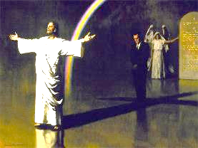
FEAR, GLORY, JUDGMENT, AND CREATION
“saying with a loud voice, ‘Fear God and give glory to Him, for the hour of His judgment has come; and worship Him who made heaven and earth, the sea and springs of water.’” (Revelation 14:7)
The message of the first angel is:
Fear or revere God in all we do. Give Him glory by putting Him in first place in all we think and do
Be aware that we will be judged, so we should obey His commandments (Ecclesiastes 12:13-14)
Worship God as the Creator, honoring the fourth commandment (i.e. Sabbath, Exodus 20:8-11)
There’s a relationship between revering God, obeying Him, and the Judgment. Obedience is a result a saving relationship with Jesus. Only His righteousness is good enough to stand in the Judgment. We’re safe in His righteousness.

Slide 7

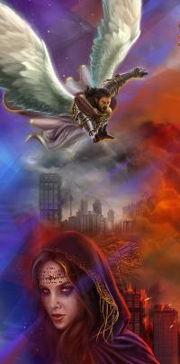
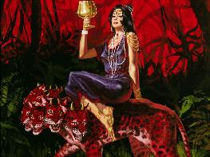
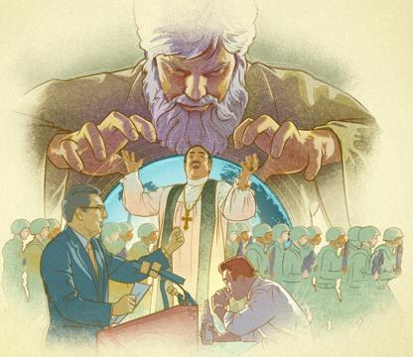
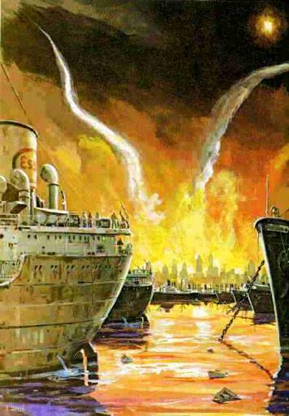
THE LAST CALL
“And another angel followed, saying, ‘Babylon is fallen, is fallen, that great city, because she has made all nations drink of the wine of the wrath of her fornication.’” (Revelation 14:8)
In the book of Revelation, “Babylon” stands for a false religion based in human works, human-made traditions, and false doctrines.
This religion combines the truths that Jesus taught with other doctrines and thoughts made by humans or by Satan. Everything is mixed in Babylon.
For this reason, God calls those who love Jesus and have accepted Him as their savior to flee from this confusion.
Revelation devotes two full chapters (17 and 18) to the fall is Babylon, so the call to come out of her is especially important.

Slide 8

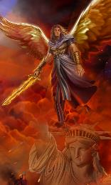
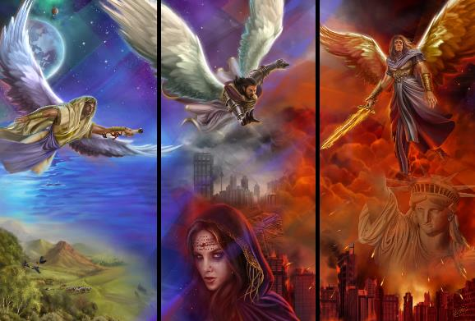
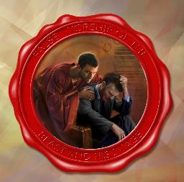
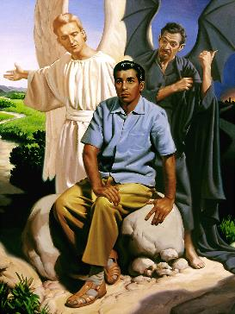
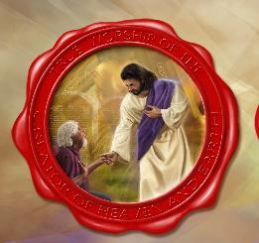
TRUE WORSHIP
“Then a third angel followed them, saying with a loud voice, ‘If anyone worships the beast and his image, and receives his mark on his forehead or on his hand, he himself shall also drink of the wine of the wrath of God […]’” (Revelation 14:9-10)
The message of the three angels is progressive. Once the Gospel has been preached throughout the world, the message is extended with a call to abandon the doctrinal confusion of “Babylon.”
The reaction to those two messages is shown in Revelation 13:15-18. The Beast–who is part and head of Babylon–imposes his mark. God places His mark on His people (Revelation 14:1).
The third message is related to worship: Worship the Creator in the day He decided, reject the Sunday rest (14:12), and do not worship the beast by rejecting God’s commandments, in order to avoid the deserved punishment (14:9-11).
We must make our own decision. Our daily choices will determine our decision in that moment.

Slide 9

“God has called His church in this day, as He called ancient Israel, to stand as a light in the earth. By the mighty cleaver of truth, the messages of the first, second, and third angels, He has separated them from the churches and from the world to bring them into a sacred nearness to Himself. He has made them the depositaries of His law and has committed to them the great truths of prophecy for this time […] The three angels of Revelation 14 represent the people who accept the light of God’s messages and go forth as His agents to sound the warning throughout the length and breadth of the earth.”
E.G.W. (Testimonies for the Church, book 5, cp. 52, p. 455)

