Slide 1
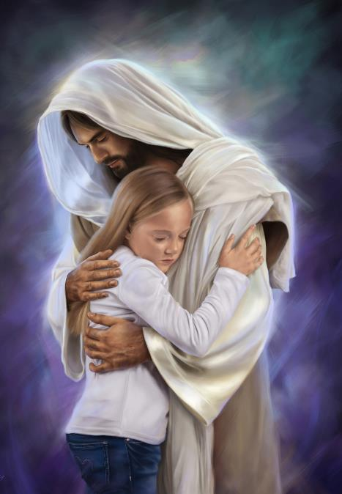
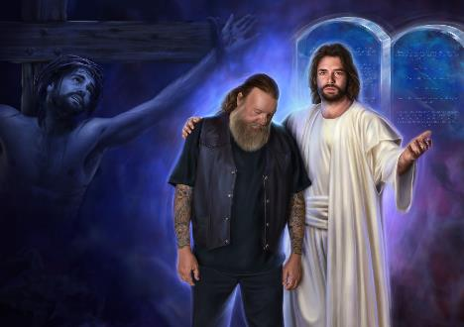
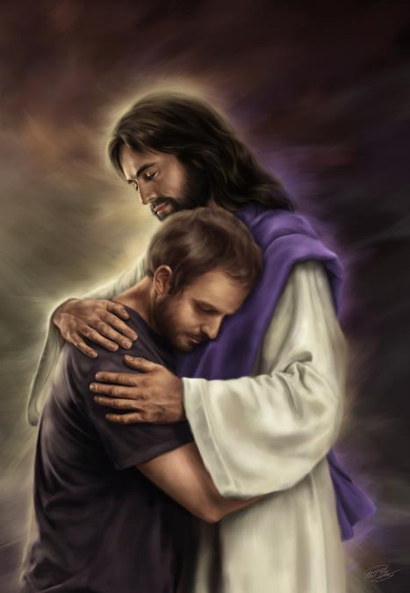
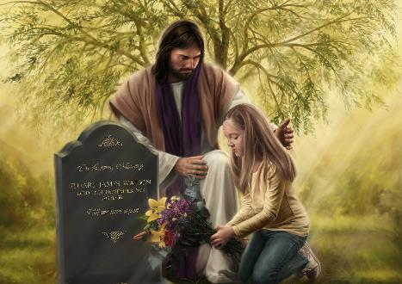
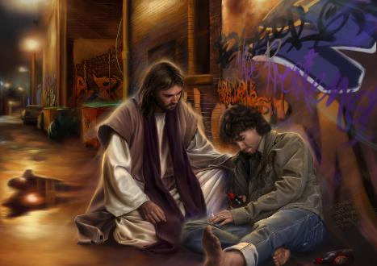
MINISTERING LIKE JESUS
Lesson 8 for August 22, 2020

Slide 2

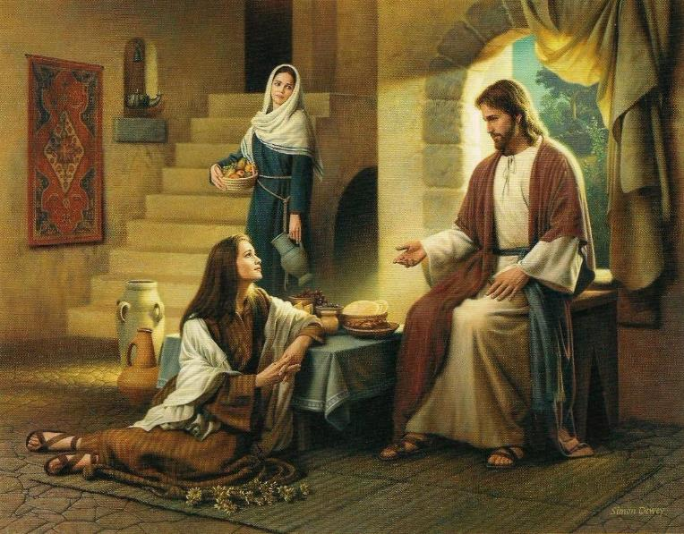
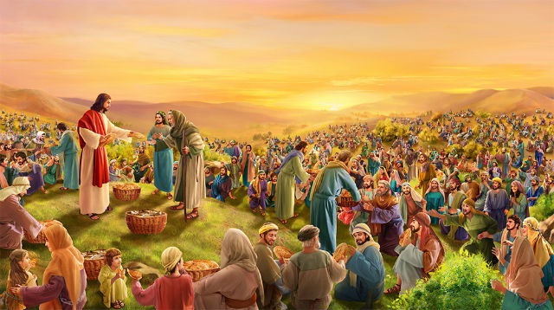





Jesus did more than preaching about the Kingdom of Heaven. He sat down with people, listened to them, and treated them with kindness.
He tried to satisfy both their temporary and eternal needs.
He’s the example to follow when ministering to others.
The light of the world
A kind treatment
Supplying their needs
The most important thing
What matters to Jesus

Slide 3

THE LIGHT OF THE WORLD
“Then Jesus spoke to them again, saying, ‘I am the light of the world. He who follows Me shall not walk in darkness, but have the light of life.’” (John 8:12)
Jesus came to this world to remove the darkness of sin with the light of salvation (John 1:4-5; 3:19-21).
He mixed with humanity to do so. “He went around doing good and healing all” (Acts 10:38).
He encouraged us to follow His example with two examples (Matthew 5:13-14):
Be salt. Salt must be mixed with food to be effective and enhance its flavor. We must be in the world to infuse it with the Gospel (John 17:15-18).
Be light. Light must shine in the darkness of neighborhoods, villages, towns, and cities, lighting them up with the glory of God
(Philippians 2:15).

Slide 4

“It is not God’s will that we should seclude ourselves from the world. But while in the world we should sanctify ourselves to God. We should not pattern after the world. We are to be in the world as a corrective influence, as salt that retains its savor. Among an unholy, impure, idolatrous generation, we are to be pure and holy, showing that the grace of Christ has power to restore in man the divine likeness. We are to exert a saving influence upon the world.”
E.G.W. (Counsels on Health, p. 592)

Slide 5

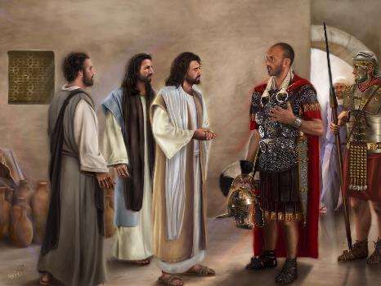
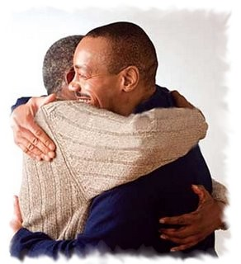


A KIND TREATMENT
“Let your speech always be with grace, seasoned with salt, that you may know how you ought to answer each one.” (Colossians 4:6)
Jesus found the good attributes of others and pointed them out (Matthew 8:10; Mark 12:34).
This way, their hearts were open to the words of Jesus.
Jesus was so compassionate that He was careful not to bruise unnecessarily someone who was just coming to faith or to quench the slightest embers of faith in their hearts (Isaiah 42:3).
We must find the good things in those around us and let them know we appreciate them. This way we will be a positive influence in their lives.

Slide 6

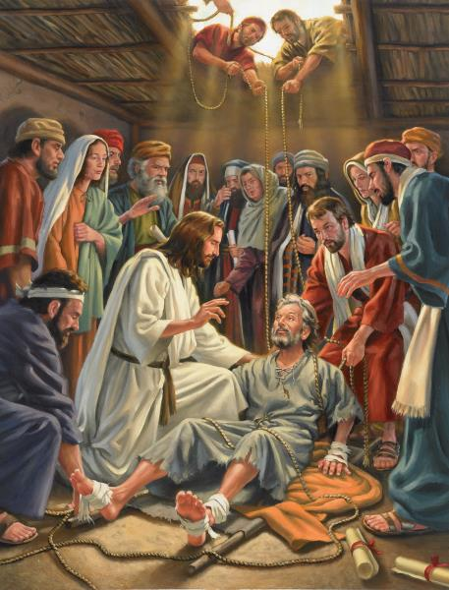
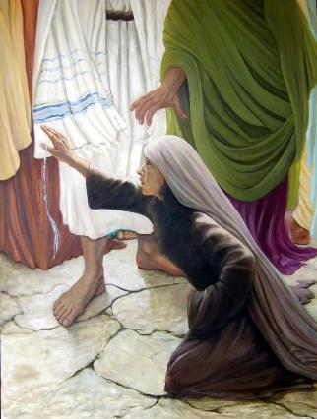
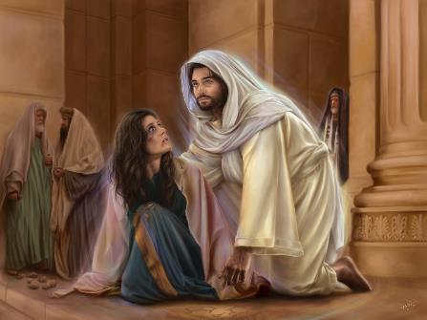
SUPPLYING THEIR NEEDS
“Then behold, they brought to Him a paralytic lying on a bed. When Jesus saw their faith, He said to the paralytic, ‘Son, be of good cheer; your sins are forgiven you.’” (Matthew 9:2)
Jesus identified the needs of others and restored them physically, mentally, emotionally, and spiritually.
He solved their issues and invited them to seek eternal life: “your sins are forgiven”; “your faith has made you well”; “go and sin no more.” (Matthew 9:2; Luke 8:48; John 8:11)
We must care for the needs of others and try to fulfill them if we’re able to do so.
When we fulfill their needs, we’re also opening a door to show them how to fulfill the greatest need everyone has (even if they don’t know it): freedom from sin, and eternal life; that is, Jesus.

Slide 7

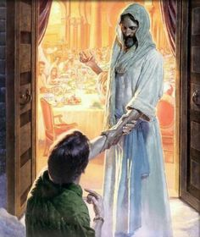
THE MOST IMPORTANT THING
“Then Jesus went about all the cities and villages, teaching in their synagogues, preaching the gospel of the kingdom, and healing every sickness and every disease among the people.” (Mateo 9:35)
The ministry of Jesus was based on three pillars:
Teaching. Teaching the truths of the Kingdom to small groups
Preaching. Tell crowds about the love of God and His plan of redemption
Healing. Free people from their temporary health issues
Which one of these pillars was more important to Jesus? (Mark 1:38)
He came to this world “to seek and to save which was lost.” (Luke 19:10). Therefore, preaching about salvation and teaching others to do so was the most important.
Besides, each healing act was a chance to reveal God’s character and to offer eternal life.

Slide 8


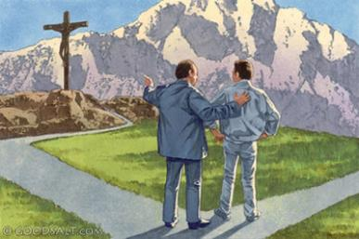
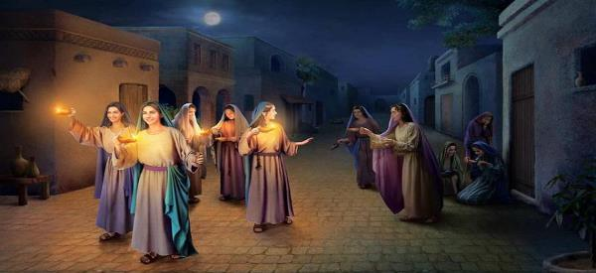
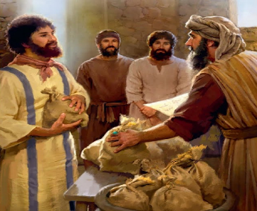
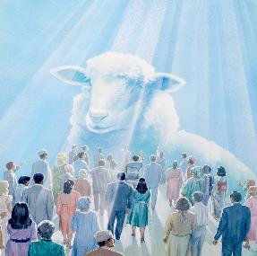
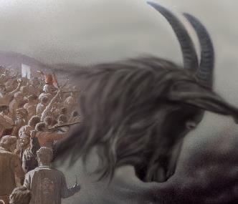
WHAT MATTERS TO JESUS
“‘For I will restore health to you and heal you of your wounds,’ says the Lord.” (Jeremiah 30:17)
God used the prophets to talk about the incurable disease of humanity: sin
(Isaiah 1:5; Jeremiah 30:12).
Jesus is eager to see everyone healed from that sickness, and to see those who are already healed bringing healing to others too.
Jesus used three parables to talk about the End of Time in Matthew 25. They encourage us to be filled with the Holy Spirit and to use the gifts He has given to us faithfully.
In the last parable, He explained the character of true Christians. Those who live to serve others instead of living a selfish life will be received by Him.

Slide 9

“The grace of Christ revealed to us must be tenderly revealed to others. A great tenderness and compassion will fill the soul for human beings who are still under the control of Satan. Christ is to be multiplied in every man and woman who believes in Him, for they are to live over the life of Christ in blessing and enlightening and bringing hope and peace and joy to other hearts.”
E.G.W. (Our Father Cares, May 20)

