Slide 1
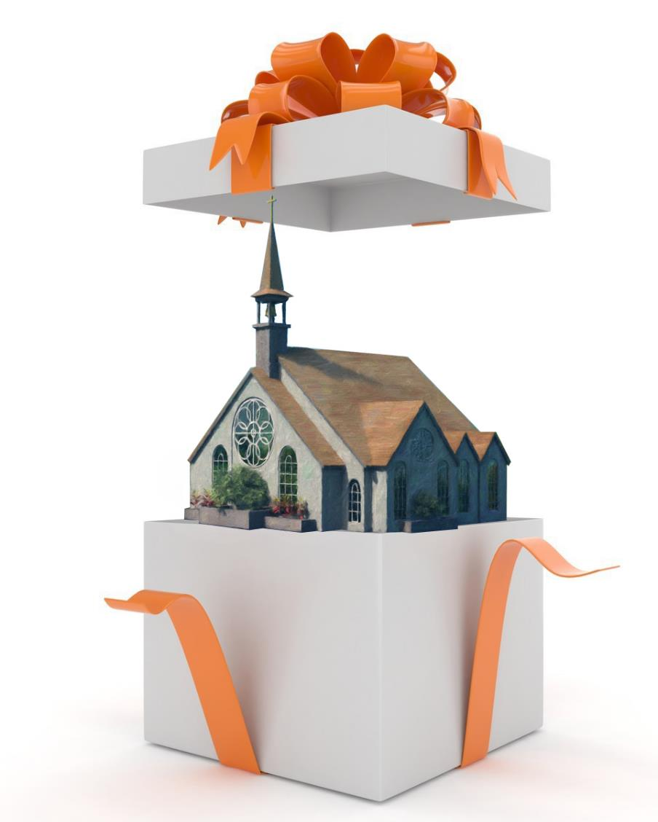

UNLIMITED POSSIBILITIES
Lesson 6 for August 8, 2020

Slide 2

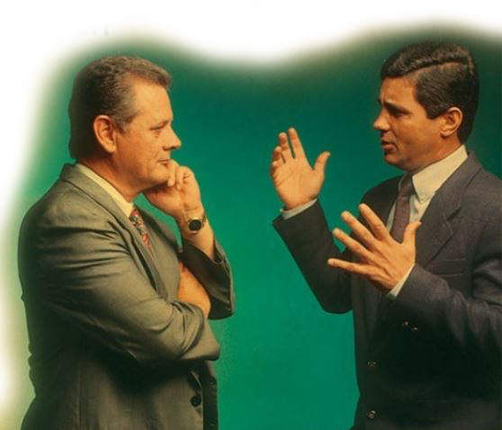





Jesus not only commissioned us to preach the Gospel throughout the world, but He also gave us gifts which empower us to fulfill that mission.
Spiritual gifts are divinely bestowed qualities given by the Holy Spirit specifically to build the body of Christ and enable believers to be effective witnesses in the world.
Who receives them?
Who gives them?
What’s their purpose?
How can I know my gifts?
How can my gifts grow?

Slide 3

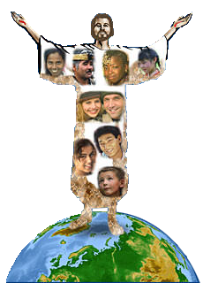

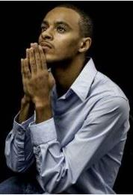
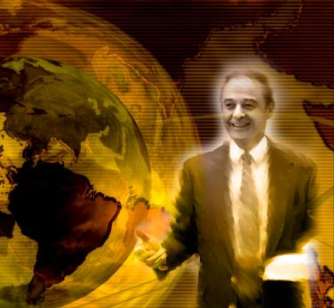
WHO RECEIVES THEM?
“But now indeed there are many members, yet one body.” (1 Corinthians 12:20)
Paul compared the members of the Church to those of a human body. In this comparison, the Church is the body of Christ (1Co. 12:12-27).
The hands, eyes, and lungs are quite different. Each member has unique characteristics and functions.
Likewise, each Church member is unique and has a unique set of gifts. All the members of the body have a purpose, and there are no Church members without gifts.
All have received at least one spiritual gift. We must work together to use those gifts to share the love and truth of Christ with the whole world.
There are no dispensable or useless members. Those preaching to crowds are as valuable as those praying silently.

Slide 4

“It is by the Lord’s orders that His servants have varied gifts. It is by His appointment that men of varied minds are brought into the church, to be laborers together with Him. We have many different minds to meet, and different gifts are needed. God’s servants are to work in perfect harmony.”
E.G.W. (This Day With God, September 10)

Slide 5

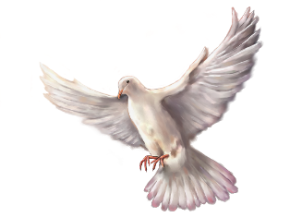

WHO GIVES THEM?
“But one and the same Spirit works all these things, distributing to each one individually as He wills.” (1 Corinthians 12:11)
The Bible explains that every perfect gift comes from God. The Holy Spirit is giving them as He considers best (James 1:17).
Why can’t we choose our gifts?
Because we know too little about how we should fulfill the mission we’ve been given.
When we surrender our hearts to Jesus, God gives us the most appropriate gifts, so they can be used effectively to make the Church grow.
In addition to specific gifts, God also entrusts us with a specific work we must carry out in cooperation with others.

Slide 6

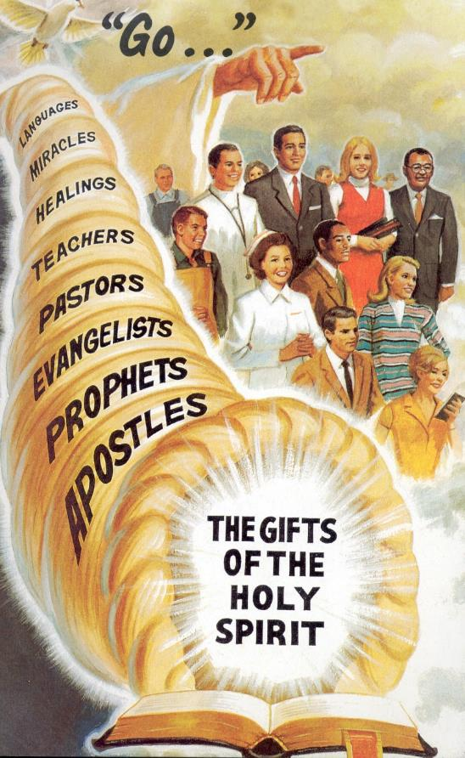
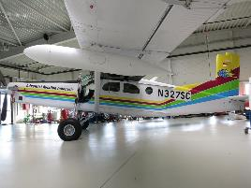
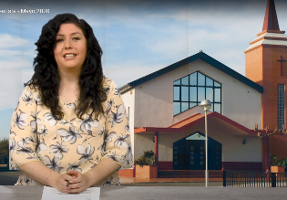

WHAT’S THEIR PURPOSE?
“for the equipping of the saints for the work of ministry, for the edifying of the body of Christ.” (Ephesians 4:12)
There are lists of gifts given to the first believers in Romans 12:6-8, 1 Corinthians 12:8-10, 28-30 and Ephesians 4:11.
There are more gifts in addition to those first ones, like editing pictures and videos, piloting aircrafts, managing social networks…
Their purpose is to empower every believer to fulfill their function in the growth and nurture of the Church, so we can preach and serve the world.
Spiritual gifts are not natural talents. However, the Holy Spirit can sanctify natural talents and put them in service of Christ (becoming spiritual gifts).

Slide 7

“All men do not receive the same gifts, but to every servant of the Master some gift of the Spirit is promised. […] If they are connected with Christ, if the gifts of the Spirit are theirs, the poorest and most ignorant of His disciples will have a power that will tell upon hearts. God makes them the channel for the outworking of the highest influence in the universe.”
E.G.W. (The Faith I Live By, October 13)

Slide 8



HOW CAN I KNOW MY GIFTS?
“Therefore you do not lack any spiritual gift […]” (1 Corinthians 1:7 NIV)
We all have received gifts… which ones do you have?
The best way to find them out is to “get on with it”. Begin working in a ministry in your local church. That way you will find out if you have the right gifts for that work or not.
Let’s define some concepts:
Gifts: Special skills (e.g. teaching with ease)
Ministries: General fields of service (e.g. Sabbath School)
Activities: Specific events (e.g. leading a Sabbath School class)
If you already know your gift, you will find the right ministry or activity for yourself easily.
If you feel comfortable in a specific ministry, you can discover your gifts in that area and the best activities for your gifts.
If you do a specific activity well, you will find your gifts and the right ministry for you as you work in that activity.
Gifts
Ministries
Activities

Slide 9

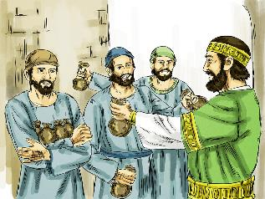
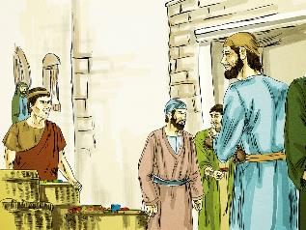
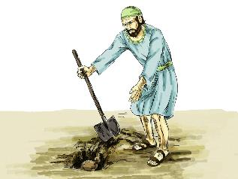
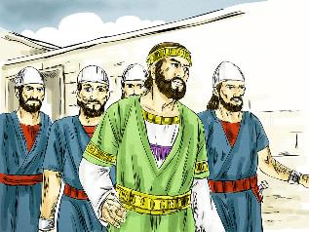
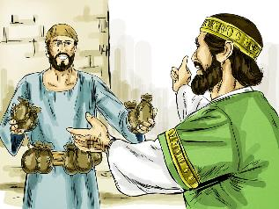
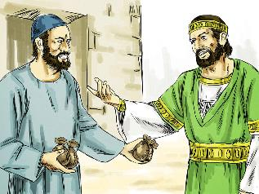
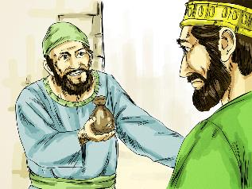
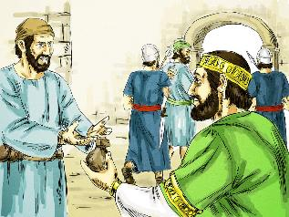
HOW CAN MY GIFTS GROW?
“For to everyone who has, more will be given, and he will have abundance; but from him who does not have, even what he has will be taken away.” (Matthew 25:29)
In the parable of the talents, Jesus explained that everyone receives gifts, but some people receive more than others
(Matthew 25:14-30).
However, that’s the starting point only. We can “negotiate” with our initial gifts.
They will grow as we use them, and we may also receive new gifts. Be careful, as we may lose our gifts if we don’t use them.
Ask God to show you which gifts He’s given you and how you can best use them. It doesn’t matter how many gifts you’ve received, but what you do with them.

Slide 10

“To His servants Christ commits ‘His goods’—something to be put to use for Him. He gives ‘to every man his work.’ Each has his place in the eternal plan of heaven. Each is to work in co-operation with Christ for the salvation of souls. Not more surely is the place prepared for us in the heavenly mansions than is the special place designated on earth where we are to work for God.”
E.G.W. (Christ’s Object Lessons, cp. 25, p. 326)

