Slide 1
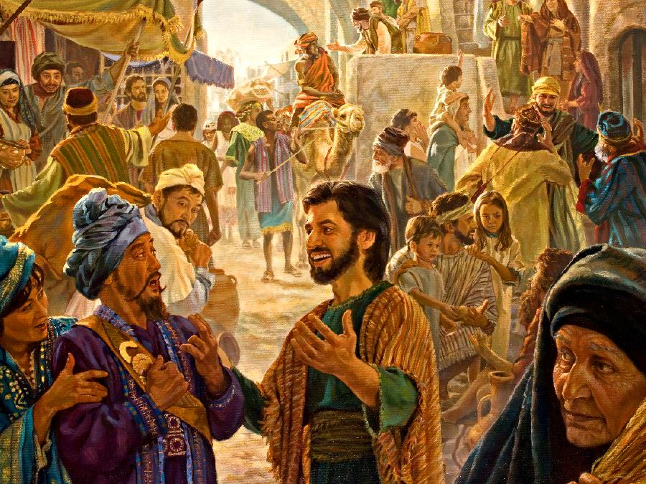
SPIRIT-EMPOWERED WITNESSING
Lesson 5 for August 1, 2020

Slide 2
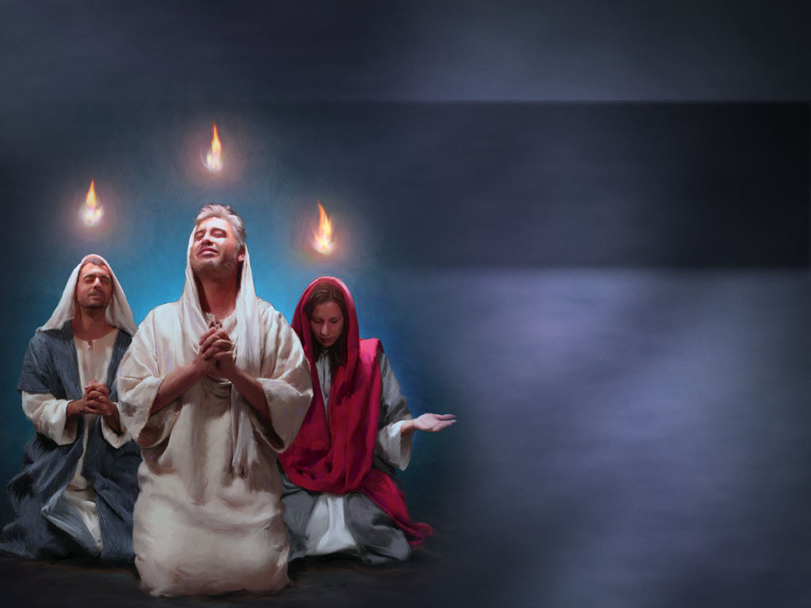
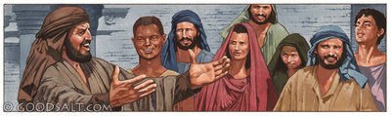





How’s the Holy Spirit related to witnessing?
Without the Spirit, witnessing is barren because it cannot produce fruit for eternal life.
That is why Jesus ordered His disciples to wait for the power of the Holy Spirit before beginning their witnessing work.
How does the Holy Spirit make witnessing effective?
He prepares the witness
He produces growth
He strengthens and guides
He gives the Word
He transforms

Slide 3

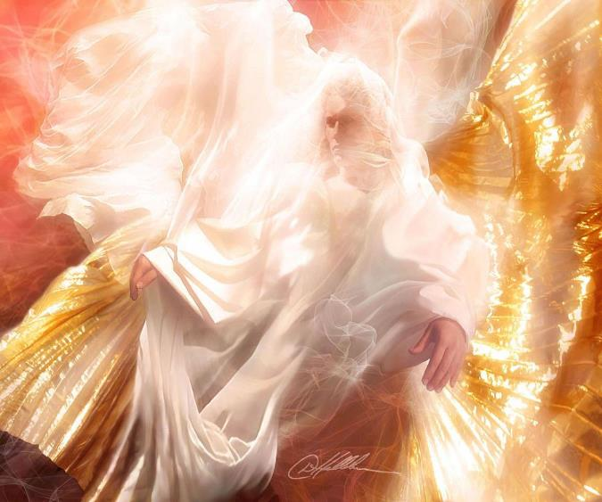
HE PREPARES THE WITNESS
“But you shall receive power when the Holy Spirit has come upon you; and you shall be witnesses to Me in Jerusalem, and in all Judea and Samaria, and to the end of the earth.” (Acts 1:8)
Before His ascension, Jesus promised that a Helper (parakletos) would come: The Holy Spirit. He would help us to carry out the mission Jesus commended us to do.
What does the Holy Spirit do?
He opens the hearts to the Gospel
He convinces people
He shows us the right opportunities
He transforms us to His image
He walks
with us
He prepares us to bear witness
He leads us in our tasks
He gives us the right words
He encourages us to testify
He reveals Jesus
Witnessing is to collaborate with the Holy Spirit.

Slide 4

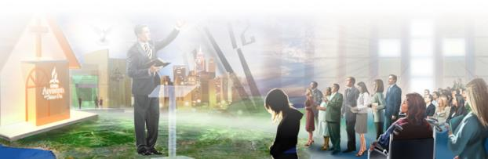
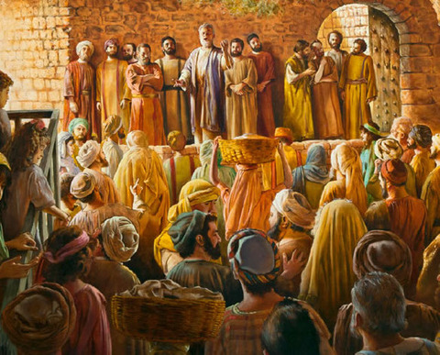
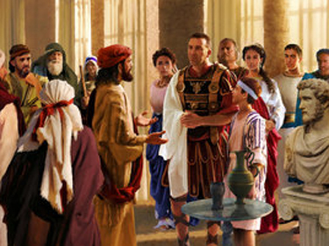
HE PRODUCES GROWTH
“And the Lord added to the church daily those who were being saved.” (Acts 2:47)
The Acts of the Apostles tells the work of the Holy Spirit through those who let Him work in their lives.
On occasion, there were mass conversions, like 3,000 or 5,000 people (Acts 2:41; 4:4). Whole families were converted sometimes (10:44-48).
New local churches were founded continuously because of this growth (16:5).
The Spirit filled the messengers with power and touched every heart that heard about the Gospel.
Every person is important to God. He died for each and every one. He wants everyone to know about Him and accept Him. He has chosen us to do this work.

Slide 5
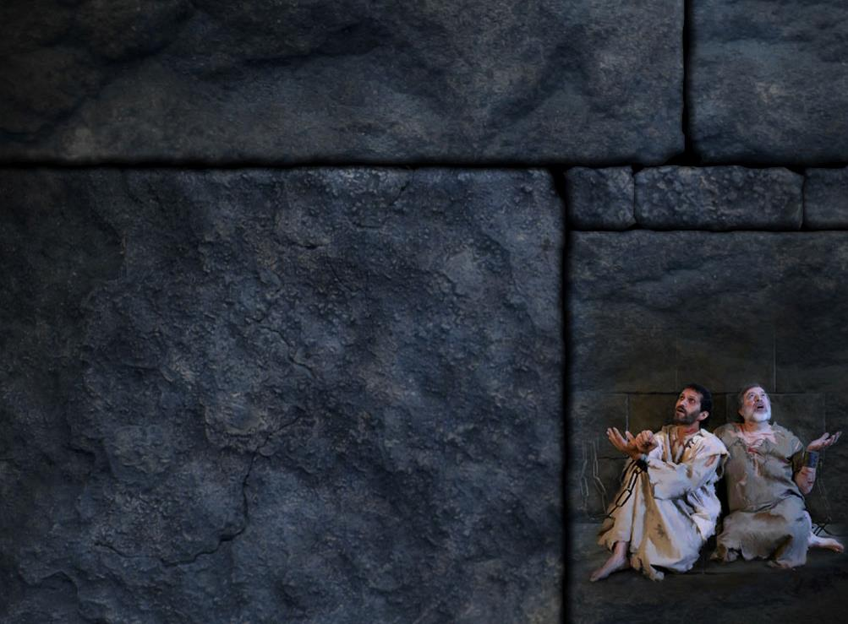
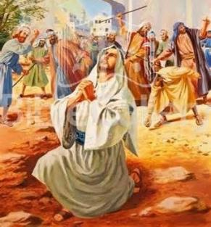
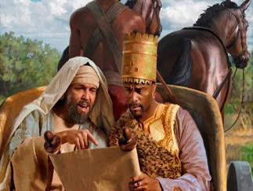
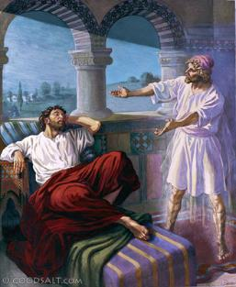
HE STRENGTHENS AND GUIDES
“But at midnight Paul and Silas were praying and singing hymns to God, and the prisoners were listening to them.” (Acts 16:25)
Preaching the Gospel is not a problem-free task. However, the Spirit strengthens His servants as He did with Stephen, and Paul and Silas (Acts 7:55; 16:25).
He brings walls down and maintains the Church united (11:15; 15:28).
He also leads us to the right places and people in a supernatural way, opening and closing the appropriate doors. Thanks to His work, the Gospel could be preached in Africa and Europe (8:26-38; 16:6-10).
The Holy Spirit longs to empower us, strengthen us, teach us, guide us, unify us, and send us out on the most important mission in the world, which is leading men and women to Jesus and His truth.

Slide 6

HE GIVES THE WORD
“many of those who heard the word believed;” (Acts 4:4)
The Spirit encourages us to base our testimony in the Word of God. Review the following examples:
Acts 2:14-21. Peter quoted Joel and Psalms in his Pentecost speech
Acts 7. Stephen used the story of Israel in his speech before the Sanhedrin
Acts 8:35. Philip began with a verse from Isaiah and went over the whole Bible
Acts 17:3. Paul based his speeches in the Word of God
The Word of God has power to change lives because the Holy Spirit inspired its authors. The same Holy Spirit is touching the heart of every sincere reader today.

Slide 7

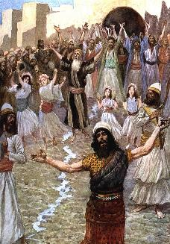
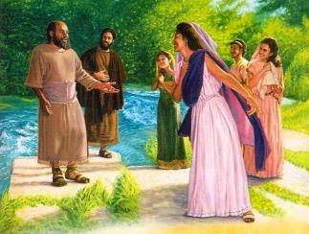
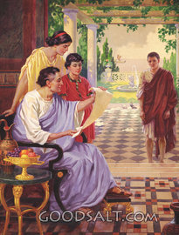
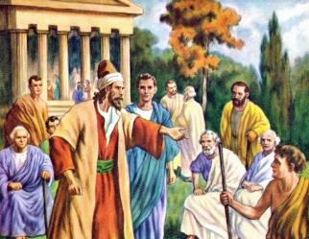
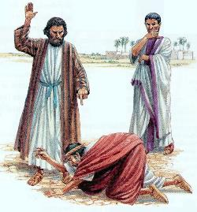
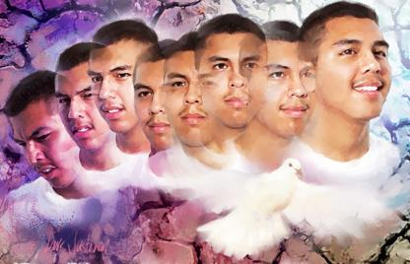
“Then the Spirit of the Lord will come upon you, and you will prophesy with them and be turned into another man.” (1 Samuel 10:6)
HE TRANSFORMS
The Holy Spirit uses people as they are. He breaks prejudices down, transforms their bad habits, and fills them with Christ’s grace and truth.
He makes no distinction between men or women, rich or poor, cultured or uncultured.
He transformed Lydia, a seller of purple (Acts 16:14-15); Onesimus, a slave (Philemon 10); Sergius, a Roman governor (Acts 13:6-12); Dionysius, an Areopagite (Acts 17:34) …
He is as powerful today as He was then. He still works miracles by transforming all kinds of people.
Our work is not to change or convert people, that’s the Holy Spirit’s. We’ve been called to be witnesses.

Slide 8

“We are to bear as definite a testimony to the truth as it is in Jesus, as did Christ and His apostles. Trusting in the efficiency of the Holy Spirit, we are to testify of the mercy, goodness, and love of a crucified and risen Saviour, and thus be agents through whom the darkness will be dispelled from many minds, and cause thanksgiving and praise to ascend from many hearts to God. There is a great work to be done by every son and daughter of God.”
E.G.W. (Selected Messages, book 1, cp. 37, p. 263)

