Slide 1

PRAYER POWER: INTERCEDING FOR OTHERS
Lesson 4 for
July 25, 2020

Slide 2

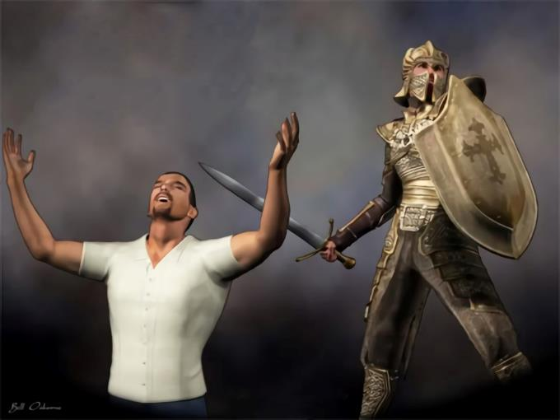
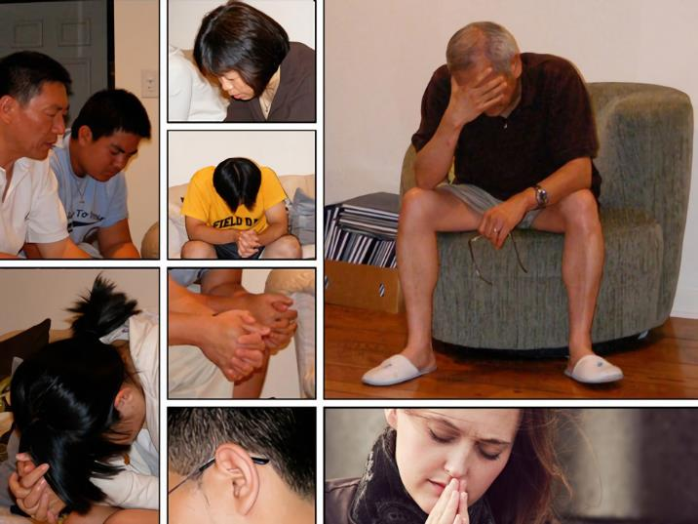






The Word of God encourages us to “pray without ceasing” (1 Thessalonians 5:17). In Paul’s description of the Christian’s armor, he stated that we should “pray always,” and asked the Ephesians to pray for him (Ephesians 6:18-19).
Prayer is especially powerful when used to intercede for others, either believers or not.
Intercessory prayer:
  Praying in conflict
  Praying for specific people
  Praying for other believers
God hears our prayers
How to pray

Slide 3



PRAYING IN CONFLICT
“For we do not wrestle against flesh and blood, but against principalities, against powers, against the rulers of the darkness of this age, against spiritual hosts of wickedness in the heavenly places.” (Ephesians 6:12)
We live in a conflict with cosmic extent. A conflict between good and evil, between Christ and Satan. Every person is serving in one side, and most people are dithering.
There’s no “compulsory military service” in Christ’s side. He doesn’t force anyone to follow Him. He doesn’t intervene if we don’t allow Him.
Intercessory prayer is the way we “let” God intervene in the lives of those we pray for.
God honors our choice to pray for them and works even more powerfully in their behalf.

Slide 4

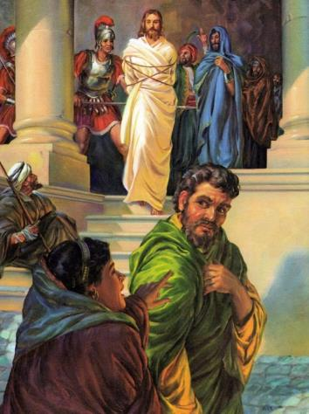
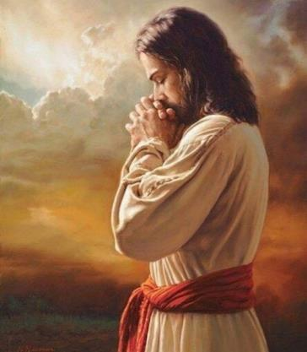
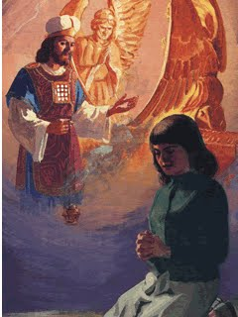
PRAYING FOR SPECIFIC PEOPLE
“And the Lord said, ‘Simon, Simon! Indeed, Satan has asked for you, that he may sift you as wheat. But I have prayed for you, that your faith should not fail.’” (Luke 22:31-32)
Jesus was a man of prayer during His stay on Earth. The harder the conflict, the more time He devoted to prayer.
He didn’t rely on His own strength to overcome the hosts of evil. He always depended on the strength of the Omnipotent through prayer.
He left an example of praying for specific people, as He did for Peter. Jesus knew that Peter wasn’t aware he needed help on that night. Therefore, Jesus interceded on his behalf.
God encourages us to bring specific people to His throne and leave them on His hands. We must persist until we see the result.
Remember that Jesus is also interceding for each one of us right now.

Slide 5


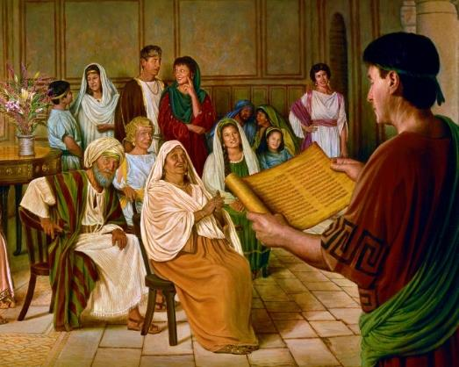
PRAYING FOR OTHER BELIEVERS
“[I] do not cease to give thanks for you, making mention of you in my prayers:” (Ephesians 1:16)
Paul used to pray for other believers. What did he ask for? See Ephesians 1:17-23.
That God may give them wisdom (v. 17)
That they may know God better (v. 17)
That they may know the hope of His calling (v. 18)
That they may know the glorious inheritance to come (v. 18)
That they may know God’s power (v. 19-23)
Paul also used to thank for the spiritual growth of his brothers and sisters, as in his prayer in Philippians 1:3-11. He prayed for them to continue their progress in the faith.
We should pray for our brothers and sisters as Paul did, so they may be strengthened and encouraged in their Christian journey.

Slide 6

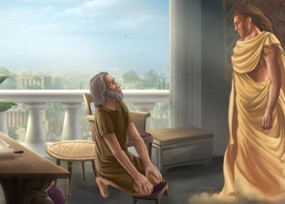
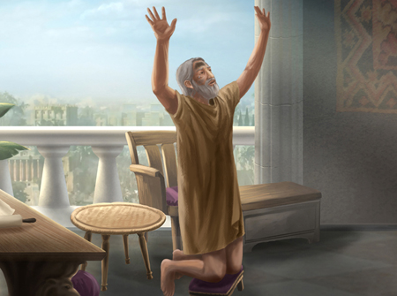
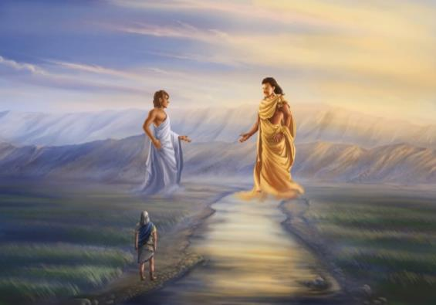
GOD HEARS OUR PRAYERS
“Then he said to me, ‘Do not fear, Daniel, for from the first day that you set your heart to understand, and to humble yourself before your God, your words were heard; and I have come because of your words.’” (Daniel 10:12)
Daniel was worried about the situation of those who had returned from Babylon to Jerusalem. Daniel was upset and prayed for them for 21 days.
It looked like his prayer was not being answered after so many days. The situation was not changing at all.
God sent a vision to the distraught prophet in the most appropriate moment. He assured Daniel that his prayers had been listened since the first one.
God had been working in other aspects of the battle before answering Daniel’s prayer. He listens to every intercessory prayer, although we may have to wait for His answer.

Slide 7

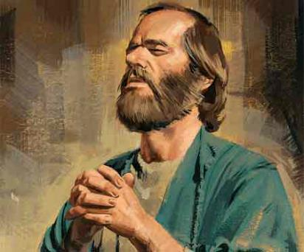
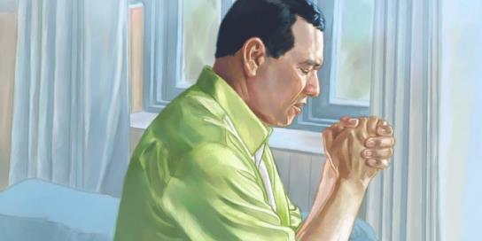
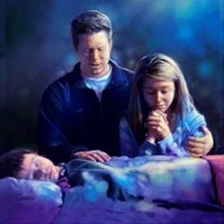
HOW TO PRAY
“As for me, I will certainly not sin against the Lord by ending my prayers for you.”
(1 Samuel 12:23 NLT)
Our intercessory prayers should be fervent, sincere and specific.
Paul prayed for specific people (e.g. his collaborators) and specific churches (e.g. Ephesus or Philippi). He also asked the church to pray for his liberation or for his preaching to be strengthened (Phil. 1:19;
Col. 4:3).
We should pray for those who we know haven’t meet their Savior yet (Jn. 17:20), for the believers to be strengthened (Eph. 3:14-16), for God to extend His forgiveness
(1Jn. 5:16), for the protection of those going through hard times (Acts 12:12)…
When we pray for others, we become a channel of God’s blessing to them.

Slide 8

“What does intercession comprehend? It is the golden chain which binds finite man to the throne of the infinite God. The human agent whom Christ has died to save importunes the throne of God, and his petition is taken up by Jesus who has purchased him with His own blood. Our great High Priest places His righteousness on the side of the sincere suppliant, and the prayer of Christ blends with that of the human petitioner.”
E.G.W. (That I May Know Him, March 13)

Slide 9

“Begin to pray for souls; come near to Christ, close to His bleeding side. Let a meek and quiet spirit adorn your lives, and let your earnest, broken, humble petitions ascend to Him for wisdom that you may have success in saving not only your own soul, but the souls of others.”
E.G.W. (Testimonies for the Church, book 1, cp. 86, p. 513)

