Slide 1
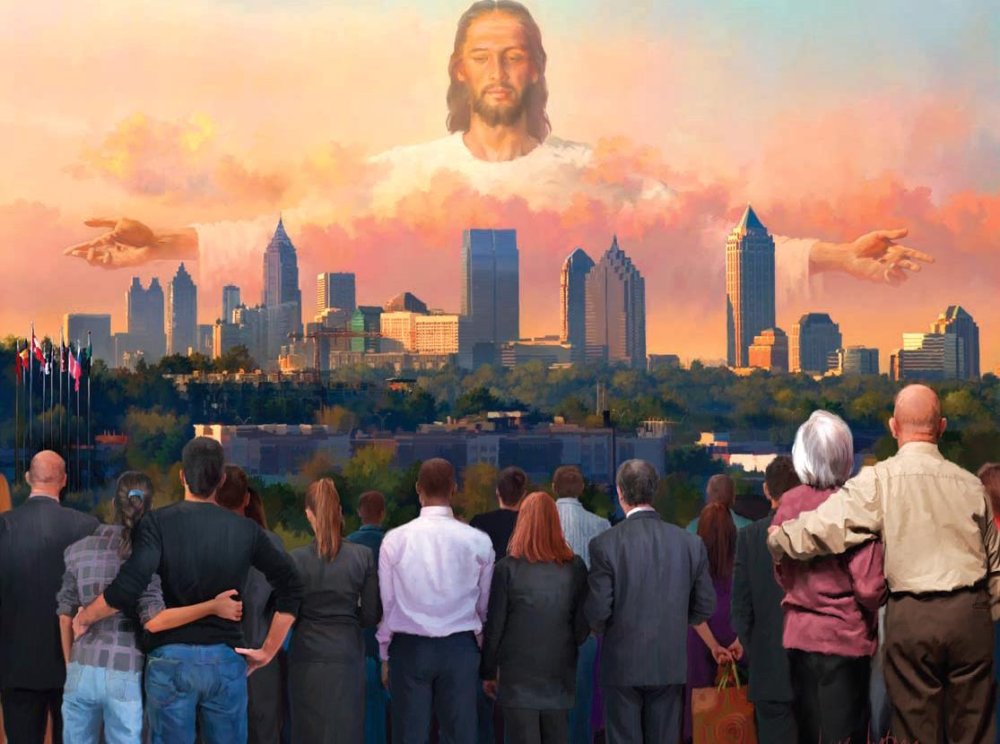
SEEING PEOPLE THROUGH JESUS’ EYES
Lesson 3 for July 18, 2020

Slide 2

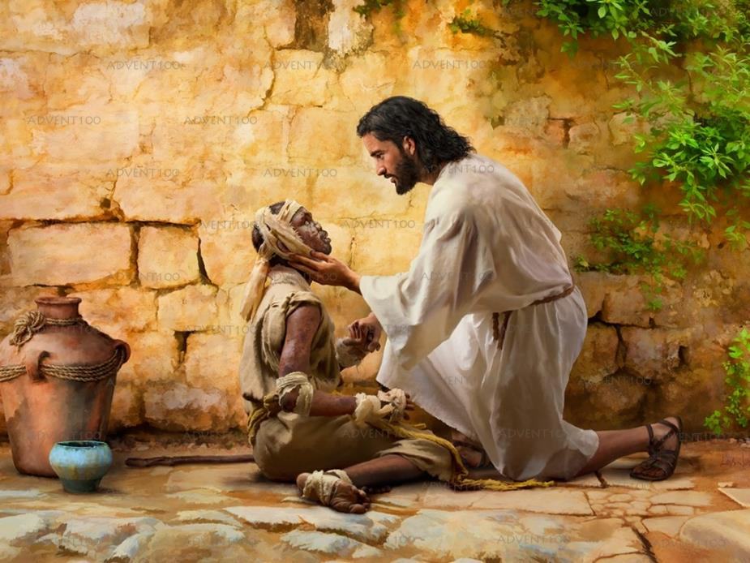

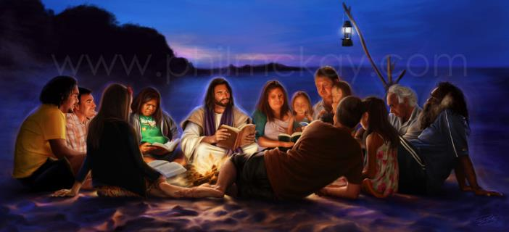




How did Jesus see people?
He saw people with sympathy. He considered each person a life to save. He saw what they would become if they accepted salvation.
Each person was valuable and unique for Jesus. Therefore, He treated everyone in a special way, and didn't despise anyone.
Let's learn to treat others like Jesus did.
Leading others
Accepting everyone
Making friends
Treating others in a special way
Taking advantage of every opportunity

Slide 3

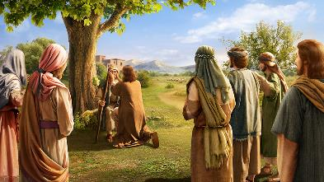


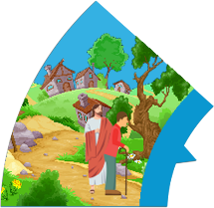
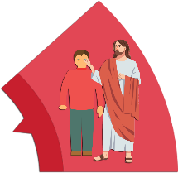

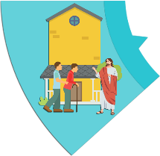


LEADING OTHERS
“Then He came to Bethsaida; and they brought a blind man to Him, and begged Him to touch him.” (Mark 8:22)
This was a special miracle in many ways.
Many people will never come to Jesus unless someone with faith brings them to Him. This is our mission.
Sometimes we may need a "second touch" from Jesus to see the spiritual truths clearly.
3. After the first touch, He asked him if he could see
anything
4. The blind man saw men like trees
5. The second touch healed the blind man completely
2. Jesus took him aside
1. Some friends brought a blind man and asked Jesus to heal him
The blind man didn't believe in Jesus, but his friends did.
Jesus used two touches to heal him.

Slide 4

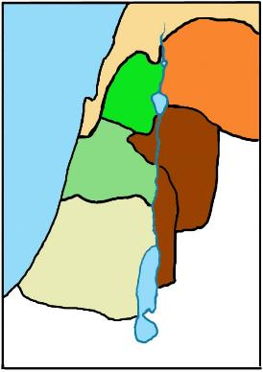
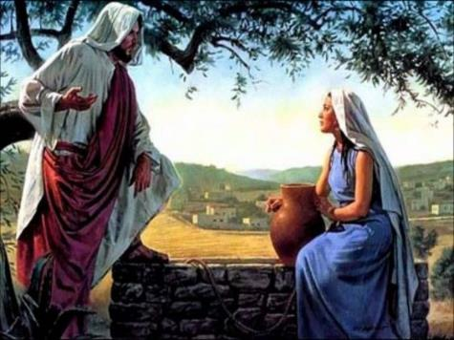
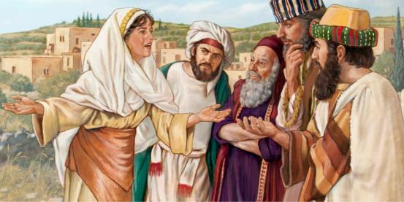
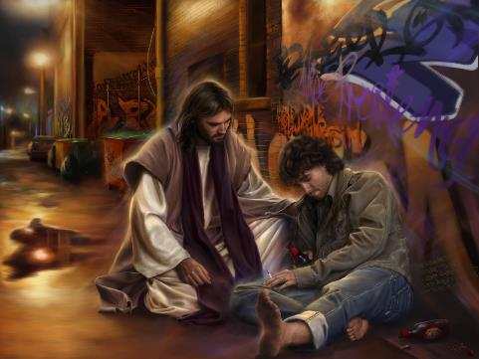
ACCEPTING EVERYONE
Galilee
“But He needed to go through Samaria.” (John 4:4)
Samaria
The relationship between Jews and Samaritans was quite tense. The Jews used to take a detour to get from Judea to Galilee, to not to go through Samaritan land.
Judea
However, Jesus sees beyond race, culture, sex and religion. He knew that there were people in Samaria who needed salvation, so His mission was to bring it to them.
When we see others with God's sympathy, every barrier is brought down. Then there's no more separation, because we see them as potential citizens of the Kingdom of Heaven.
We may not share or accept their political or religious ideas, but we always love them and want the best for them.

Slide 5

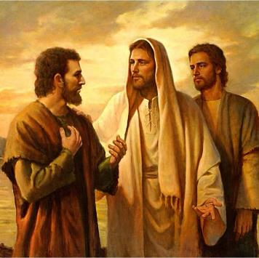
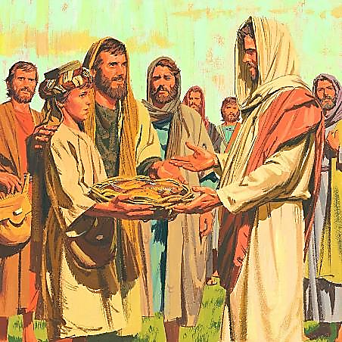
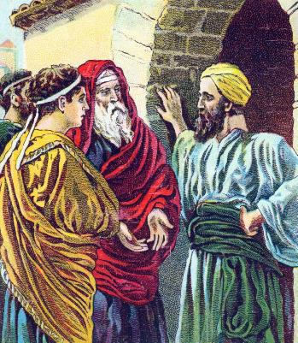
MAKING FRIENDS
“He first found his own brother Simon, and said to him, ‘We have found the Messiah’ (which is translated, the Christ).” (John 1:41)
When Jesus said goodbye to His disciples, He asked them to preach the gospel in increasing areas: “in Jerusalem, and in all Judea and Samaria, and to the end of the earth.” (Acts 1:8).
The apostle Andrew set an example of this method. First, he told his brother about Jesus [Judea].
Later, he befriended a lad [Samaria] and Jesus made a great miracle through him (John 6:5-11).
He eventually shared the Gospel with strangers [to the end of the earth], like the Greek men who were looking for Jesus
(John 12:20-26).
We can learn an effective method of bringing souls to Jesus from Andrew's example: building affectionate relationships with others.

Slide 6

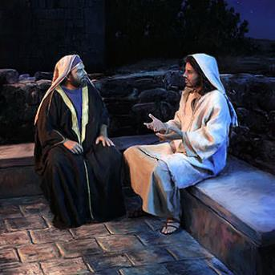
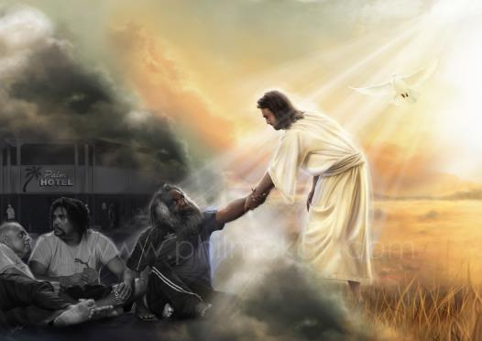
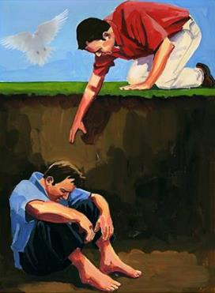
TREATING OTHERS IN A SPECIAL WAY
“Now when Jesus saw that he answered wisely, He said to him, ‘You are not far from the kingdom of God.’ But after that no one dared question Him.” (Mark 12:34)
How did Jesus deal with difficult people?
He listened to them carefully
He asked them questions
He revealed the truth gradually
He acknowledge the desire of their hearts
He saw potential in the most despicable people
He didn't consider anyone out of the Gospel's reach
He saw a reflection of the glory of Creation in everyone
He raised their thoughts so they could discover what they could become
Seeing others through Jesus’ eyes means to see everyone as a candidate for the Kingdom of Heaven, and treating them accordingly. To be successful witnesses, we must ask the Holy Spirit for this kind of vision.

Slide 7

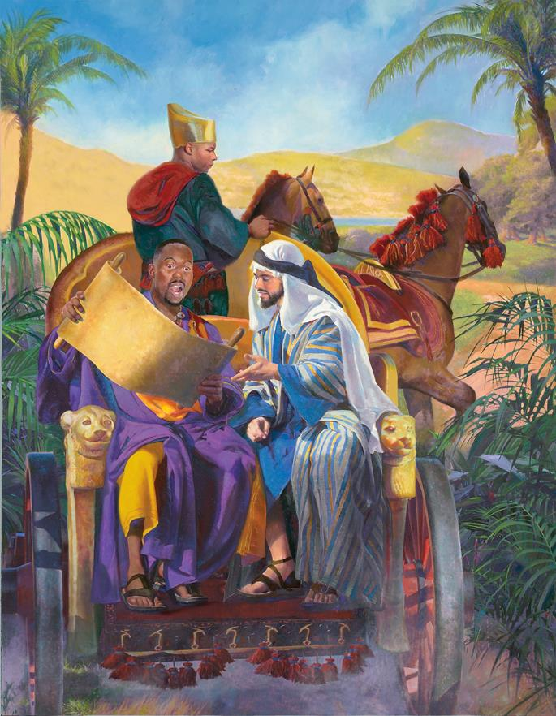
TAKING ADVANTAGE OF EVERY OPPORTUNITY
“I know your works. See, I have set before you an open door, and no one can shut it.” (Revelation 3:8)
God opens doors to give us providential opportunities to share the Gospel.
See Philip's example. God carried him to a specific place so he could meet a person reading a specific passage of the Scriptures. That person needed just a little push to surrender his heart to our Savior (Acts 8:26-39).
There are invisible angels eager to lead us through those "open doors." Ask God to give you judgment to recognize those providential opportunities, and to give you the appropriate words in those moments.

Slide 8

“Jesus came in personal contact with men. He did not stand aloof and apart from those who needed His help. He entered the homes of men, comforted the mourner, healed the sick, aroused the careless, and went about doing good. And if we follow in the footsteps of Jesus, we must do as He did. We must give men the same kind of help that He did.”
E.G.W. (Our Father Cares, February 17)

