Slide 1
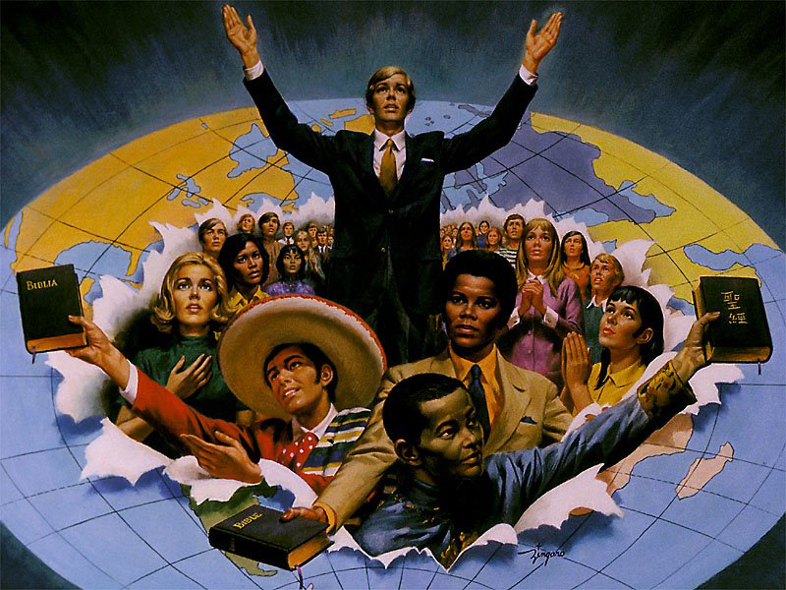
WHY
WITNESS?
Lesson 1 for July 4, 2020

Slide 2

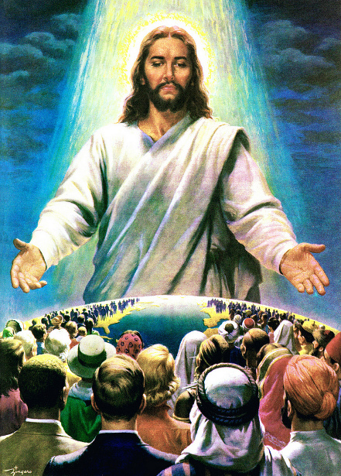





What’s God motivation to offer salvation to humankind?
God’s greatest desire is to see every person saved and transformed by His Spirit. He loves every human being. His love has no limits, His compassion is everlasting, and His forgiveness is endless. God is a loving father who wants all His children to come home as soon as possible.
God has chosen us to offer salvation to others. What’s our motivation to do so? Why witness?
To offer salvation
To make God glad
To grow
To obey
For love’s sake

Slide 3

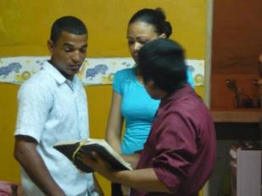
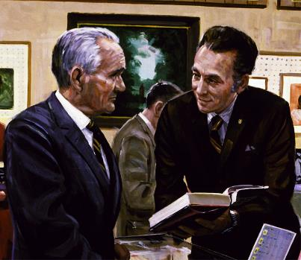
TO OFFER SALVATION
“How then shall they call on Him in whom they have not believed? And how shall they believe in Him of whom they have not heard? And how shall they hear without a preacher?” (Romans 10:14)
God reveals Himself in several ways:
Through the work of the Holy Spirit (Acts 5:32)
Through nature
(Psalm 19:1)
Through special or providential circumstances (1 Chronicles 16:12)
Through the life and ministry of Jesus
(John 1:18)
Despite being able to use all those means of communication, God has chosen us to announce the plan of salvation to others.
He wants those who have accepted Salvation to share it with others. He wants us to share what we have received, giving others the opportunity to accept eternal life (Matthew 10:8; James 5:20).

Slide 4

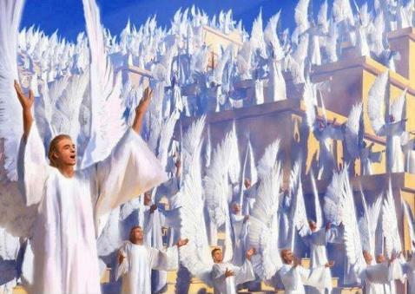
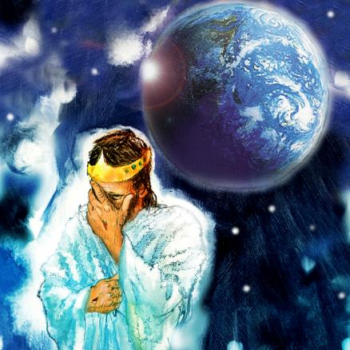
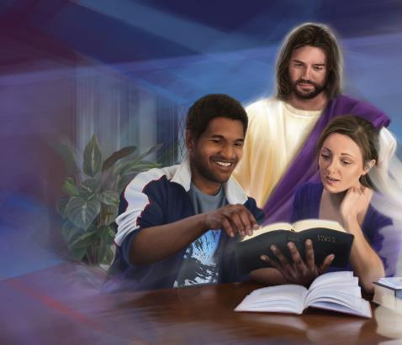
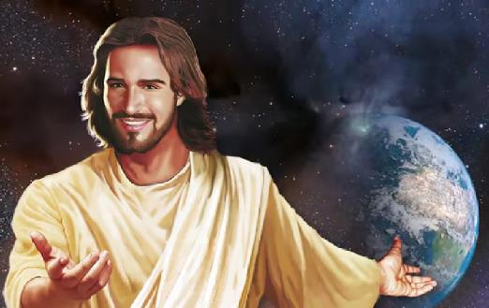
TO MAKE GOD GLAD
“Likewise, I say to you, there is joy in the presence of the angels of God over one sinner who repents.” (Luke 15:10)
Have you ever wondered how God feels about the pain, suffering and injustice sin has brought to our world?
(Jeremiah 13:17).
Heaven is filled with expectancy every time we share the Gospel with others, as God is eager to see them opening their hearts and accepting Salvation.
When a heart is opened to Salvation, the angels burst into shouts of cheerfulness, and God sings joyfully (Luke 15:7; Zephaniah 3:17).
What can be more rewarding, more fulfilling, than knowing your witness brings joy to the heart of God in a world of sadness?

Slide 5

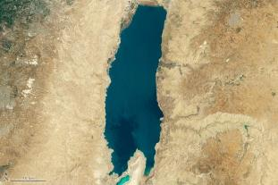
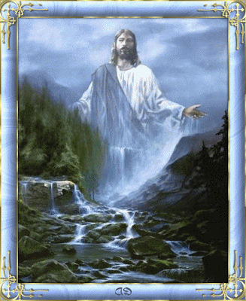
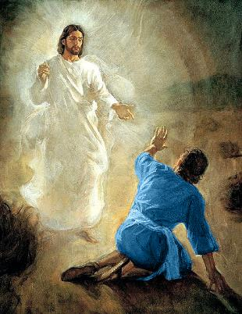
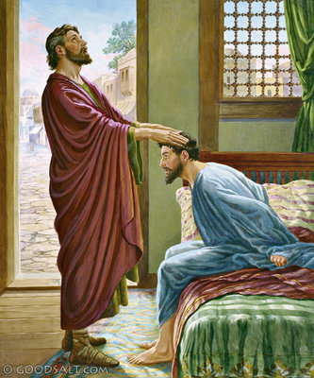

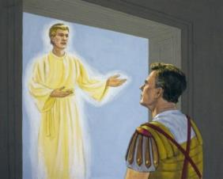
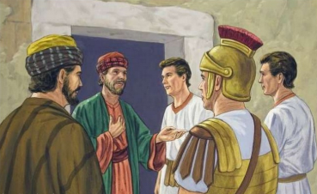
TO GROW
“Whoever believes in me, as Scripture has said, rivers of living water will flow from within them.” (John 7:38 NIV)
What happens when water stagnates?
The water in a pool gets spoiled if is not renewed in a daily basis. We may also “get spoiled” if we don’t let living water flow through us.
As we mentioned before, God has many ways to reveal Himself. However, even when revealing Himself directly, He always put people in contact with other people. Check the experiences of Saul or Cornelius, for example (Acts 9:3-6; 10:1-6).
Preaching the Gospel is a blessing for us. We can grow spiritually and rejoice with Christ when people accept Him.

Slide 6

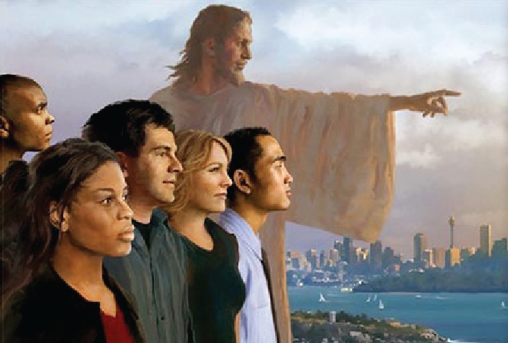
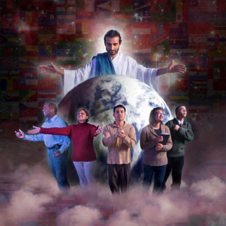

TO OBEY JESUS’ COMMAND
“Go therefore and make disciples of all the nations, baptizing them in the name of the Father and of the Son and of the Holy Spirit.” (Matthew 28:19)
God doesn’t want “anyone to perish, but everyone to come to repentance.”
(2 Peter 3:9 NIV)
Therefore, He has commanded us to share the Gospel with everyone. He patiently waits for us to fulfill that command (Matthew 24:14).
God has chosen men and women (2P 2:5;
Gn. 12:1-3), nations (Is. 49:6) and peoples (Acts 1:8) to make Salvation known through history.
For the church to neglect or minimize the command of Christ is to fail in the purpose of her existence and miss her prophetic calling to the world.

Slide 7
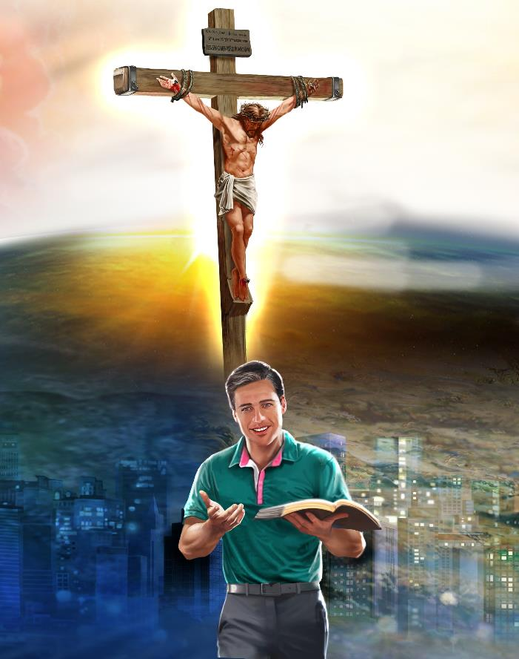
FOR LOVE’S SAKE
“For the love of Christ compels us, because we judge thus: that if One died for all, then all died; and He died for all, that those who live should live no longer for themselves, but for Him who died for them and rose again.”
(2 Corinthians 5:14-15)
Compel means “to force somebody to do something, or to make something necessary” (Oxford Advanced Learner’s Dictionary).
The love of Jesus moved Paul to spread the Word of God all over the world since he understood that Jesus had given His life to save him.
Witnessing is a loving response to God’s love.
“Most of the brothers and sisters have become confident in the Lord and dare all the more to proclaim the gospel without fear […] out of goodwill. […] [they] do so out of love.” (Philippians 1:14-16 NIV).

Slide 8

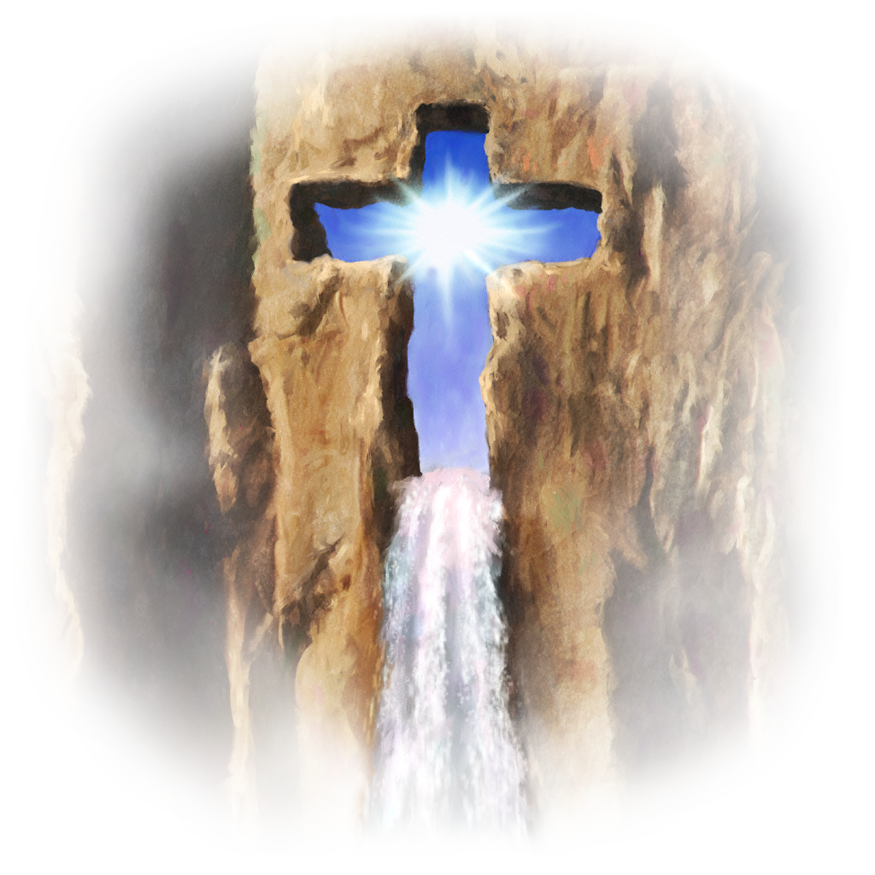
“In the power of the Spirit the delegated servants of Christ are to bear witness for their Leader. The yearning desire of the Saviour for the salvation of sinners is to mark all their efforts. The gracious invitation, first given by Christ, is to be taken up by human voices and sounded throughout the world: ‘Whosoever will, let him take the water of life freely.’ Revelation 22:17”
E.G.W. (Testimonies for the Church, book 9, cp. 4, p. 43)

